Slide 1
Transportation in New Castle
Ferries, Wharves, Packet Boats, Roads,
Stage Coaches, Steamboats,
C&D Canal, NC & FT Turnpike and RR,
Trolley, Paper Streets – What is a Street?,
N.C. and Travel in an 1802 Expense Report of E. I. du Pont
Is New Castle Historic, Why Study It?

Slide 2
Roads before 1838
“Early roads replaced Indian trails. Trees were cut down and some stumps were removed, but there was no grading, no drainage, or use of anything but natural earth. They were maintained or not by the local communities. Travel was difficult or impossible after heavy rains or snows.”
Holmes, 1960
“Road-Making is a branch of engineering which has been vey little cultivated in America.”
Sketch of the Civil Engineering of North America, David Stevenson, London, 1838

Slide 3
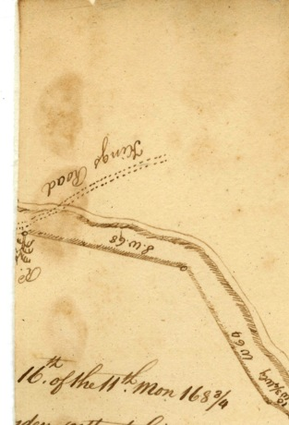
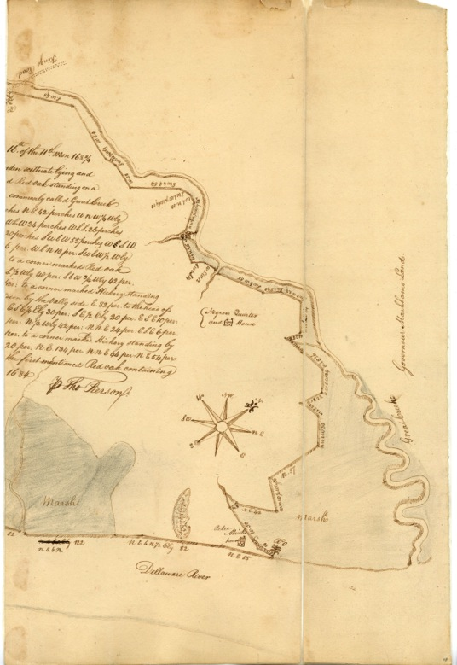
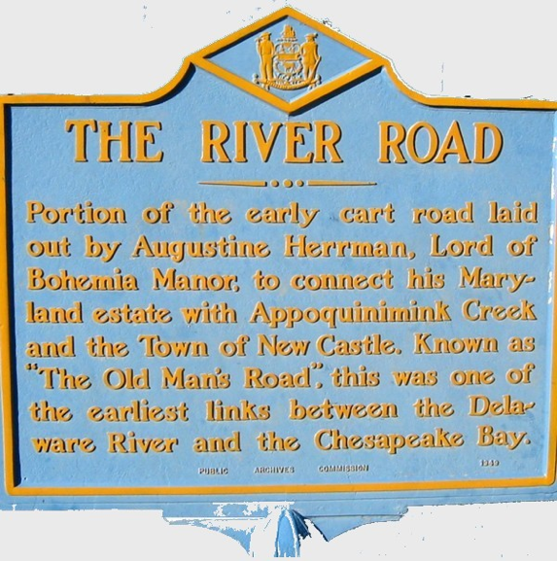
Roads before 1700
King’s Road south of New Castle, modern Rte 9 near Grantham Lane
< 1664 Dutch Period: dikes, trails along water and into woods
1675 Broad dyke was built to facilitate building wagon or cart roads (Dike Uprising)
1679 Danckaerts’ journal reports many “broad cart roads” and many blazed trails (all confusing)
1684 - Survey for Peter Alrich's lands
DPA 22555-00
Notes:
English started building roads, after the revolution, done by levy court

Slide 4
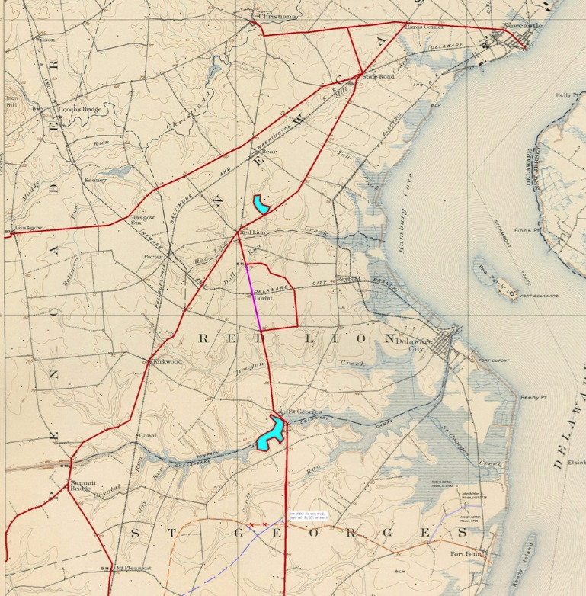
18th Century Roads in Delaware
Based on the 1737 Eastburn Map, overlayed on 1904 topographic map.
Overlay by Alice Guerrant, DE DHCA
Roads existed from New Castle via Hare’s Corner to
Christiana, Elkton/Frenchtown, southern Delaware.
No road is shown along the river in 1737, but the Kings Road (one of the Kings Roads?) is known to have existed.
“The principal route [in Delaware] was a north-south passage that follows roughly modern day US 13.
http://nc-chap.org/resources/archives/del_roadways.pdf

Slide 5
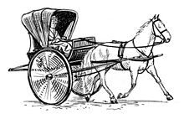
Early Traveler’s reports within Delaware
Jasper Danckaerts, Benjamin Bullivant and Dr. Alexander Hamilton left
behind details of their travels through Delaware (1679, 1697, and 1744).
All wrote that they traveled by horseback and boat.
Hamilton did say that a person he had planned to travel with instead “went
to Bohemia by water, and then took chaise [shay] over land to Newcastle and
Wilmington, being forbid for certain physical reasons to travel on horseback.”
http://nc-chap.org/resources/index.php#histories

Slide 6
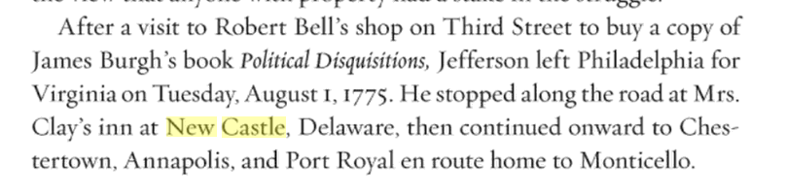

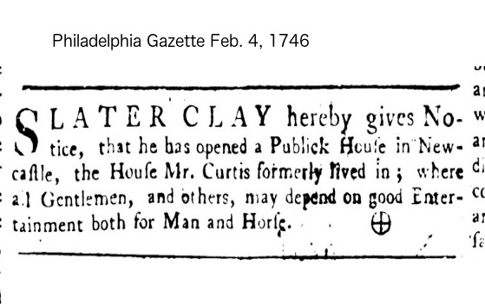
Thos. Jefferson Stops in New Castle
on Trip From PHL to Monticello
Meacham, “Thomas Jefferson: The Art of Power”
Definitions (maybe)
Inn: eat, drink, sleep
Pub(lic house): eat, drink
Tavern: drink
Courtesy Osher student Jim Williams

Slide 7
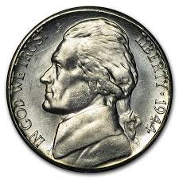
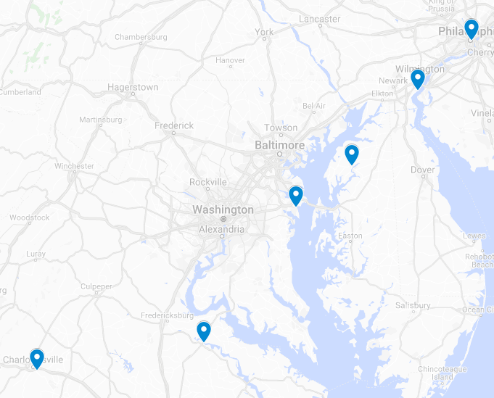
Unanswered questions about logistics of Jefferson’s trip in 1775
Did he spend the night? Where? Mrs. Clay’s was a Public House –food and drink. She inherited the property across the street in 1753. In the 1803 Latrobe survey it was called the “Stage Inn” but it’s not clear when it became an inn . The Tile House two doors from the George Read I house WAS an inn in 1744 when Dr. Hamilton stayed there [Griffith’s Inn].
Jefferson had written the first draft of the Declaration the previous month, but would not become the Virginia governor for 5 years. ☺ So, no state trooper to drive him. Did he travel alone? Did he ride? Did he take his horses along
Were boats always available for these connecting routes?
How long did this grueling trip take?
Why did he go to Chestertown rather than the nearer Frenchtown?
Road not ready? No boats available?
Were McKean or Read around in New Castle?
Did they join him at Mrs. Clays?

Slide 8
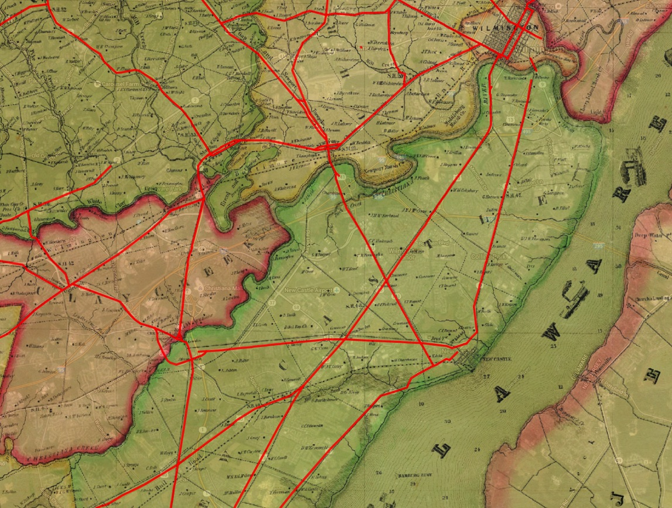
Roads built by 1849 pretty much define the location of modern major roads (in red). Local changes in alignment are relatively minor.
Rea & Price 1849
Notes:
Aside from the memorial bridge, & interstates probably roads once built are not abandoned.

Slide 9
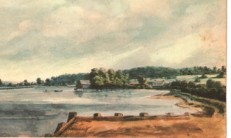
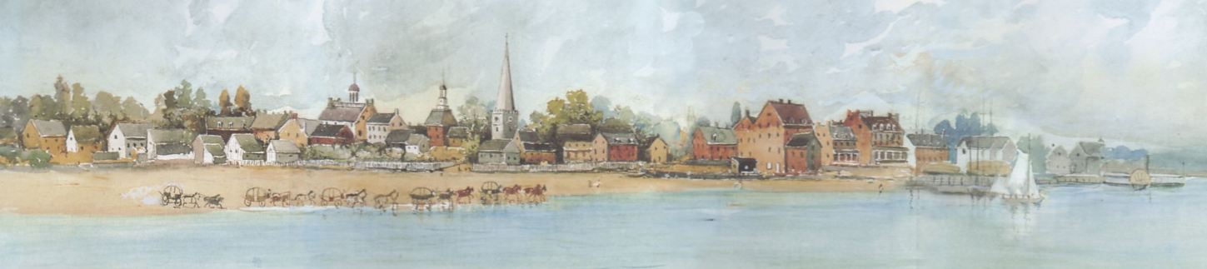
Stagecoaches
1775 Joseph Tatlow started stages between New Castle and Fenchtown.
This 1895 Robert Shaw painting of a c1825 scene may be derived from a similar panel picture in the steamboat “New Castle” [now lost]. Both show a steamboat, anchored packet boat and stagecoach drivers watering their horses and soaking the wheels to swell them.
Stages ran up through the toll both at Delaware & 4th or 5th, through Hares Corner, Bear, Aikentown (Glasgow) to Frenchtown MD.
The stages were owned by the owners of the companies that ran steam ships or packet boats from PHL to Packet Alley and Frenchtown to Baltimore
The toll road (NC & FT Turnpike Co.) was slow, difficult to maintain and subject to evasion.
Notes:
1825 based on immanuel steeple and courthouse wings. Probably also stages to dover

Slide 10
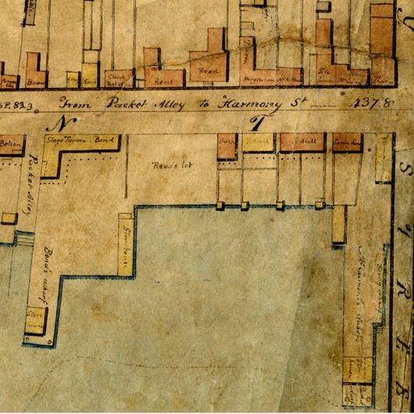
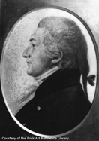
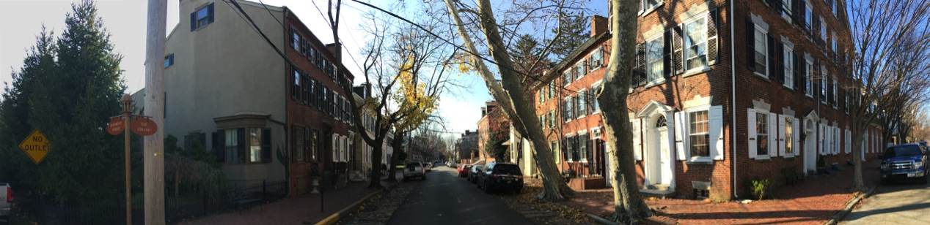
Early Ferries
Ferry House, McCallmont House
Licensed in 1724 between New Castle & Salem by Pa. Governor
Then to Michael King, ancestor of the family who ran the icehouse up Harmony
Then a monopoly to James McCallmont by act of the legislature in 1801 for 21 years to carry travelers, horses, cattle, carriages and goods across the river. He was a busy guy– naval surgeon, prisoner of war, physician, cofounder of the Med. Soc. Of De., ferry owner …
Ferry House McCallmont House
Notes:
1835, then abandoned. 1906 Gas powered boats for passengers only
Note ferry wharf longer packet wharf

Slide 11
Wharves
Small ones existed from colonial days
Harmony St. always had public wharves. In 1817 the Trustees made the "Free Wharf” 54 ft wide, 310 ft long
There was no Delaware St. Wharf until 1832 for the NC&FT RR. In 1837 Elihu Jefferson extended it 600 ft. into the river. It was locally known as "Old Major Wharf" or "Cape May Wharf" for the steamboats that docked there.
A wharf was off Packet Alley since before 1790 to service the packet boats from PHL and stage coach companies. Later the "Major Reybold" docked there instead of at Delaware Street
Archibald Alexander and Alexander Harvey had a wharf and business at the end of Alexander Alley
The 600 ft long “Coal Wharf" or "Long Wharf” was near the flagpole in Battery Park from 1863 (to 1875?)

Slide 12
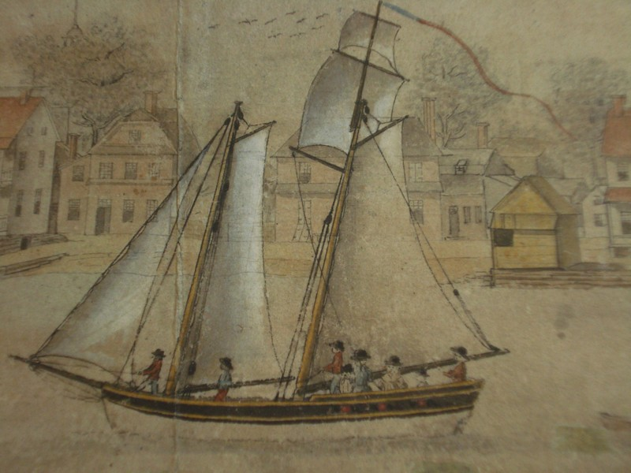
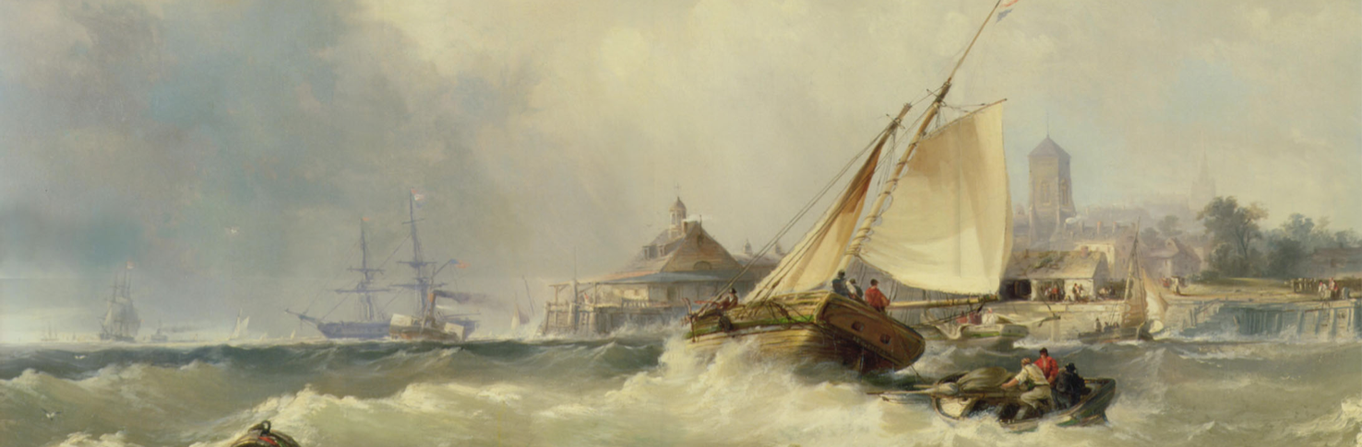
Packet Boats
A view of The Town of New Castle from the River Delaware, -- Taken the 4th of July 1797 –by Ives Le Blanc
Small boats for regularly scheduled mail, passenger and freight service on rivers, canals and transatlantic. Varied in size from narrow (canal) to clipper ships for transatlantic travel.
Edward Moran 1857, “New Castle on the Delaware”, Butler Inst. Of American Art
Notes:
One on display at st michaels between places on a more or less regular schedule.

Slide 13
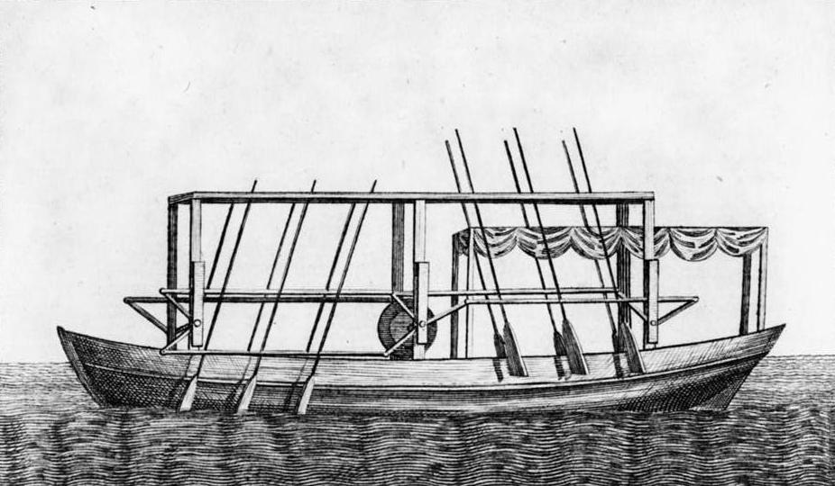
Steamboats
  John Fitch made first successful steamboat in PHL, witnessed by Constitutional Convention. Ran trips PHL – Burlington; Patented
  Robert Fulton built Clermont, ran NYC to Albany
  E. I. du Pont meets, mentions meeting, taking or sending stuff via steamboat 10 times in his correspondence
  1830 “Robert Morris” started 40 years of travel PHL->New Castle
  1844 Ericsson Line steamboats went via canal PHL -> Baltimore

Slide 14
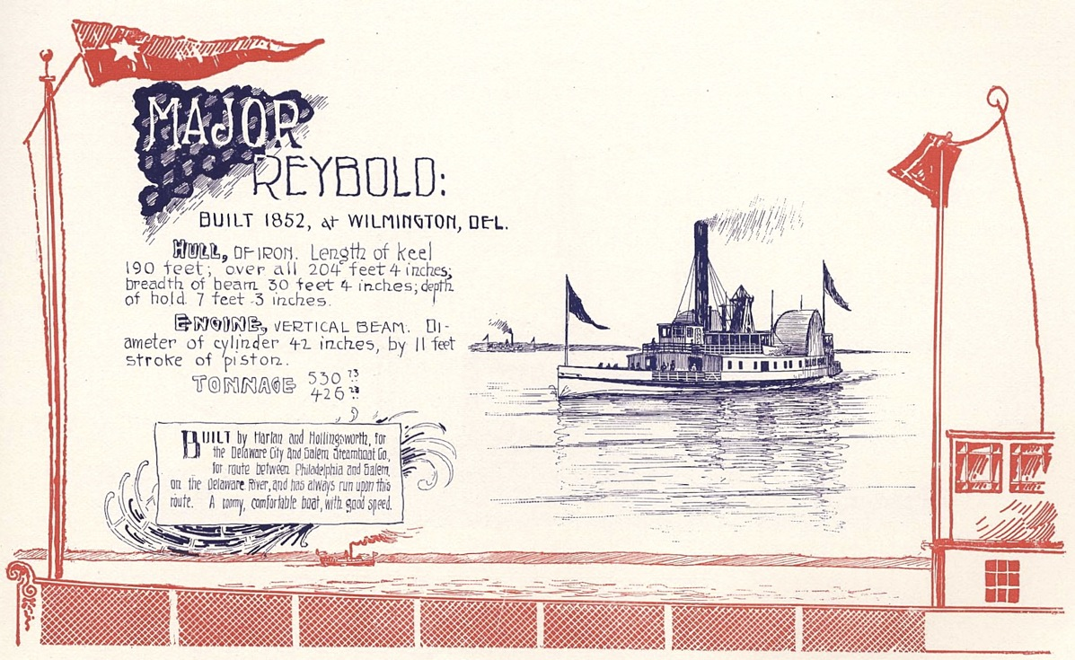
“The Major” – Major Reybold
Ran from PHL to Salem and New Castle. Originally owned by the Delaware City & Salem Steamboat Co. Wm, Reybold head. Ran until 1906 Shipped peaches from his farm in Delaware City, people welcome then and the rest of the year

Slide 15
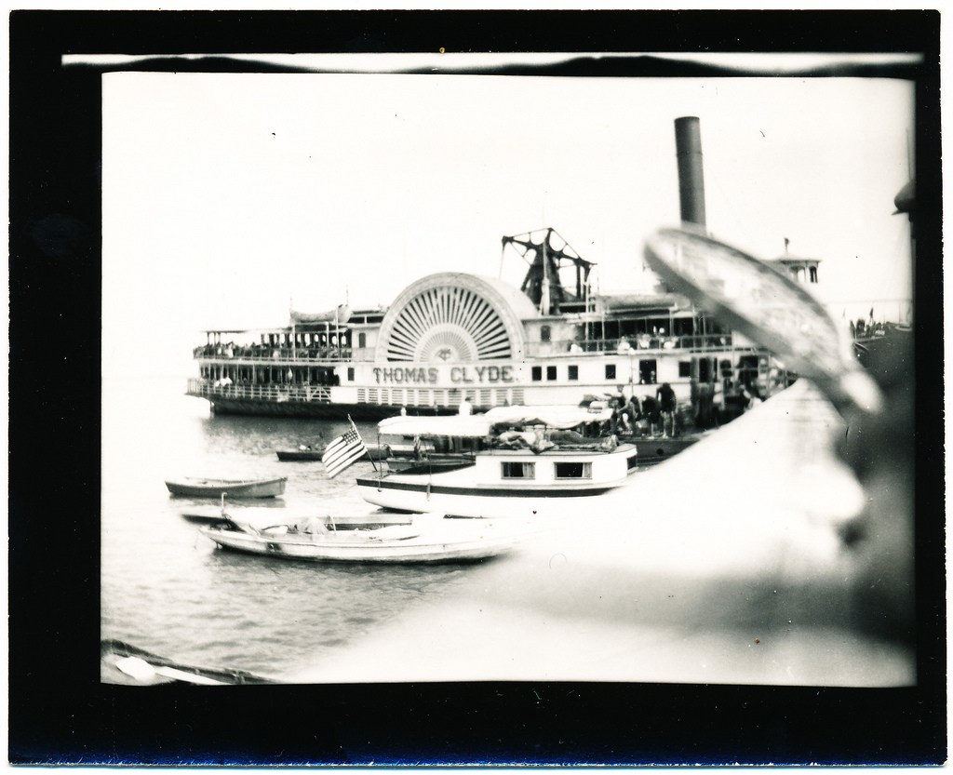
The sister ship Thomas Clyde, sailed 1878-1929 also went from PHL to NC and Bombay Hook where the owner had farms a picnic grounds or to Augustine Beach or Riverview Beach (NJ) for pleasure cruises for clubs and Sunday School groups.

Slide 16
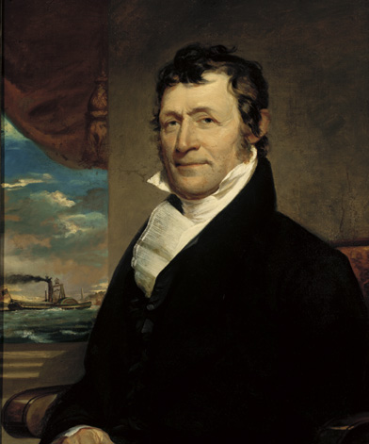
Captain Whildin was one of the most successful steamboat captains on the Delaware.
His ship Delaware went between PHL and Cape May, between 1821 and 1827, stopping at New Castle . The all day trip cost $5.
He opened Cape May Point in 1829 and opened a hotel there, with connection by the steamboat “Emerald”
His ship W. Whildin was the first iron steamboat on the river in 1841. It ran between Baltimore and PHL on the canal.
Wilmon Whildin
artist John Neagle, c1823
.

Slide 17
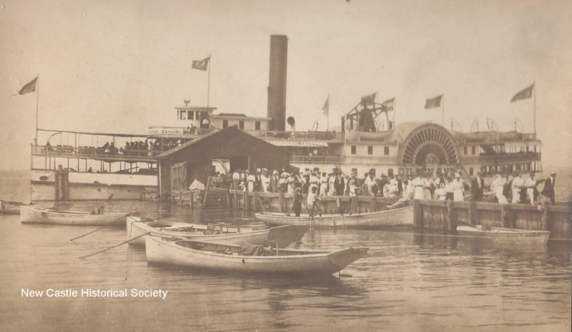
The Queen Anne, c. 1930
Notes:
Returning from an excursion to Deemer’s Beach

Slide 18
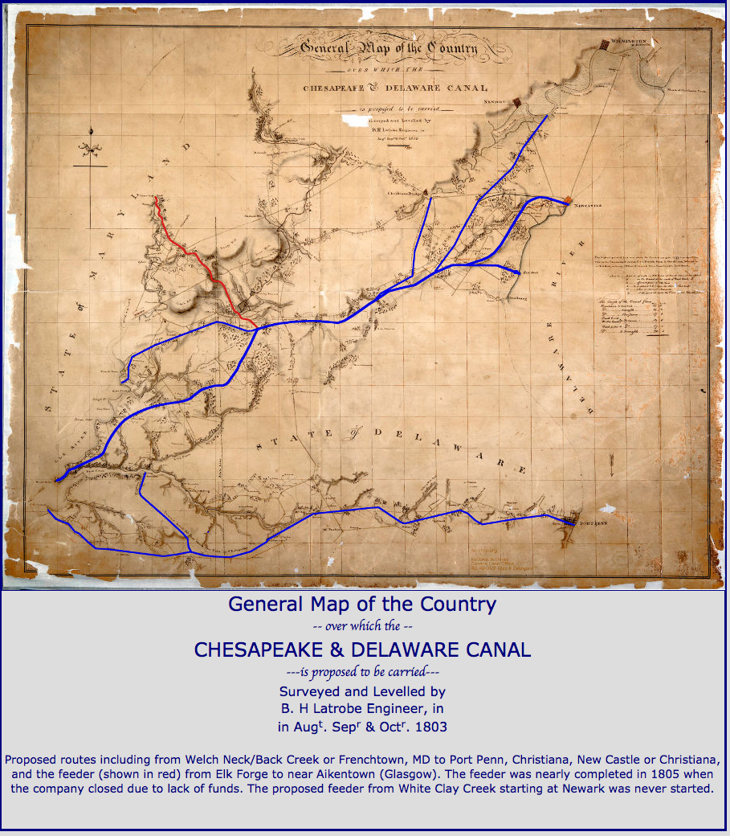
C & D Canal (1803-5)
New
Castle
Canal Company mainly from PHL, also MD and Delaware. Route with 14 locks but minimal digging proposed by Latrobe. Started 1803, ran out of money 1805.
No federal support.
Possible termini included Frenchtown and Battery Park ☺
Chestnut
Hill
Frenchtown
Notes:
First architect, but training in canals and

Slide 19
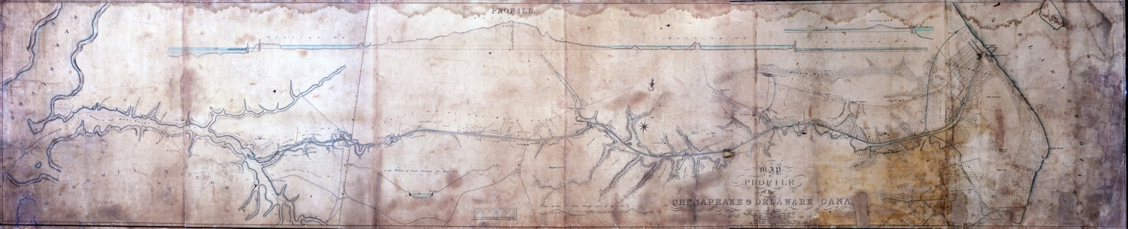
C & D Canal – a slow but efficient competitor for the New Castle & Frenchtown Turnpike & RR Traffic
Canal begun in 1824, finished 1829.
Back Creek MD to Delaware City DE
Investors: PA $100k, MD $50k, DE $25k, US $450k
Barges pulled by mules and horses (slow but efficient)
Width: 36 ft originally (450 ft currently)
Water supplied from Lums Pond
Required a “Deep Cut” at Summit Bridge (90 ft above bottom).
Four locks vs 14 in Latrobe’s 1803 plan (slow compared to the NC & FT RR)
Locks
Deep Cut
Locks
Notes:
Slow horse drawn travel, but more confortble than stages

Slide 20
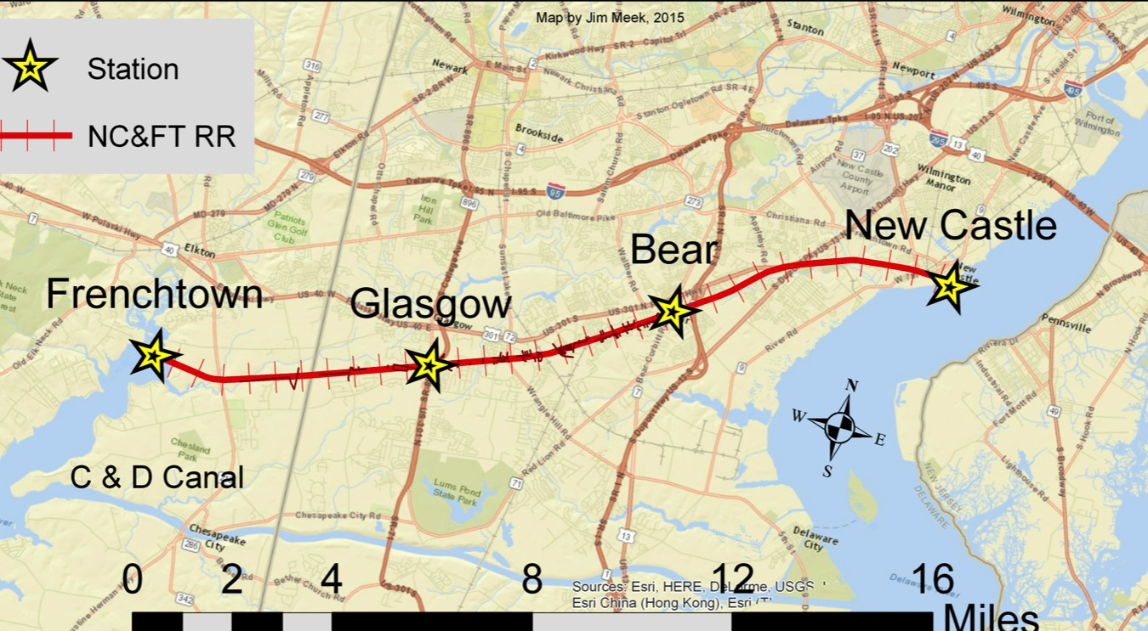
New Castle & Frenchtown RR
Notes:
Bult by many of the same people that ran the canal

Slide 21
The NC& FT RR was NOT the first RR by 5 years!
Railroad | State | Year | Miles
Quincy quarries to Neponset River | MA | 1827 | 4
Mauch Chunk to coal mines | PA | 1828 | 5
Mount Carbon | PA | 1830 | 7.5
Schuylkill Valley (Port Carbon to Tuscarora) | PA | 1830 | 30
Little Schuylkill (Port Clinton to Tamaqua) | PA | 1831 | 23
Pontchartrain | LA | 1831 | 5
New Castle & Frenchtown | DE | 1832 | 16
Camden and Amboy | NJ | 1832 | 61
Mohawk & Hudson | NY | 1832 | 16
Saratoga & Schenectady | NY | 1832 | 22
Westchester to Columbia | PA | 1832 | 9
Rochester to Carthage | NY | 1833 | 2
Philadelphia & Trenton | PA | 1833 | 9
[in 1838] Within a very few years, a wonderful change has been effected in land communication throughout Great Britain and America where railways have been more extensively and successfully introduced than in any other parts of the world…The first, the Qunicy RR, was intended to convey stone from the quarries to a shipping port.
Sketch of the Civil Engineering of North America, David Stevenson, London, 1838

Slide 22
The number of railroads exploded
By the end of 1832, the year the NC & FT RR was completed, there were about 10 railways.
“…in 1837 there were no fewer than 57 railways in operation.. And 33 railways were then in progress and 150 more railway companies had been incorporated….”
(Stevenson, 1838)

Slide 23
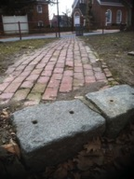
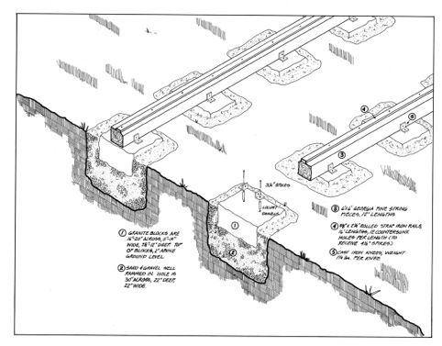
The Stone “Sleepers” of New Castle
“The early American railroads consisted of iron rails and chairs resting on stone blocks and were constructed on the same principles as those in [England]. But American engineers soon discovered that this construction of road was not at all capable of withstanding the rigours of an American winter. The intense frost…was found to ..materially alter their positions… and the rails had to be relaid at the close of ever winter.”
(Stevenson, 1838)
HAER – Historic American Engineering Record, 1976
In New Castle, the sleepers were understood to be undesirable already in 1833, and a new track of “T” rails on wooden cross ties installed in 1835.

Slide 24
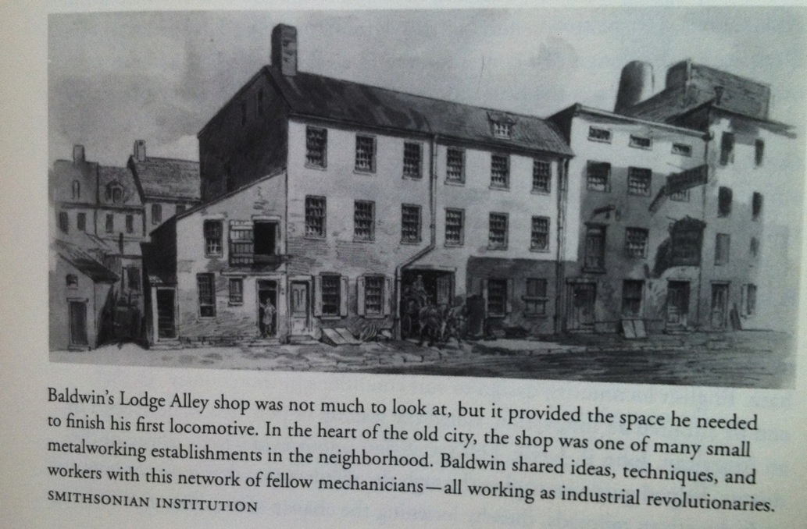
Industrial Espionage/Skulduggery
NC&FT RR hired Matthias Baldwin to assemble the English Stevenson engine. He sent a worker who, after erecting a tent on the Battery to hide his activities, took 2 months to assemble the engine. A second engine with another assembler took 1 week.

Slide 25
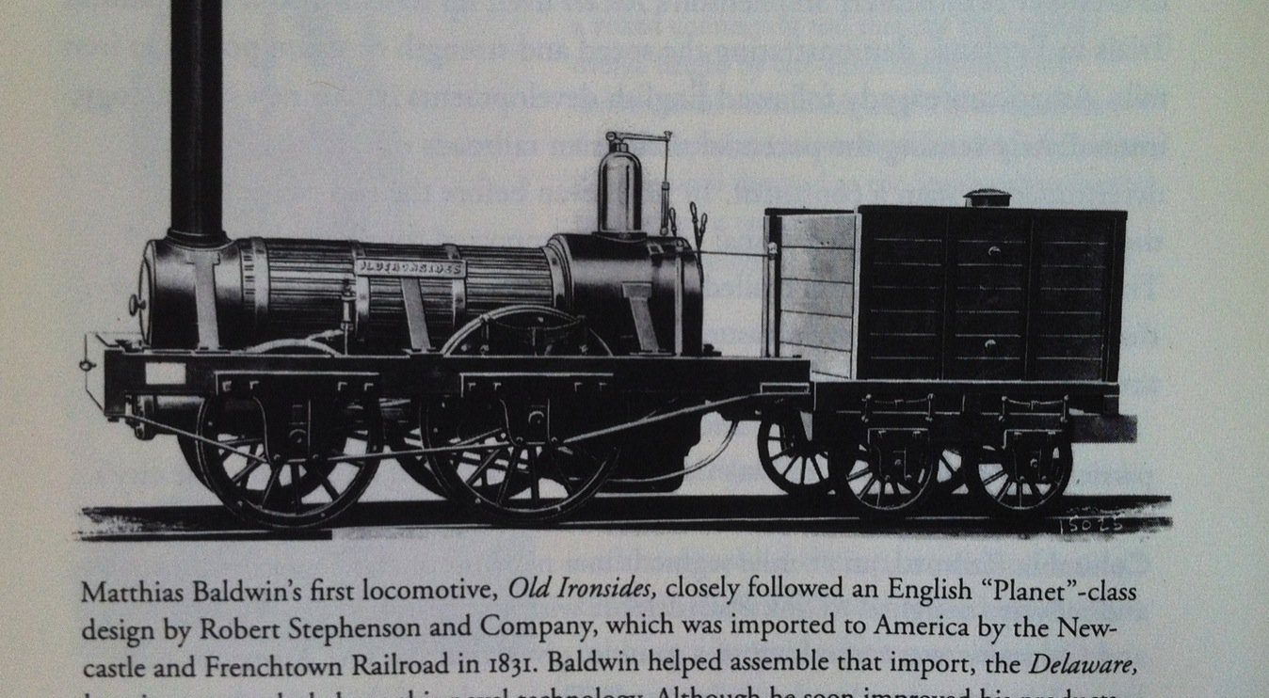
Baldwin’s copy of the “Delaware”

Slide 26
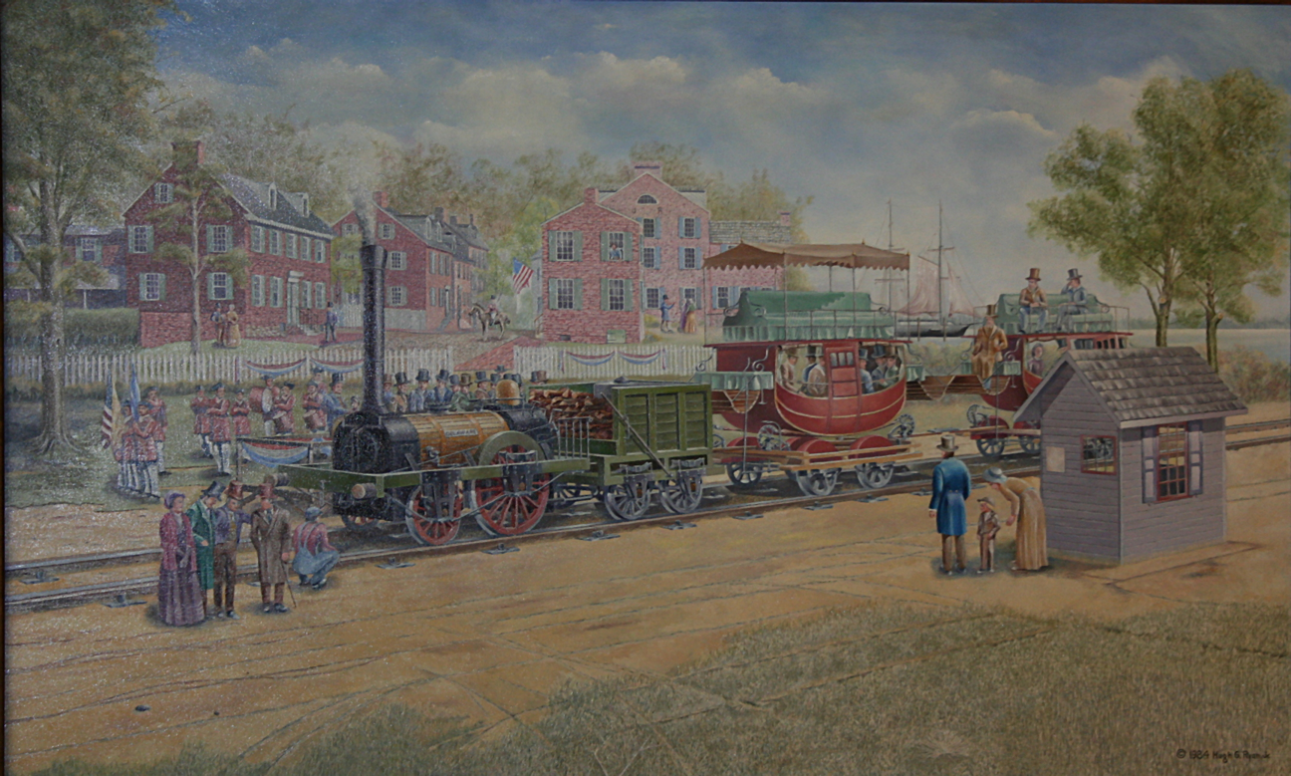
Opening of New Castle & Frenchtown Railroad
(September 10, 1832 )
Hugh Ryan, 1985
Notes:
Note ticket booth, cars similar to stage coaches

Slide 27
A Short Lived Success
The railroad was successful. In 1833 the builders (from NC & PHL) imagined extending it to Boston, or even South America!
Travel was rapid (about an hour) and comfortable.
??Passengers a day
The owners had not conceived how rapidly railways would expand and eliminate the need for steamboat connections provided by New Castle.
By 1839 the Philadelphia Wilmington & Baltimore RR completely bypassed the NC&FT route, and eventually absorbed it.

Slide 28
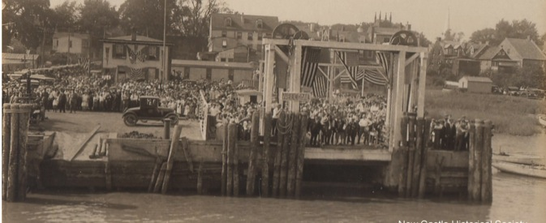
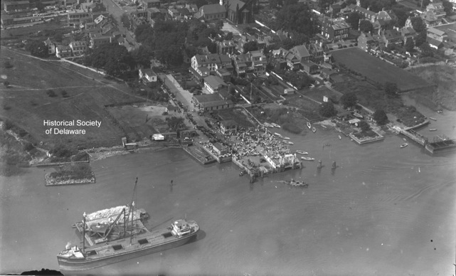
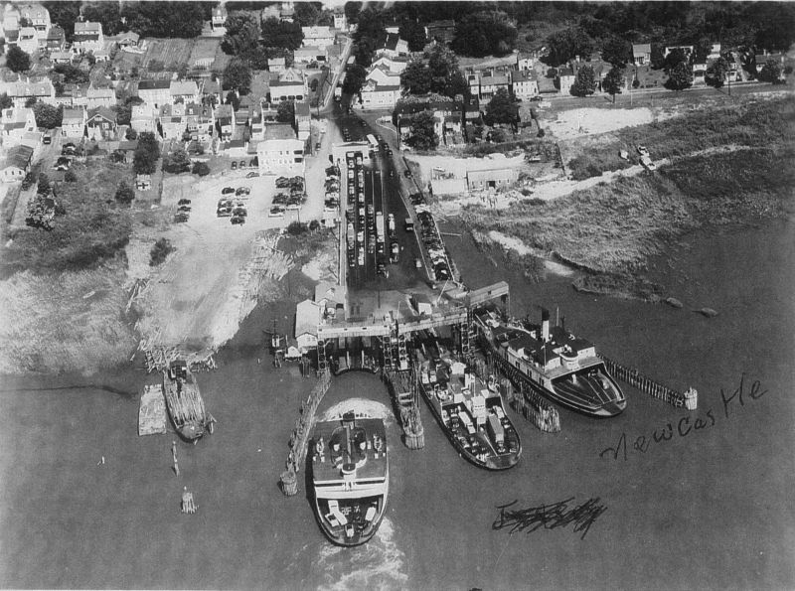
Great (and Brief) New Castle Ferry War
Sept. 1925 The White Line/Pioneer Line had a grand opening of a terminal at the end of Delaware St.
June 1926 Wilson Line started operating from Chestnut St. hourly 6 a.m. to midight
1927 The two lines merged and became VERY popular until 1954 when the bridge opened.
Notes:
Note toll both, short waiting line.

Slide 29
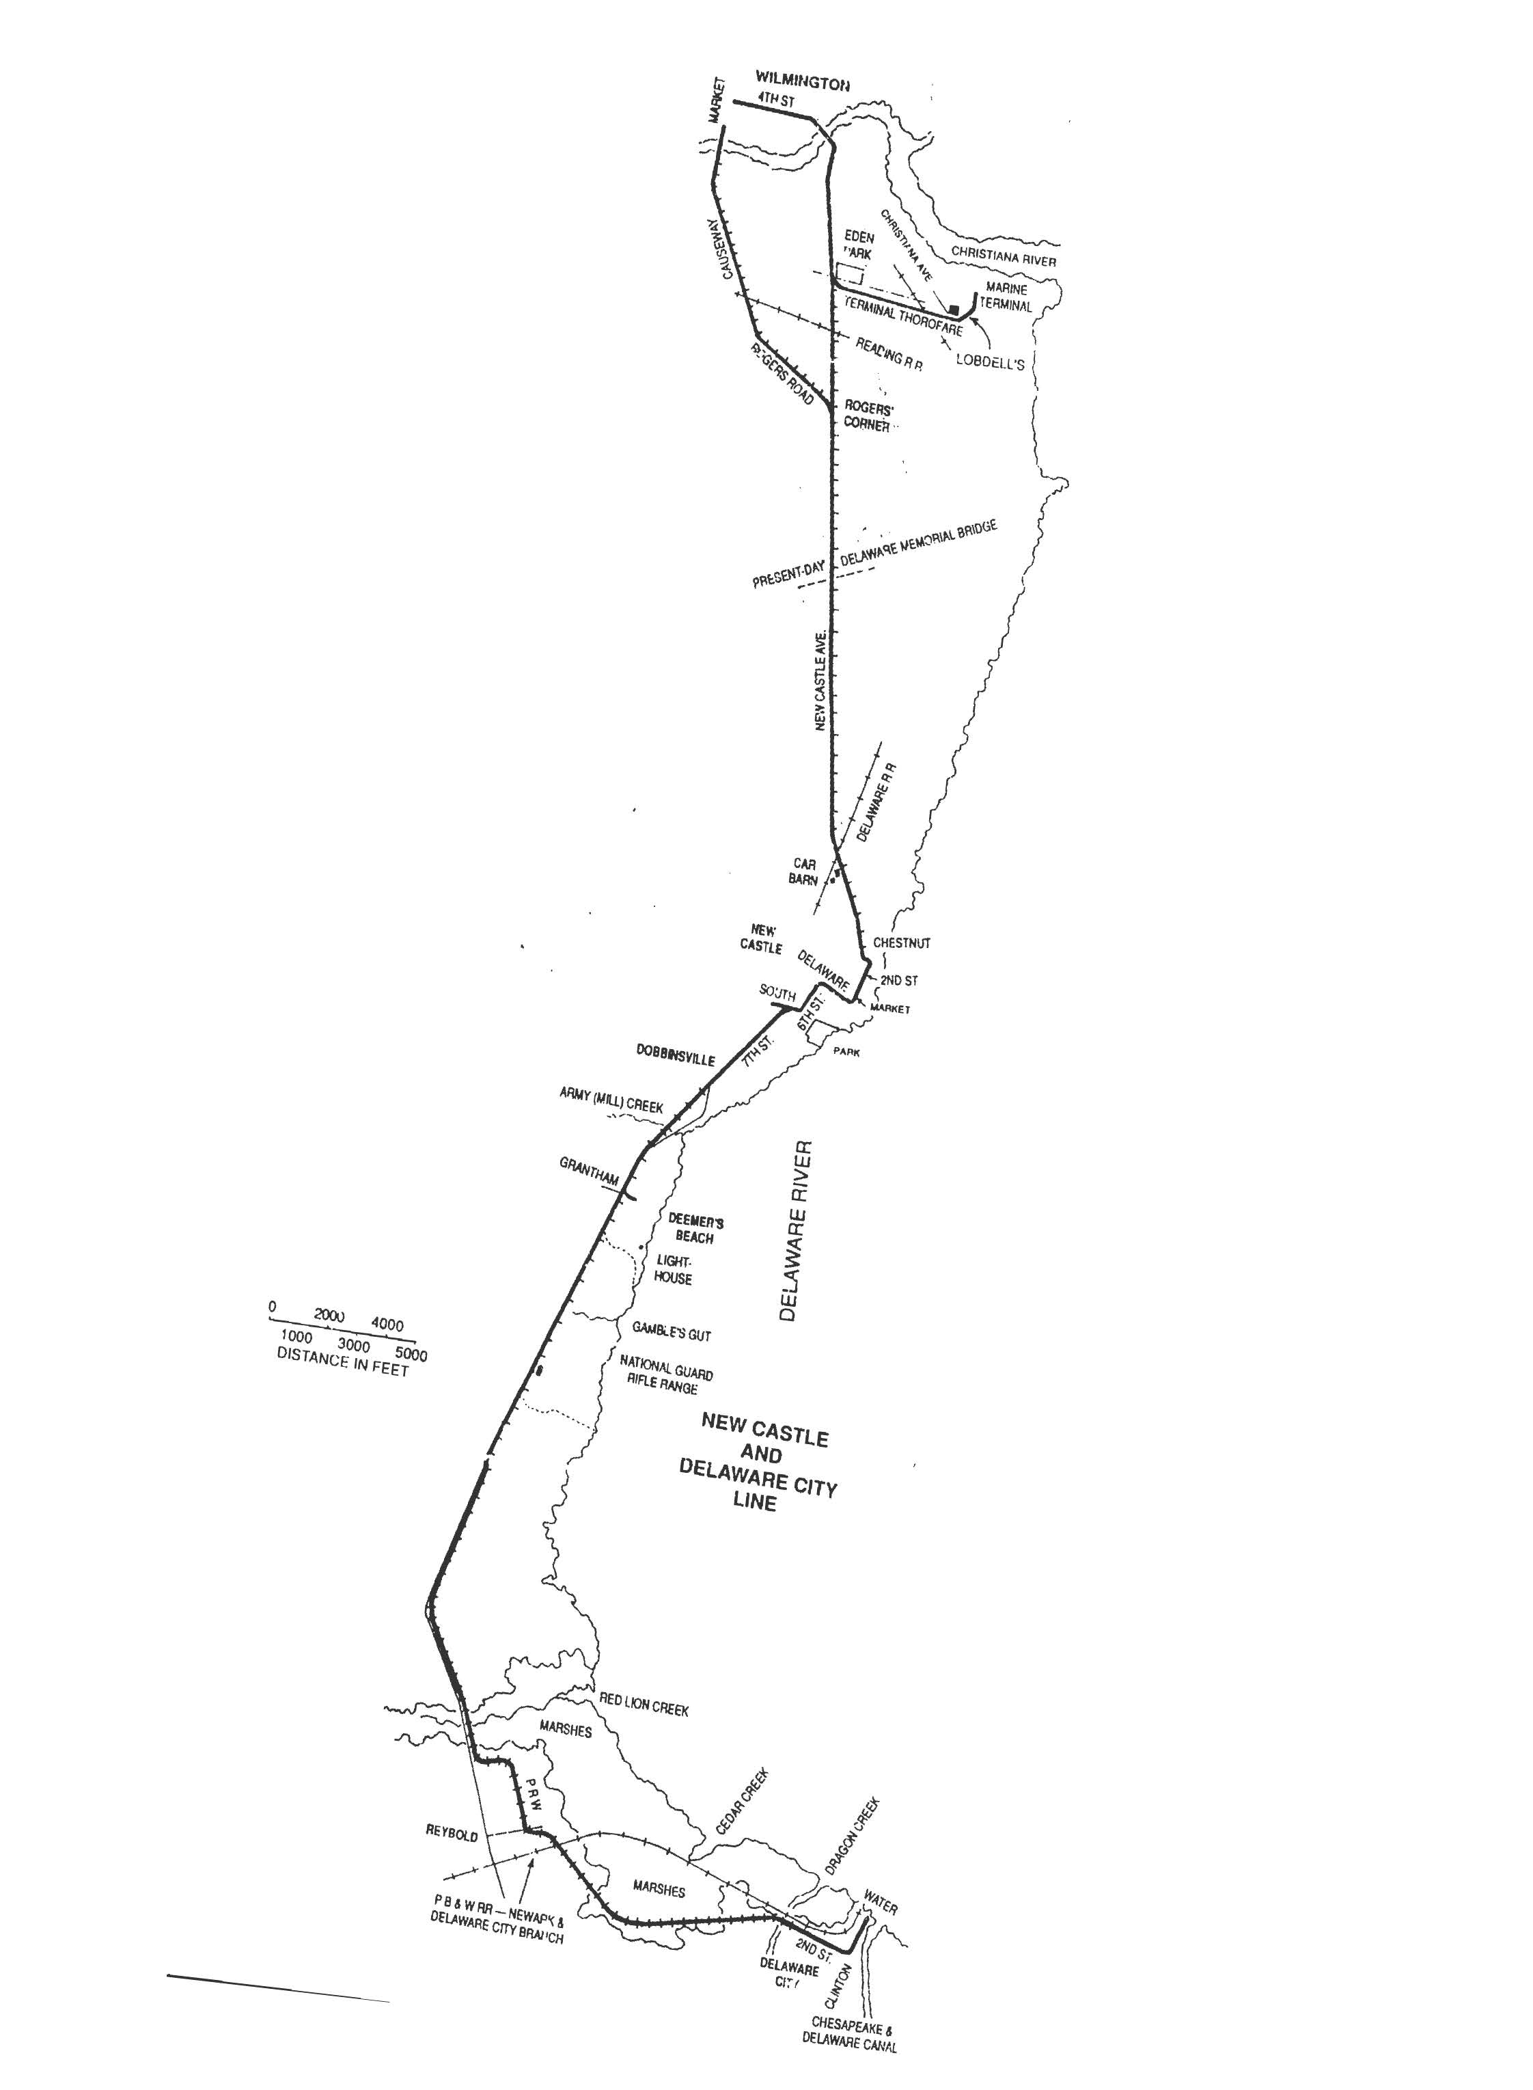
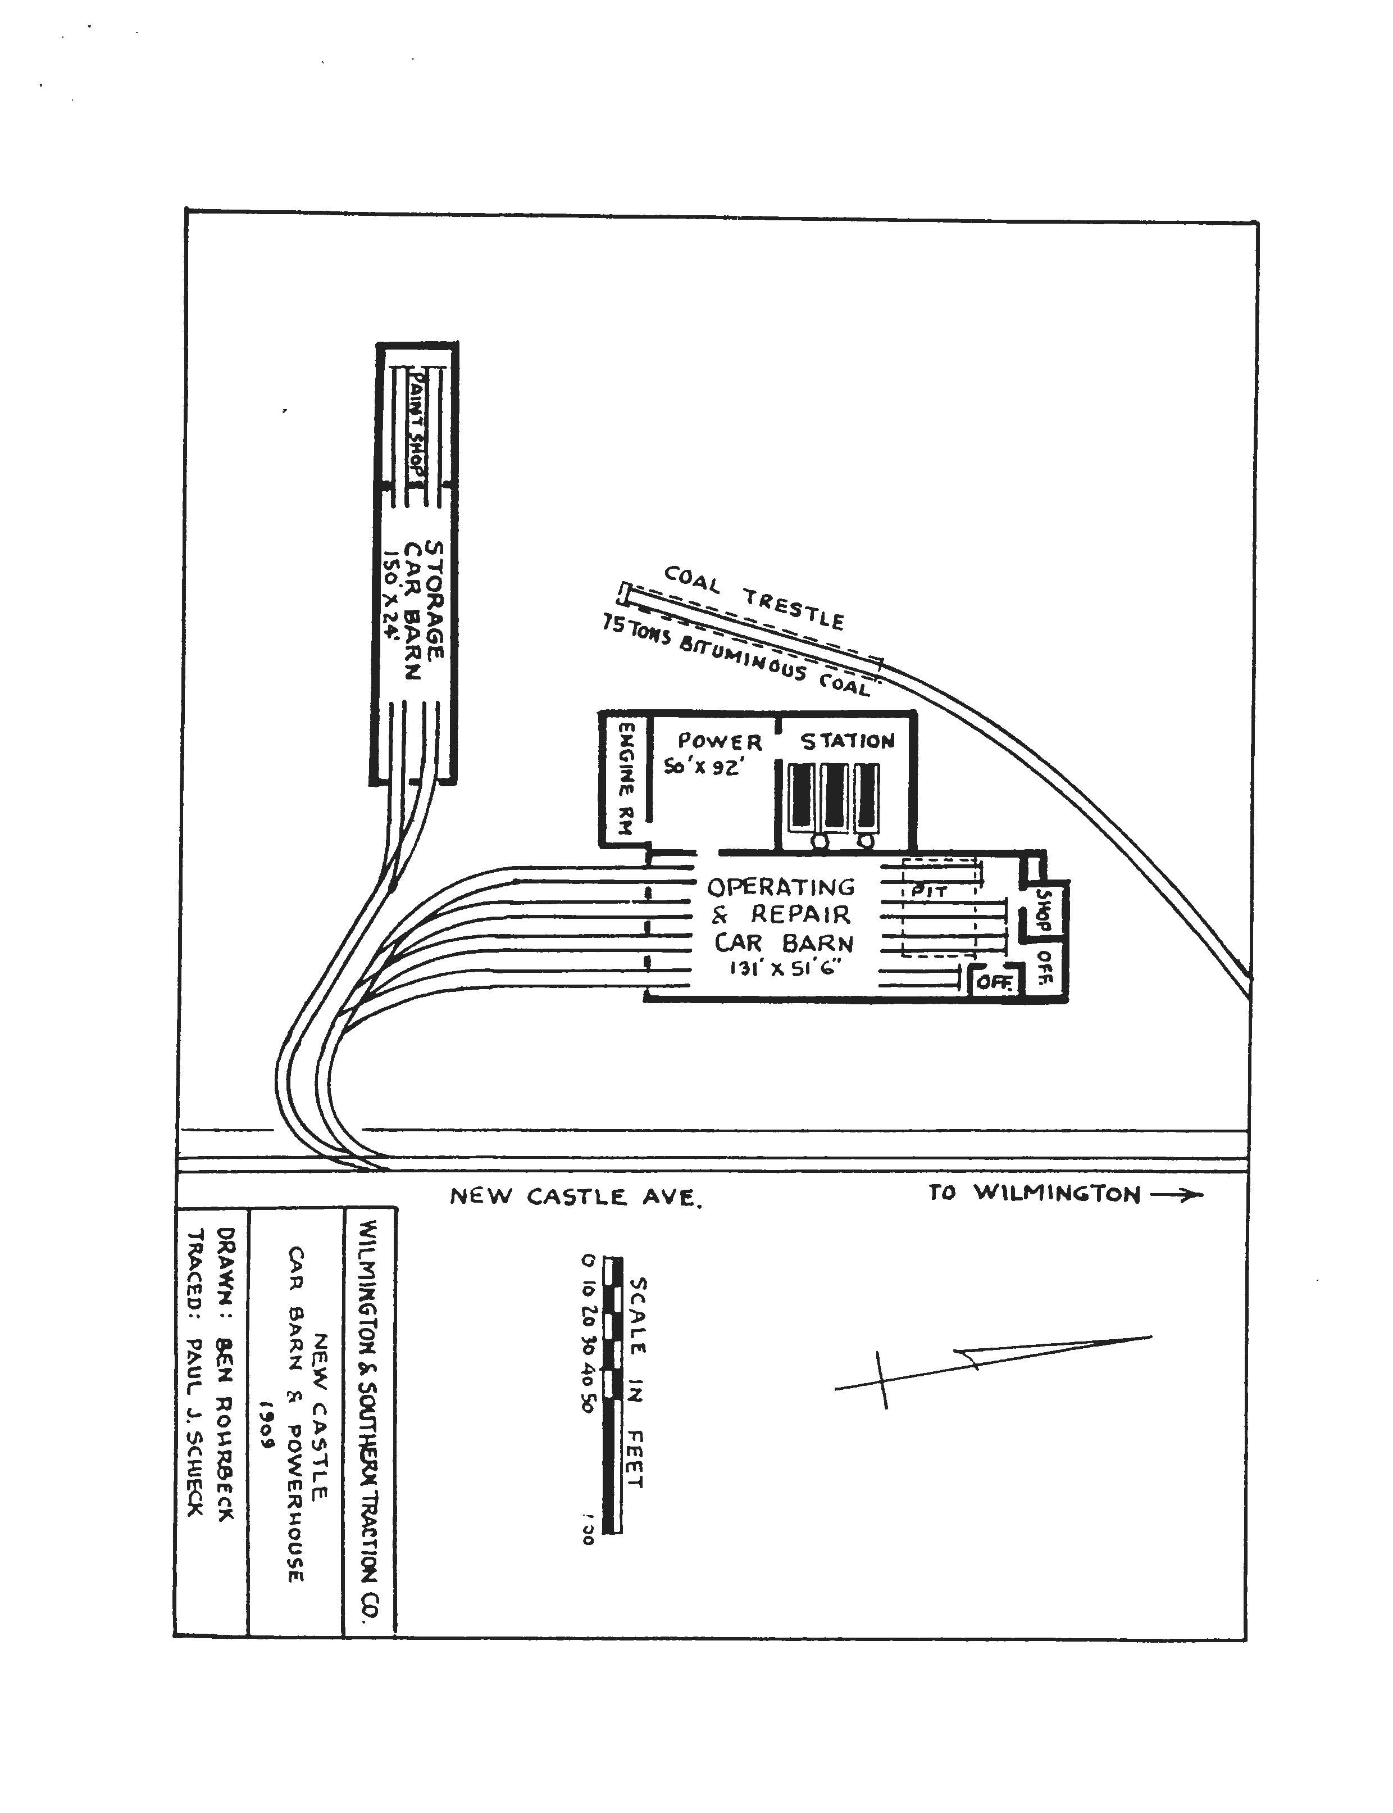
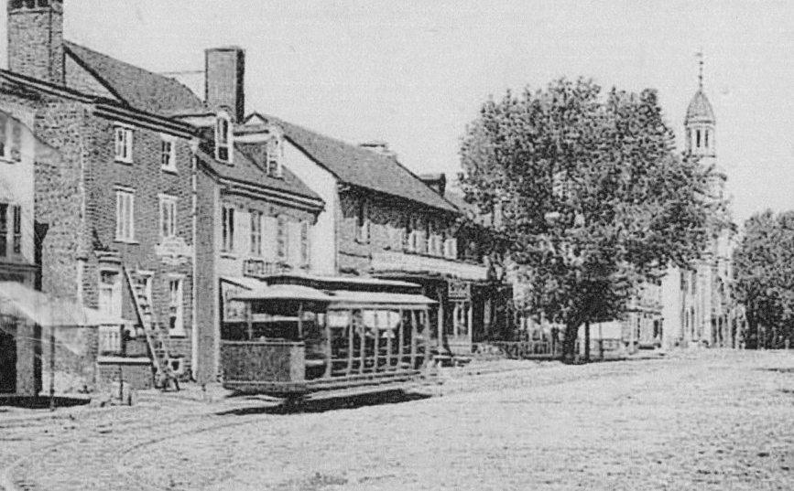
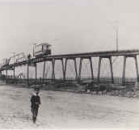
Trolleys
Started c. 1896
From Wilmington to New Castle
to 2nd St. up Delaware St.
left town on 6th and 7th to Dobbinsville & Delaware city

Slide 30
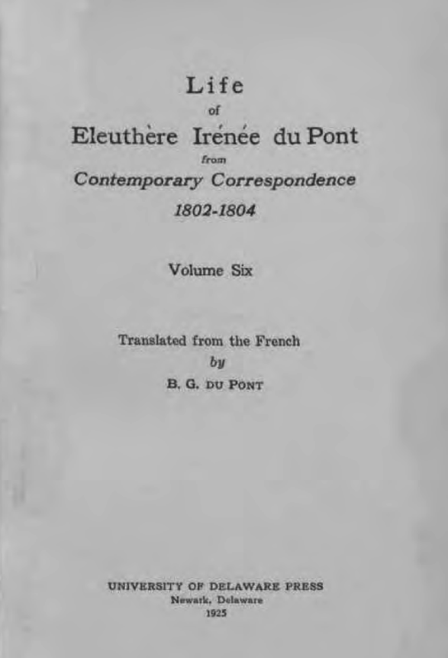
Transportation and Everyday Life for
E. I. du Pont (1802-1818)
Boats leave directly from New Castle to France
E. I. du Pont to Du Pont de Nemours.
Mill near Wilmington, August 15,1802
The departure of M. de Marbois, who sails
from New Castle, gives me an opportunity at
last of writing to you, dear Papa; until now I
have always had the bad luck not to know of
ships for France until too late, but I hope for the
future to have better arrangements in Philadelphia
and to be informed of the sailings.
(of 12)

Slide 31
Another letter home
E. I. du Pont to Du Pont de Nemours.
July 16, 1803.
I have just received your letter of May
13, my very dear Papa, and hearing at the same time that a ship for Bordeaux is today at New Castle I am seizing the opportunity to answer you. The news of the cession of Louisiana was published here about ten days ago. It had a great effect on public opinion and gave Jefferson the position that his talents and his patriotism deserve. No one expected this result of the negotiation and much admiration is felt for the President's sagacity in making so important an acquisition. The Federals are ashamed of their blustering of last year and are obliged to admit that Jefferson's methods are better, safer and cheaper than would have been a war with France and Spain, and a forcible invasion of the country by Kentucky Riflemen.
New Castle is still the seat of government
Peter Bauduy to E. I. du Pont.
Wilmington, August 20, 1802.
No news from Victor—for either you or Me. Do not forget to come and breakfast with me tomorrow so that we can go to New Castle. I have made an engagement with Rodney to arrange about your naturalization; and I shall expect you.

Slide 32
Du Pont to ship 60 kegs of gunpowder to New Castle!
New Castle the last stop before France
Duplanty to E. I. duPont.
Philadelphia, September 2, 1808.
My dear Mr. Irenee,
I wrote you two letters yesterday … As I told you, I have seen Price and another man, [he] agrees to go to New Castle to receive about 60 kegs….tomorrow night I shall be more sure of the day and will write to you again in order that you may have the shipment at New Castle at the right time. I hope that tomorrow I may have your answer to my letter of yesterday telling me exactly what quantity and qualities you can let me have. You know as well as I what is best—TP Cannon Fr; Fz; P. A. & W. in a smaller quantity.
E. I. du Pont to Du Pont de Nemours.
Brandywine, Eleutherian Mills, October 1, 1808.
My dear Papa, I sent Mr. Michaux a letter and a drawing for you while he was in Philadelphia, but he has come to dine with us on his way to New
Castle where he is to join the ship…

Slide 33
Travel by red-eye is not new
Customs in New Castle a problem
Goodstay
Packet from
New Castle to Bordentown
E.I du Pont to P. Bauduy, 1808
However, all that I have written is the result of stupidity caused by the longing for sleep after my ride on the mail stage; for you have, of course, answered the letter Already. McCall will have written to you that it is too late for the 200 kegs of cannon and musket powder; so please tell Dalmas not to grain any more for cannon. As for what is already done, we can send it to Boston with the P. A. In Philadelphia I spoke to Capt. McCoy of the brig Harmony which sails early in next week; he would be glad to have the powder, but it would have to be delivered to him in the river, for he cannot and will not sail from New Castle because of the Custom House.
New York, August 17, 1802.
my duties as furnisher of supplies will end—and I go to Goodstay to hide myself from the clamoring of the fifteen hundred angry blacks and whites who will probably die of hunger if that happens; and then I should not need him. However, if it suits him and you 1 should like to have him; but as he will need his trunk and the stage is expensive, could he not come almost as quickly and more comfortably by the packet boat from New Castle to Boordentown and from there to Amboy? Do as seems best to you about sending him—the necessity is growing doubtful—and about the route,
...V. d.P.

Slide 34
Isaac McKim to E. I. du Pont. In English.
Baltimore, 31st July, 1802.
My dear Sir—
I read this morning your esteemed favor of the 28th Inst and I called immediately at the Collector's office, respecting your three Barrels Machinery which arrived in the Maryland Sloop of War from Havre. the Collector being Convinced that every
thing was Strictly True respecting their use &c. has been pleased to give orders that they be delivered up to me, whenever I may call for them, free of duty, there has been some small charge attending the Landing of them, as also the Storage, which I shall pay, and render you an account thereof—it now remains with you to give the necessary instructions respecting their being forwarded to you, and I believe the best way will be to send them by the way of the french town and Newcastle Stage Boats, so that you will have to Send from Wilmington to New Castle for them, if they are forwarded by this route.—I can give directions for them to be left at the Storehouse in Newcastle until you send for them. Be Pleased to inform me if I shall forward them to you by the french Town & Newcastle Stage Boats—or any other way that you may think best, believe me to be with great Regard
Sir, your most obt. Servt. Isaac McKim.

Slide 35
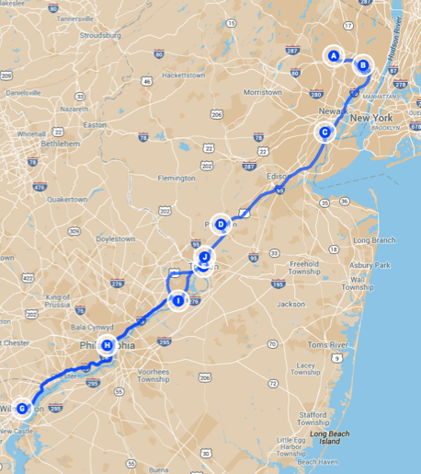
Travel Expense Report of E. I. du Pont.
1802 To Little Fall D sh,p (Pounds, shillling)
March 25 At Aquakimunk 5
Lodging—Little Fail 1 7
26 Breakfast at Patterson I 2 a
Bridge at Hackensack 4 b
Tolls 3
April 11 Boat to Elisabethtown 1 c
Carriage 4
Supper—Elisabethtown 6
Carriage to Princetown 4 d
12 Stage – Princetown 2 4 e
Breakfast—Trenton 4
At Philadelphia, porter for trunk 2 f
16 Inn at Philadelphia 6 6
To Wilmington – tolls 2,4 g how? Toll road
  19 Gig, 4 days 10 two wheel carriage
22 Inn at Wilmington 13 6 not yet home?
Stage to Philadelphia 1 6 not packet boat?
…
29 Francis Hotel at Philadelphia 1 6
Mail Stage 8 expensive!!
Dinner at Bristol 6
Supper at Brunswick 4
Gig to Bergen
….
Notes:
Continenetal currency worthless at end of revolution. Dollar was the official unit of the us in 1792
Same basic categories you report now lodging, food, transportation. Only means of transportation has changed.

Slide 36
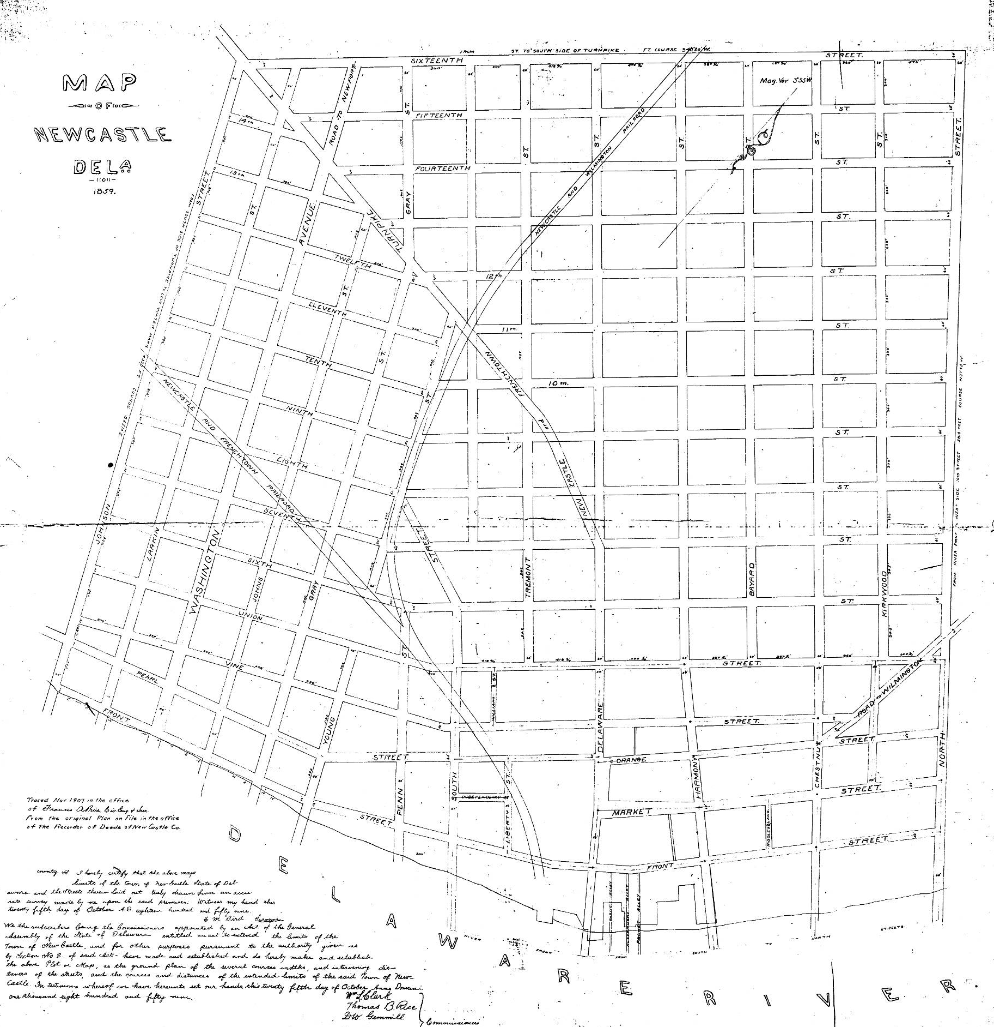
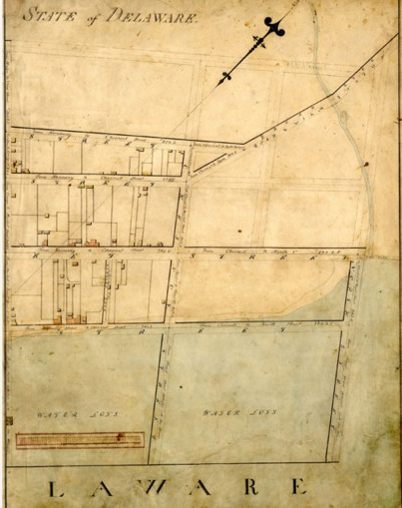
Streets and Paper Streets
When is a street a street?
The General Assembly passed an act extending the limits of the town of New Castle.
11 Del. L. Ch. DCXXIII (1859).
Latrobe 1804
Notes:
I hereby certify that the above maps limits of the town of new castle state of delawar and the streets thereon laid oiut trulyi drawn from an accurate survey made biy me upon the said premisses Oc5 a1859 G M Bird, surveyor

Slide 37
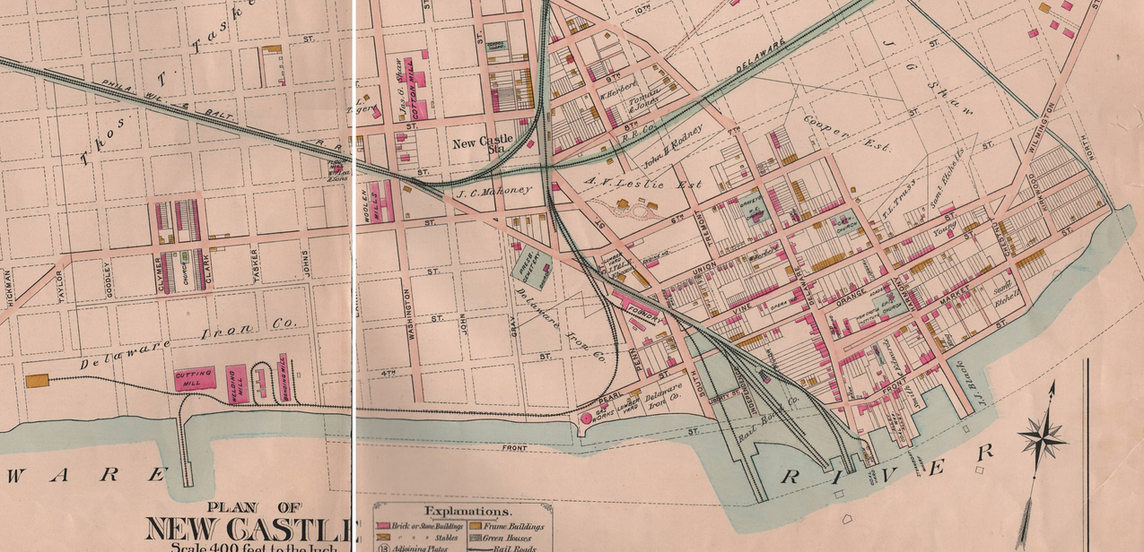
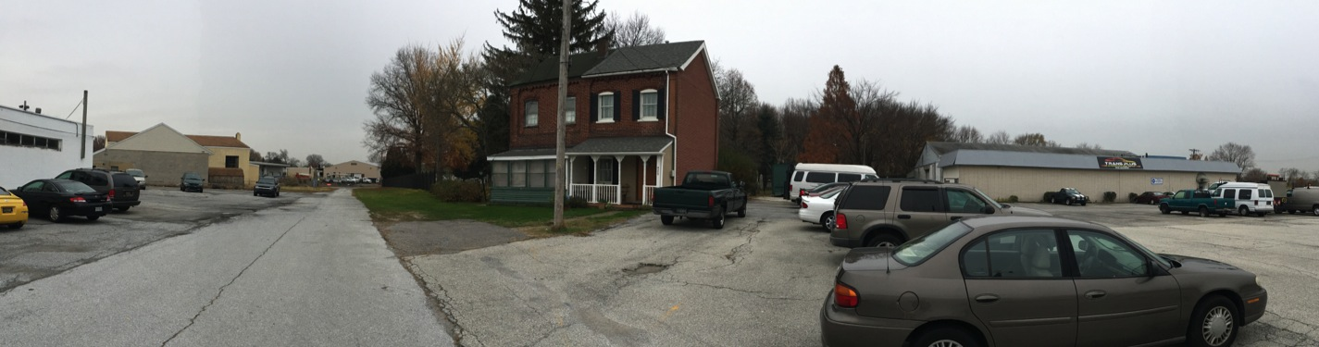
Dotted Line Streets

Slide 38
November 15, 1991
BROSIUS-ELIASON CO., A DELAWARE CORPORATION, PLAINTIFF,
v.
JOHN A. DIMONDI AND THE MAYOR AND COUNCIL OF NEW CASTLE, DEFENDANTS
COURT OF CHANCERY OF DELAWARE, NEW CASTLE, Berger, Vice Chancellor.
“In 1875, New Castle was incorporated as a city pursuant to 15 Del. L. Ch. 152 (1875) (the "City Charter"). Pursuant to Section 25 of the City Charter, new streets could only be opened upon written application by twenty resident freeholders and the Concurring vote of the City Council.
“The City … has no knowledge of any ordinance or resolution by which the disputed portion of Young Street was opened, of any condemnation proceeding relating to the disputed property; it has no records of any payment being made to a landowner with respect to the disputed property; and it has found no evidence that the City ever maintained the disputed property as a public street.
“There is some evidence that Young Street once existed over the disputed property. Jefferson M. Moak ("Moak"), an archivist for the City Archives of Philadelphia and former librarian who has studied the history of Philadelphia map making, testified as an expert on DiMondi's behalf. Moak examined three maps … and the George William Baist Atlas of New Castle County dated 1893. According to Moak, each of those maps shows Young Street as an open street between Sixth and Seventh Streets. Moak reached that Conclusion because the relevant portion of Young Street is drawn with solid lines rather than dotted lines.”
http://de.findacase.com/research/wfrmDocViewer.aspx/xq/fac.19911115_0005.DE.htm/qx

Slide 39
A public street may be created by statutory dedication and acceptance, common law dedication through adverse use, or the recordation of a subdivision showing streets, the conveyance of lots by reference to the subdivision plan and public use.
Here there is only some circumstantial evidence that the disputed property may have been used as a public street at some time between 1859 and approximately 1935. This evidence is insufficient to establish public use of the disputed property as a street.
Moreover, even if there once was a street, the evidence clearly establishes that it has been abandoned.
A public road acquired by use, as opposed to dedication, may be abandoned where there is non-use for at least 20 years.
There has been no showing of public use of the disputed property.
DiMondi, likewise, failed to establish a public easement by implication.
Berger, Vice Chancellor.
Notes:
My conclusion that existance on a map is no proof that something is a street.

