Slide 1
Industry in Historic New Castle??
1926 View (and now??) -- it’s somehow invisible
THERE are few communities to-day which have retained their early American flavor as completely as has New Castle, Delaware…
While there are some factories with their resultant nondescript housing, they are all grouped near the branch-line railroad which comes in to the west of the town proper. The compact older portion is still complete and removed from too much “progress.”
NEW CASTLE, DELAWARE an EIGHTEENTH-CENTURY Town
Wm. D. FOSTER White Pine Series of Architectural Monographs
Notes:
The facto or industries in NC commonly ignored

Slide 2
Industry in Historic New Castle??
YES. New Castle industries have come and gone since 1833
They brought people and jobs. As with Wilmington (think Bancroft Mills and Du Pont departments), when they left, so did many of the people.
New Castle had factories for making:
railroad engines flour
iron pipe cotton and woolen fibers
anchors illuminating gas
gloves, shirts, umbrellas artillery shells
rayon fabric vulcanized fiber
hardened steel for railroad switches and brakes
bulk polypropylene for bottles etc

Slide 3
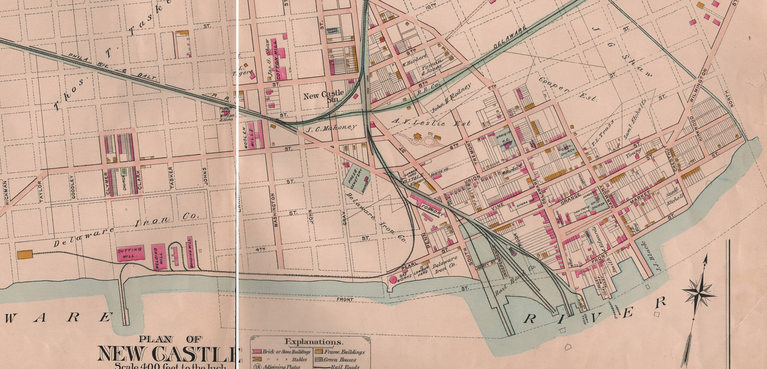
Industrial sites in New Castle before 1900
Later industries were north and east of town: Bellanca, Baldt &Brylgon Steel
Flour mill
Triton/Shaw cotton mill
Tasker/Deemer steel
Umbrella factory
Glove factory
Baist Atlas, 1893
Tasker iron/National Tube
Woolen mill/Wilmington Fibre
Gas plant
New Castle Manufacturing/
Hicks Engine Works/ ‘the foundry’
Notes:
Starting in 1900 the Town ctively recruited industry These are the sites closeto town. Then the townl, as the statedid to lure Astra Zeneca with tas rebates the town attracted steel mills north of town. A factory was established below town (maybe without rebate.

Slide 4
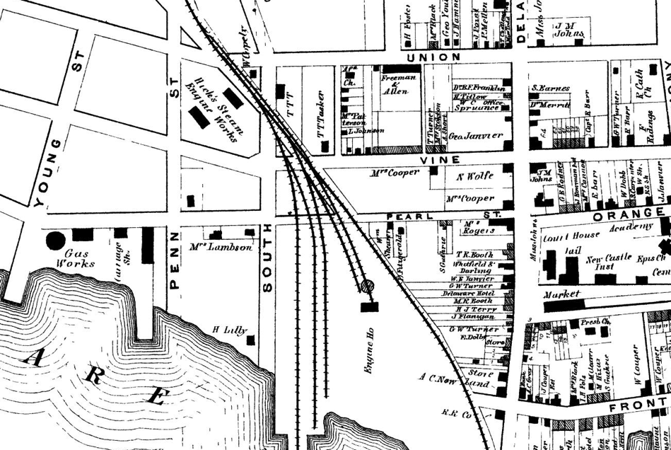
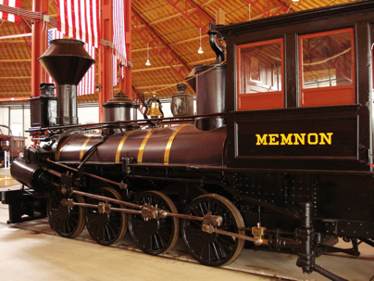
The First Heavy Industry in New Castle:
New Castle Manufacturing Company/Hicks Engine Works
Beer’s atlas 1868
The Foundry
Initially not for engines: founded in 1833 for cotton, wool, grain, plaster of Paris…
Tank
In 1837 the company started to make engines on contract to RR.
The only surviving engine built in New Castle is the 1848 'Memnon', #57, now in the B&O museum in Baltimore. It was built to haul coal in WVa, then used to haul troops for the North in the civil war.
Notes:
Note gas works; early map engine works only factory at time (1830’s) Eventually Brosius Eliason store, then

Slide 5
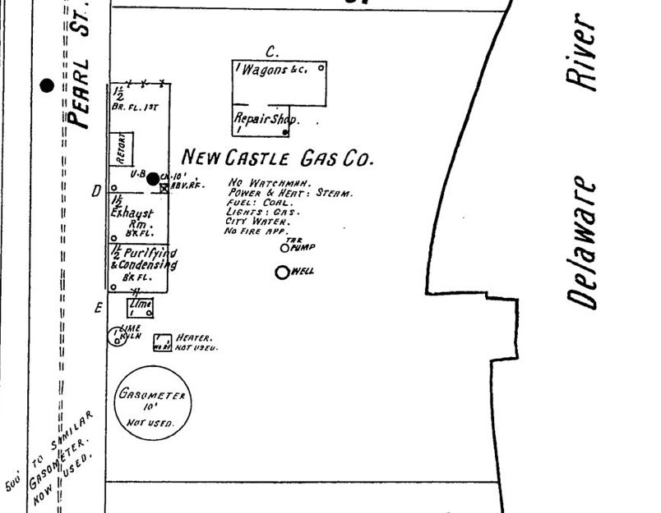
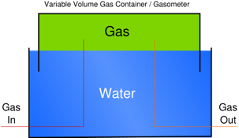
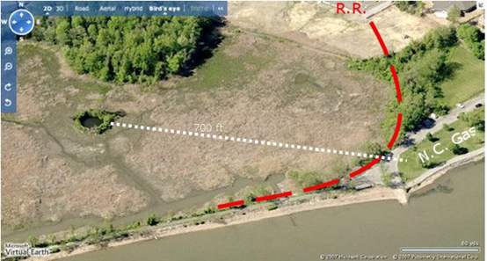
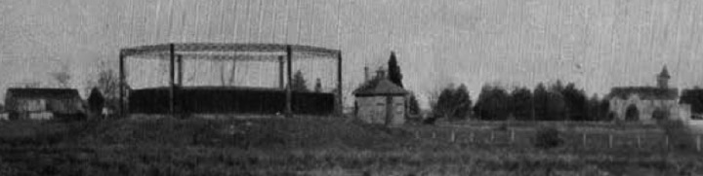
New Castle Gas Co
1857-1918.
Thermal decomposition of coal -> methane, hydrogen, carbon monoxide, tar
A pier gave easy access to the raw material, coal.
Byproduct (tar) could be pumped into the well (!).
Gas could be pumped into a nearby ‘gasometer’, a storage device with a floating lid which provided absolutely constant gas pressure (important for distribution into nearby houses).
Notes:
Now the boathouse in battery park

Slide 6
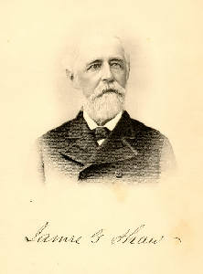
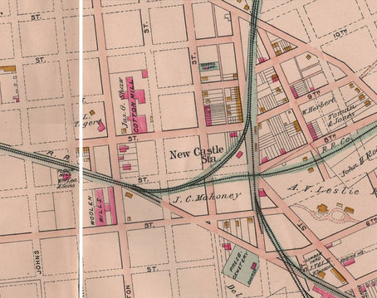
Triton Cotton Mill (later Deemer Steel)
c1861-1900, Washington St., Shawtown
From Speculator (1860) to Plant Owner and Developer
321 | Brumfield | Mary | 14 | F | W | Pa
321 | Reynolds | Andrew C | 48 | M | W | Del | Dentist
321 | McClain | Edward | 32 | M | W | Pa | Clerk
321 | Evans | John | 23 | M | W | Del | Commision Merchant
321 | Caussey | William | 23 | M | W | Del | Lawyer |  | 1,000
321 | Cann | William | 28 | M | W | Del | Merchant | 2,000 | 4,000
321 | Shaw | James G | 30 | M | W | Pa | Speculator | 10,000 | 5,000
321 | Plesants | Charles F | 28 | M | W | Pa | Clerk
321 | Hartis | George | 40 | M | W | England | Ostler
321 | Hartis | Ann | 25 | F | W | England | Domestic
321 | Holladay | Sarah | 18 | F | W | Ireland | Domestic
321 | Miller | David | 18 | M | M | Del | Servant
In 1857 he moved to NC and bought land west of town (including Shawtown) – former Kensey Johns farm.
In 1860 he built a cotton yarn factory to be run by a Boston co. But the civil war…
Notes:
Now Deemer Landing. Nothing to do with a landing Deemer steel was never waterfront.

Slide 7
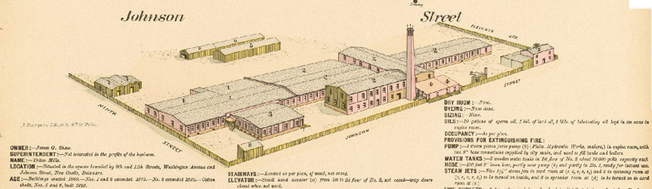
Triton Cotton Mill/Deemer Steel
After the war, Shaw bought cotton fiber machinery himself, joined with an experienced partner, James Knowles and started Triton Mills, which lasted until the 1880’s. At one time he was the largest employer in town.

Slide 8
Occupations in the Town of New Castle (1870)
In 1870, working in a cotton mill (presumably Triton Mill, founded c1861) was the third most common paid occupation, after laborer and domestic (not counting ‘at home’ and ‘without occupation’
There were 151 occupations listed. One person each was a gold beater, telegraph operator, sail maker, watch repairer, book gilder, cigar maker, hedger, distiller
OCCUPATION (1870) | Number | Real Value | Personal Value
 |  | (Avg) | (Avg)
At Home | 736
Keeping House | 343 | 9,177 | 1,955
Without occupation | 160 | 16,422 | 8,136
Laborer | 123 | 1,028 | 143
Domestic | 92 | 1,000
Works in Cotton Mill | 84 |  | 125
Carpenter | 28 | 1,625 | 276
Farmer | 19 | 17,214 | 4,573
Blacksmith | 12 | 1,700 | 335
At School | 11
Machinist | 11 | 6,750 | 856
Hotel Keeper | 10 | 4,200 | 593
Clerk in Store | 9 | 1,000 | 200
Works on Farm | 8 | 750 | 133
Gardener | 7 | 1,133 | 130
Lawyer | 7 | 14,200 | 23,028
Ostler | 7 | 1,500 | 200
Sailor | 7 | 1,000 | 40
Around 1880 Triton Mills closed – put out of business by competition with mills in the South much closer to the source of the cotton.

Slide 9
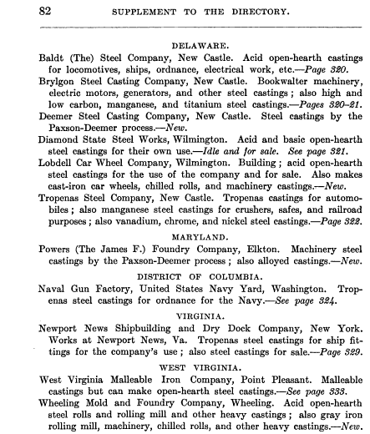
By 1910, Triton Mill had been converted to the Deemer Steel Casting Company.
Four of the 6 steel works in Delaware in 1910 Were in New Castle
(Directory of the Iron and Steel Works of the United States)

Slide 10
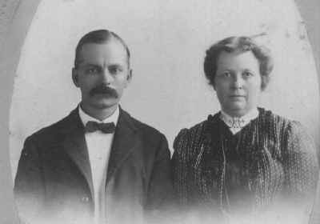
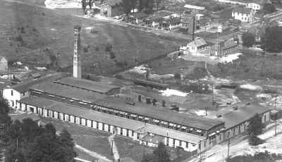
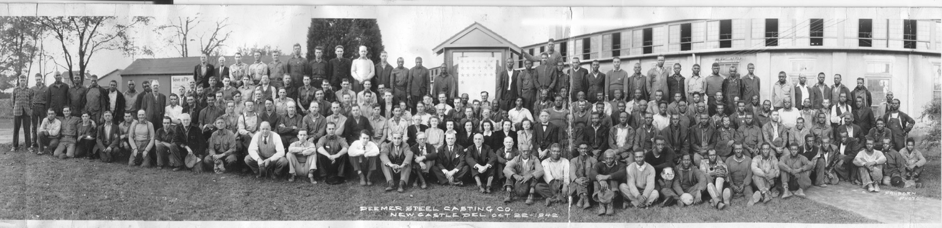
Portrait c1900 of Selden Scranton Deemer (1861-1934) and Kate Deemer. He had been superintendant of Brylgon Steel Casting Co, built 1903. He lived in the Lesley/Deemer mansion.
After his death, the mill was sold to Newlin Booth
Notes:
By continuing on from Triton mill, I’ve ignored another mill that started shotly after,triton mills, on land Shaw sold to Thomas Tasker.

Slide 11
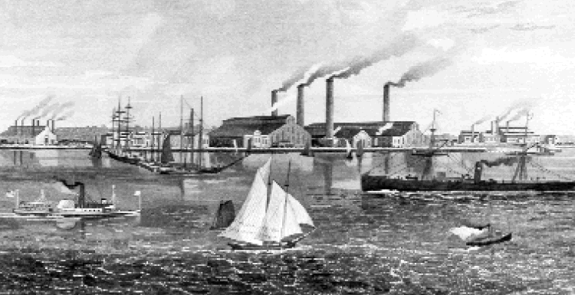
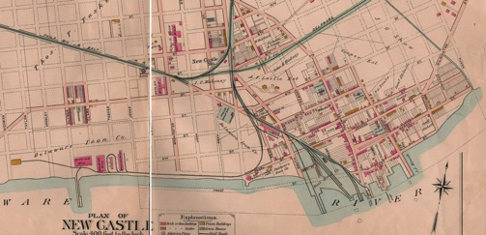
Tasker Iron Works (1872)
The land was originally granted by Penn to cousin William Markham, and called “Markham’s Hope”. Recall that he was fired by Penn c1701 because of the problems of piracy in the colony.
Dobbinsville
Tasker Iron Works
Notes:
Note single track railroad on current river walk. Off river walk. Note the pier still is a hull of a baarge type vessel waiting for the final days.

Slide 12
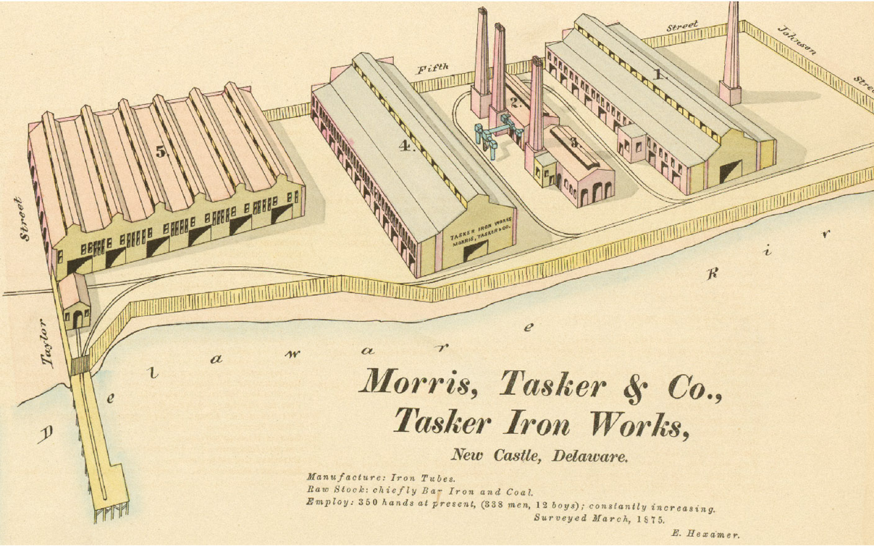
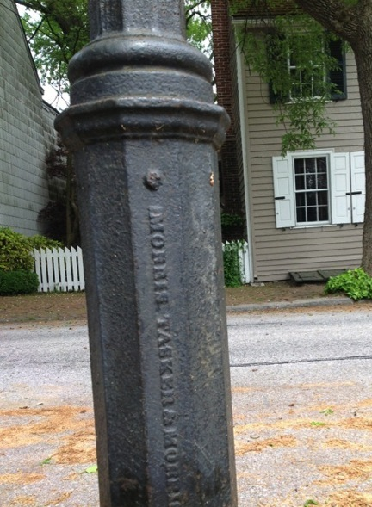
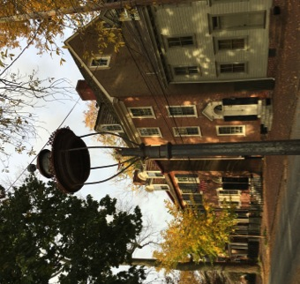
Manufactured iron tube, employed 283 men 12 boys in 1875
Last remaining gas light fixture: near Dutch House on E 2nd
Notes:
Trust, then National Tube “Manufacturer of iron tubes; raw stock chiefly bar iron and coal.

Slide 13
In 1864 Shaw sold land between the river and Triton Mills to Thomas Tasker who was one of the owners of the Morris Tasker Iron Works in Philadelphia.
In 1872 Tasker moved most of his plant to Delaware (same name). It was reincorporated as Delaware Iron in 1876 with his son as president.
About 1899 it became part of National Tube Company, a “Trust” -- a corporate monopoly organized in order to eliminate competition.
The company closed in 1900 and all assets were removed.
Workers in nearby Dobbinsville left.
Then new life when Baldt, Brylgon, Deemer & Edgar Allen steel mills opened nearby.

Slide 14
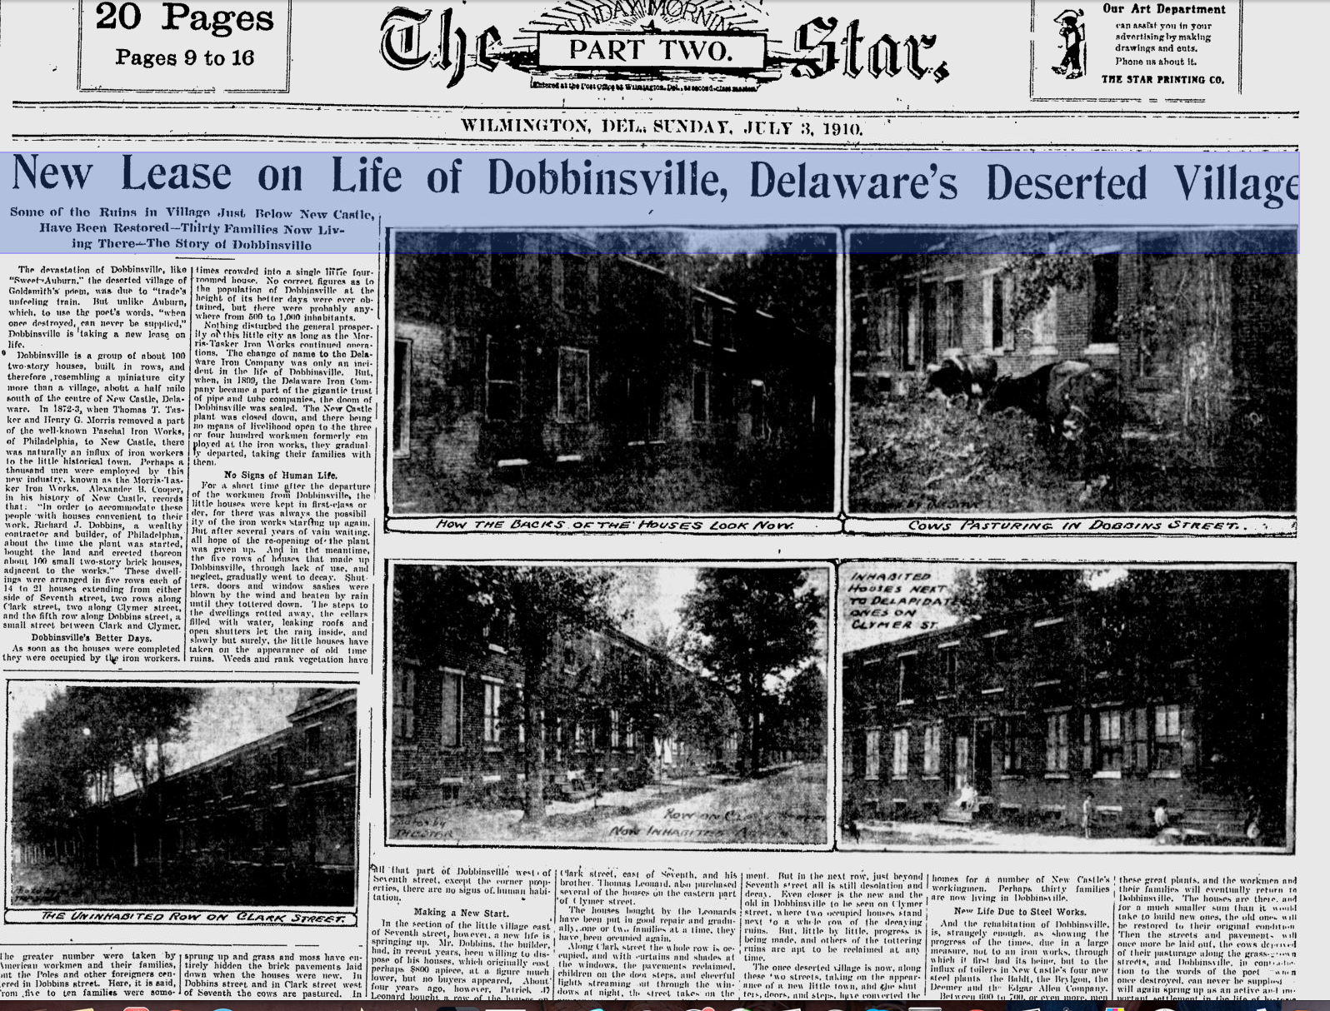
Notes:
Head line “No sign of human life” How bad was it? After several years of vain waiting all hope of the reopening was given up. The houses went nto decay. Shutters, doors and windows tottered dodwn No sign of human life.

Slide 15
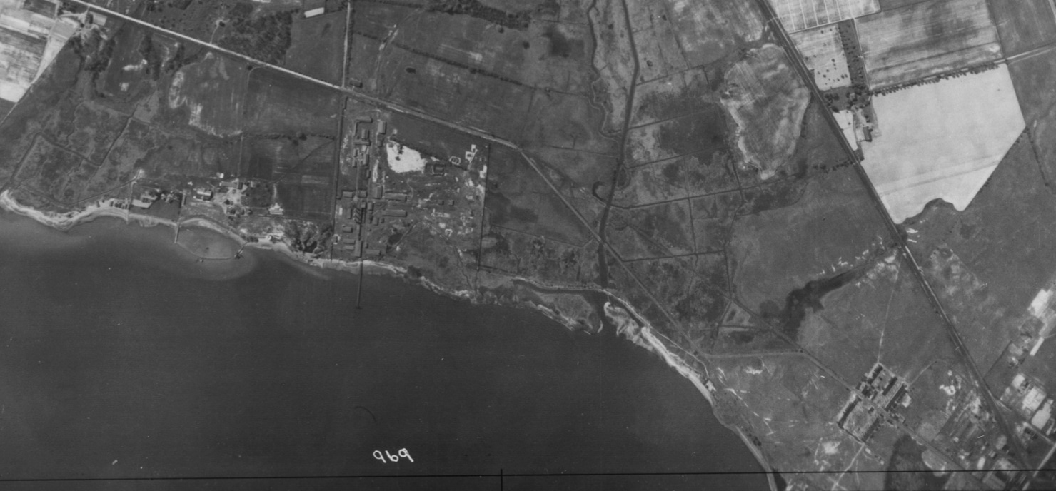
Former Tasker Iron/ National Tube Co
Dobbinsville
Industry Sites South of New Castle in 1926 aerial view
Future site of Amoco polypropylene factory
Built c1961, exploded October 22, 1980
Rte 9
Bethlehem Steel (artillery shells), Delaware Rayon, Printpack
(Deemers Beach)

Slide 16
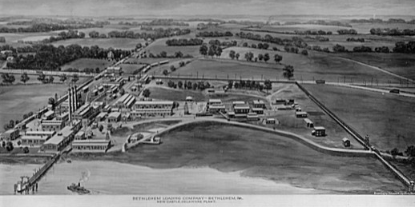
Bethlehem Loading Company (1914—1919)
It and 14 similar plants were established around the country before the U.S. entry into the war (1917). The factories loaded artillery shells.
We can learn about the layout and functions of the buildings from a similar plant in New Jersey (1917-1918)
Notes:
Note the smokestacks and big building next to it – the power plant One of the few buildings to survive.

Slide 17
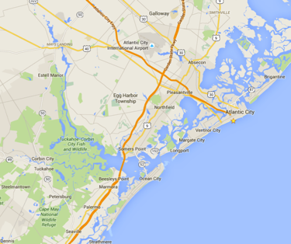
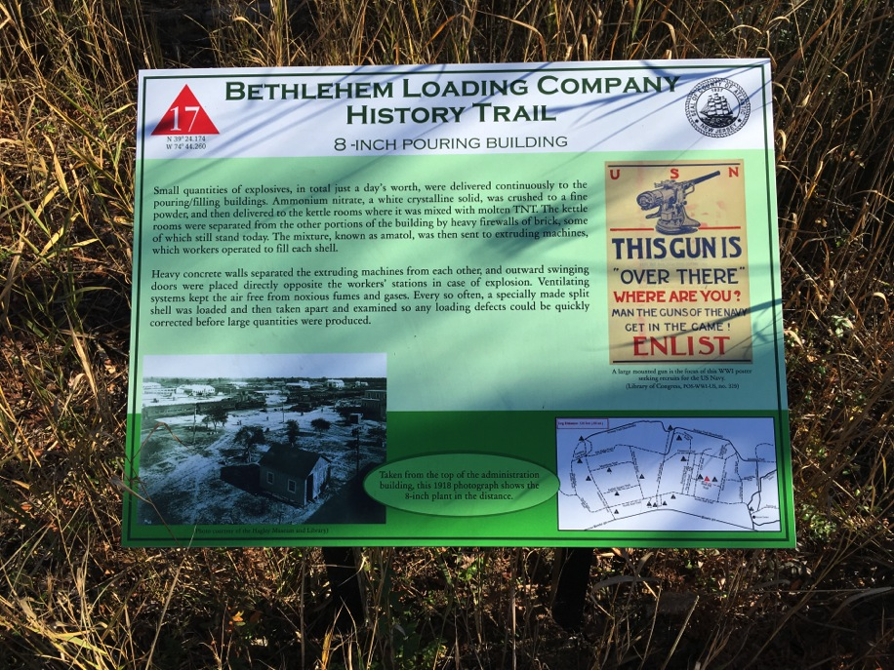
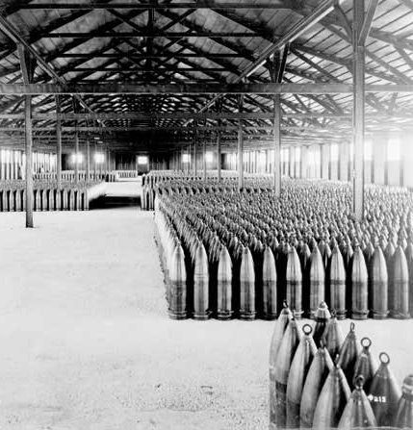
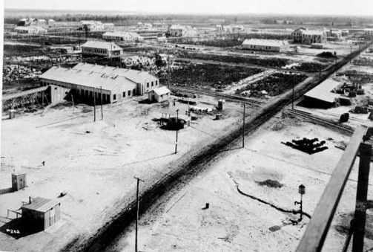
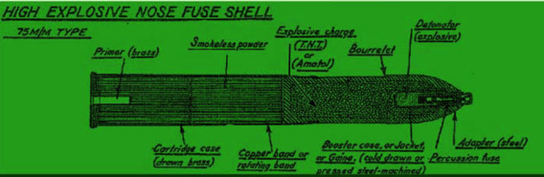
Estell Manor State Park, Mays Landing NJ — Site of Another Bethlehem Loading Co.
Bethlehem Loading Co, Mays Landing plant was one of 14 built nationwide. It employed up to 2000 people, and had loaded 134,000 shells before the war ended in Armistice Day, 1918.
The plant assembled the parts of 3,6, and 8 inch shells and filled them with molten TNT. Buildings were connected by trains which carried parts and finished shells.

Slide 18
Workers at the Bethlehem plant lived in New Castle.
-- recollection from Frances Haut, age 99, interviewed at Methodist Country Home
The "Canary Cottage" near Witt's Bakery on Delaware was a rooming house for girls.
It wasn’t named for color of the buildings, but the color of their skins from working in explosive plant [with nitro compounds]

Slide 19
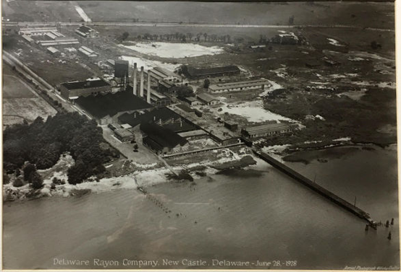
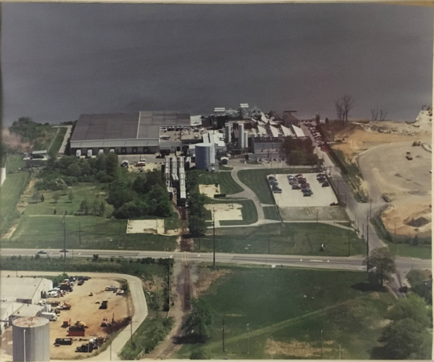
Bethlehem Steel, Delaware Rayon, Printpack
The Grantham Lane Industrial Site Still Active After 100 Years
A few of the buildings, like the power plant structure are still in use.
Delaware Rayon (1928)
1914-1919 Bethlehem Loading Co
1919-1926 Plant closed
1926-1946 Delaware Rayon
1946-1953 Mohawk Carpet –rayon carpet
1953-1959 Plant closed
1959-1967 American Viscose – cast/ extruded films
1967-1973 Amoco - same
1973-1986 Crown Zellerbach– same
1986-1996 James River – same
1996- present Printpack Inc –films used in packaging
Power
Plant
Printpack Inc (~1993
Power
Plant
Two other active industrial sites: Woolen Mill/Wilmington Fibre, Baltd Steel/Speakman co.

Slide 20

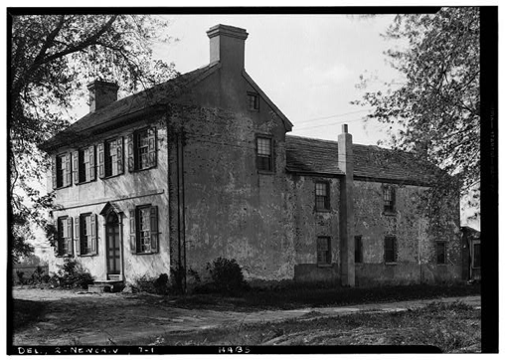
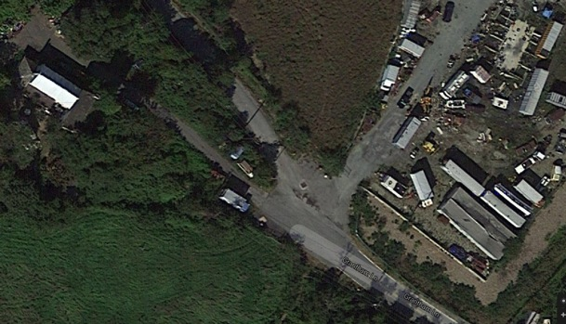
Printpack Inc.
Grantham Lane & River Rd.
Produces extruded plastic film, prints on it, and delivers it to the product manufacturer.
At the other end of Grantham Lane, Grantham House, National Historic Register, roof of front section collapsing, surrounded by refrigerators and cars, adjacent to a junkyard and marshes. Early settler (c1700?), sons fought in Rev. War

Slide 21
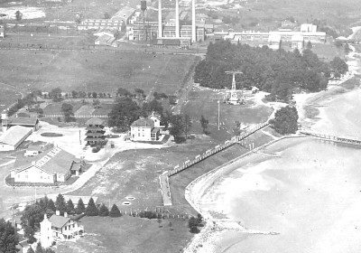
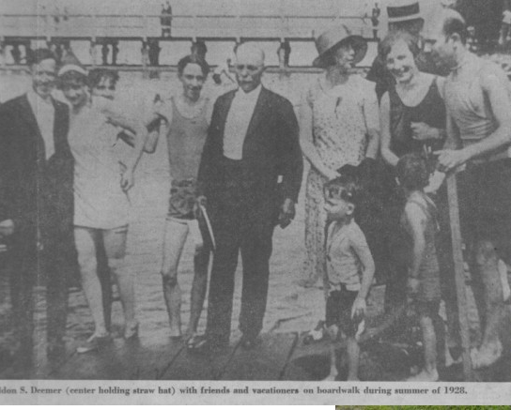
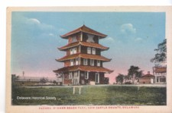
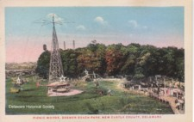
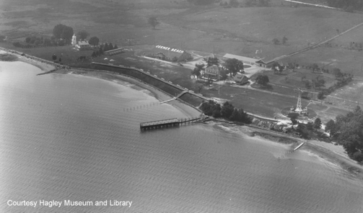
Bethlehem Steel,
Del. Rayon,
Printpak
Deemer’s Beach (1925-35)
Inner range light

Slide 22
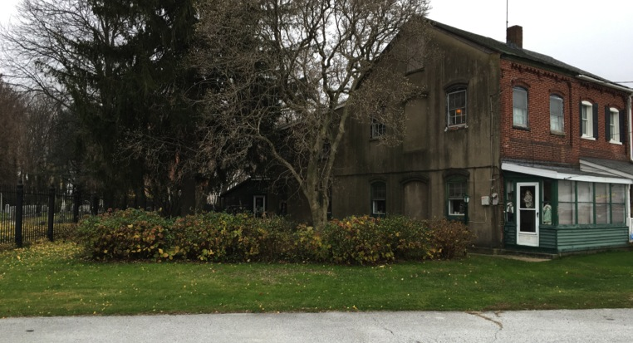
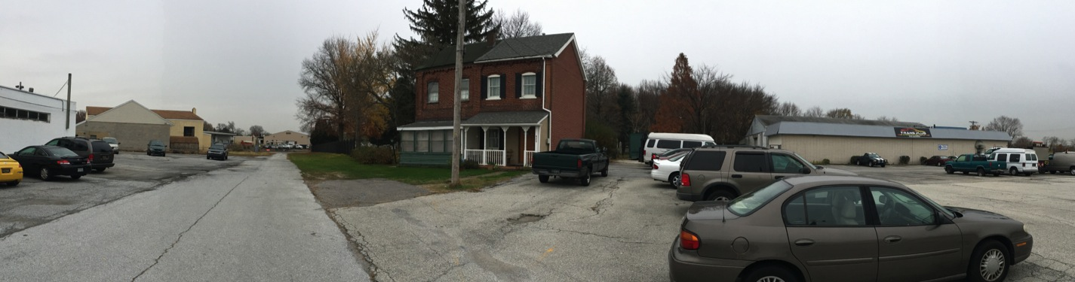
The Umbrella Factory
425 Umbrella Row (a.k.a Gray St). between the Presbyterian Cemetery & former Gambacorta car dealerships
Built c1880 by A. V. Lesley as an umbrella factory, but lasted only a short time. Converted to four houses (two since demolished).
The adjacent “rural cemetery” was once only accessible by rail!
The adjacent street was the subject of a prominent 1991 lawsuit between Brosius-Eliason Co. and John DiMondi about and what constitutes a street. http://de.findacase.com/research/wfrmDocViewer.aspx/xq/fac.19911115_0005.DE.htm/qx

Slide 23
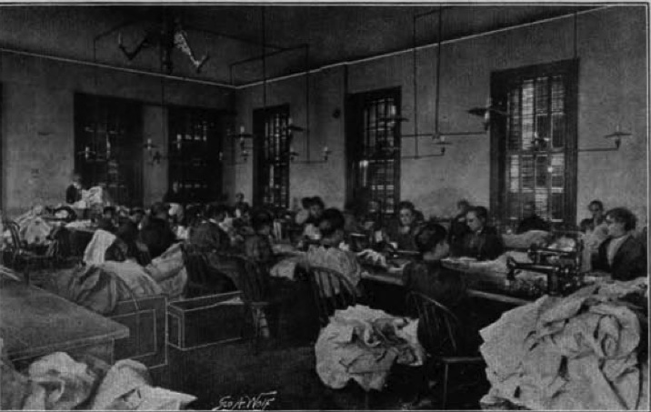
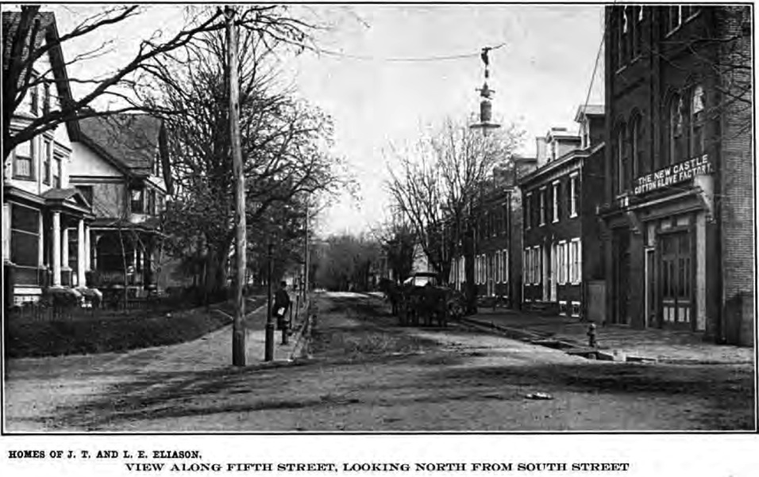
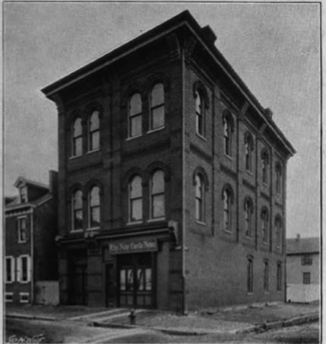
New Castle Cotton Glove Factory (c1895?)
&
Shirt Factory
Multi purpose: glove factory, newspaper, fire hall, Red Men’s hall

Slide 24
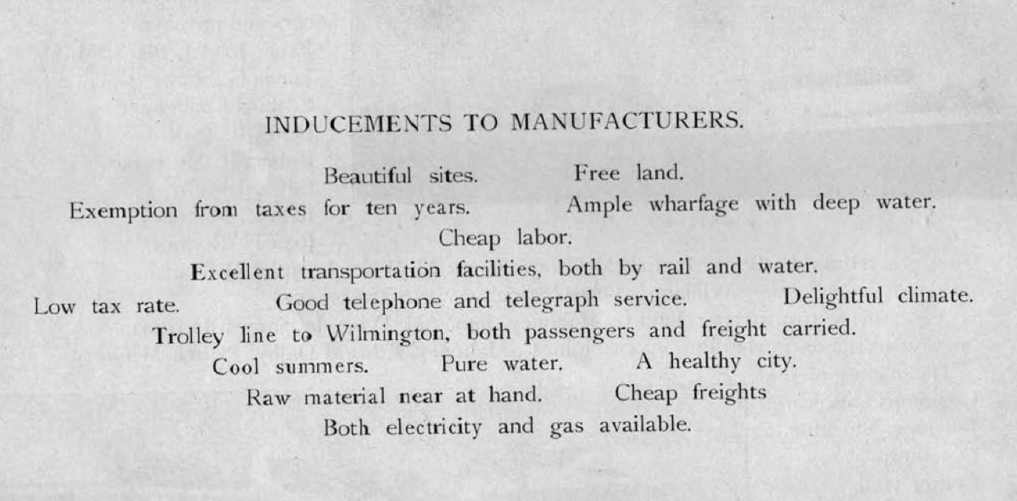
From Ideal New Castle, 1899, Commercial Club

Slide 25
June 2, 1903 Agreement between Trustees & Baldt Steel
“Whereas the said Trustees are willing and desirous of facilitating and assisting in the establishment of said industry and company,
Baldt erect an open hearth steel plant costing $200,000 on land purchased from Francis Janvier, a Trustee
The Trustees will pay $6,000 in installments
Whereas, owing to the abandonment of many of the manufacturing interests of the City, the City of New Castle has for some years been in an unfortunate financial and industrial condition, whereby many inhabitants of the City have been unable to obtain employment and the welfare of the whole City materially injured; …
Notes:
A similar agreement with Brylgon mentioned anticipating hiring 100 workers.

Slide 26
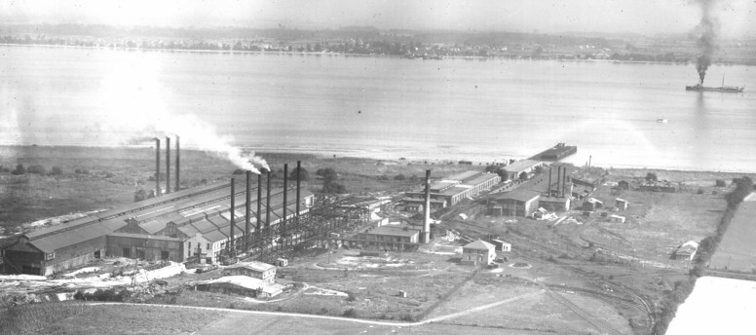
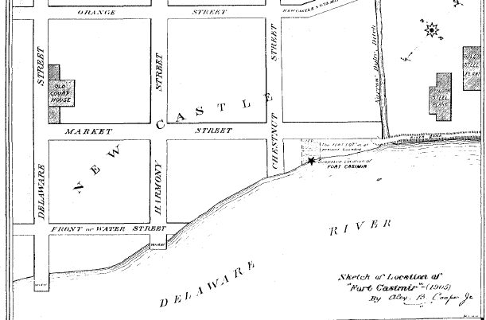
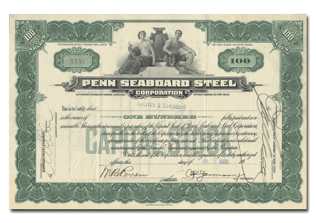
North of New Castle (adjacent to Glebe & Cemetery)
Baldt Steel
Brylgon Steel
These companies and others merged c1916 to form the Penn Seabord Steel Co.
A. B. Cooper, 1905
Notes:
Penn seabord steel company formerly baldt & brylgon now twin spans industrial park, warehouses; glebe cemetery just below picture

Slide 27
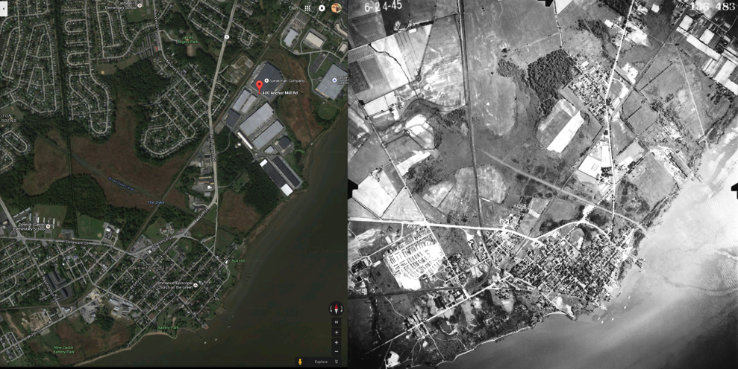
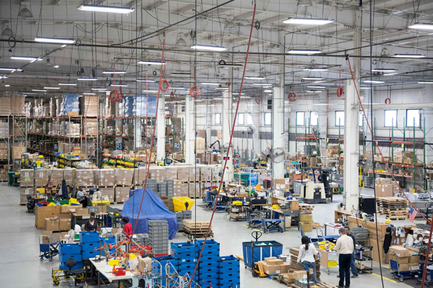
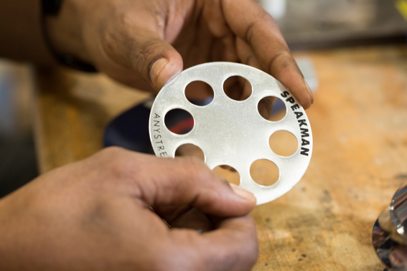
Speakman Co,
Founded 1869; recently moved from 30th St., Wilmington to the Baldt/Brylgon site in Twin Spans area. Employs > 100 workers. Manufactures plumbing fixtures
Some onsite manufacturing, mostly assembly of materials from China.
Speakman Co.
Baldt Steel
Brylgon Steel
Notes:
Davida donohoe 302 764-100

Slide 28
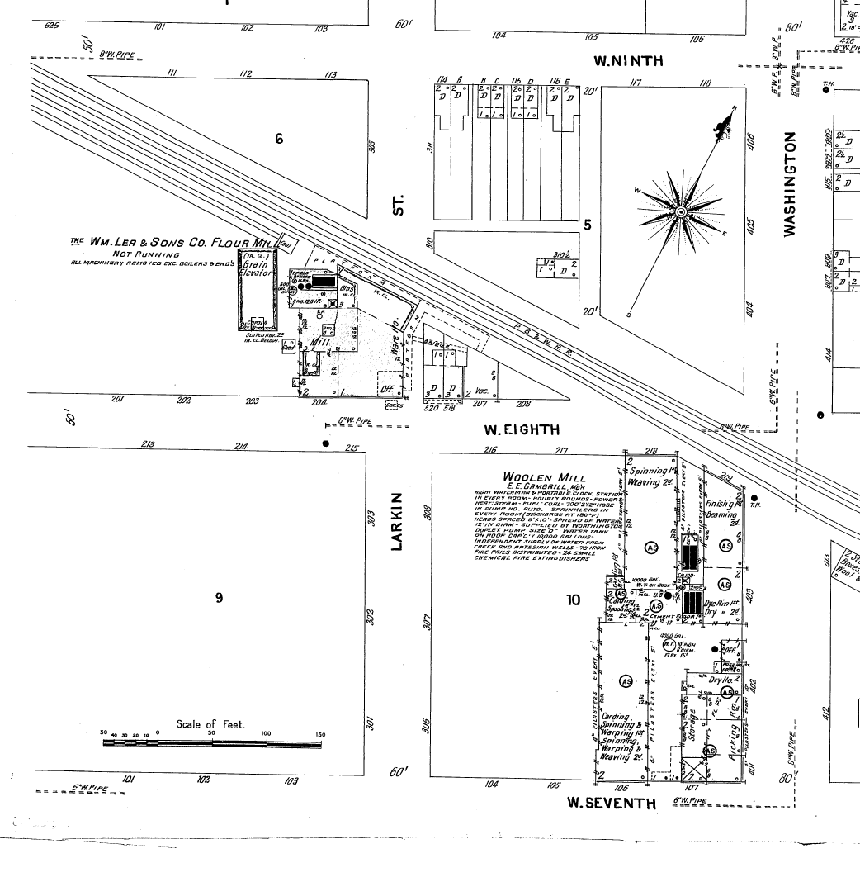
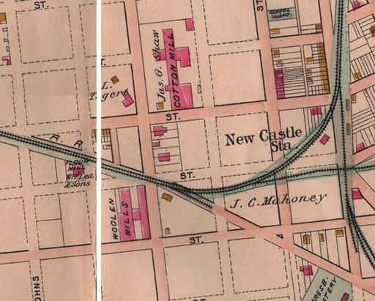
Knowles Woolen Mill --> -> Wilmington Fibre
1873 Founded by James Knowles, former partner of James Shaw (Triton Mills)
1878 Destroyed by fire
1884 Again destroyed by fire
1886-1902 Flourished, employed 200 people

Slide 29


Wilmington Fibre Specialty Co.
Along with Printpack, the last manufacturing companies in New Castle
1904 Founded in Wilmington
Moved to New Castle, made fibre parts like gaskets.
1970s Began fabricating plastic products like
guitar picks

Slide 30



‘The Manganese’ (AMSCO, American Manganese Steel)
Factory site
Waste dump
1909 – Tropenas Steel, later Edgar Allen, AMSCO, ABEX – closed 1986
Produced work-hardening manganese steel by Tropenas process used in railroad switches and brakes.

Slide 31
From “Men of Steel”, by Hugh Ryan Jr., March 6, 1986
The presence of the American Manganese Steel Plant, as I knew it, had considerable economic effect on the New Castle area through the years. Many of us were clothed, fed put through school and lived on earnings from the sale of railroad frogs, steam shovel buckets, drag buckets, points, lips , links and the vast variety of steel castings fabricated here at New Castle. The molds were made by Roy White, Ed Cline, Dick McGrory, Lou Stidham and others, all working under the watchful eye of Grover Ingle, the foundry foreman. The castings would be shaken out and sent over to the annealing furnace where Ed McDaniel's team would don their asbestos suits and fasten the crane hooks to the pile of six or eight tons of cherry red steel. He would then guide Dominick Chirilli's crane over the water pool and signal "lower". The resultant steam explosion and flying water was a dramatic sight to witness.
The Plant was not an easy place to work as indeed no steel foundry is. It was physically demanding on its workers. The air was always dust filled and you breathed it. But somehow you had pride in associating yourself with this work. It was an invaluable experience working with men like Alex Garneski, Joe Medora, Ralph Divito, John Gilkey, Joe Armpriester, Joe Rossell, Harold Emery, Bill Dalby, Dominick DiSabatino, Fred Rush, Edgar Bowen, Mope White, Bill Denny, Grover Ingle, Harry Ingle, Chick White, Bill Payton, Charlie Hewlett, Joe Mullin, Frank Kelly, Tony Esopi, Hughie Ryan (Sr) , Ed Butler, Ed Cline, Horace Conover, Harry Gallagher, Bill Peden, Barney Williamson, Cliff Ivery, Francis White, Johnny Proud, Earl DiSabatino, Johnny McDevitt, Mike Indellini, Emmett Covelli, Frank Yaccucci, Johnny Hall, Claude Phillips, Norman Banks, Don Nichols and many others.
Notes:
On the other side of the railroad tracs was quite a different company

Slide 32



One week after Lindbergh’s flight to Paris,
Bellanca’s Columbia flew to Berlin
July 4, 1927
1928 Bellanca moved his plant to New Castle
Video: friendsofbellanca.org
Notes:
Employed 3000 people WWII

Slide 33



Slide 34





Slide 35

Tasker Iron/ National Tube Co.,
Dobbinsville
Industry South of New Castle, 1926
Future site of Amoco polypropylene factory
Built c1961, exploded October 22, 1980
Rte 9
Bethlehem Steel (artillery shells), Delaware Rayon, Printpack
(Deemers Beach)
Notes:
38 years to another phillies world series victory (1980 -- 2008

Slide 36


Slide 37


Slide 38



Slide 39


Slide 40

Marcello (‘Mike’) DiAllesandro worked at Amoco the day of the explosion. He was worried about other tanks exploding.
Youtube video
Born in 1943, came to New Castle via Canada in 1961 and immediately went to work at Amoco. The plant took oil byproducts from Sunoco to produce polypropylene pellets for pellets etc. Among his jobs was working inside reactors chipping product off beaters.

Slide 41
Industry becomes the Major Employment in New Castle
Shipping >1664 English Took Over; Ships by law went first to NY
>1682 Penn Arrived; Commerce on the river went to PHL
Law >1777 British Invasion; General Assembly -> Dover
1880 State Courts, county offices -> Wilmington
Transportation
NC was a transit hub since c1800 for Boston->NY -> PHL -> NC ->Baltimore ->DC
NC & FT Turnpike Co. (Competition: C&D Canal 1829)
NC & FT RR 1832 (Bypassed by PHL, Wilm. & Baltimore RR 1839)
Industries came and went: manufacturers of railroad engines, iron pipe, anchors, hardened steel for railroad switches and brakes, cotton and woolen fibers and cloth, flour mill, illuminating gas, gloves, shirts, umbrellas, artillery shells, rayon fabric, vulcanized fiber, bulk polypropelene for bottles etc. AN INDUSTRIAL TOWN!! They brought people and jobs. When the jobs disappeared, so did the people. Limited lifetime of companies same as today.
Shopping area
NC stores served the town and surrounding area (less over time) and employed locals.
The Trolley came in 1896, a two edged sword: people could come, but they could go
Workers and shoppers could commute to Wilmington. Cars continued the trend.
Notes:
Todays talk about industry

