Slide 1
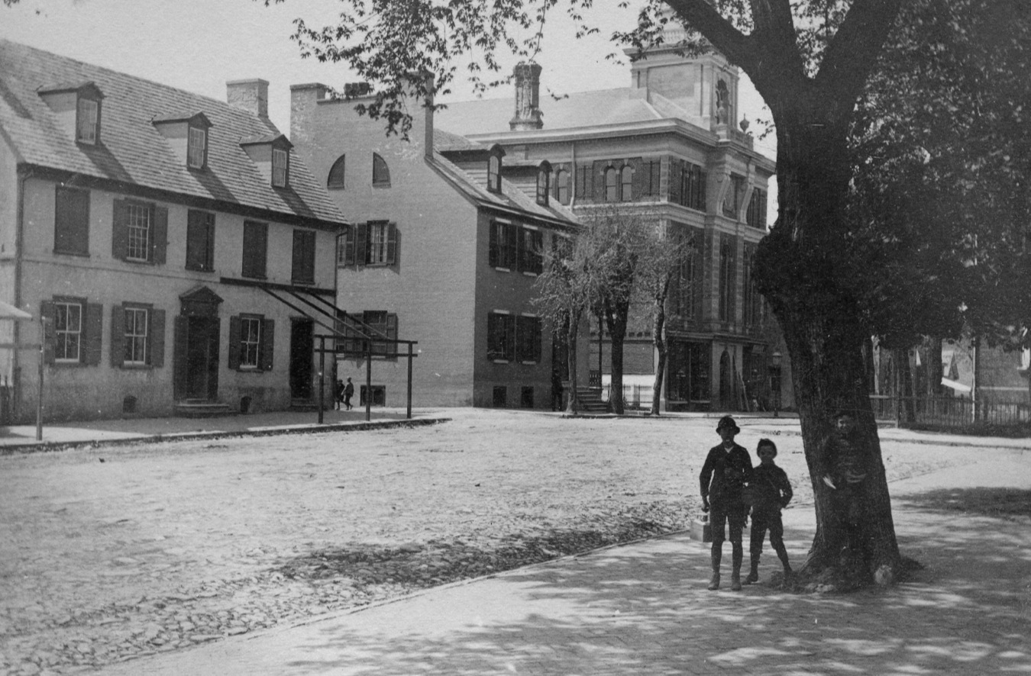
Architecture in New Castle
This talk:
What are the architectural periods and styles?
What to look at when we look at buildings
What style is that house?
How old is that house?
How many buildings are colonial in New Castle?
Are historic buildings protected?
Are homeowners limited in a historic district in what they can do with their house?
Historic Preservation
Another Course
Preserve what, for whom?
Originally associated with major person, (Washington)
Start: Mt. Vernon (1850), Independence Hall (1916), Williamsburg (1923), Santa Barbara(1925), Greenfield Village (1929), Charleston (1936)…
Natl. Historic Pres. Act (1966)
Cultural significance; high style AND vernacular
History as entertainment
Is society now changing to consuming vs saving the old
If you’re interested in above topics, Thomas Reed gave an
OLLI course on “Saving our Architectural History” and may again in 2019F or 2020S

Slide 2
PERIODS
Refers to government or ruler when something was built
STYLES
Either the period or decades or country of origin or what the house looks like.
Early Georgian 1700-1750
Mid/Late Georgian 1750-1780
Federal 1780-1812, 1824-1840
Greek Revival 1825-1855
Gothic Revival 1840-1900
Italianate 1850 -1900
2nd Empire 1860-1890
Queen Anne 1870-1900
Bungalow 1890-1930
Colonial Revival 1880-1950
1620-1780 Colonial/Georgian
1780-1830 Federal
1830-1900 Victorian
1900-now Modern
The styles are relatively brief periods: mostly 30 years or less.
I claim that YOU can guess the date of a building to within 15 years,
based on knowing architectural details which they display.

Slide 3
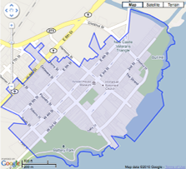
Is New Castle a Colonial or Historic Town?
Periods of the 506 buildings in the 1984 Historic District Nomination of New Castle
Colonial 1620-1780
Federal 1780-1830
Victorian 1830-1900
Modern 1900-1984
Count
Percentage
Notes:
So how do you look at a house

Slide 4
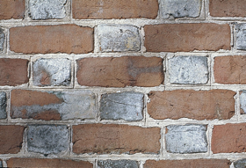
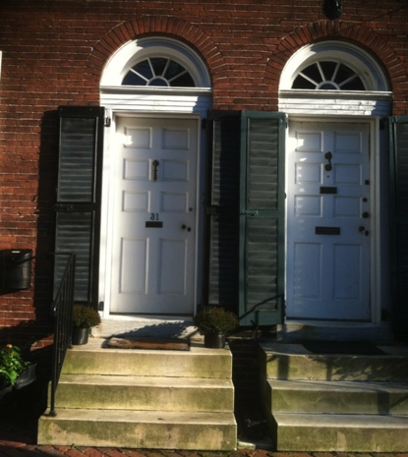
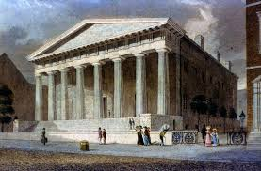
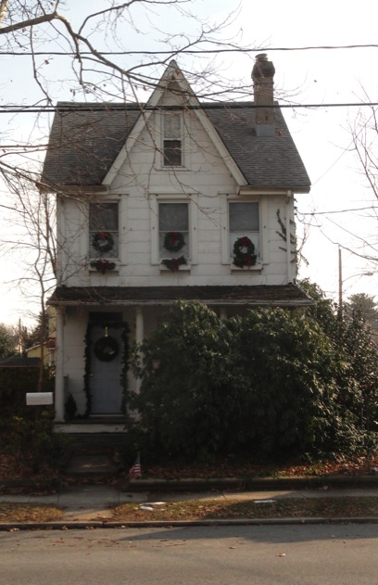
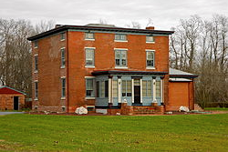
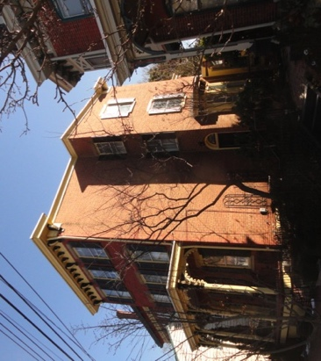
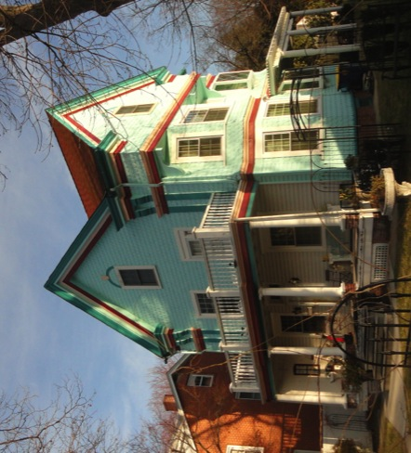
What are some obvious details that tell about the age of a house?
Brickwork: glazed header flemish bond is usually Georgian (or colonial revival)
Fan lights with tracery
are often Federal
Italianate houses have
Low pitched roofs and bracketed cornices
Houses with little third floor windows are often Greek Revival (and may have columns)
Gothic houses have
steeply pitched roofs
Queen Anne houses are exuberant. Porches, color, projecting
eaves on every surface.

Slide 5
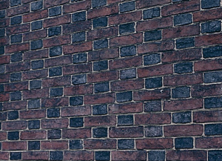
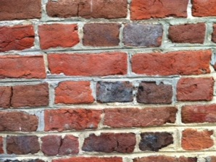

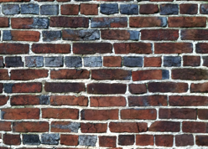
Flemish bond:
Bricks have only one rectangular shape but are laid in different ways. In Flemish bond, they have alternating header and stretcher in each row.
Used in Georgian and Federal periods in façade.
In early Georgian, the headers were often glazed.
Header
Short side of brick is exposed.
Stretcher
Long side is exposed
VA, DE
PHL
The bricks are glazed if the were near the smoke channel in the stack of bricks in the kiln when fired. The glaze color is from the smoke used to fire them, and varies with wood used: in Va, oak gives blue gray; in Phil., other wood gives black color.
Stretchers
Headers
Stretchers
Headers
English bond (less common):
Rows of all headers alternate with rows of all stretchers. Common in water tables, and sides and back of early Georgian (and one colonial revival) buildings.
Back of
Presby. Ch.
Running bond :
All stretchers. Used from Greek Revival on.
9 The Strand
Common bond:
Rows of all headers are separated by 3-12 rows of all stretchers. Used on sides and backs; rarely on front façade.
Header
3 rows stretchers
Header
5 rows stretchers
Header
Amstel House,side

Slide 6
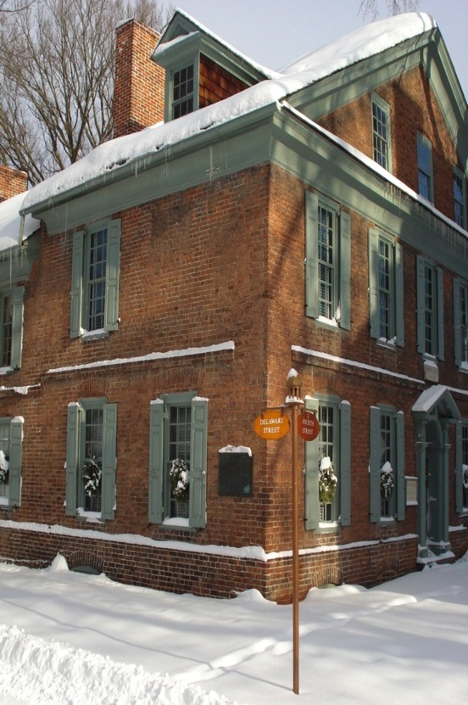
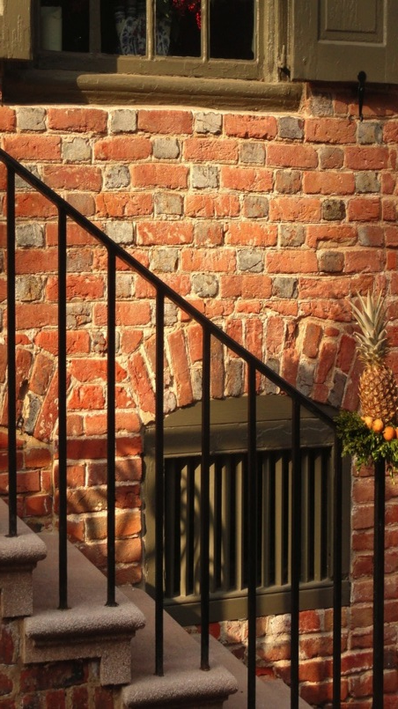
Architectural Features – Early Georgian, 1700-1750
String/belt course
Glazed header
Flemish bond
Brickwork
9/9 Window
Arch
Water table
Amstel House, 2 E 4th
McWilliams House, 8 The Strand

Slide 7
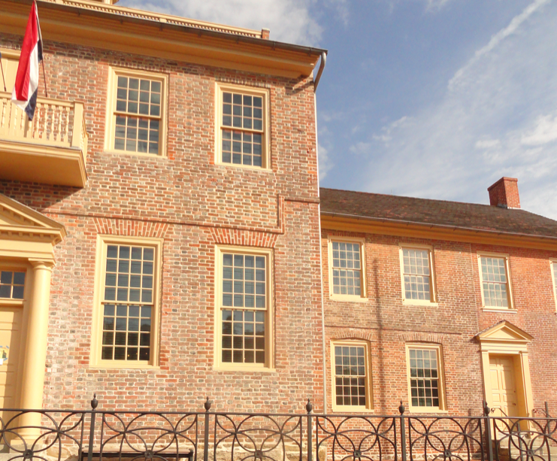
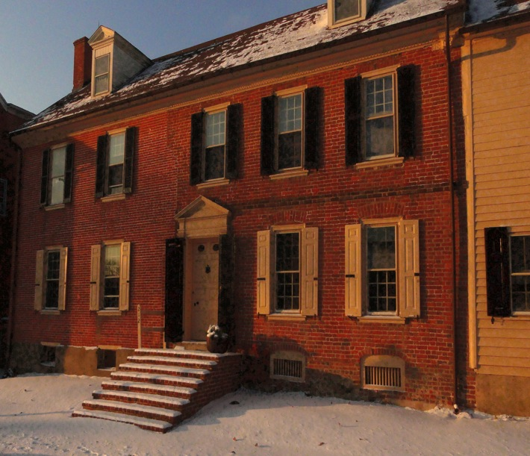
Early vs Mid/late Georgian
Two buildings built in stages in different eras show changes in styles
No String course
String course
212 Delaware, Booth House
1795, <1719, 1860s
Courthouse
(1845), 1732, 1756, 1802
No arches
Arches
9/9 window
“Symmetry” (vertical alignment of windows) in both sides

Slide 8
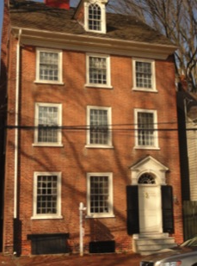

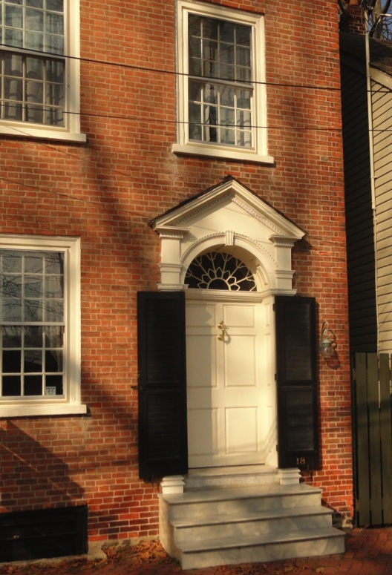
Early/Late Federal
~1780-1812/1824-1840
18 E 3rd, c1800
27-29 The Strand, c1826
“Symmetrical”
Fanlights with tracery
No string course or water table
“Flemish bond, not glazed header
Medium mortar joints, not pressed brick
9/9 window
6-8 panel door
Different entrances
(pediment vs arch)

Slide 9
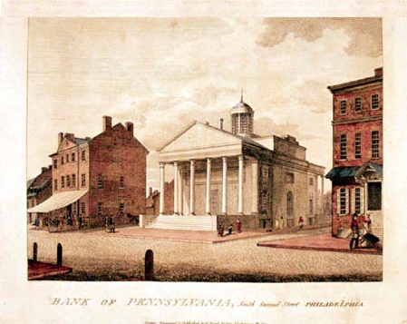
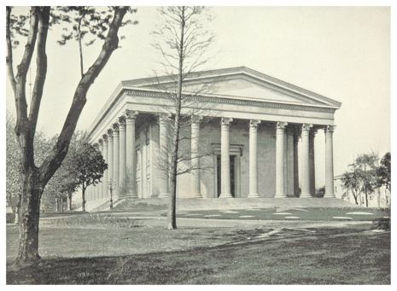
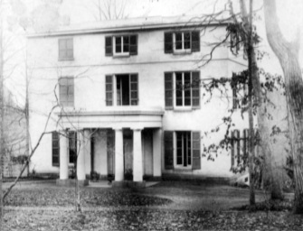
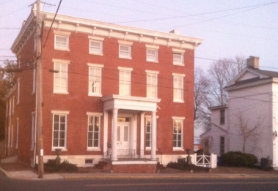
Greek Revival (I)
Temple Style Public Buildings & High Style Residences
Latrobe, First Bank of Pennsylvania, 1801
Strickland, Second Bank of United States, 1824
T. U. Walter, Girard College, 1847
Winterthur, c1840
Chelsea, Delaware City, 1848
“Bank House”, Milford, 1850
Houses, note: shallow roof, columns, small 3rd floor windows that mimic ‘triglyphs’ in Greek structures.

Slide 10
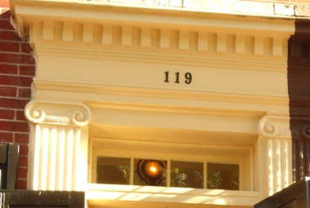
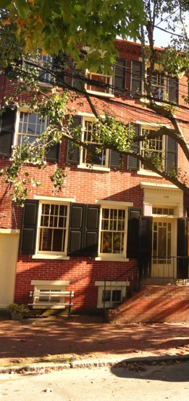
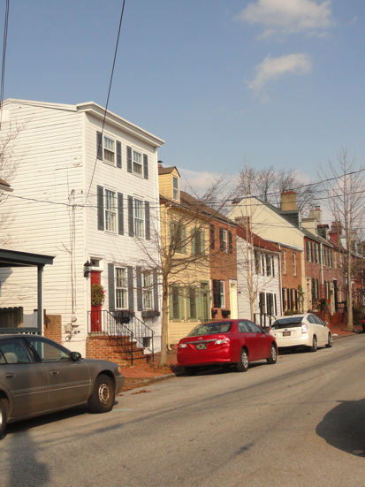
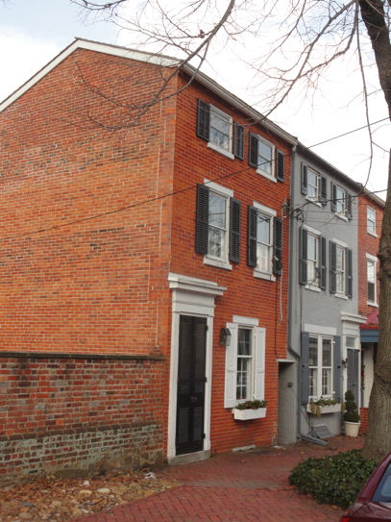
Greek Revival II
(c1825-c1855)
Urban houses in New Castle
32 W 4th, c1850
10-16 E4th, c1840
119 E 3rd
Flat or shallow pitch roof, short 3rd story, no or rectangular transom (Greeks did not have arches), may not be symmetrical, running bond (all stretchers, no headers), smooth brick, narrow mortar joint Windows 4/4 or 6/2

Slide 11
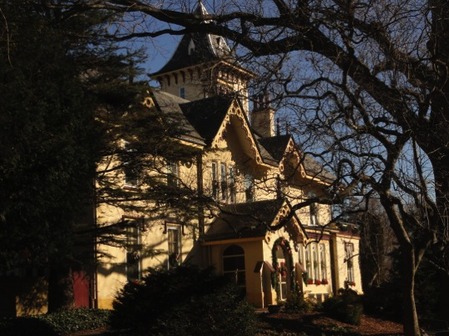
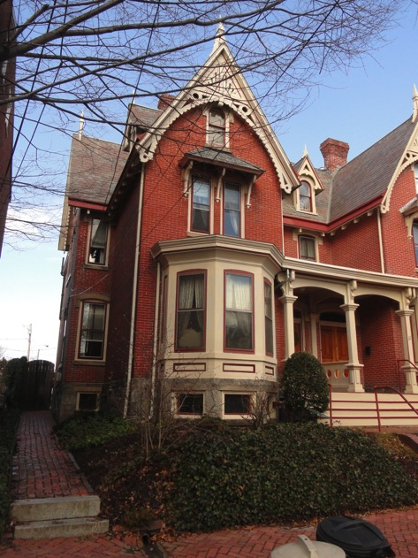
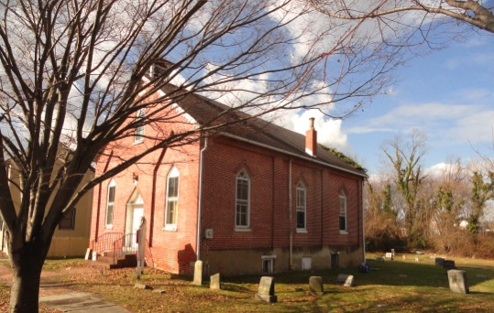
Gothic Revival (1840-1901)
24 W 4th St, Aquila Hizar, 1876 39 W, 5th 125 W 7th, Dr. A. V. Lesley, 1855
138 E 4th, Mt. Salem ME Church, 1878
Gothic distinguishing features: “verticality”, steep pitch roof, cross gables, v-shaped barge boards,
one story porch, windows 1/1

Slide 12
What about internal stuff – did that change with the period?
Yes, but you can’t see the parlor molding and mantelpiece design as you walk by. That’s another interesting area.

Slide 13
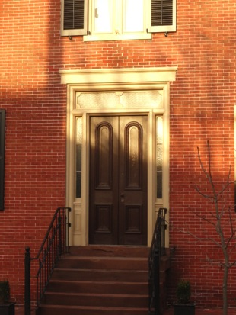
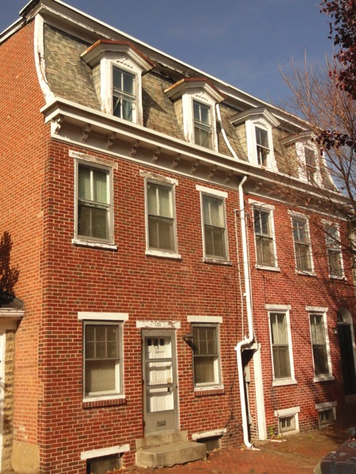
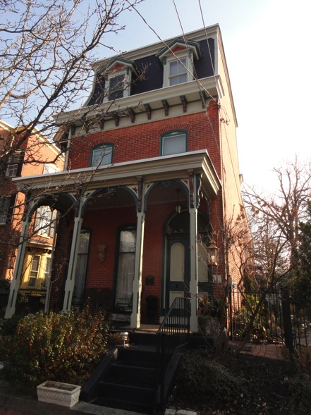
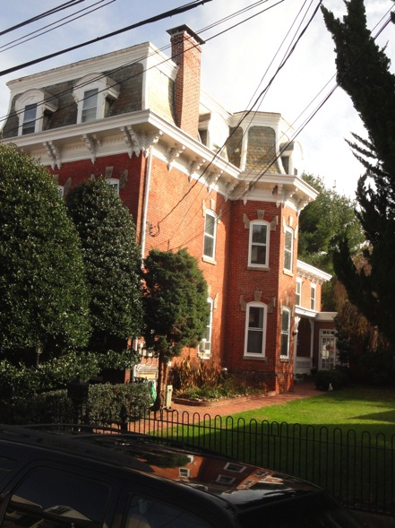
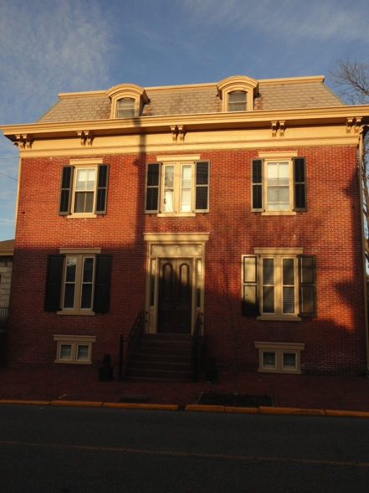
2nd Empire
1860-1890
Key characteristic: Mansard roof (double pitch roof, the bottom very steep, usually with dormers) gives 3rd floor good height.
Frequently bracketed cornices, tall windows and 2 panel doors (often a pair of 2 panel doors with glass in upper panels)
122 E3rd, 1875 17 W 4^{th,} 1879 125 E3rd, 1884, 427 Delaware 1875

Slide 14

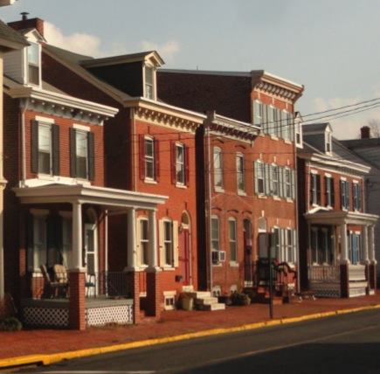
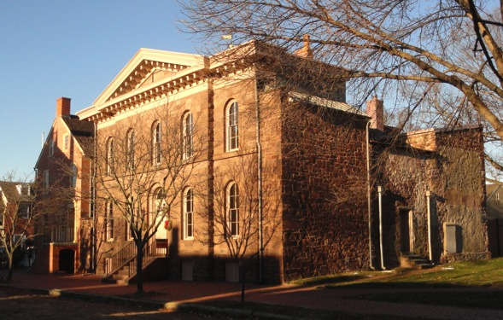
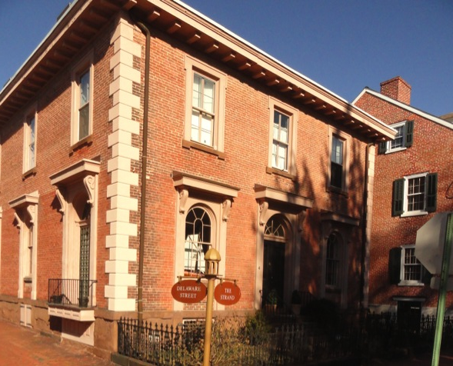
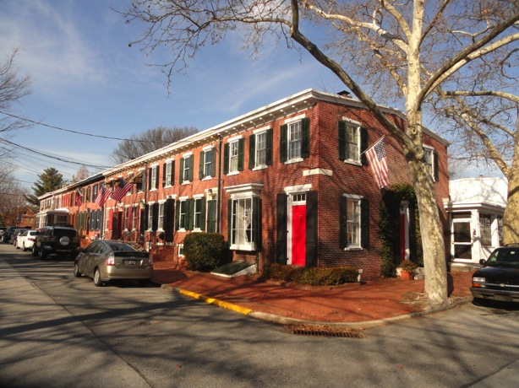
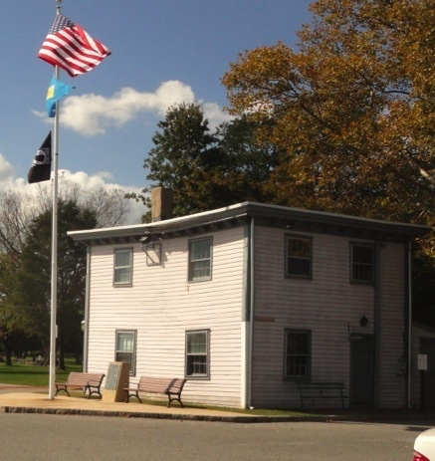
Italianate (1850 - 1900)
Bracketed cornices and usually flat or shallow pitched roofs.
American Bracketed houses: a.k.a “bracketed Italianate” Renaissance Revival public buildings

Slide 15
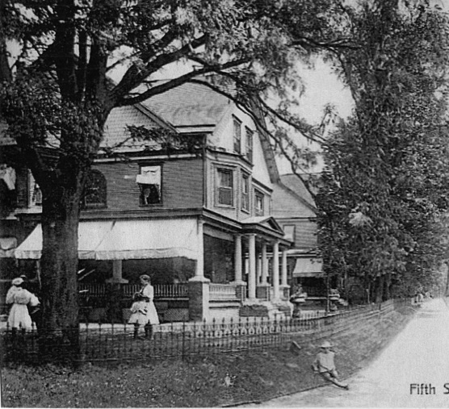
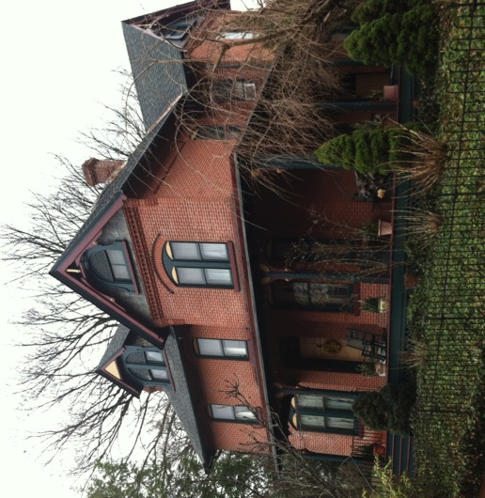
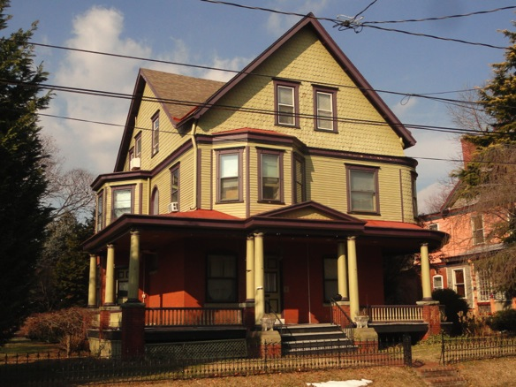
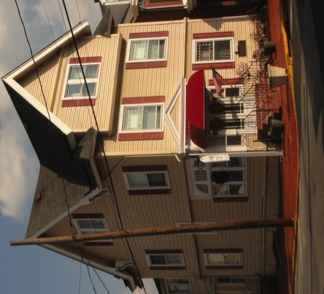
Queen Anne (1870-1900)
Steeply pitched roof
Asymmetrical, cross gables
Overhanging eaves
Projecting windows breaking up planes
Porches
Multicolor
80 W 5th 1894, J. T. Eliason
531 Delaware, late 1800s Gebhart
111 W 6th 1898

Slide 16
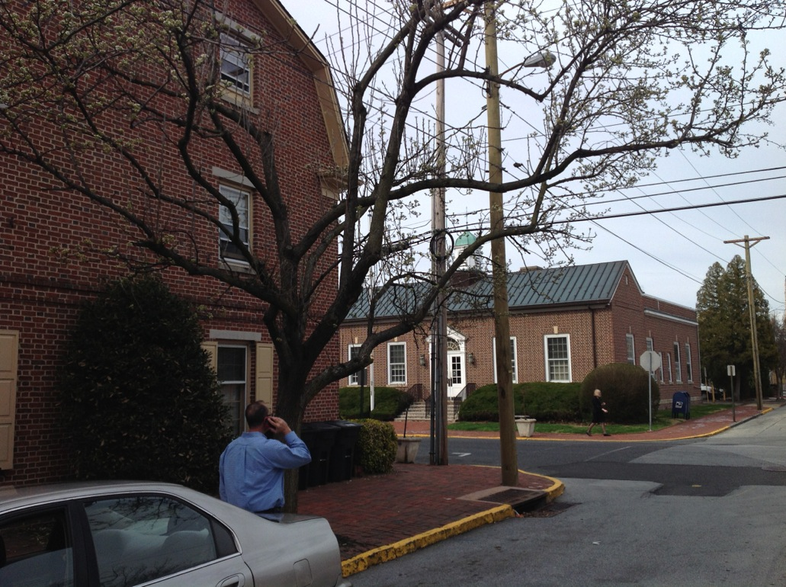
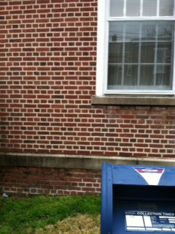
Colonial revival (1880-1950)
Apartments at 5th & Delaware, U. S. Post office, 1935
Apartments: flemish bond
P.O.: English bond (alternate rows; all header, all stretcher)
random dark bricks
Apartments on site of Earle Theatre; earlier Knights of Pythias Hall

Slide 17
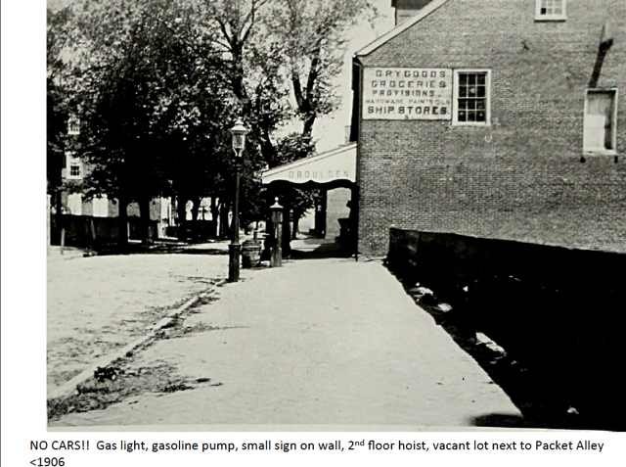
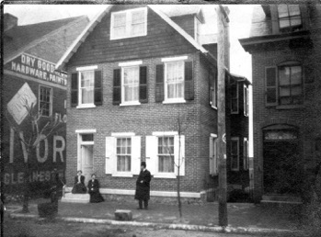
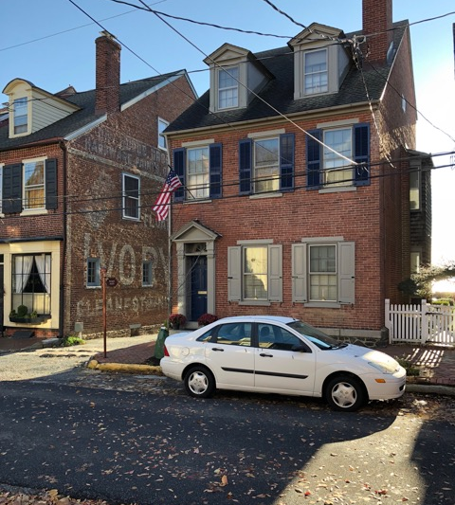
Colonial Revival makeover at 23 The Strand
Site of a hotel, burnt in 1824, then the Stockton House, principal Hotel in New Castle burnt in 1870
Left: before 1900, a vacant lot,
Below left, the new Cavanaugh house with front gable and plain door and rectangular transom
Below right, 2018, side gable, door with colonial entablature

Slide 18
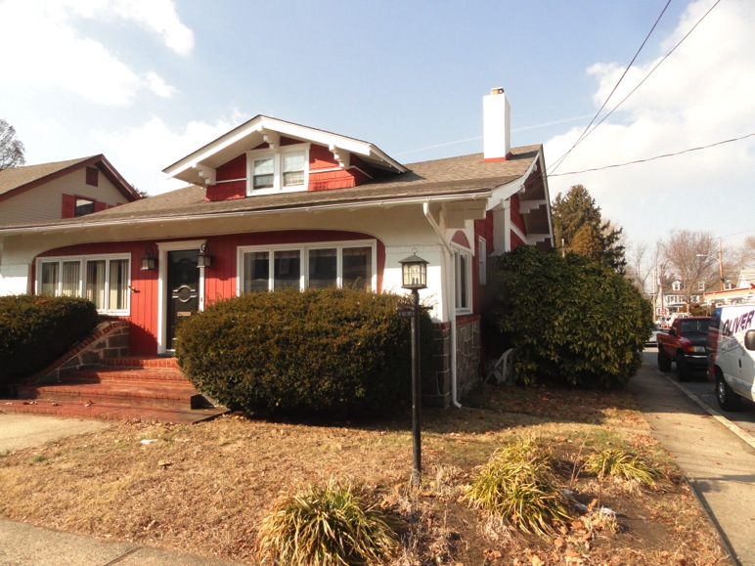
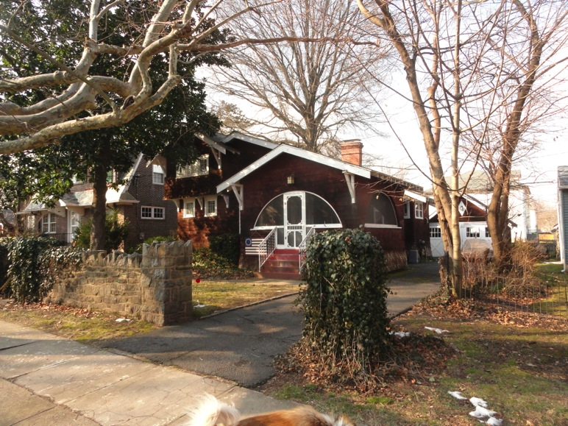
Bungalow (1890-1930)
One, 1 1/2 or two stories, wide variation in structures;
Some designed and built locally, some from kits
50 W 5th, 1930
108 W 6th, 1920, Luoma house

Slide 19



How old is MY (or THAT) house?
1) Easy: Look at it for 5 seconds -- look at details
2) Still easy: Check maps (available 1803-1927) on nc-chap.org
3)A little harder: Using owner’s name from maps, check if they are mentioned in http://nc-chap.org (e.g. Eckman’s deed and title searches) using google search box.
4) Much harder: do a chain of titles at the county courthouse.
????
1912
1927
17 W 3rd

Slide 20

Review, reminders, caveats
New Castle has amazing diversity. One block (E. 2nd) has houses spanning >300 years!
Colonial revival
Georgian
Federal
Quaker, early 1700s
Italianate
Mod. Federal, Greek R
Buildings may have very different facades and layout now than when they were built.
What holds for New Castle is somewhat relevant in Harrisburg or Bloomington IN, much less so in Denver or Seattle.
Facades, like interiors, may be totally changed. Documentary and title searches are very useful. Aerial views, as with the yellow house above can be useful. Poking around in adjacent basements and attics with the owner can reveal openings and construction methods.

Slide 21
‘Date that building’ challenge
I will show you buildings one at a time.
You should look for architectural details, and guess a period/style/date
Choices in every case:

Slide 22



Late Federal, c1836
Fanlight, symmetrical, Flemish bond, 6/6 windows, 8 panel door
Harmony House, 46 E 3rd

Slide 23


Gothic, 1855
Steep pitched roof, cross gables, one story porch,
v-shaped barge boards, 2/1 windows
Lesley Mansion, 123 W 7th

Slide 24

2nd Empire (1880) / Queen Anne (1895)
Left: Mansard roof, projecting window, bracketed cornice, 2/2, 1/1 windows
Right: steep roof, cross gables, fish scale siding
412, 414 Delaware

Slide 25


Early Georgian (early 1700’s)
(heavily modified several times)
String course, water table; some brickwork may be original, may be reproduction
“Hotel Louise”, “David Finney Inn”
Delaware & W 3rd photo taken c1891; Mary Robeson (1833-1920)

Slide 26

Italianate (c1881)
Bracketed cornice, elaborate gingerbread
16 W 4th

Slide 27

Late Georgian (1800)/Early Federal
Unglazed Flemish bond façade, fanlight, Palladian window, stone sills and lintels, 6/6 windows, dentil cornice, symmetrical
42 The Strand, George Read II house

Slide 28

2nd Empire
Mansard roof, bracketed cornice, 2/2 windows, running bond, [fanlight]
602-4 Delaware

Slide 29


Early Georgian (1704?)
String course, water table, dentil cornice, 6/9 windows,
symmetrical, Flemish bond, no fanlight
Rosemont house, 110 Delaware

Slide 30



Late Federal, c1830
Fanlight, Flemish bond front, 7 course common bond side,
8 panel door, 6/6 windows
144 E 4th

Slide 31



Greek Revival, c1826
Short 3rd story, rectangular transom with brackets, 4 panel door,
running bond, pressed brick, narrow mortar joint
But: fairly steep roof, symmetrical. Was house in forefront of style or modified later?
9 The Strand

Slide 32

Gothic
Steep roof; cross gables, 1/1 windows?
39 W 5th

Slide 33


Italianate (1878)
Bracketed cornice, shallow roof, porch, flat façade, 2/2 windows
15 W 4th

Slide 34

Georgian (1750)
String course, water table, dentil cornice, 6/6 windows,
symmetrical, Flemish bond above water table, English below , no fanlight
Bricks not glazed.

Slide 35

Italianate (c1880)
Decorative brickwork; pressed tin cornice instead of brackets, running bond, flat roof
13 W 3rd

Slide 36

Queen Anne (c1900), Bungalow (c1920)
Steep cross gables, projecting bay window and porch
Single story, owner thinks building a kit, but no match in Sears or Aladdin.
182,184 E 4th

Slide 37


Colonial Revival, c1980?
Flemish bond, 8/8 windows, 6 panel door, concrete window sills and lintels
113/115 Delaware

Slide 38


Georgian (1707, 1712?)
String course
English bond Flemish bond
Water table

Slide 39

Bungalow, Aladdin kit house, 1917
One story
166 E 3rd

Slide 40

Italianate (1876-owner, mid 1800s NHR)
Bracketed cornice, pressed brick, running bond, 2/2 windows, fanlight, 4 panel door (the latter replacing in 1990’s cheap colonial revival windows and doors from the 70’s

Slide 41



Queen Anne (1899, 1894)
Cross gables, bay window, porch, fish scale siding, colorful !
80 W 5th St. J. T. Eliason
72 W 5th, L. E. Eliason

Slide 42

Greek revival (c1850)
Asymmetrical, rectangular transoms, running bond,
but roof not shallow pitched, no frieze band 3rd floor
19 W 3rd

Slide 43
As you walk around,
LOOK UP!
David Ames
UD Center for Historic Architecture and Design

Slide 44



Another ride: Thos. Jefferson Stops in New Castleon Trip From PHL to Monticello
Meacham, “Thomas Jefferson: The Art of Power”
Definitions (maybe)
Inn: eat, drink, sleep
Pub(lic house): eat, drink
Tavern: drink
Courtesy Osher student Jim Williams
Notes:
Need tofind a journal or diary to understand this.
Did he stop for a drink? Or stay, if so where?

Slide 45
From Jefferson’s Memorandum Books, 1775
Pd. toddy at a country tavern 1/.
Pd. ferriage over Christiana 27 1/8.
Aug 2. Pd. lodging, supper &c. Mrs. Clay’s, 28 Newcastle £1–3–4.
Pd. breakfast &c. McCullogh’s, Warwick 7/8.
Footnotes
…
26 John Biddle and his wife were the proprietors of the “staid old” Indian King Tavern, which had been in operation since the early years of the century. It was on the south side of Market Street between Second and Third streets (Historic Philadelphia, p. 320).
27 TJ would have crossed the Christiana River at Wilmington, Del.
28 Ann Curtis (Mrs. Slator) Clay (d. 1789) kept an inn on the site of present 30 The Strand, New Castle, Del. (Jeannette Eckman, “The Strand,” 1947-1949, typescript report in Historical Society of Delaware, Wilmington, Del.; J. Thomas Scharf, History of Delaware, 1609-1888 [Philadelphia, 1888], ii, 1016).
29 Now Chestertown, Md.
Problem: 30 The Strand is not really big enough to be her and 11 children’s residence, a tavern and lodging. Did she use the building across the street as an annex?

