Slide 1
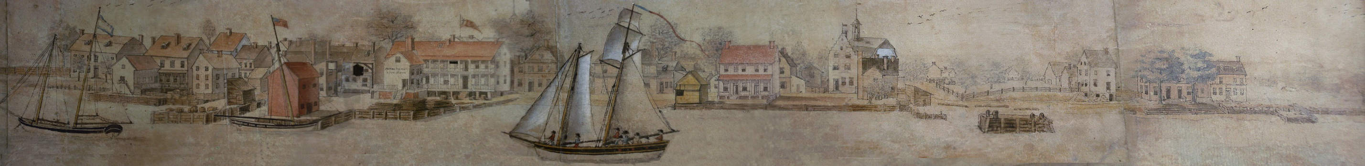
New Castle History
A View of The Town of New Castle From The River Delaware, -- Taken the 4th July 1797 -- By Ives le Blanc
Jim Meek
Fall 2018
james.l.meek@gmail.com
Notes:
History, archaeology, nc-chap.org is source, highlight buildings lost 1650 1950

Slide 2
Who am I?
Not a historian!
College at William and Mary in Williamsburg and got to love colonial revival!
My career was in research:
  Ph. D in biochemistry, post doc with Arvid Carlsson in Sweden (Nobel Prize, 2000)
  14 years in research at NIMH, Washington (lived in victorian house) on Capitol Hill
  17 years in research at Dupont Exp. Sta. (research, creating in-company web sites)
  2 years at Astra Zeneca
  3 years at the News Journal in the newsroom doing web maps and database work
We bought 30 The Strand, N.C. in 2003, started researching our house, the street, the town
Together with people from U.D., Courthouse and Delaware Historical Society I formed NC-CHAP – New Castle Community History and Archaeology Program
I started putting the information up on nc-chap.org and have never stopped

Slide 3
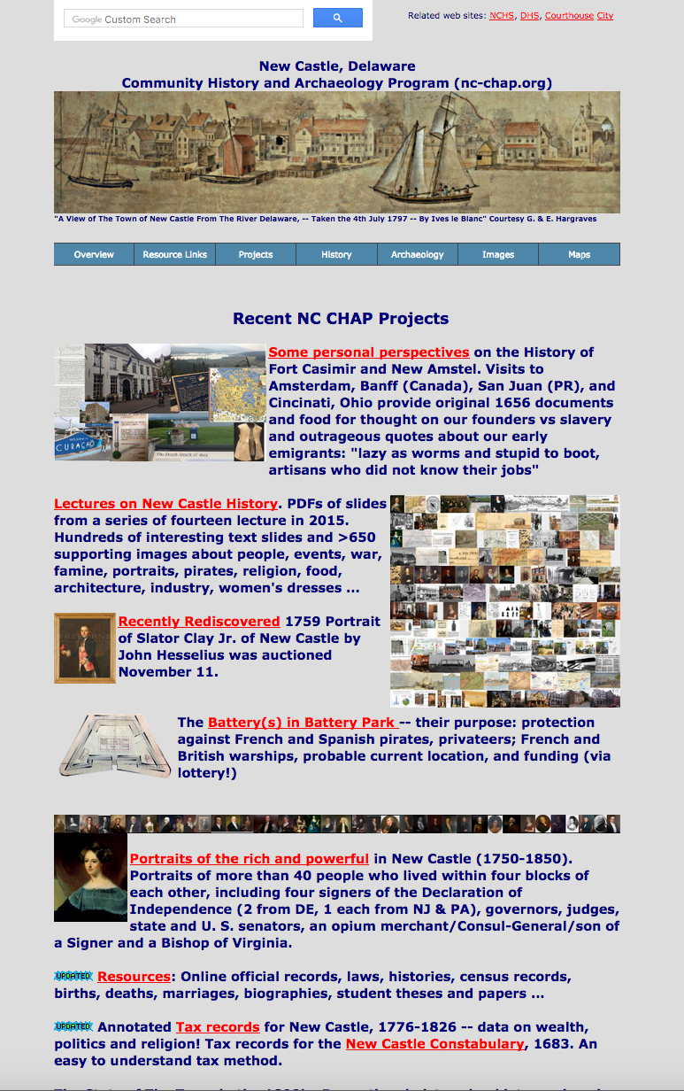
http://nc-chap.org
Currently > 6,000 pages, files and images according to Google!
Search bar to find stuff on this VERY large site
New information used in today’s lecture
Lectures from 2015
Resources: Histories, guidebooks, census and tax records
Archaeology, maps, aerial photos, Portrait, railroad and railroad engine manufacture …
Churches: Lutheran, Presbyt. Episcopal, Quaker, Methodist
Women in Ft. Casimir
Virtual tours
Oral History, Post cards
Day in Old New Castle
“Williamsburg on the Delaware”
Crime & punishment: hanging, scarlet letters, whipping…
...
Notes:
Aug 30k visit, 13k distinct sites, 1400 visits/day
Prespyterian, portraits, cranehook, castello, quaker, natinal register,
6000 total urls

Slide 4
Course Plan
First half of the course:
-dates, wars, people etc. the usual history
-the not-usual history – why it happened
Second half of course
-virtual tours, clothing, transportation, architecture
(maybe a few words: beer, punishment, scarlet letters, organized religion, prostitution)
Notes:
Ask questions. May have images and data and will defer, might talk about it now.
This lecture complicated; only one with lots of date need it to establsh background and context
Cooper 10% of his 45 chapter history

Slide 5
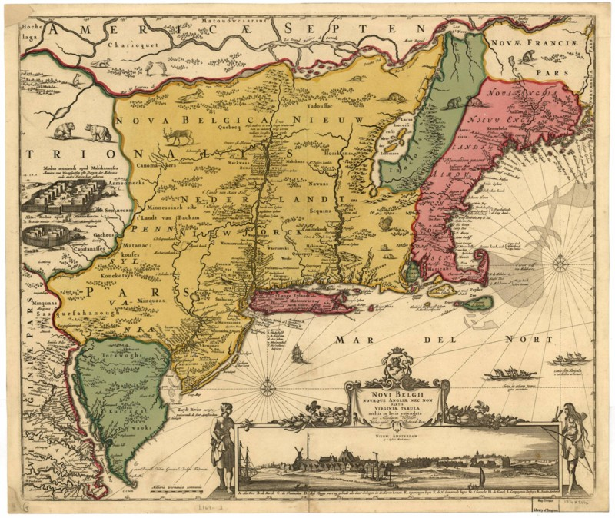
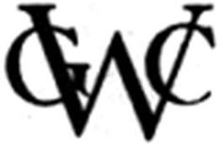
The Usual Beginning, not
The Very Beginning
H. Hudson-S, N, Fresh Rivers
Peter Minuit & WIC buys Manhattan for $24
1638 Minuit, Swedes, Kalmar Nyckel
Stuyvesant/Ft. Casimir
1655 Swedes/Ft. Trinity
Amsterdam/New Amstel
Duke of York/New Castle
1682 Grant to Wm. Penn
Visscher map (1650/1685)
Notes:
Sound of Music slightly expanded; colored to show players peter minuit was a director of the WIC; he led the founding on kalmar nyckel
North river, south river
Why did hudson come ?? Indies

Slide 6
What the usual beginning doesn’t answer
The ‘usual beginning’ is available from histories from Scharf (1888) to Federal Writers program in the 30’s
What kind of a trading company was the WIC -- like Macy’s?
What were it’s major trade products, here and elswhere?
Why did it wait from 1625 to 1651 to build Ft. Casimir?
Who was Ft. Casimir named for?
What was life like here?
What were the relations like between the Dutch & Swedes?
When/why did it become New Amstel
I got answers to most of these questions from a few books, and serendipitous occasions on vacations!

Slide 7
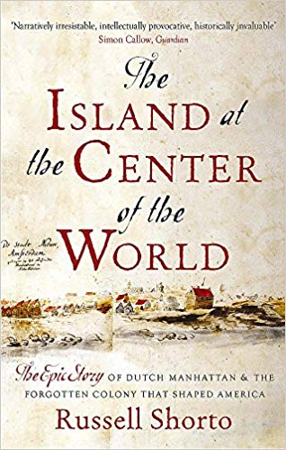
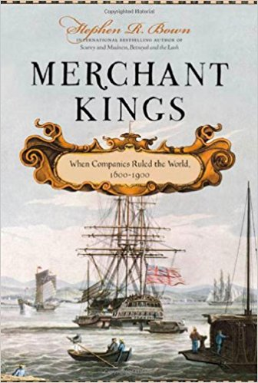
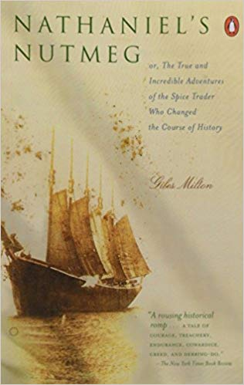
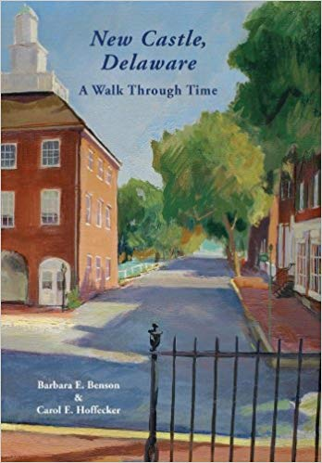
Recommended books
Island at the Center of the World (Russel Shorto) -- Hudson, WIC, New Amsterdam (New York), Stuyvesant..Not much about New Castle. Available in Delaware libraries both in print and audio form. Great to listen to in the car!
Merchant Kings: When Companies Ruled the World, 1600-1900. (Stephen Bown) -- Chapters on the Dutch EAST India Company, Stuyvesant and the WIC, and the Hudson's Bay Company. Perspective on the way people given power to rule a colony behave so unlike the behavior of the countrymen at home. Blunt: Stuyvesant: “We derive our authority from God and the WIC, not from the pleasure of a few ignorant subjects.”
Nathaniel's Nutmeg: Or the True and Incredible Adventures of the Spice Trader Who Changed the Course of History (Giles Milton) -- Details on the Spice Race -- the race for the incredibly lucrative spice trade between the English and Dutch, and why at the end of the Anglo Dutch wars, England chose to take New Netherland including New York, despite it's relatively puny trade income, and the Dutch chose the East Indies with their fabled spices.
New Castle Delaware,: A Walk Through Time, Benson & Hoffecker Best book I know of on New Castle.
Notes:
First three gave me a different perspective on why we are here, why the west india company founded this place.Benson and hoffecker sold here

Slide 8
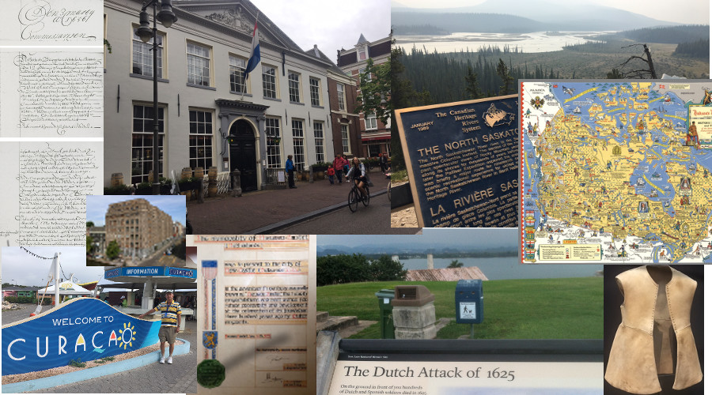
What’s new: new perspectives from trips on the history of Fort Casimir and New Amstel
Amsterdam, headquarters of the West India Company (WIC)
Hudson’s Bay Company, Banff, Canada. Another monopoly trading company
Amsterdam, original documents for purchase of land from WIC for New Amstel
Rijksmuseum, Amsterdam. Clothes (with bullet holes) worn by Mr. Casimir
Curacao. WIC center for trade in salt and slaves
San Juan, PR where the WIC besieged, then burned the town
Details on nc-chap.org -- the first link (http://nc-chap.org/newAmstel/
Notes:
Addition to books, travel gives me perspectives What kind of cmpany is the WIC
So who founded New Castle? Who was Mr. Casimir?
So what has the West India company got to do with it

Slide 9
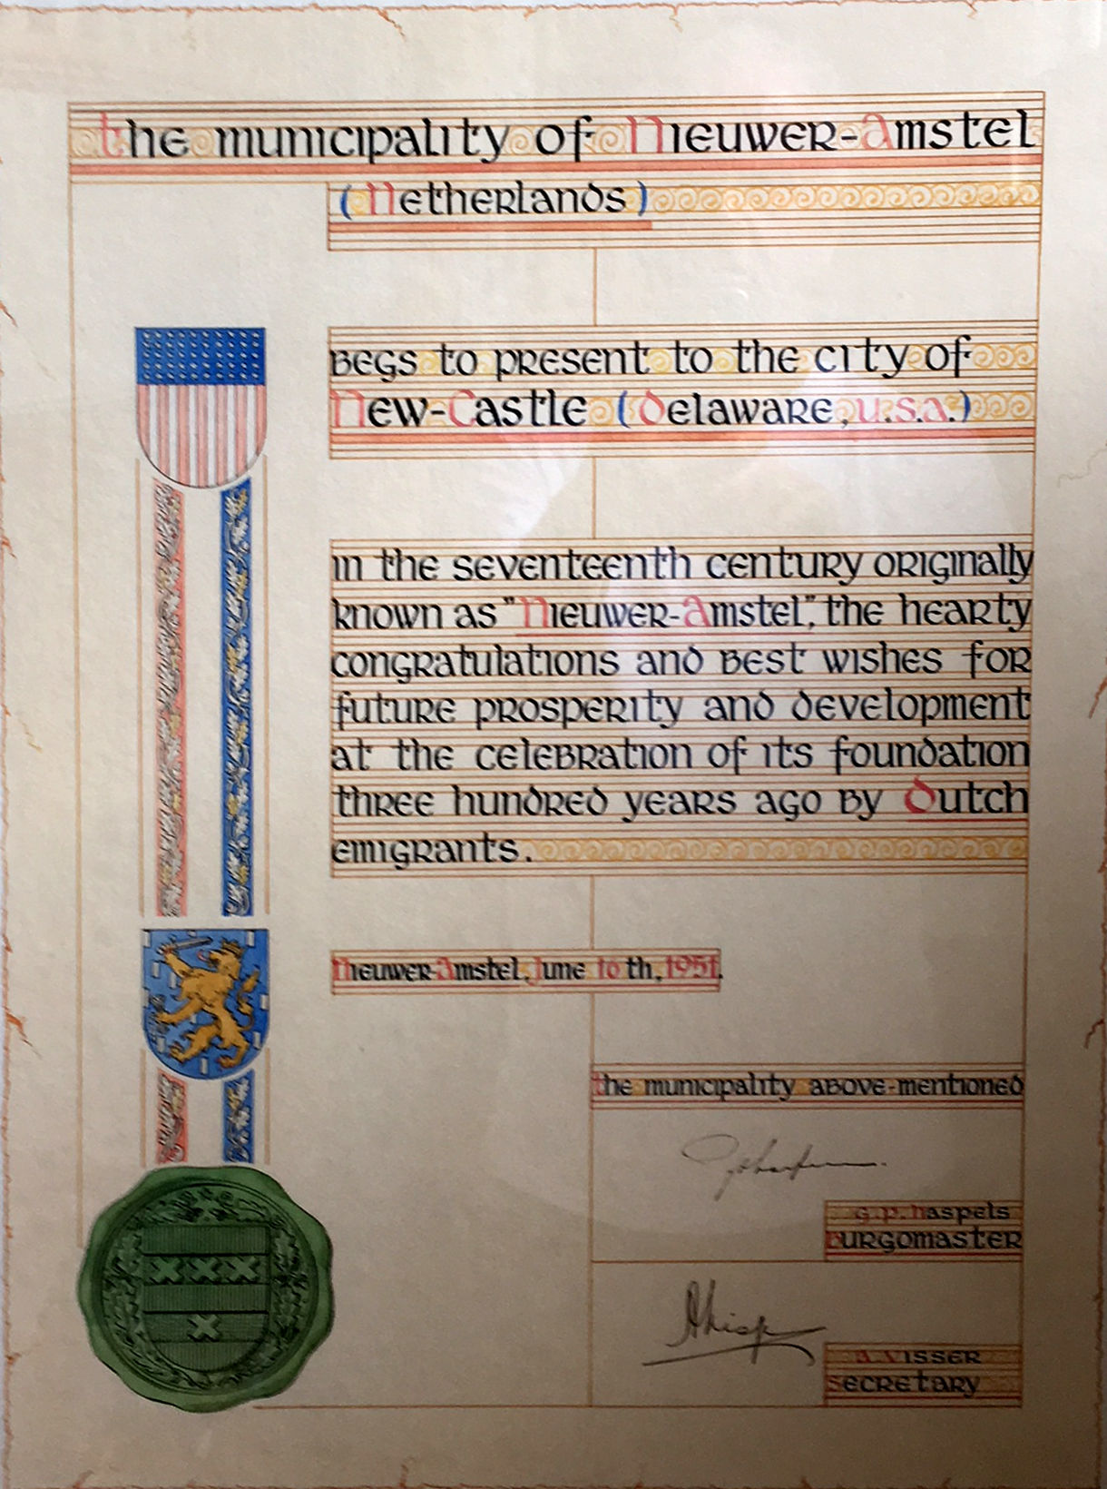
Certificate in the stairwell in the
New Castle City offices given by the City of
Nieuwer Amstel (suburb of Amsterdam)
on the occasion of the 300th anniversary of
founding of New Castle in 1651.
Minor discrepancies from fact.
The town was originally founded as the military outpost Ft. Casimir by the Dutch West India Company in 1651, not by ordinary emigrants. It replaced Ft. Nassau (near current Camden, N.J.)

Slide 10
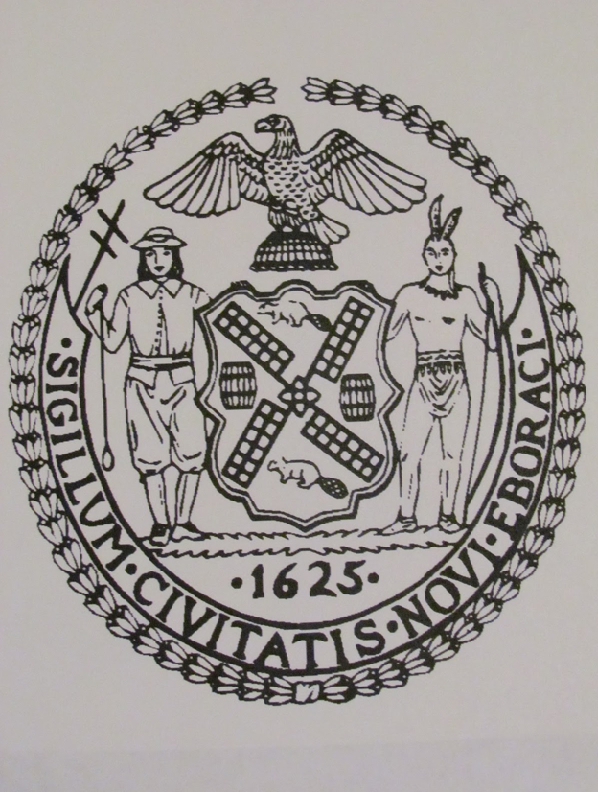
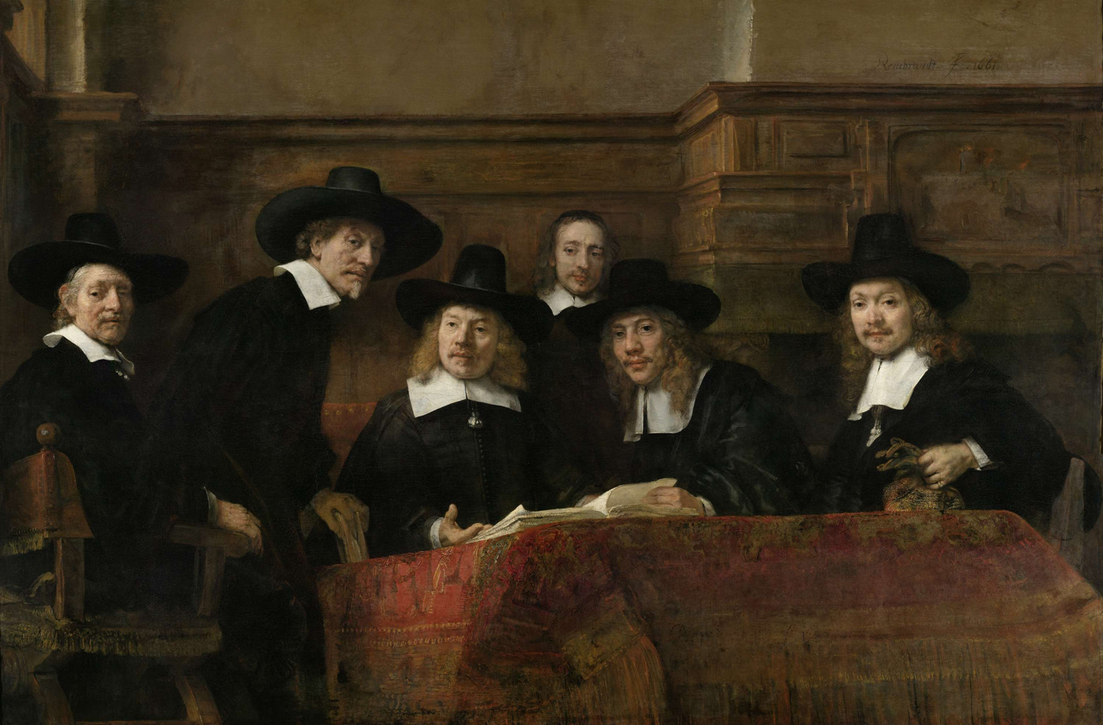

Why did the Dutch want to come to North America?
Seal of New York City Seal of New Netherlands
Notes:
Dutch wanted to come immediately after the first expedition in 1609 and 3 or 4 in next 5 years Why did they come TRADE
First shipment of goods from New Netherland (manhattan) was grain and beaver 1625
Given a monopoly for all the north atlantic coasts including western africa (SLAVES), and South Amrerica SUGAR PLANTATIONS

Slide 11
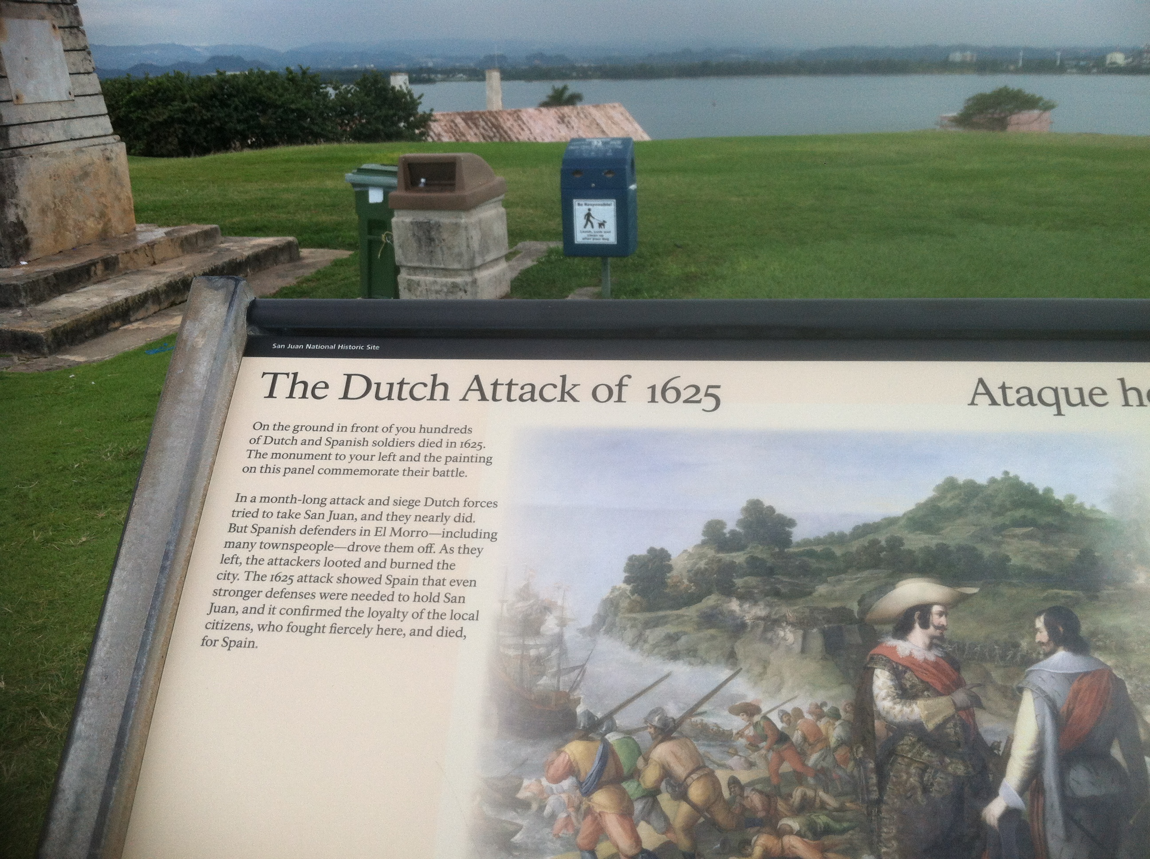
Cruise liners
“El Morro” San Juan National Historical Park, Puerto Rico
The Dutch West India Company was not just a warm and friendly trading company
The WIC in 1625 was simultaneously seeking to expand trading areas in Manhattan, Delaware River and San Juan!
Notes:
Context attacked the spanish. Holland was at war with spain until 1648, 30 years war. The WIC was privateers it had hundreds of ships, hudreds fo thousands of pounds of gunpowder. he sign said "The Dutch Attack of 1625. On the ground in front of you hundreds of Dutch and Spanish soldiers died... In a month-long attack and siege, Dutch forces tried to take San Juan, and they nearly did...As they left, the attackers looted and burned the city." That was in 1625, the same year the WIC bought Manhattan for "$25" in trinkets. The WIC captured St. Maarten/St. Martin in 1634 with 6 ships and 225 men. It was later captured by the Spanish. Stuyvesant lost his leg to a cannon ball in 1644 when trying to retake the island with 12 ships and 1,000 men. The WIC was a trading company with a government granted monopoly, but a military orientation towards its operations and subjects. Stuyvesant said "We derive our authority from God and the West India Company, not from the pleasure of a few ignorant subjects."

Slide 12
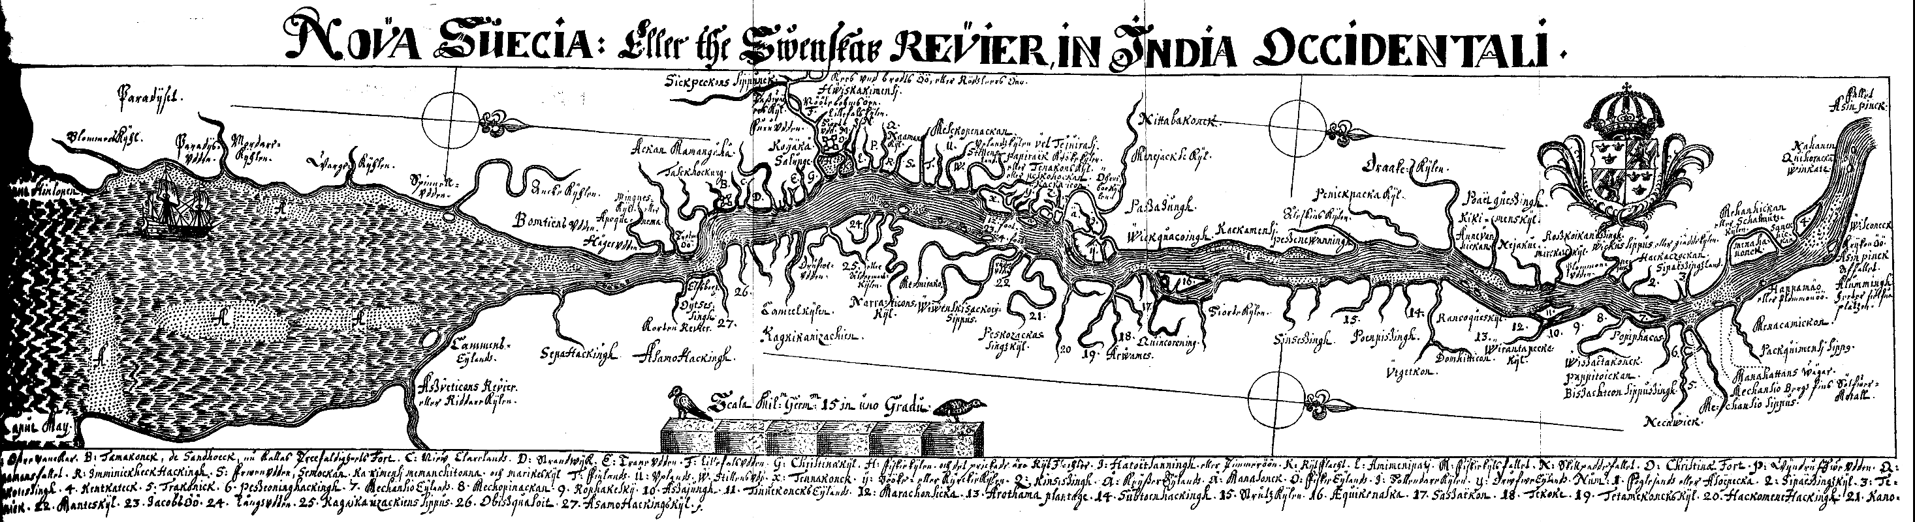
New Sweden, or the Swedish River in East India
The Swedes had only a few villages but many farms spread along ‘their’ river.
Notes:
Max of 500 Swedes between the Atlantic and Trenton – miles between settlements A couple of villages – Christina, Wicaco, Printzhof Casimir
Not just Ft. Christina.

Slide 13
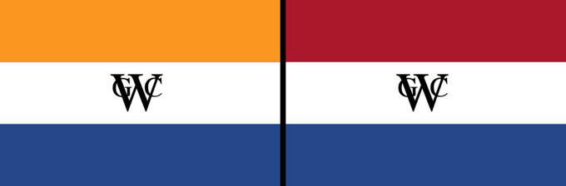
Summary of the Very Beginning, or why the Dutch West India Company was part of the founding of
Fort Casimir/New Amstel/New Castle
Geoctroyeerde Westindische Compagnie
<1650 >1650
1492-1508 Columbus discovered Puerto Rico, found gold, built fort, started colonization
1498 Pope gave Caribbean and West Coast of America to Spain; Portuguese got Brazil
The Caribbean was a "closed sea” Trade was restricted to Spain
1500s Dutch and English came to Caribbean anyway to trade salt, hides, spices, dyewoods
1609 EAST India Company (VOC) hired Hudson to search for northwest passage; he discovered Delaware River
WEST India company (WIC) founded for trading and for military attacks on Spain and Portuguese colonies
1625 WIC attacked Puerto Rico; couldn't get into the forts. Burned San Juan; built fort on South River (Delaware)
WIC seized the Spanish silver fleet, hurting Spain
WIC conquered part of Brazil
1638 Former WIC Director General Peter Minuit arrives on Kalmar Nyckel to found New Sweden at The Rocks, Dutch are allies of Sweden
WIC names Peter Stuyvesant Director General of Dutch West Indies islands: Curacao, Aruba, Bonaire; later America
Thirty years war over, Dutch no longer allies of Sweden
1651 Stuyvesant builds Ft. Casimir for WIC to counteract Swedish presence
1655/1656 SWEDISH CAPTURE FT. CASIMIR/ STUUVESANT CAPTURES FT. CASIMIR, IT IS BOUGHT BY AMSTERDAM RENAMED NEW AMSTEL
1664 English capture New Netherland including Ft. Casimir/New Amstel (2nd Anglo Dutch War)
1674 Treaty of Westminster (3rd Anglo Dutch War) England gets New York, New Castle, Dutch get Surinam , Caribbean islands
We now speak English, not Dutch
Don’t read this
Notes:
VERY BEGINNNIING!!

Slide 14
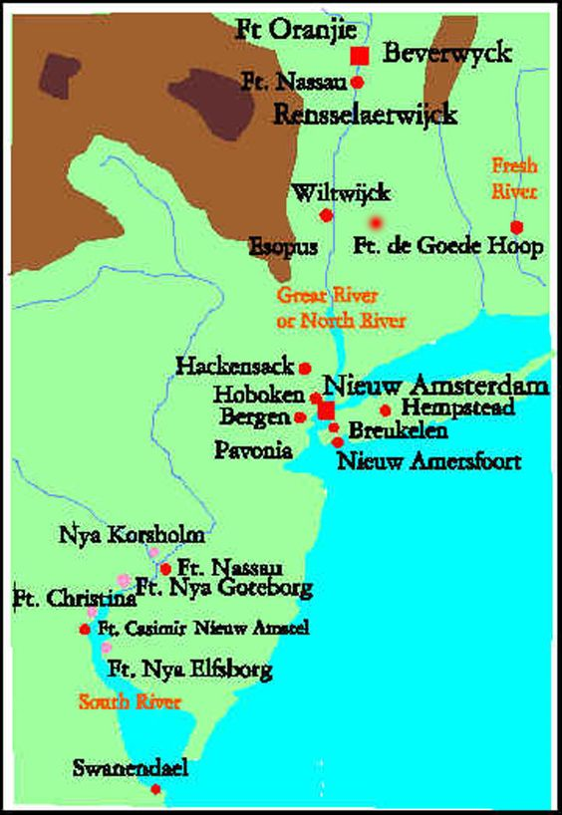
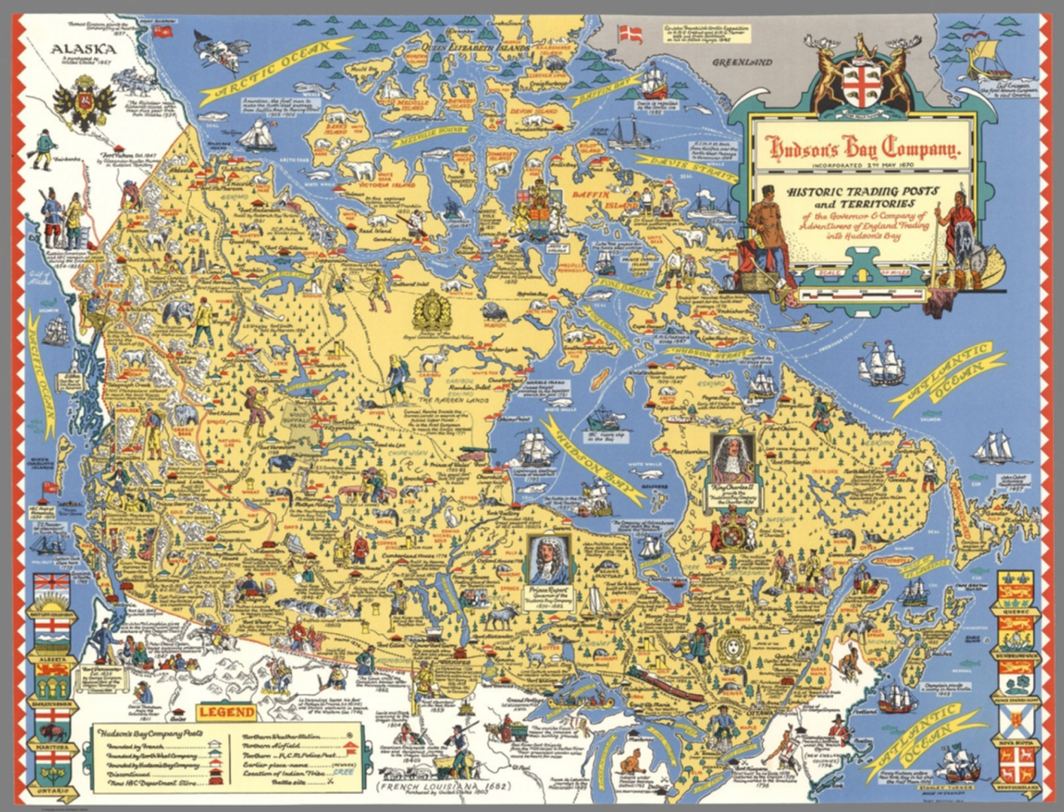
Hudson’s Bay Company Forts and Trading Posts
Dutch (red) & Swedish forts (pink)
Canadian headquarters: York Factory (trading post)
As seen in a Banff, Canada HBC store Aug, 2018
Like the HBC, the Dutch favored building
‘factorijen’, factorys or trading posts with soldiers
and a few settlers.
Notes:
HBC very thin model: 400 employees for hundreds of forts of half of Canada
https://en.wikipedia.org/wiki/Fortifications_of_New_Netherland

Slide 15
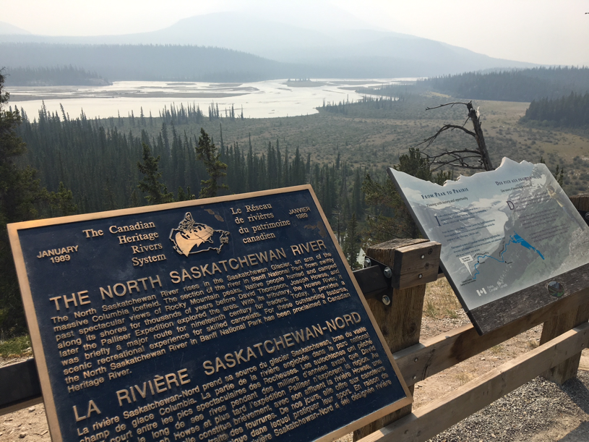
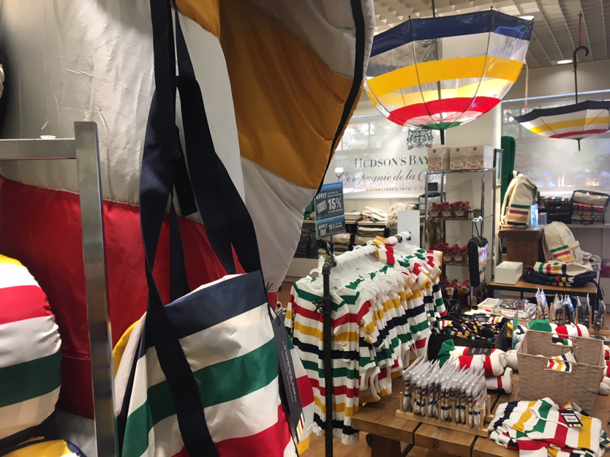
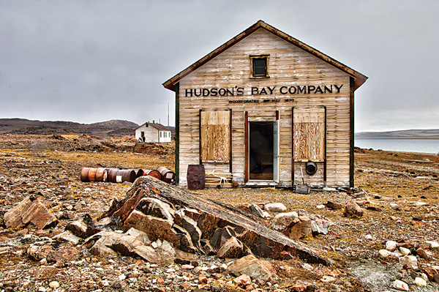
The ‘thin’ business model of a few employees covering a very long area did work for the Hudson’s Bay Company for many years
Route north of Banff between the Pacific and Hudson Bay
HBC store in Banff, Canada
Last HBC post built

Slide 16
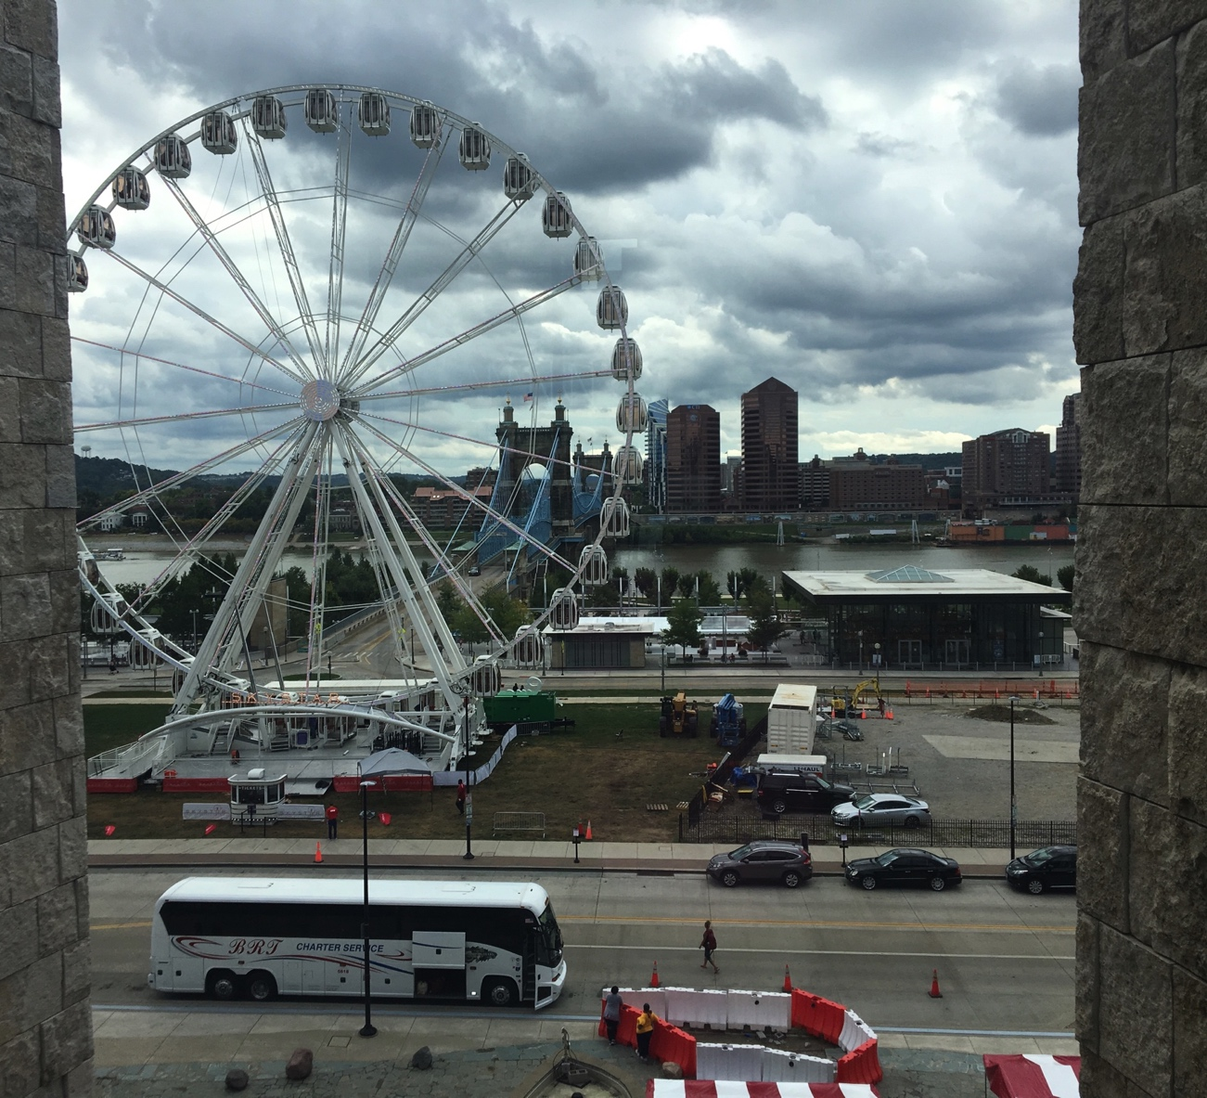
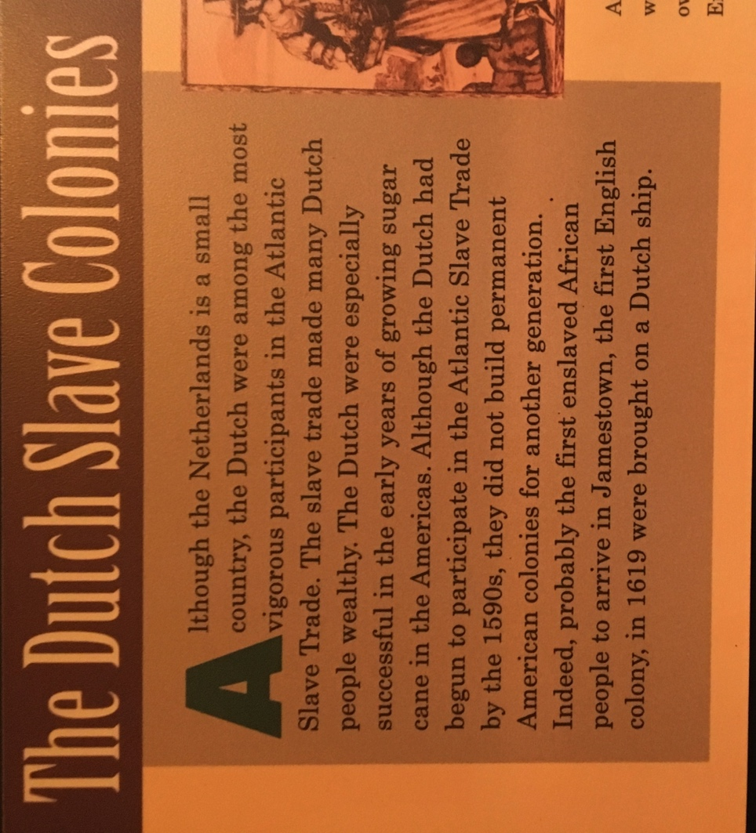
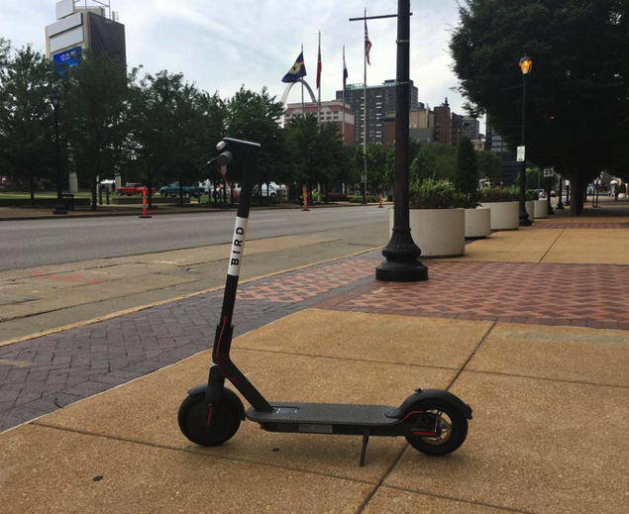
New Castle Research while traveling: From the Underground Railroad Museum, Cincinnati, OH Aug. 31, 2018
View from 2nd floor window, past temporary ferris wheel, Roebling bridge over Ohio R. to Kentucky (a slave state)
“The Dutch [West India Company] were among the most vigorous participants in the Atlantic Slave Trade.”
Elsewhere stated more than England & Portugal combined.
Bird electric rental scooter
Notes:
Riverfront scene of uncle tom’s cabin like escape to freedom over ice floes
Scooter $10 for an hour, 5 mile ride; 8$ for bandages.

Slide 17
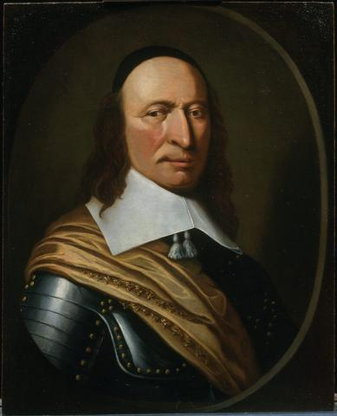
Peter Stuyvesant , the West India Company and
Ft. Casimir/New Amstel
Peter Stuyvesant director general of Dutch West Indies islands Curacao, Aruba, Bonaire
1644 He lost right leg to a cannonball attacking Spanish-held Sint Maarten
1645 He became governor general of all Dutch possessions in North America and the Caribbean
He founds Fort Casimir on South (Delaware) River
1654 He travels to Barbados; captured, released by Admiral William Penn
Stuyvesant recaptures Ft. Casimir from Swedes
1664 English capture New Netherland
Peter Stuyvesant
attr. H. Couturier
Notes:
Usual beginning of NC history

Slide 18
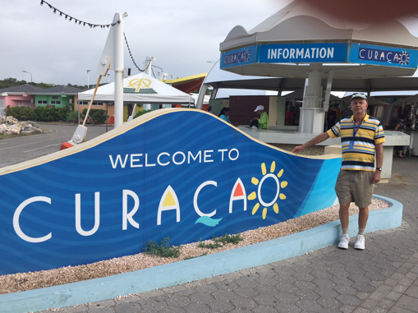
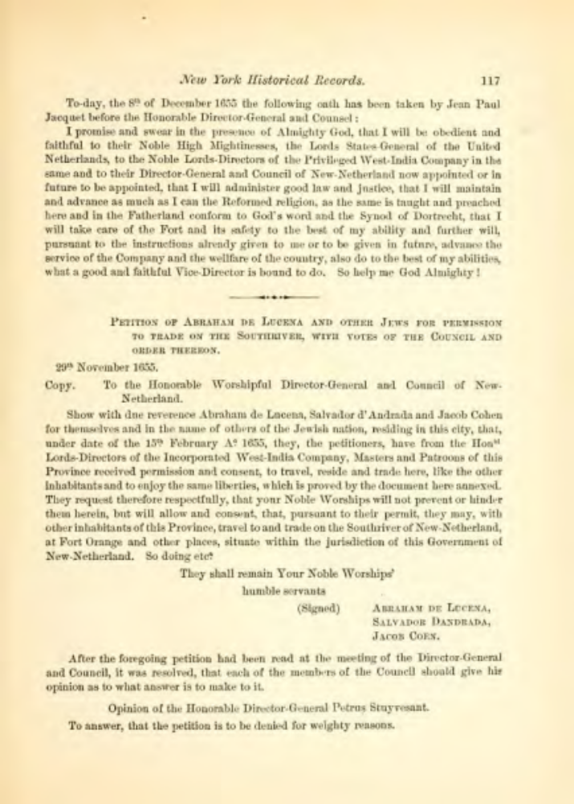
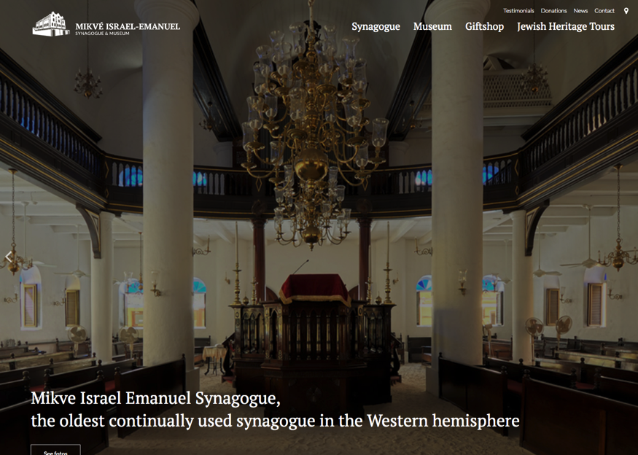
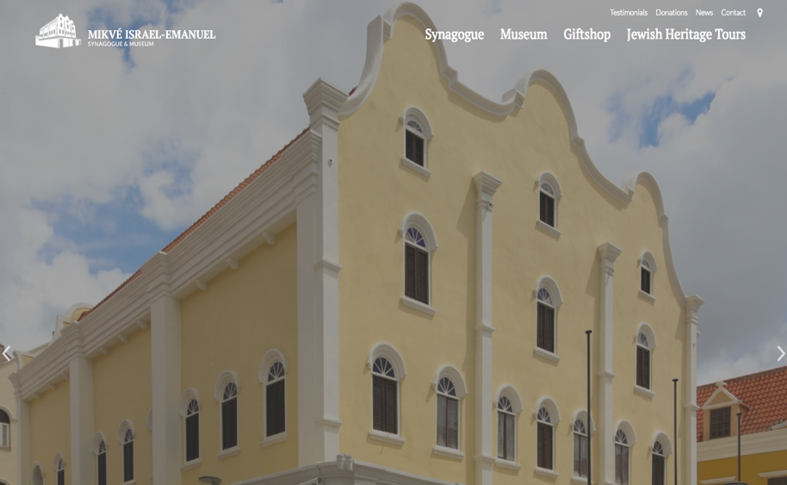
Jews were in Curacao, New Amsterdam, but not permitted to trade in Ft. Casimir
Dutch Islands: Curacao, Bonaire, Aruba and St. Maaarten/St. Martin:
Snorkeling, beaches, tourist amenities, early synagogue, slavery museum
Stuyvesant was Director General of the first three then lost his leg trying to retake St. Maarten
Vol 12
Jews were granted land for a farming community on the coast in 1651. Unable to grow their own food on the poor land they moved town in 1674; their interests moved to banking and commerce. A portion of the congregation emigrated to Newport RI in 1694.

Slide 19
Aruba, Bonaire & Curacao were not particularly profitable. In 1650 the WIC had proposed to give it away of open it up to other companies and traders.
As the islands of Curasao, Bonaire and Aruba have been found for many years to be only
a burden to the Company, not producing any profit, we have, therefore, considered whether it
would not be well to request permission of the Supreme government to give up said Islands:
but if such were not feasible, 'twould, in our opinion, be best, to permit every one to establish
Colonies on said Islands, to distribute and concede the land free of rent,
Documents Relative to the Colonial History of New York, V1, p363

Slide 20
Claims to Delaware by Dutch, Swedes, and English (Baltimore & Penn) were conflicting
1497 Italian John Cabot claims all North America for English based on discovery of Newfoundland
1609 Dutch claim New Netherland, including Delaware based on Hudson and settlement
1632 Charles I granted Maryland from north of the Potomac and Watkins point to 40th parallel
1638 Swedes claim land near Ft. Christina based on settlement and treaty
1676 Charles II granted James, Duke of York James II “Hudsons river, and all the lands from the west side of Connecticut, to the east side of Delaware Bay.” (NY, NJ)
1681 Charles II grants Wm. Penn “All That tract of land in America Called by the name of Pennsilvania as the same is bounded on the East by Delaware River, from twelve miles distance Northwards of New Castle Towne, unto the three and fortieth degree of Northern Latitude, etc”
1682 Subsequent grant of the New Castle and south (Three Lower Counties)
In the end, “might makes right”, possession is 9/10 ….”

Slide 21
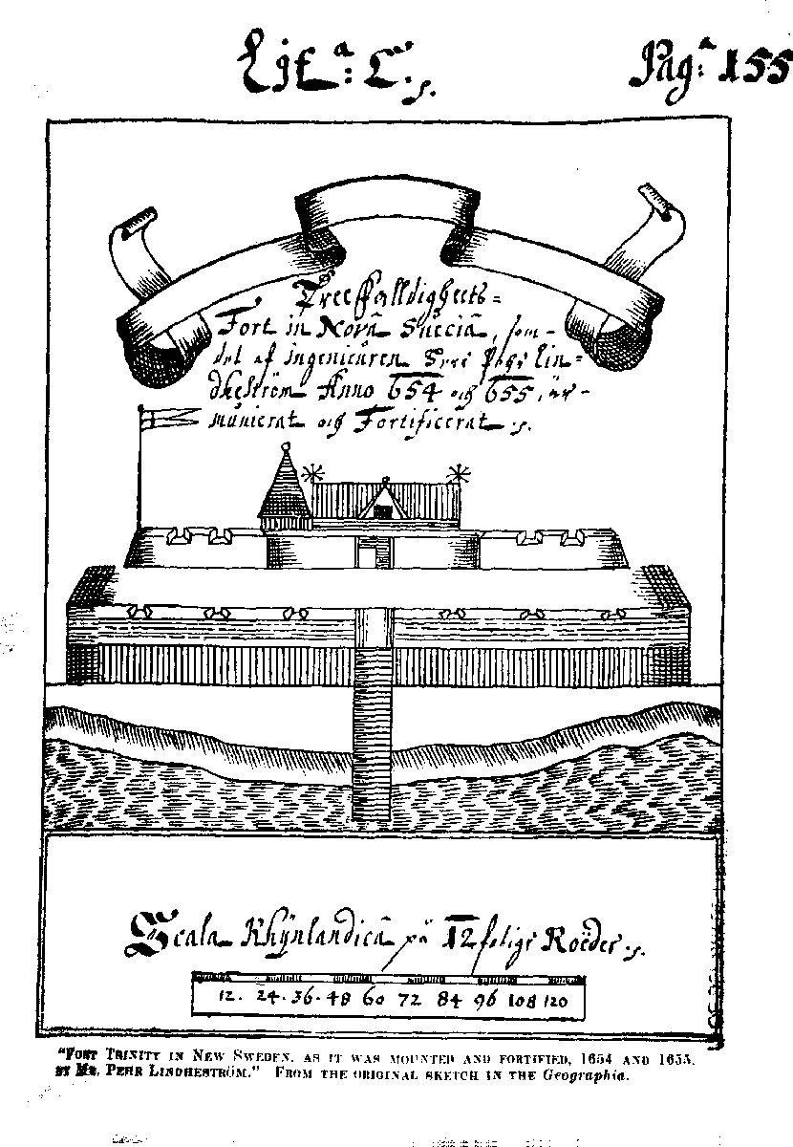
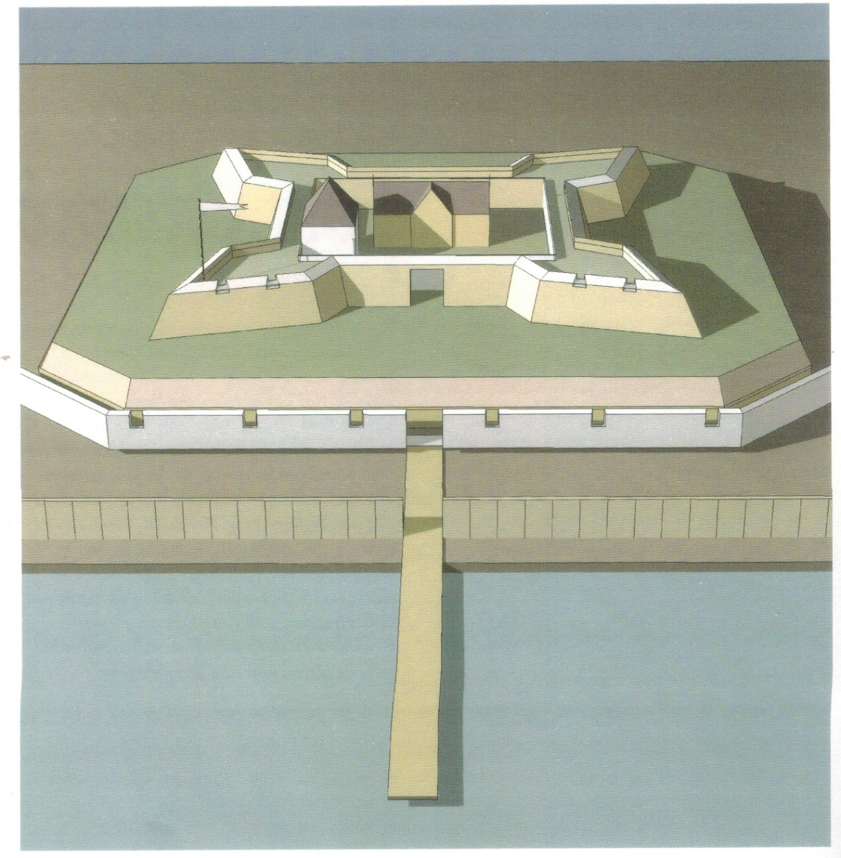
Fort Casimir/ Fort Trefalidighet
Pehr Lindestrom, 1655/1695
Len Tantillo, The Edge of New Netherland, 2012

Slide 22
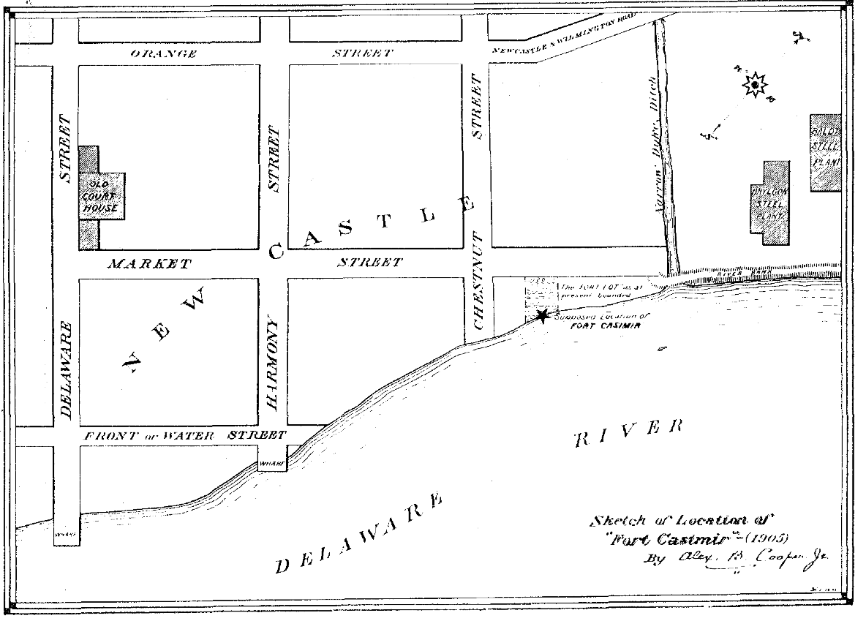
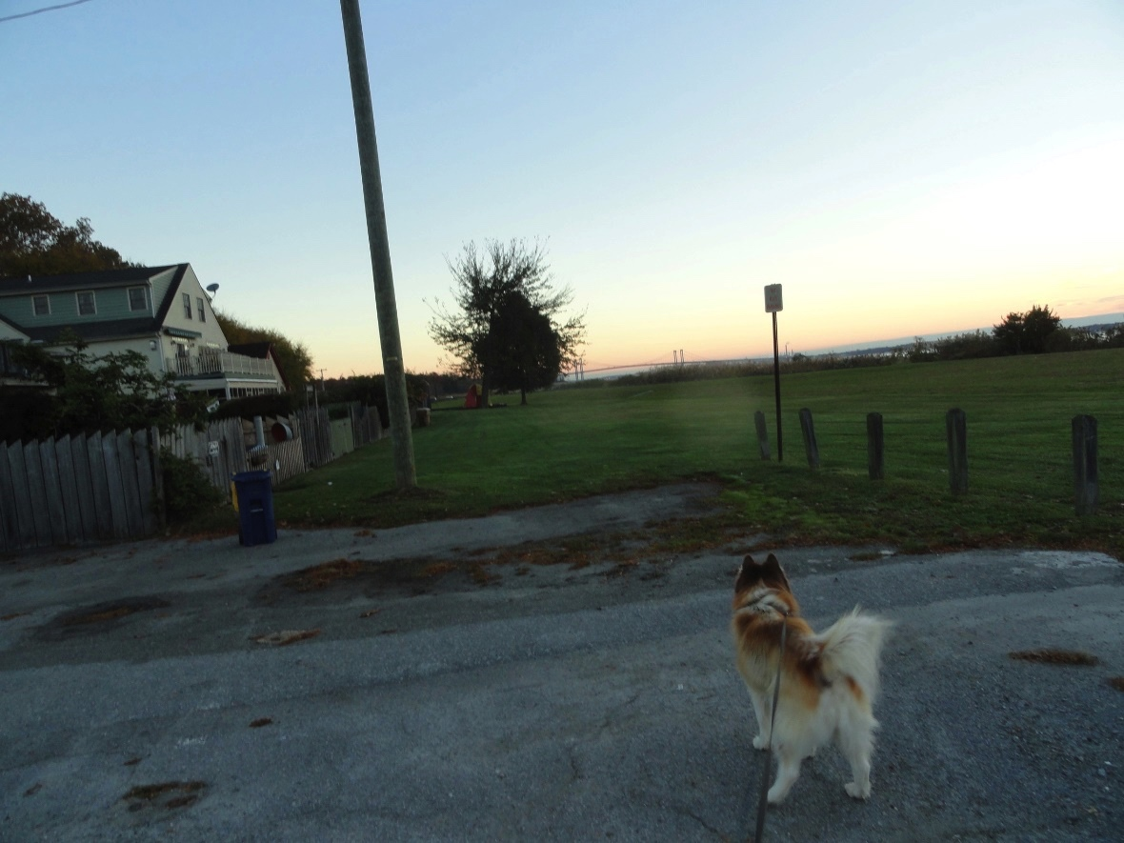
Location of Fort Casimir
Alexander B. Cooper, 1905

Slide 23
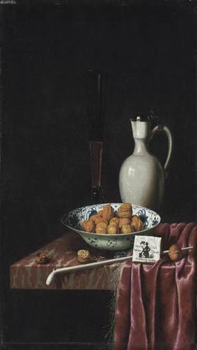
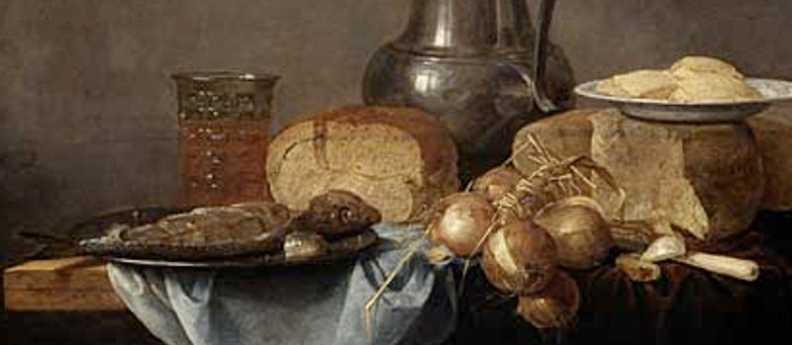
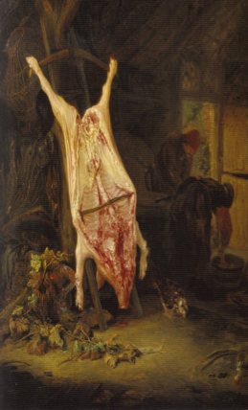
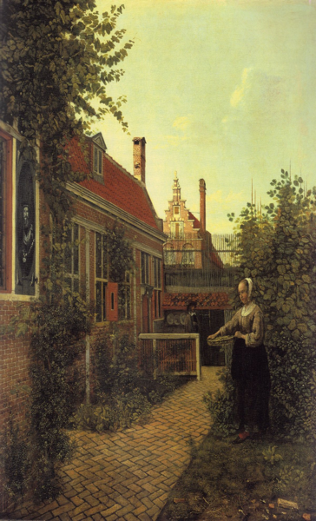
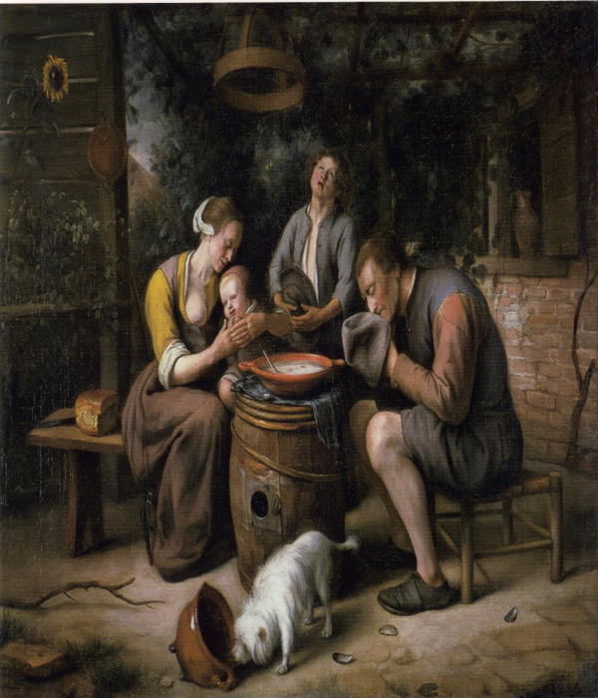
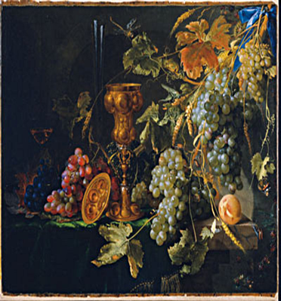
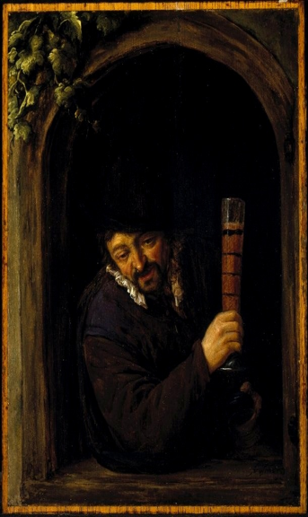
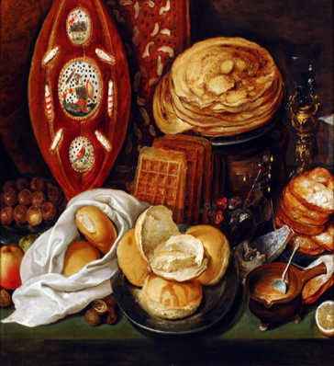
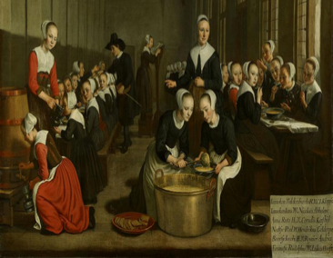
Items in Dutch Paintings found at site of Ft. Casimir
Notes:
Breakfast Bread Butter Beer CHeese
Lunch Bread Beer Hutspot (hodgepodge vegetables and meat or fish Pancakes
Dinner Bread Beer porridge wheat/milk pacakes/lefovers

Slide 24
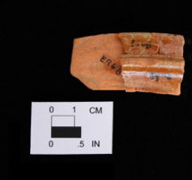
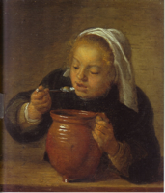
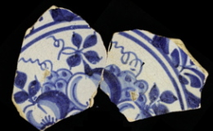
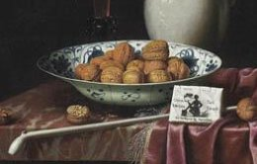
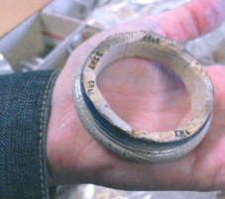
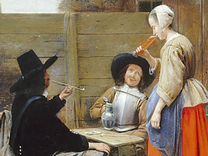
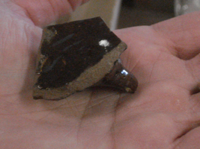
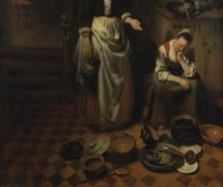
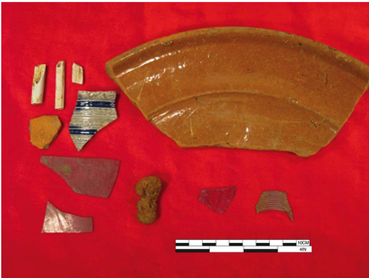

Archaeological evidence for foodways
Artifacts from Ft. Casimir
Red glazed earthenware pot
Wan-Li period tableware
Rim of salt glazed cream colored vessel with cobalt blue decorations
Fragment of dark brown glazed pottery with a handle attachment
Notes:
Potshards survive when roemer originall roman here it’s a wine glass

Slide 25



Follow-up archaeological dig in 2014 by John Milner Assoc.
at the Ft. Casimir site at 2nd & Chesnut
Initial ground penetrating radar scan to locate areas of interest
Trench away from where Heite found Dutch artifacts to look for fortification lines
Result: found possible palisade line. Needs another study to find out where it goes, and shape.
http://nc-chap.org/pdfs/fort_casimir_2014.pdf

Slide 26

Who was Ft. Casimir named after?
A display case in the Rijksmuseum, Amsterdam has a coat, once owned by Henry Casimir (1628) and a hat of Ernst Casimir (1628-1640). Both had bullet holes in them, and the owners both were ‘Stadsholders’ (~kings) of Friesland, the province where Stuyvesant grew up. Both they, and king John II Casimir of Poland have been suggested as a source for the name.
However we don’t know, nor did the Directors of the City of Amsterdam.
They wrote in 1652 “For what reason this fort is so named has not been revealed to us.”
Bullet Hole

Slide 27

The Rise and Fall of the Dutch West India Company
The headquarters was built in 1617, rented to the WIC from 1623, until 1647 when the company went bankrupt the first time. Stuyvesant would have come here after his leg was shot off in 1644 until he was named "Director General of New Netherland, Curacao, Bonaire, Aruba and their dependencies" in 1645. The company was then in deep financial difficulties due to the loss of its Brazilian colonies and the expense of the war thereof. Initially the company's goals were land conquest and privateering. A major success in that area was the capture of the 16 ships in the Spanish "Silver fleet". The company was in financial difficulties in 1656 when Stuyvesant retook Ft. Casimir, and that contributed to selling it the Amsterdam. After the second bankruptcy in 1674, a new company was formed, mostly funded by the financially lucrative slave trade in the Caribbean.
Notes:
We visited in 2017 400 years after built

Slide 28



Purchase of land from WIC for Ft. Casmir by the City of Amsterdam March 3, 1656
Amsterdam City Archives
nc-chap.org/newAmstel

Slide 29

Simon Hart, Director of the Amsterdam City Archives, wrote an article for the Halve Maen
in 1956 on the “Colony of the City of Amsterdam on the Delaware River”. In it he quotes a
1658 letter from Jacob Alrichs, director of New Amstel to the burgomasters who had appointed him.
"Many that come hither are as poor as worms, and lazy to boot."
Comparatively few of the new arrivals were capable of doing agricultural work. The City Fathers then sent out poor house orphans to the colony. The City colony did not prosper, harvest failure, heavy rains, sickness and the behaviour of the British all contributed to its decline. In 1658 the prevalent fevers had already caused the deaths of about one hundred persons, owing to which many families were left unsupported. In August 1659 there were 110 houses and some public buildings. The number of really good farmers was estimated as being three! For the rest a total of 137 artisans (most of whom did not know their jobs), 70 soldiers and 300 women and children, had come into the colony. With one thing, and another, the City was losing money. The debts which many colonists had contracted to the City Council were never paid.
The feeling was mutual. Fifty residents (1659) deserted to Virginia and Maryland, apparently because of Alrichs’ “too great preciseness”

Slide 30






What did New Amstel Look Like?
Maybe like New Amsterdam 1650-1657, or Amsterdam (1600-1665)
Maybe like some of the buildings in New Castle in 1804 (and 1884)
Notes:
According to the Amsterdam Canal Guide, the step gable was the most common building type until 1625

Slide 31

Gardens in New Amsterdam c1655
Most houses in Manhattan had gardens, either vegetable, formal or orchard
Lot dimensions in New Amstel were similar to those in Manhattan and were described as for ‘a house and garden’
Colonial records show that gardens in New Amstel produced cabbages and hops. Adam Onkelbach, a soldier, was accused of stealing 23 cabbages in 1656
Castello Plan, NYPL
Notes:
----- Meeting Notes (9/14/15 21:33) -----
relations good in ft asimir
as opposed towhat happend near gov dtizilliams

Slide 32
Food
(During good times)
Notes:
Breakfast Bread Butter Beer CHeese
Lunch Bread Beer Hutspot (hodgepodge vegetables and meat or fish Pancakes
Dinner Bread Beer porridge wheat/milk pacakes/lefovers

Slide 33


A Common Indian food was Sepawn
(suppan/sepon/suppawn) corn meal mush
Boiling stew in wooden vessel
Theodore de Bry, 1590 after John White’s 1585 watercolors of North Carolina
"their common fare for which this grain [maize] is most used is porridge, there known as sappaen. Its use among the Indians is so general that rarely a day passes without their eating it, unless they are traveling or hunting., and one can hardly ever enter an Indian dwelling that this porridge is not being eaten. When they visit us or one another they first of ask and look for sappaen. It is often cooked with meat or fish when available, mostly not fresh but dried and pounded into meal. ...
A Description of New Netherland, A Van Der Donck, Ed. C. T. Ghring, W. A. Starna, D. W. Goedhuys 2008.

Slide 34

What was life like in
Ft. Casimir/New Amstel?
Translations of primary documents are online (google & archive.org):
e.g. letters to and from Stuyvesant and the directors of Ft. Casimir & New Amstel
NYHD (New York Historical Documents)
https://archive.org/details/documentsrelativ12brod
Notes:
FUN to read original

Slide 35

We DO know of foods shipped into New Amstel from official records and one ship’s manifest from Amsterdam, 1863
Deer
Pork, Bacon
Peas
Wheat, Bread
Corn
Grapes
Cabbages
Vinegar
Cheese
Radishes
Beer
Spanish, German Wine
Brandy
Partridges (law against shooting on Sunday in town)
Waterfowl
Dried codfish
Fresh fish

Slide 36
Common occurrences in Ft. Casimir/New Amstel: hunger, sickness, death, fear
Glimpses of hunger in official letters to from New Amstel, New Amsterdam (NYHD)
1658, to Stuyvesant:
To the Noble, Honorable, Worshipful, Wise, Prudent and Very Discreet Mr. Petrus Stuyvesant, General in New-Netherland, Curacao etc, residing at the Manhattans in Fort New- Amsterdam. By a savage.
I have not received .. Duffels, which is very inconvenient, as without duffels it is hard to get deer-meat or maize from the savages. Over one hundred souls have also arrived now, without that provisions have been sent with them, which causes here rather some scarcity and inconvenience. It is rather difficult to provide for many mouths, when one has but little stores, one hardly dares to think of it and I am ashamed to speak of it or to ask again your Honor, to send some necessaries of grain, which is very much needed here, also a lot of peas and some bacon.

Slide 37
The outposts/settlements were marginal and not self supporting; supplies came from New Amsterdam
They complained to me lately, that they had no more victuals, as they harvested little from their land last summer, they had received their seed-corn from Alrichs very late, which was English corn and ripened late; therefore it was mostly frozen on the field, so that they have little or no provisions. These farmers have got a good deal of winter grain into the soil: yet some say, that if they cannot get help or assistance, they will have to leave, before the new corn ripens, for they have sold their remaining clothes for eatables last winter.
To Stuyvesant from Beekman, Ft. Altena, Jan. 1660
Last Saturday I distributed our last meat, I have yet about one ration of bacon and 200 lbs. of dried codfish. I request that your Honor will please to send us some bacon and meat by first opportunity.
To Stuyvesant from Beekman, Ft. Altena, June 1660

Slide 38
Sickness a frequent problem
I have been very unwell and have suffered a hard shock, likewise my wife, who is still very weak, together with some 3 or 4 of my housepeople, for a fever or other disease prevails here very much, so that hardly a family is free from it, although nobody has died yet).
Jacob Alrichs to Stuyvesant, Oct 1657

Slide 39
Some positive notes about the colony
Extract from the letter of Evert Pietersen, Comforter of the sick, and
Schoolmaster in the Colonie established by this city, Amsterdam, on the
South river, in New Netherland, dated 10 th August, 1657.
We arrived here at the South river, on the 25 th April, and found 20 families there, mostly Swedes, not more than 5 or 6 families belonging to our nation. I find the land here right good and well timbered…fine oak and hickory trees ; also, excellent land for tillage the land produces whatever it can, but of the best kind ; I therefore firmly believe were we to have 1 to 2 thousand hearty farmers we should reap an excellent crop here, where, therefore, nothing is wanting but people. Wharves are already laid out here and almost built ; land is also given out already, and every effort made to get the winter grain in the ground….
I already begin to keep school, and have 25 children, etc.
Your Honors' most obedient servant,
(Signed), Evert Pietersen.
Dated the 10 ,h August, 1657. In Fort New Amstel, on the South river, in New Netherland.

Slide 40
More Illlness
To Mr. Petrus Stuyvesant,
General in New-Netherland, Curacao etc. residing at the Manhattans
Per skipper Jacob, whom God may guide.
……
A general fever-like disease has raged here again for some time and it is prevailing much among the inhabitants. The Lord please to take us into his merciful protection and relieve many weak people from it. I, too, have been ill for some days, but am now, thanks to God, a little better.
Closing herewith. Noble, Honorable, Worshipful, Wise, Prudent Sir, I commend your Honor and family with cordial salutations to God's Almighty protection. In New- Amstel, the 6th of August 1658.
Your Honor's obedient and faithful servant
J. Alrichs.
Notes:
----- Meeting Notes (9/14/15 21:33) -----
There were many days of fasting and worship declared to

Slide 41
More Illness
a burning and violent fever ……..raged badly…… almost all people here….. but few old ones have died, but rather many young children, who could not endure it ; we have also had our turn with six of us, but, God be praised, I myself did not lie long. The members of the Council Messrs. Hinijossa and Rynevelt, as well as the Sheriff and all the Schepens have most of them had a long sickness and are mostly still a-bed, but I hope, it will take a turn to the better, as the disease now begins to subside and the good God may please to take it away entirely and keep it from us.
Alrichs to Stuyvesant
Oct 1658, p226

Slide 42

Alrichs’ response to criticisim of his leadership and lack of ability to hire soldiers in defense of town includes illness and acts of God
Alrichs to Council in Manhattan , Oct, 1659

Slide 43

The Minister dies
Beekman, Ft. Altena Dec. 1659

Slide 44
Director Alrichs dies
Noble, Honorable, Very Worshipful, Wise, Very Prudent Sir.
Sir.
Since my last by the Galiot we lost the Hon^{l} Director, Mr. Jacob Alrichs, who died
at New-Amstel on the 30th of December. His Honor' s death causes a great alteration in the Colony, especially among the Council and the heirs. Mr. Hinojossa is desired as successor by a clause in the last will of the late Mr. Alrichs and established himself already somewhat sharply and harshly, as I am informed. The inhabitants desire (to see) your Honor here in the spring, to bring everything in order and appoint another Director.
…
I have been yesterday at New-Amstel the first time after my severe illness, going
overland. Many of the inhabitants received me cordially and rejoiced at my being
well. I did not hear that many more are inclined to go to Virginia, they prefer the
Manhatans.
…
I would have like to send this letter sooner, but could not get a savage for the journey,
Beekman in Ft. Altena to Stuyvesant, Feb 1660

Slide 45
Prayer and fasting
[Stuyvesant ordered general days of prayer and fasting at various times including
for general sickness, preparation for attacks on the Swedes, anticipation of attacks by
the English …]
Gentlemen ! I received on the 9'" inst. your Honors' orders and directions in regard to a general day of fasting and prayer, which we shall observe and carry out according to their contents.
I refer to my last regarding our wants ; we are almost destitute of everything.
Beekman to Stuyvesant Aug, 1663

Slide 46

Archaeological evidence for foodways in Ft. Casimir
Artifacts found in excavations near the Ft. Casimir site
(end of Chestnut St.) in 1986 and 2011

Slide 47
Summary: Two periods of Dutch of New Castle:
Ft. Casimir and New Amstel
Founded by Director General Peter Stuyvesant for the WIC in 1651
Direct response to increased Swedish Forts & end of 30 years war
It was a military garrison with minimal goal of settlement
WIC in financial difficulties, recapture from Swedes added to these
Bought by City of Amsterdam in 1656 with goal of creating a colony
Initial troubles with quality of settlers, harvests …
Close to making a trading profit when English captured it in 1664
Notes:
What I’ve told you

Slide 48


Architectural Features – Early Georgian, 1700-1750
String/belt course
Glazed header
Flemish bond
Brickwork
Arch
Water table
Amstel House, 2 E 4th
McWilliams House, 8 The Strand

Slide 49
New Castle, A Walk Through Time
Benson & Hoffecker, 2011
New Castle is an extraordinary town, an early outpost of European explorers and settlers and a colonial capital beautifully situated on one of America's great rivers.
In a compact space it provides an unusual richness of architecture that spans more than three centuries. Sometimes people say that New Castle is so beautiful because it is a town that time forgot, but that isn't exactly true … the town itself is not a museum, nor is it a place that remains frozen in an earlier era.

Slide 50
New Castle – an active adult community but not limited to over 55
Easy walk to library, post office, drugstore, senior center, parks, activities, churches, restaurants
Strong sense of community
Housing is modest sized and affordable (maybe quirky)
Little or no yard maintenance
Many younger citizens including young families
Safe, cute, interesting, picturesque
Notes:
How many over 55, under 100?

