Slide 1
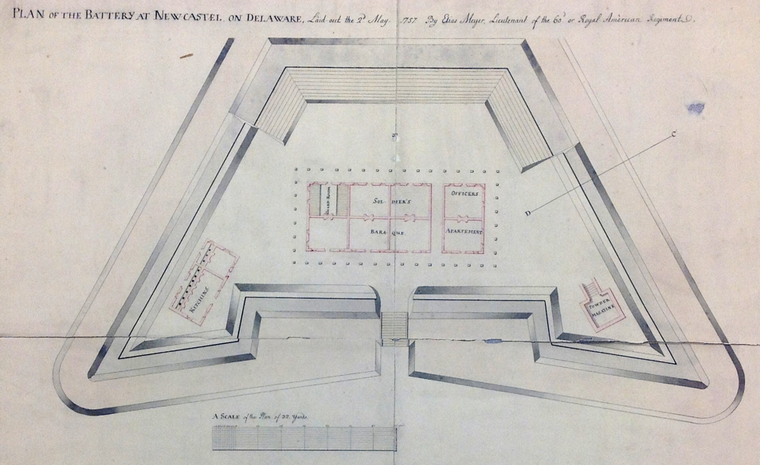
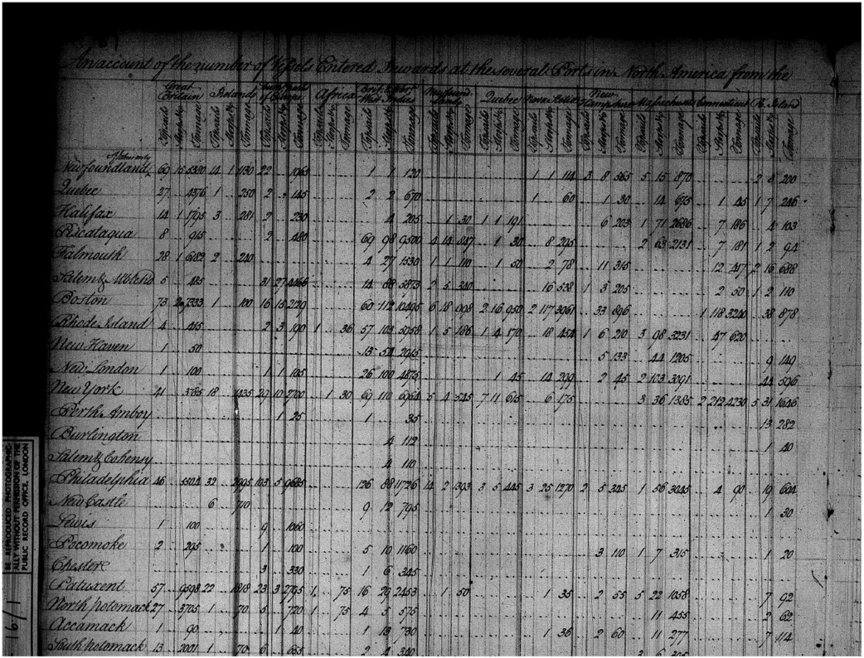
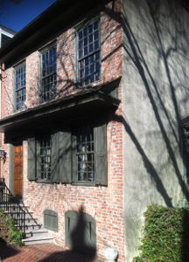
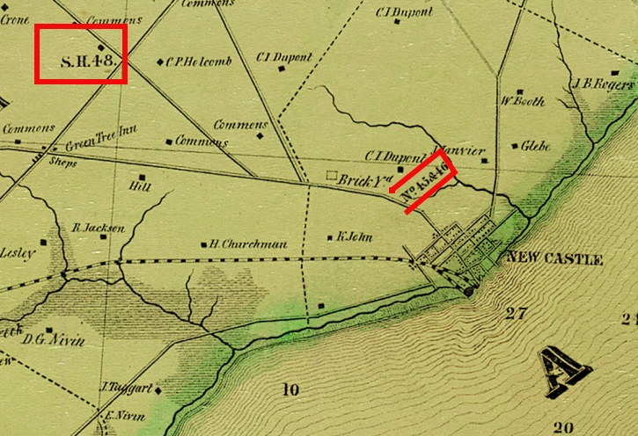
New Castle History
Class 3
  Immigration continues
  B. Franklin, Sir Wm. Keith, A. Mouse
  French & Indian War, weekly reports of
  scalpings; finance a fort with a lottery!
  (1757--)
  Taxation & shipping details from
  a VERY BIG spreadsheet
  Revolutionary war: terror, minor skirmishes nearby,
  visit by the British commander's secretary
  Patriots: Scots Irish Presbyterians (McKean,
  Van Dyke, Bennett, Hopkinson …
  Capitol relocated to Dover (1777)
  Arsenal construction (War of 1812)
  George Read II organizes a Corps of
  Flying Artillery at the Green Tree (Hares Corner)
  Mrs. Read makes contingency
  plans to flee to Carlisle PA if we're attacked.

Slide 2
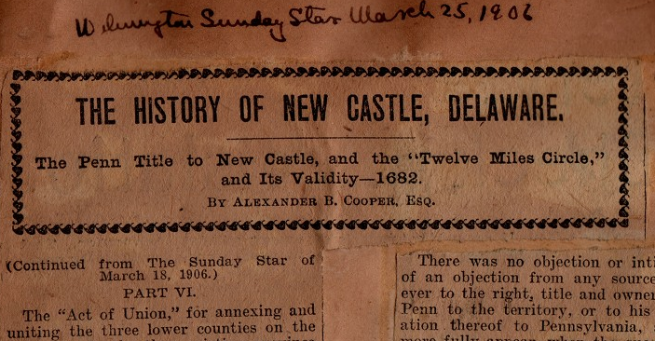
“Under Wm. Penn and his Heirs”
Cooper’s History of New Castle, Part XIII
Beyond what has already been said…, very little of interest to the town of New Castle, or in fact to the three lower counties, has been preserved between the year 1700 and the beginning of the revolutionary war. In explanation of
this, however it may be stated, in the first place, that the people lived
throughout that period in a comparatively quiet way and there were no
very stirring events to record.
Secondly, there seems to have been no full and accurate records made. Thirdly, such as were made have been removed, lost or destroyed. It is well known that many of the records, however important or unimportant they may have been, were carried away, lost and destroyed during the revolutionary war.
http://nc-chap.org/cooper/
Not really true:
Continued immigration of Scots-Irish
Attempted expansion of the town by Gov. Keith
French & Indian War
Building of the battery

Slide 3
Immigration
Half of all Scots-Irish immigrants arriving in the Delaware Valley before 1763 first set foot in New Castle, and about two thirds of them arrived as indentured servants.
German speaking immigrants, who arrived in the region in far greater numbers than the Scots Irish were prohibited from disembarking at New Castle because … they had to register and swear an oath of allegiance to the king in Philadelphia.
Many Identities, One Nation, Liam Riordan, 2007

Slide 4
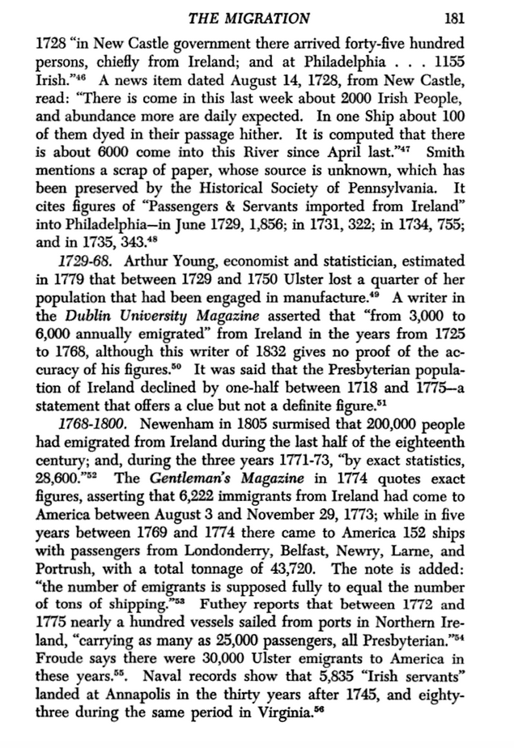
Scotch-Irish
Imigration
There was a huge migration to America during the 1700s of Scots who had lived for a time in Ireland.
The Scotch-Irish: A Social History, J. G. Leybaum, 1962

Slide 5
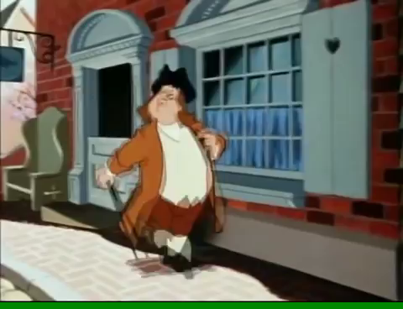
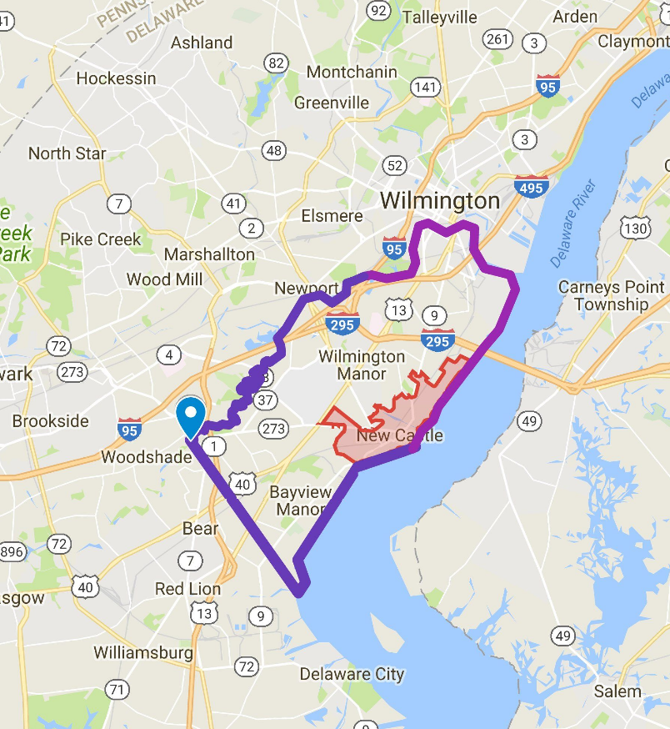
Governors of Pennsylvania (& Delaware)
William Markham, led colony in Penn’s absence for years, friend of pirates
Evans -1709 young, rash, faked a raid on PHL, seized PHL ship in New Castle
Charles Gookin (1709-1717) Hated by Delaware colonists
Sir William Keith (1717-1726) impoverished nobility, supportive to Ben Franklin, created a charter for an enlarged City of New Castle in 1724 (never really happened), he was replaced, died in poverty in Old Bailey, London
Youtube of Disney’s Ben & Me (1953); Ben meets Keith & Col French
New border of City of New Castle (1724) and current town

Slide 6
Real Story of Ben Franklin & Sir William Keith (Gov. of Penn.)
Keith: "Give me an inventory of the things necessary to be had from England, and I will send for them. You shall repay me when you are able; I am resolv’d to have a good printer here, and I am sure you must succeed." This was spoken with such an appearance of cordiality, that I had not the least doubt of his meaning what he said... I afterwards heard it as his known character to be liberal of promises which he never meant to keep.
...
The governor, seeming to like my company, had me frequently to his house, and his setting me up was always mention'd as a fixed thing. I was to take with me [to London] a letter of credit to furnish me with the necessary money for purchasing the press and types, paper, etc.
Franklin books passage from New Castle to London, but doesn't succeed in getting the promised letter of credit. Colonel French had brought on board the governor's
despatches, [and Franklin] ask'd the captain for those letters. There was none for Ben. A friend let him into Keith's character. he: told me there was not the least probability that he had written any letters for me; that no one, who knew him, had the smallest dependence on him; and he laught at the notion of the governor's giving me a letter of credit, having, as he said, no credit to give.
Returning to Philadelphia in 1726 "I found sundry alterations. Keith was no longer governor, being superseded by Major Gordon. I met him walking the streets as a common citizen. He seem'd a little asham'd at seeing me, but pass'd without saying anything.
I soon after obtain'd, thro' my friend Hamilton, the printing of the Newcastle paper money, another profitable jobb as I then thought it; small things appearing great to those in small circumstances; and these, to me,
Ben, age 17, meets, impresses Gov. Keith
Keith suggests Ben go to London buy printing stuff
Ben leaves from New Castle without Letter of Credit from Keith
Ben works for a year in London, then returns to PHL
Keith removed from office, ignores Franklin
Autobiography of Benjamin Franklin, project Gutenberg

Slide 7
New Castle in 1750
Rev. George Ross to Rev. Bearcroft
The town of Newcastle consisting of about fourscore houses waxes poorer & poorer, And falls into Contempt more and more every year, having Several houses without inhabitant, & Some not fit for habitation.
…This dying Condition is partly owing to an upstart village [Wilmington] lying on a Neighboring creek, which yields a convenient port to the adjacent country.
From the papers of the Society for the Propagation of the Gospel
Notes:
Water power, not limitedby marshes,quaker

Slide 8
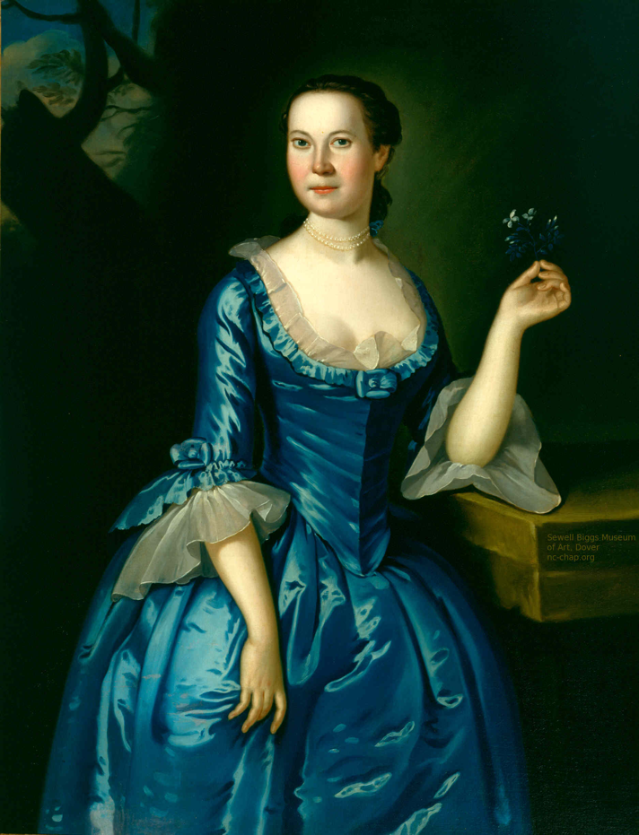
Echoes of a distant war
The French & Indian War began on the western frontier
Braddock defeated in battle for Fort Duquesne (Pittsburgh).
G. W.: “We have been most scandalously beaten by a trifling body of men (1754)
Anna Dorothea Finney (1735-1817) grew up in New Castle, Delaware, the daughter of a wealthy physician and landowner of Irish descent named John Finney, and lived in Amstel House, which her father had built in 1738. According to one source Anna fell in love with a young British officer. When he was killed in the French and Indian War, she resolved never to wed. Her father had other ideas and arranged her marriage to her first cousin John Finney,
Biggs Museum, Dover
Anna Dorothea Finney, by John Hesselius, Biggs Mus. c1758
Notes:
From beginning no govt organized militias till 1750’s
No commonwealth has existed thaat has not been protected by those willing to preserve it with their lives

Slide 9
The War Comes Closer - 1756
There were 69 reports of scalpings in 1756 in The Pennsylvania Gazette according to the Accessible Archives index -- more than one per week.
The closest was about 75 miles from Philadelphia.

Slide 10
June 2 1757
"Just now a Messenger arrived, who informs, that on
Saturday last one Eckinrod, of Linn Township [near Lehigh?], … was shot
and scalped by some Indians behind his House,
… that one of his Sons, about eight Years of
age, was carried off; and his Daughter, about six Years old,
shot through her Right arm, but escaped, and is likely to do
well. She says she saw two Indians; and another of Eckinrod
Sons saw two Indians scalping his Father, but had Time to run
off."

Slide 11
"I am sorry to inform you that the Indians are committing their savage barbarities on the poor defenceless inhabitants of this county. From the 23d of last month to the 8th instant, that have killed and captivated twenty one of our inhabitants, which intimidates the settlers so much, that those who live above us, on both branches, are all preparing to come to the towns, and have given up all thoughts of putting in any fall crops, which is a plain demonstration that it is all over with our county, if something is not speedily done by our legislative body at this sitting, to encourage the people to make a stand. The 8th instant a party of Indians came to the house of John Lee, when they took him, his wife and seven children prisoners, also John Walker and three more, that were in the house, thirteen in all; the savages promised not to hurt them, provided they made no noise and would go quietly along, but about a quarter of a mile from the house they tomahawk John Lee, John Walker, and two of Lee children; a young child of Lee they threw against a sappling and left for dead, but it is likely to recover; they likewise tomahawked and scalped a woman and her daughter, who are still alive, but it is the general opinion they cannot long survive."

Slide 12
IN your Paper of the 9th Instant, I observe the following
Paragraph, viz. "The last Letters from Philadelphia bring
Accounts of the Scalping the Inhabitants of the Back Provinces
by the Indians: At the same Time the Disputes between the
Governor and the Assembly are carried to as great a Heighth as
ever, and the Messages sent from the Assembly to the Governor,
and from the Governor to the Assembly, are expressed in Terms
which give very little Hopes of a Reconciliation. The Bill to
raise Money is clogged, so as to prevent the Governor from
giving his Consent to it; and the Obstinacy of the Quakers in
the Assembly is such, that they will in no Shape alter it: So
that while the Enemy is in the Heart of the Country, Cavils
prevent any Thing being done for its Relief. --- Mr. Denny is
the third Governor with whom the Assembly has had these
Disputes within a few Years."
Pa. Gazette Sept 23, 1757

Slide 13
A Lottery for Civil Defense
SCHEME Of a LOTTERY for raising 2000 Pieces of Eight for erecting a BATTERY at the town of New Castle , and purchasing some GUNS for the same.
THE defenceless state of the town of New Castle , particularly at this juncture, when a war between Great Britain and France seems almost inevitable, renders it exceedingly dangerous for the country around, as well as the Inhabitants thereof: And as the inhabitants from the fewness of their number, are unable to erect any fortification by subscription, that may be of service in time of danger, hoped an undertaking that may, with the divine assistance, not only be the preservation of our lives and fortunes, but, in a great measure, of the last importance even to Philadelphia itself, by warding off the impending evil, or keeping an enemy at play till notice can be given thereof, will meet with encouragement from all lovers of their country and liberties....
So soon as the drawing is finished, the prizes will be published in the Pennsylvania Gazette, and the money paid to the possessors of the 166 large prizes, Twenty per Cent being first deducted, and the 664 small prizes to be paid without any deductions, which makes the deduction on the whole less than Fifteen per Cent.
Proper Notice will be given of the Time of Drawing.
The persons following are appointed managers of this lottery, viz. Benjamin Chew, John Ross, William Patterson, David Witherspoon, Jacob Vanbebber, and David Bush, Esquires; and William Armstrong, John Vandike, Alexander Porter, Richard McWilliam, John Vangezell, William Bedford, George Monro, Zachariah Van Leuvenigh, and Nathaniel Silsbee, Gentlemen; who are to give bond and be on oath for the faithful performance of their trust. Tickets are to be sold by the said managers, at their respective dwellings.
Pennsylvania Gazette, August 26, 1756

Slide 14
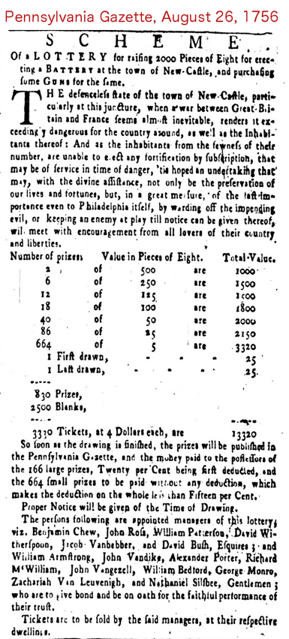
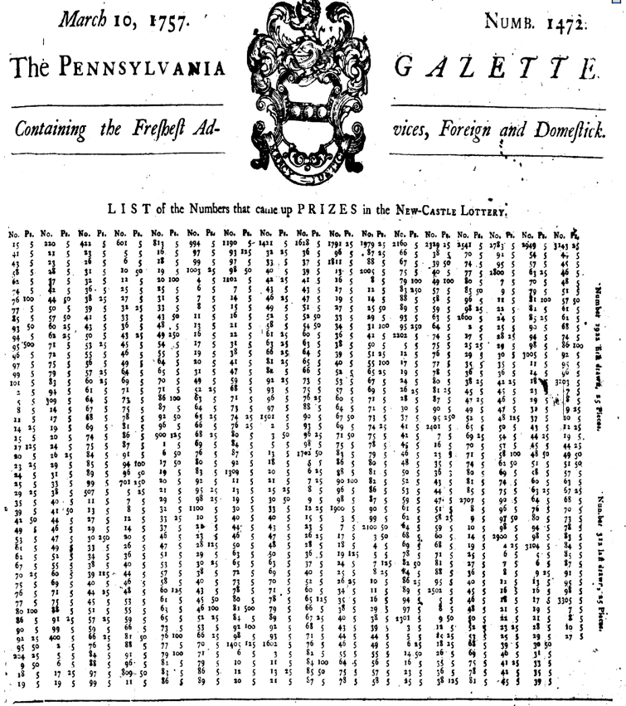
Prospectus and announcement of prizes for Lottery to erect a BATTERY at the town of New Castle and purchase some Guns for the same
Scheme of a lottery for raising 2000 Pieces of Eight for erecting a Battery at the town of New Castle and purchasing Guns for the same. The defenceles state of the town …

Slide 15
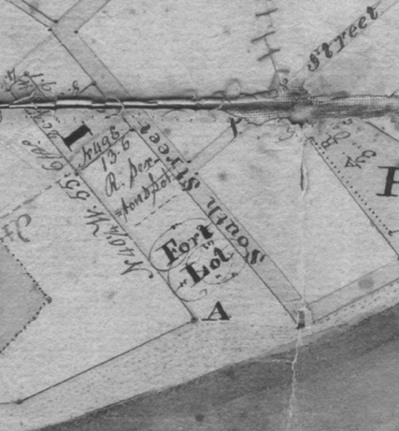
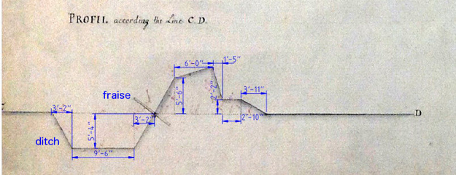
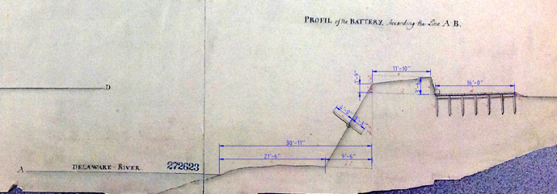
PLAN OF THE BATTERY AT NEWCASTEL ON DELAWARE, Laid out the 2nd May 1757 By Elias Meyer, Lieutenant of the 60th or Royal American Regiment
Location of the Fort Lot, South St. at the river. Orphan’s court map, 1810
PAMHC
Harrisburg
MG11

Slide 16
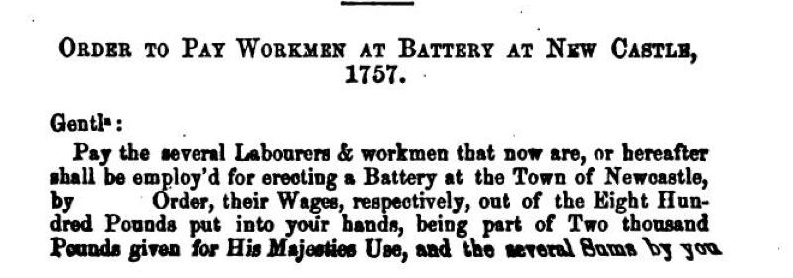
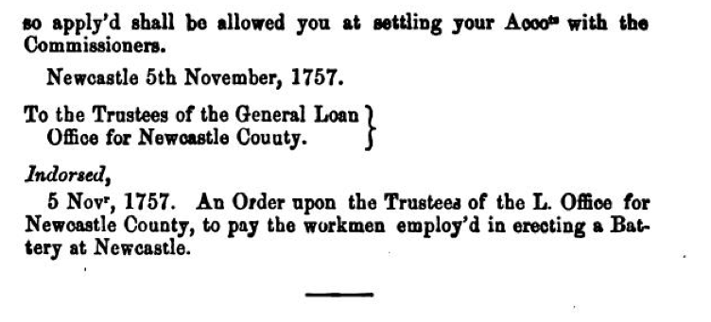
Pennsylvania Archives Series 1 Vol 3 p318 (1852)

Slide 17
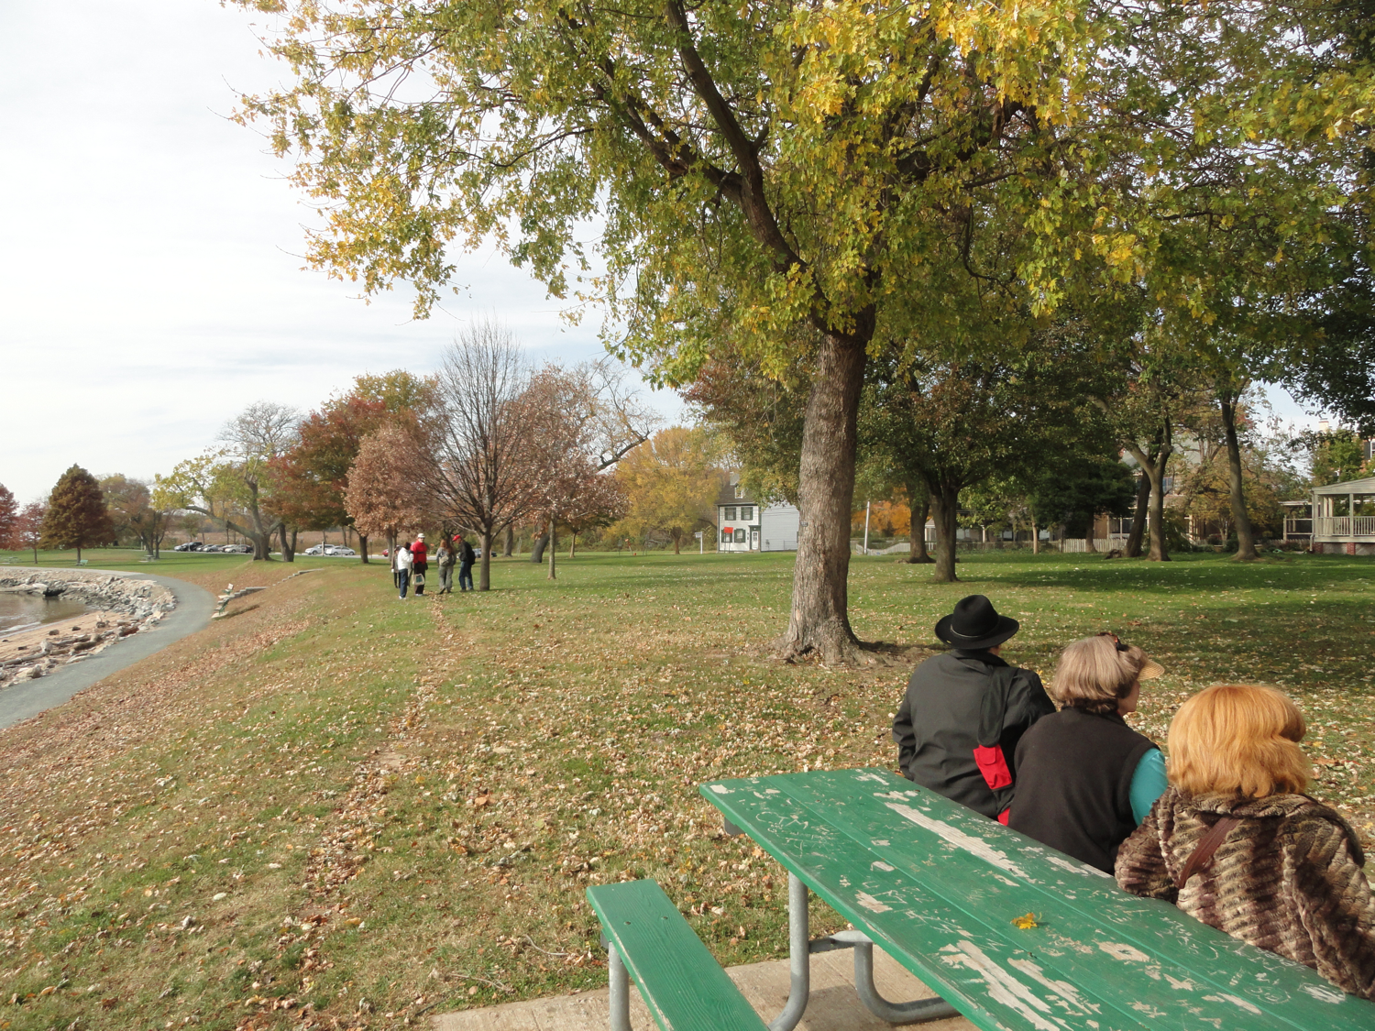

Slide 18
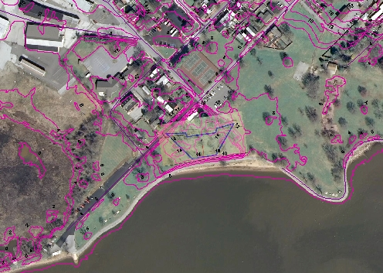
Overlay of 1757 Plan on Contour Map
Note: Battery is correct scale, but placement location is totally arbitrary:
It should be 30’ from the waterline, but where was that in 1757?

Slide 19
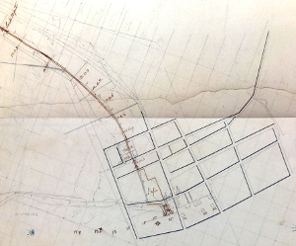
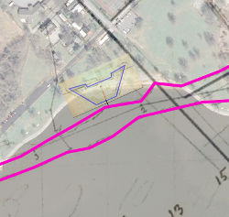
Possible location of the Battery based on the waterline of the 1803 Latrobe C&D canal plan
There MAY be some remnants of the battery on the knoll. A GPR study might be very interesting.

Slide 20
Vesssels, Imports And Exports Just Before The Revolution: The American Board Of Customs,
An account of the number of Vessels Entered Inwards at the several Ports in North America
From: Great Britain, Ireland, South ... of Europe, Africa, Brit...West Indies, Newfoundland, Quebec, Nova Scotia, New Hampshire, Massachussetts, Connecticut, R. Island
Ports:
Newfoundland, Quebec, Halifax, Piscataqua, Falmouth, Salem & Mbleh'd, Boston, Rhode Island, New Haven, New London New York, Perth Amboy, Burlington, Salem & Cohensy, Philadelphia, New Castle, Lewis, Pocomoke,
Chester, Patuxent, North Potomack, Accamac, South Potomack, Rappahannock, York River, James River, Do. upper part, Currituck, Roanoke, Bath Town, Beaufort, Brunswick, ???, Charles Town, Port Royal, Savannah, Sunbury,
St. Augustine, Pensacola, Mobile, Bahama, Bermuda

Slide 21
Account of the number of vessels and their tonnage that have entered inwards at the several ports in North America from the 5th of January 1772 to the 5th of January 1773
 |  | Topsail | Schooner | Tonnage
PHL | Great Britain | 63 | - | 7,757
 | Ireland | 12 | - | 25
 | Brit. West Indies | 137 | 110? | 12,947
New Castle | Great Britain | - | - | -
 | Ireland | 10 | - | 1085
 | Brit. West Indies | 9 | 10 | 713
Philadelphia imported 10x more than N.C. in 1772
New Castle’s imported from Ireland and B.W.I (and a few American ports)
43 incoming vessels both extra and intracontinental– about one per week
American Board of Customs p225

Slide 22
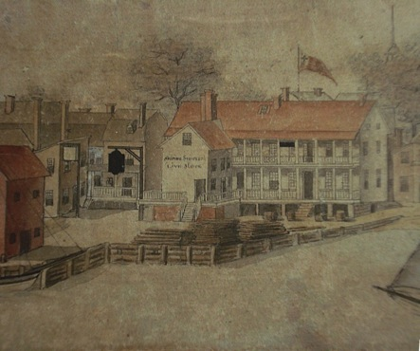
Non-dutiable goods imported into New Castle in 1772
Le Blanc, ‘Taken July 4, 1797’
Item | Amount | Units
Cotton | 5,100
Hides | 137 | No.
Rum | 138,000 | gal
Limes | 200 | bbl
Sugar | 66
(Rum punch: one of sour, two of sweet, three of strong, four of weak)
Notes:
----- Meeting Notes (9/21/15 13:42) -----
EXPORTING in this year-- much less than PHL except shingles! Largest exporter on whole coast! > NYC, >PHL
WHY?

Slide 23
Setbacks to New Castle
Before 1682, New Castle was the only large town on the Delaware River
Ft. Casimir: hunger, illness, death
The town is surrounded by marshes restricting growth
British require all ships to come to NYC before unloading in New Castle
Penn founds Philadelphia as the prime city of the colony
The ‘upstart village to the north’ (Wilmington) develops into a trade center
1777 State capitol moved to Dover due to the exposed position of New Castle on the river
New Castle & Frenchtown RR bypassed by Phila.-Baltimore line
County courthouse moved to Wilmington
Looking at it negatively, historian Connie Cooper calls New Castle a “Town among Cities” in her 1983 Ph. D. thesis
Looking at it positively, she called it “…one of Delaware’s oldest, most significant and most beautiful towns”
Benson & Hoffecker in 2011 wrote “New Castle is an extraordinary town … the crown jewel of Delaware”

Slide 24
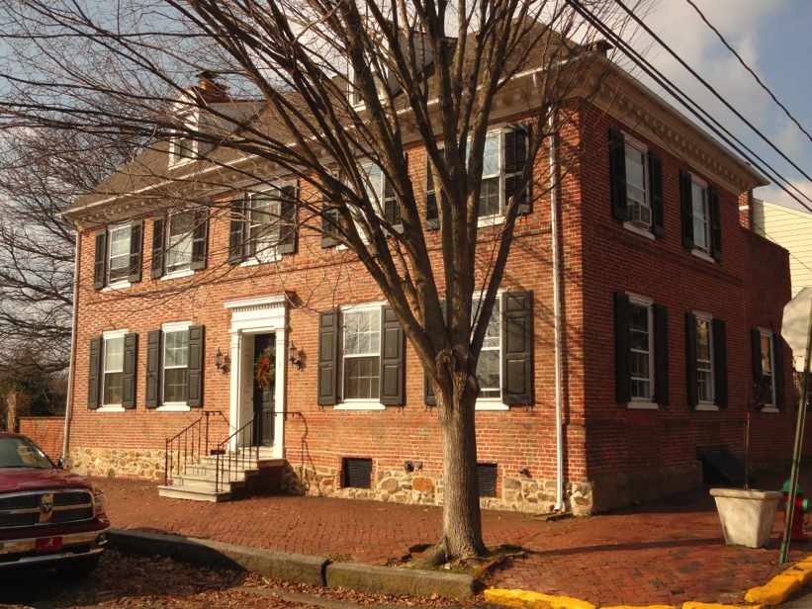
War has Started!
The News Comes to New Castle (a week later)
“After the battle of Concord the news was sent by messenger and receipted for in each town and sent forward - no matter what the hour day or night. The message was received here in New Castle on Wednesday evening April 26, 1775, and receipted for by Zachariah Van Leuvenigh and Stephen Spencer, a relative. Van Leuvenigh, at the time, lived in the house. They sent the message to "Christiana Bridge" where it was received by Samuel Patterson who sent it on to Col. Thomas Cooch, and he forwarded it to Tobias Rudolph at Head of Elk or Elkton, where it was received at 4: 30 A.M. on Thursday morning April 27.”
Collected Essays of Richard S, Rodney,(1955), 1975
The battles were on April 19.
(Remember “twas the 18th of
April in ‘75; hardly a man is now
alive…)
Van Leuvenigh house: Delaware & Strand. Typical early Georgian house: water table, string course, symmetrical, hip roof

Slide 25
New Castle, A Town Divided
Patriots, (Whigs), often Scots-Irish, often Presbyterian, often radical, support revolution
The three ministers of the New Castle Presbyterian Church from 1769 to 1824 were born in Ireland or were of Scots Irish descent.
The congregation as well as the population of New Castle County had a strong Scots-Irish presence by the revolution.
Minister: Joseph Montgomery preached to the militia in 1775 on the Continental Congress day of fasting, urging the need to "separate from our parent state". In 1776 he became Brigade Chaplain to Delaware Regiment of the Continental Army
Leader: Thomas McKean. helped organize resistance to the Stamp Act (1765), in 1774 organized a mass meeting to protest the post-tea party treatment of Boston. He held NUMEROUS positions public simultaneously in both Delaware and Pennsylvania.
Patriot gangs roamed the town. Howe's secretary Ambrose Searle was almost captured when "60 of the Rebel militia" seized the seamen accompanying Searle.
Loyalist, Tories, often Anglican, loyal to crown
Leader: George Read (Dublin Irish descent, inside the “Pale”) was moderate, and respected
Openly loyalist residents faced abuse: surgeon John Watson was "mobbed and insulted by the People of the Town." Innkeeper John Drake and his wife fled New Castle.
His wife "received a Musket Ball in the back of her neck " when the militia fired at her and Mrs. Watson as they fled to a British vessel. [one of 150 in 1777]

Slide 26
General William Howe was Commander in Chief during the Revolution
His Secretary (Ambrose Searle) visited New Castle
Sept. 11, 1777
…We passed by Newcastle, an inconsiderable Town pleasantly situated upon the Delaware. The Prospect of the Ships Sailing up this River, the Banks of which are extremely beautiful and the most like the Banks of the Thames of any River I have yet seen in America, was very grand and Splendid
…The Admiral is about 10 or 15 miles higher up, about Chester; and as much firing was heard to-day, we conjectured it passed between our Ships and the Rebel Batteries, as our people were removing the Obstructions in the River.
Oct 14, 1777
Landed at Newcastle and walked about the Town & its Environs, which are by far the most pleasant and the most fertile Lands I have yet seen in America.
The American Journal of Ambrose Searle, 1776-1778, p257
Notes:
----- Meeting Notes (9/28/15 15:53) -----
no attempt to stop the invaders with the tiny fortifaction on the battery.
There were many heavily armed men-of-war capable reducing the town to ruble.

Slide 27
Searle’s description of New Castle
The Town is small, and its Buildings mean & scattered; yet, though inferior in Size & every other Respect to Wilmington, it is the principal Town of the County where the Courts of Justice are held: and here are a Parish Church, a Presbyterian Meeting House, a Court House, a Gaol, a Pillory, a Pair of Stocks, one old Cannon for Signals or rejoicing Days, and a Pound for Hogs. The inhabitants seem poor, and their appearance is by no means healthy, though the Country about them is pleasant. The Fever & Ague prevails here in Autumn, as in all the Low Lands of Delaware Bay & River. There being no Wharf or Dock, [???] where Ships can ride out of the strong Current, it does not seem probable that this Town will ever grow (at least not grow rapidly) into Consequence.
--The Flat Boats were this evening ordered to Wilmington, in order to take the Troops stationed there (about 3,000 men) up the River to assist in opening the Passage to Philadelphia by annoying the Rebel Ships from the Shore.

Slide 28
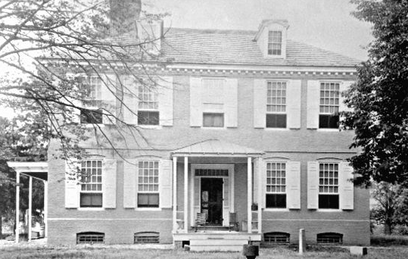
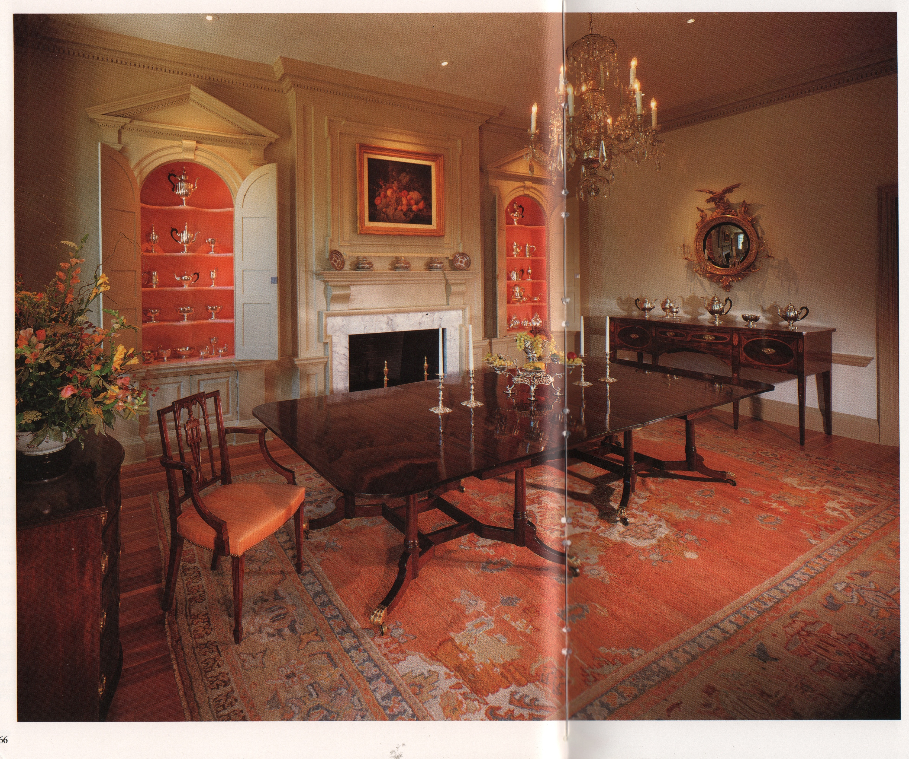
Lord Howe’s Secretary 1777 Visit to New Castle
The principal Houses, of wch there are but few, are utterly abandoned by the Inhabitants on account of their Concern in the Rebellion. I walked to a handsome Country House about a mile from Town, belonging to a Richard McWilliams Esq. (a native, like most of the People in the Neighborhood, of Ireland ) and had some Conversation with him. He was too old [d 1785] to be concerned actively in the Rebellion; but by some of his Expressions, I could not but perceive with Sorrow, that he was tainted with its Principles.
McWilliam House
8 The Strand
McWilliam House, Spring Garden, New Castle, NCHS
Fireplace wall removed in 1929 from
“Green Spring Manor”, New Castle for Hennage House, Williamsburg, Va
American Antiques, The Hennage Collection, Colonial Williamsburg, 1990, Courtesy M. Moskovis
Notes:
----- Meeting Notes (10/7/15 08:42) -----
capitol moved to dover
note that in wilmingtonwhen occupied the governor mckinley captured taken as prisoner to a ship in chester, all records siezed

Slide 29
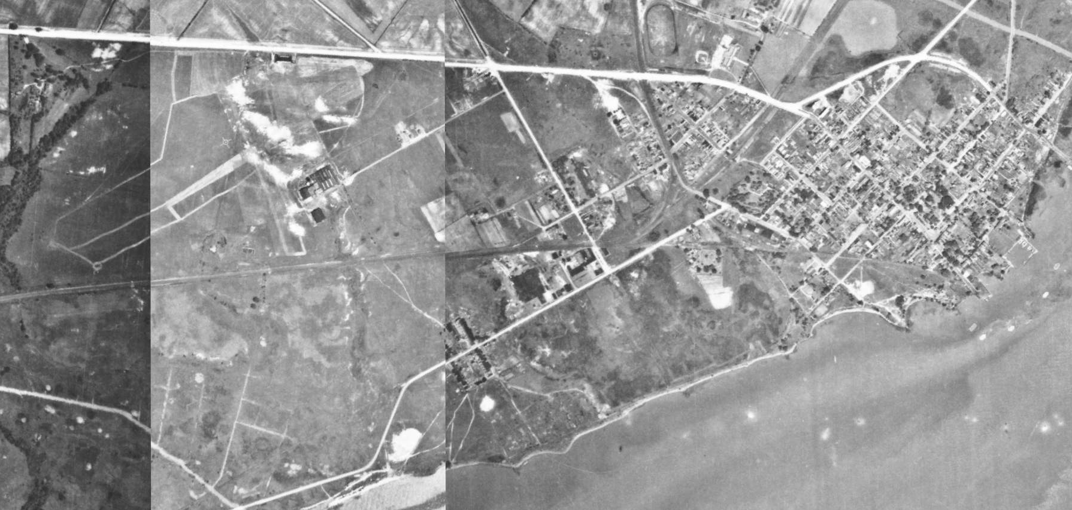
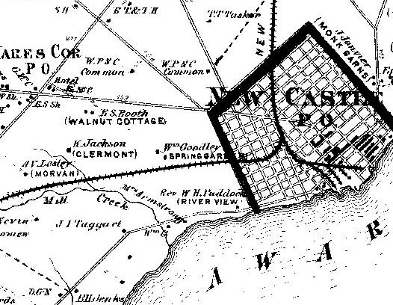
Where, When, was Spring Garden?
Look at maps, aerial photos: present in 1868, 1926, gone in 1937, replaced by Bellanca
Beers Atlas, 1868
http://firstmap.gis.delaware.gov/arcgis/rest/services/DE_Imagery/DE_Imagery_1937/ImageServer?f=jsapi
Amazon.com
1926
Notes:
Easiesst ways to get rough dates is via maps aerial for >1930

Slide 30
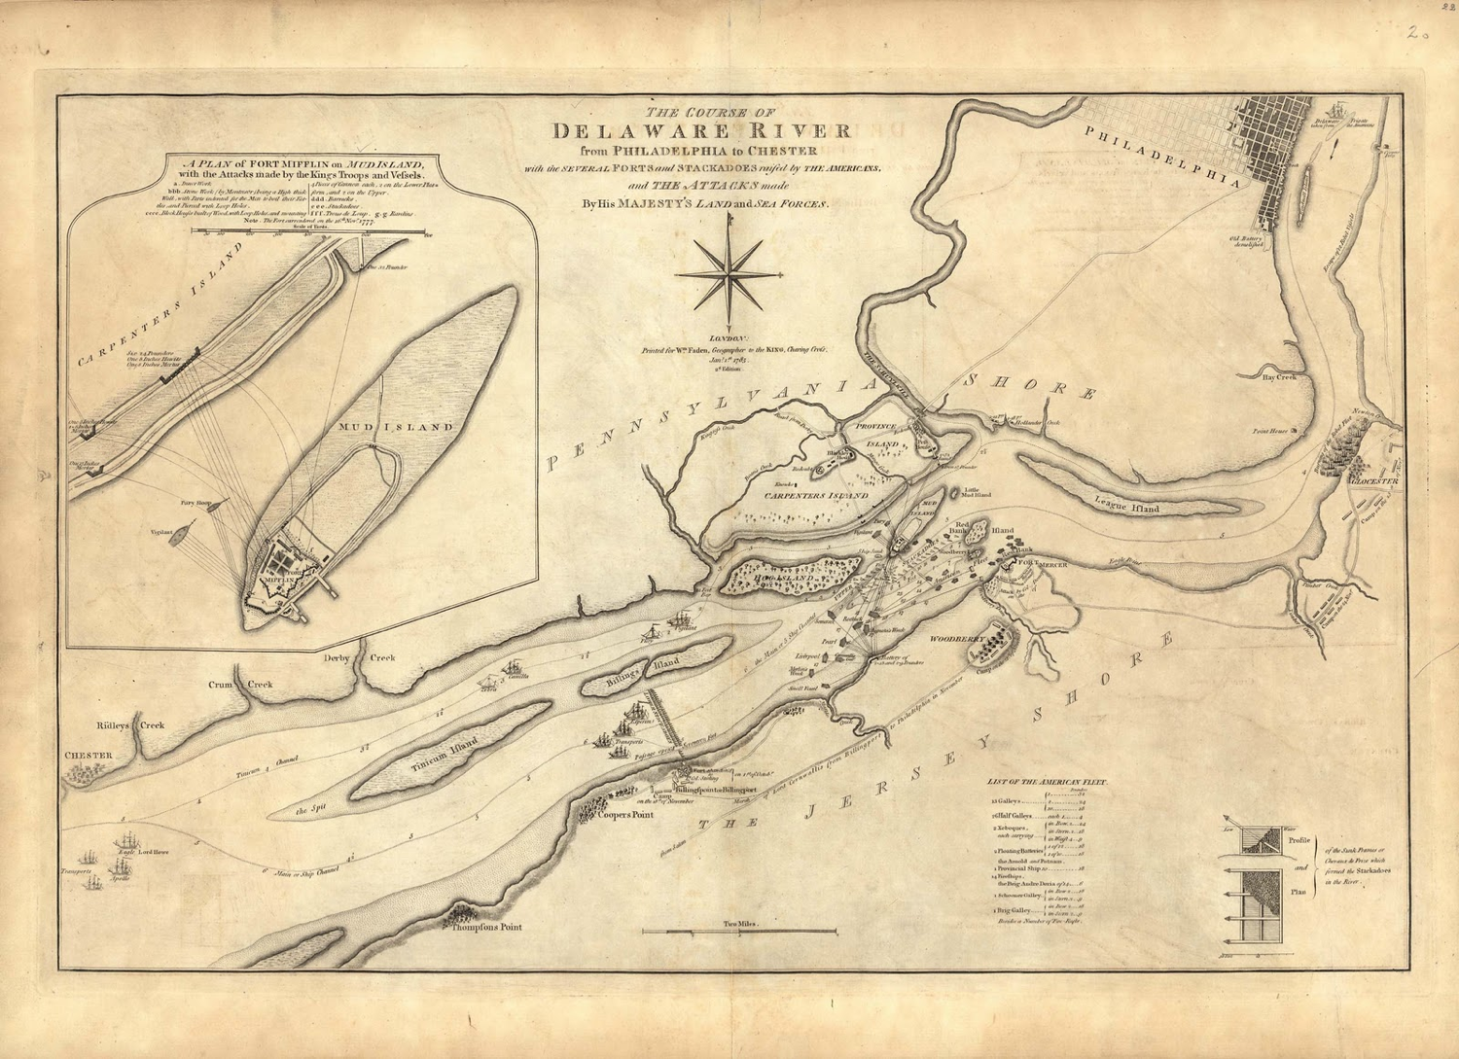
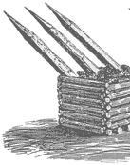
Cheveaux de Frise
Notes:
Frisian Horses in teaser. These are Frisian horses; iron tipped stakes set in a log crib filled with rubble iron foundry still around
News item 5 yr ago iron tippedlog found nr Sunoco refinery near philadelphia

Slide 31
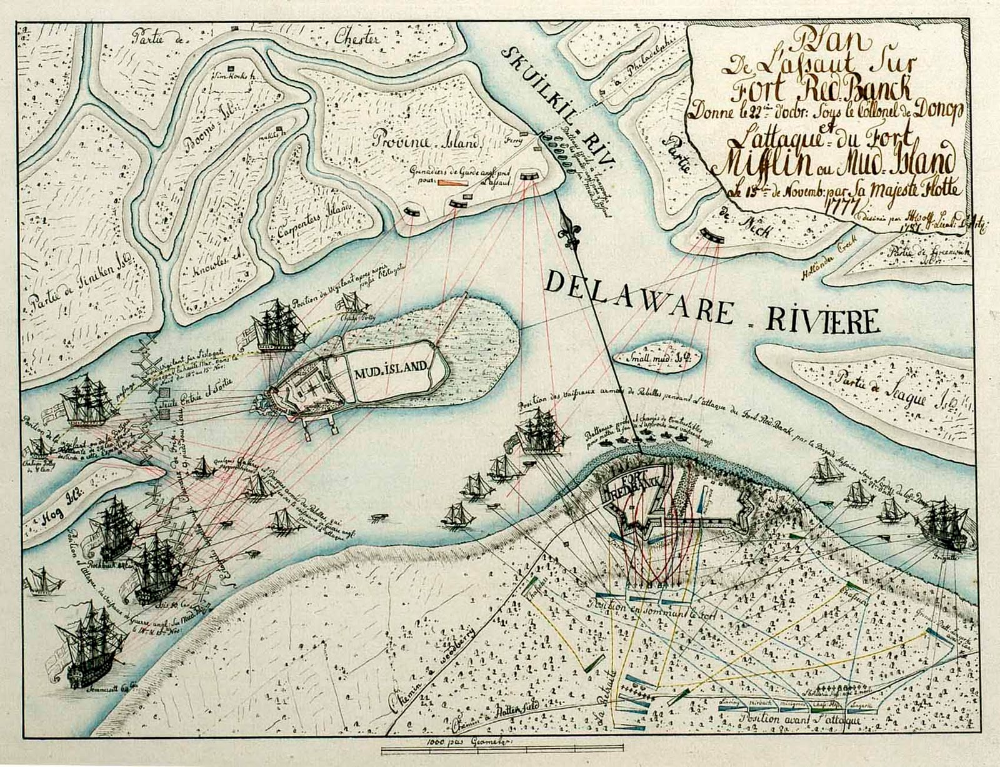
Notes:
Started as 4gs

Slide 32
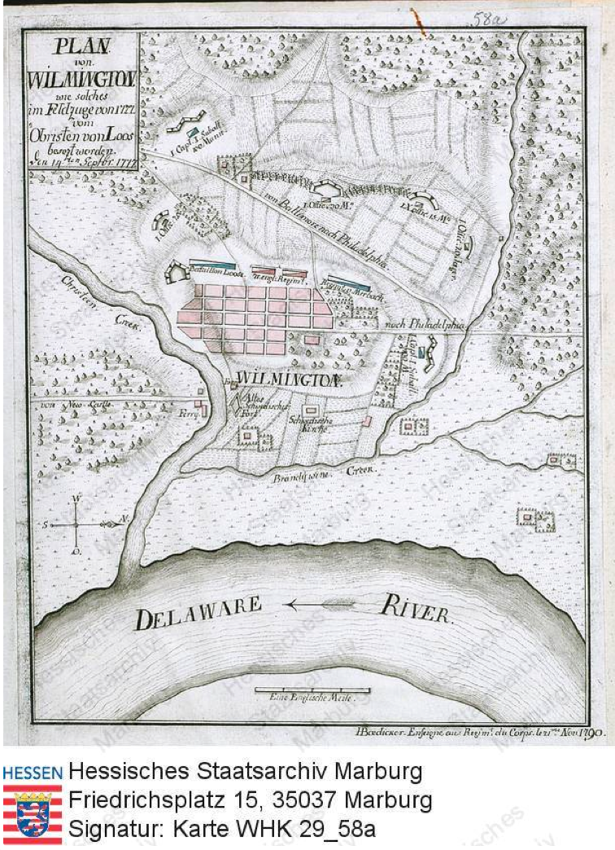
Hessian Fortification Map of Wilmington, Sept. 1777
verz2117774
Identifier: HStAM, WHK, WHK 29/58a
Description model:Map / Plan
Series title: Nordamerikanische Kriege von 1775-1782
Title: Plan der Besetzung von Wilmington durch Oberst Loos, 14. Septmber 1777
Dating: (1777) 1790
Original title: Plan von Wilmington wie solches im Feldzuge von 1777 vom Obristen Loos...
Description of contents: Nach Westen ausgerichtete Karte von Wilmington an der Straße von...
Description of contents: Unterer Kartenrand: Delaware
(Previous) provenances: Wilhelmshöher Kriegskarten
Author: H. Bädicker
Format: 220x280 mm
Scale: 1 Englische Meile = 4,5 cm[1:33.800]
Design: Handzeichnung, farbig
Number of sheets: 1
Descriptors: Loos
Descriptors: Bädicker, H.
https://arcinsys.hessen.de/arcinsys/
detailAction.action?detailid=v2117774

Slide 33
New Castle, A Town Divided
Patriots (Whigs) Supported Revolution
They were often Scots-Irish, often Presbyterian, often radical
The three ministers of the New Castle Presbyterian Church from 1769 to 1824 were born in Ireland or were of Scots Irish descent.
The congregation as well as the population of New Castle County had a strong Scots-Irish presence by the revolution.
Minister: Joseph Montgomery preached to the militia in 1775 on the Continental Congress day of fasting, urging the need to "separate from our parent state". In 1776 he became Brigade Chaplain to Delaware Regiment of the Continental Army
Leader: Thomas McKean. helped organize resistance to the Stamp Act (1765), in 1774 organized a mass meeting to protest the post-tea party treatment of Boston. He held NUMEROUS positions public simultaneously in both Delaware and Pennsylvania.
Patriot gangs roamed the town. Howe's secretary Ambrose Searle was almost captured when "60 of the Rebel militia" seized the seamen accompanying Searle.
Notes:
Two groups majority pro separation
----- Meeting Notes (9/28/15 15:53) -----
It was said of him: he is the kind of man on whom public positions are placed without his even seeking them

Slide 34
New Castle, A Town Divided
Loyalist, Tories, often Anglican, loyal to crown
Leader: George Read (Dublin Irish descent, inside the “Pale”) was moderate, and respected
Openly loyalist residents faced abuse: surgeon John Watson was "mobbed and insulted by the People of the Town." Innkeeper John Drake and his wife fled New Castle.
His wife "received a Musket Ball in the back of her neck " when the militia fired at her as she fled to a British vessel. [one of 150 in 1777]

Slide 35
Service during the war (including militia) was widespread
Richard Adair, William Adams, Veazy Alexander, Robert Bail, Samuel Barr, Gunning Bedford (1742-97), James Booth, Joseph Booth, James Boyd, Archabald Boyd, Hugh Brown, Robert Bryan Jr, Charles Bryson, William Buchanan, William Clark, Thomas Clark, John Clark esq, John Clawson, Slator Clay, Thomas Clay, John W. Clay, William Coffey, William Colsbery, James Crawford, James Creed, John Dougherty, Cornileous Dushane, John Elliots, Joseph Enos, Richard Enos, John Enos, David Finney esq., William Fryar, Robert Furnis, Isaac Grantham, Samuel Hanna, Hance Harman, Fredrick Hill, David Irvin, Francis Janvier, Richard Janvier, Thomas Janvier, Samuel Janvier, Philip Janvire, John Jaquet, Peter Jaquet Jr., John Jordan, Robert Kerr, John Kirk, James Kirkpatrick, John Lewden, John Lewden Jr., John Maleclon ? esq., Andrew McCahan, Patrick McCormick, John McGinnis, William McGinnis, Thomas McKean esq., John McKee, John McKinly esq., William McKinney, Richard McWilliam esq., Robert Mears, Alexander Montgomery, Thomas Morton, Morton Morton, Daniel Murphy, William Norris, John Pasmore, James Patrige, Samuel Patterson esq., David Porter, Alex Porter, John Powel, James Read, George Read esq., John Reynolds, James Rezous, Samuel Ruth, Abraham Sankey, William Scott, William Shannon, Abraham Short, Sampson Smith, John Stafford, John Stewart, William Stidham, Jospeh Tatlow, John Thompson esq., John Titus, Abraham Vandigrift, Robert Wiley, James Wilson, John Yeates
94/226 entries in annotated 1776 tax records had service in the military
http://nc-chap.org/census/riordan/tax1776.php Liam Riordan
Notes:
----- Meeting Notes (10/7/15 08:42) -----
many ideas, one nation

Slide 36
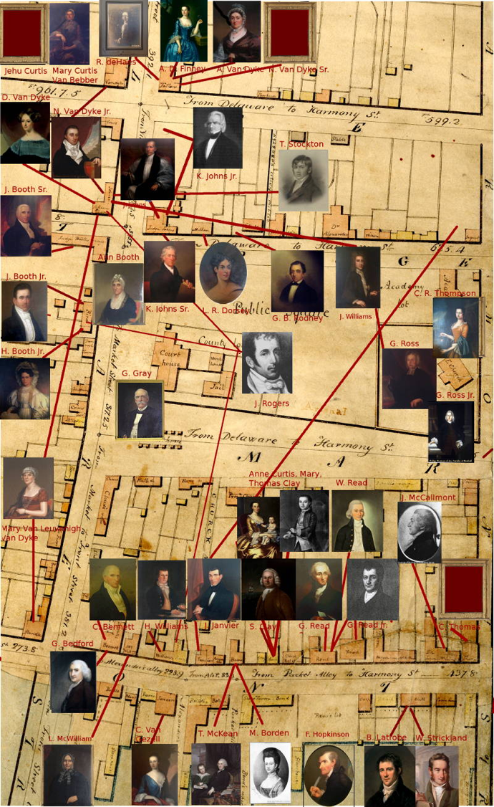
Prominent N.C. Residents Active in the Revolution
Patriots, Whigs, support revolution
Predominantly Scotch-Irish,
Presbyterian
T. McKean, N. Van Dyke
Quaker
C. Bennett
Anglican
F. Hopkinson, J. Booth Sr.
Loyalists, Tories, loyal to Crown
Predominantly Anglican
Switched to Patriots 1774-1776
Anglican
G. Ross Jr.
G. Read Sr.
Riordan lists 121 individuals with military service

Slide 37
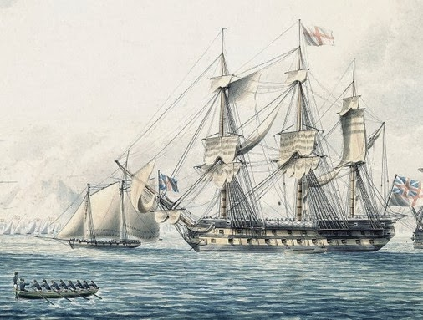
Incidents near New Castle
During the Revolutionary War
Roebuck was attacked below New Castle [near power lines from NJ] by ‘row-galleys’ and due to shallow water, able to be driven off.
H.M.S. Roebuck,
1769-1811, 44 gun-9, 18lb
May 10, 1776 from George Read
Gentlemen…the Roebuck … were in the bight
below New Castle.. We have had warm cannonading between the ships and galleys these two days past, -- all within our view. … They compelled the ships to retire… much powder and shot have been expended by the galleys, but they have produced a very happy effect upon the multitudes of spectators on each side of the river.., British ships of war will not be thought so formidable.
William T. Read, Life and Correspondence of George Read,
[Cannonballs from the Roebuck were fired into houses: the Eves place (nr. I-295), and a house in Port Penn.]

Slide 38
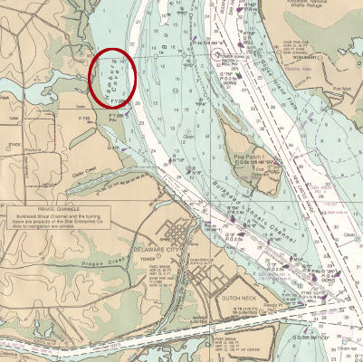
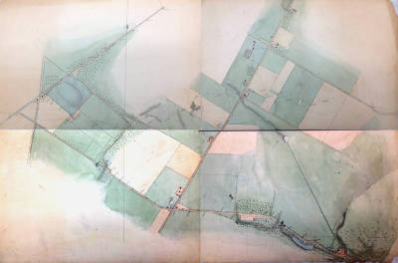
Incidents near New Castle
During the Revolutionary War
2. Hamburg Landing – capture of troops foraging for food 1777-1778 Hamburg Landing was a small settlement – a hotel and mill about where the power line crosses from N. J., just above Delaware City.
Winter 1777-1778, One boat captured, 6 men sent to Wilmington.
Feb. 1778, a Lt. put on farmers clothes and lured a boat from a man-of-war with promises of food. His men ambushed the boat and captured 8 men.
Hamburg landing was never very large. In 1803, it and Bear each had only 3 buildings in Latrobe drawings. However, it was considered significant. It was included with Newark, Wilmington, New Castle and Newport in supporting the ‘Philadelphia Agreement’ of non-importation

Slide 39
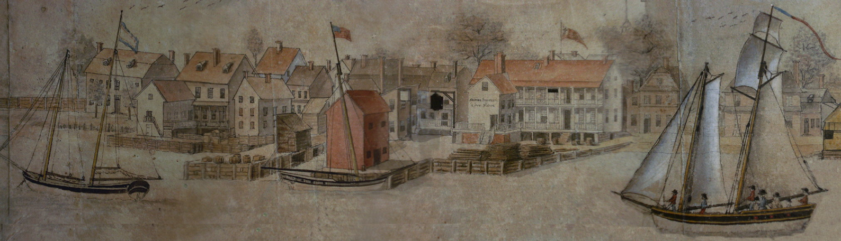
Description from a traveler (1795)
Le Blanc, ‘Taken July 4, 1797’
Newcastle is the true point from which all the Philadelphian ships take their departure. When they are laden, they drop down thither with their pilot, and take in their poultry and vegetables, where the captains who remain at Philadelphia to settle their accounts at the custom-house, join them by land, and from whence they sail with the first fair wind.
From Duke de la Rochefoucault Liancourt
Travels through the United States of North America - 1795
Notes:
leblanc a myster who when published???

Slide 40
Irish immigrants, passenger lists, 1803
American Brig Neptune, Seth Stevens, master, bound for Newcastle and Philadelphia, at Warrent Point, Newry on 29 March 1803
Passengers on Board the Ship Catherine of Dublin, George Thomas, Master, now in the Port Killybegs and bound for New Castle & Philadelphia Sworn at Ballyshannon 9 June, 1804. (72 passengers. All but one in hold.
John Grimes, labourer age 28
Agnes Grimes, his wife age 26
James Crummy, farmer, 45
Agnes Crummy his wife, 30
Mary Crummy, their daughter, 15
Sarah Crummy, their daughter, 12
James Crummy, their son, 6
David Crummy, their son, 4
Susan Dene, spinster, 18
David gallon, farmer, 40
John Henry, farmer, 40
Hanna Henry, his wife, 30
Nancy Henry, their daughter, 18
James Henry, their son, 11
William Countes, laboourer, 26
Mary Countes his wife, 21
Conyngham John dark 55 farmer hold
Conyngham Isabella dark 49 blank hold
Conyngham William fair 26 labourer hold
Conyngham Isabella dark 23 blank hold
Conyngham Alexr. fair 21 labourer hold
Conyngham Jas. fair 18 labourer hold
Conyngham John fair 15 labourer hold
Conyngham Catherine fair 12 blank hold
Conyngham George dark 49 schoolmaster hold
Conyngham Andrew dark 34 farmer blank
Conyngham Elitia fair 34 blank hold
Conyngham John fair 12 blank hold
Conyngham Andrew fair 6 blank hold
Johnston Robt. fair 15 blank cabin
Henderson Robt. dark 45 farmer hold
Henderson Elenor dark 44 blank hold
Henderson Elenor dark 18 blank hold
Henderson Jane dark 15 blank hold
Henderson Prudence dark 13 blank hold
Henderson George dark 11 blank hold
Henderson Ann dark 8 blank hold
Henderson Alexr. fair 6 blank hold
Fawcett Arthur fair 19 labourer hold
Porter John dark 43 farmer hold
Porter Elitia dark 44 blank hold
Porter Catherine dark 22 blank hold
Porter William fair 20 labourer hold
Porter Alexr. fair 13 blank hold

Slide 41
African Americans in New Castle
In 1800, the earliest year for which records survive, African Americans were one of the largest groups in New Castle – 23% of the local population.
They lived in 150 of 304 households.
Racial segregation was impossible: blacks lived in every section and on every street.
In 304 households, only once were there 7 houses in a row without a black inhabitant.
Ten of 21 exclusively black households were grouped together.
Many Identities, One Nation, Liam Riordan, 2007

Slide 42
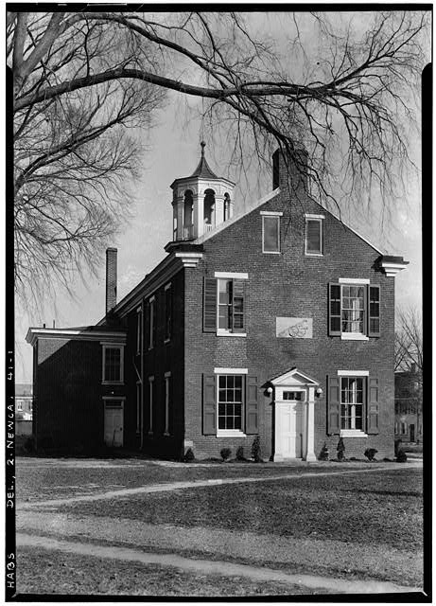
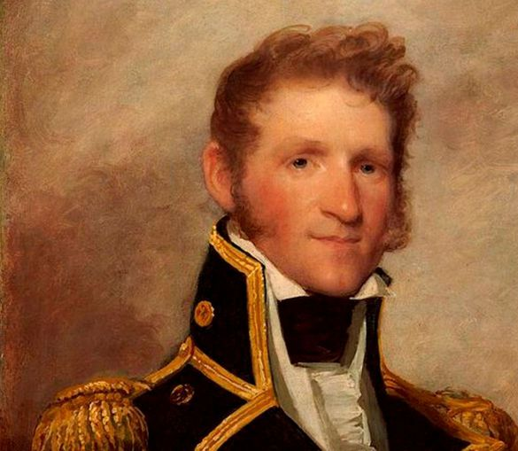
War of 1812, The Arsenal
Many theaters of war:
4 on the Canadian border,
1 each on Chesapeake, southwest, Gulf coast, high seas
Selected events:
1807 U. S. frigate “Chesapeake” attacked, 4 seamen seized
(“Don’t give up the ship”)
Embargo on all exports to Britain
1809 Arsenal built in New Castle
1812 War declared
American privateers seize 450 prizes in 6 months
British capture 150 American privateers
Fort built on Rocks in Wilmington
British blockade Chesapeake & Delaware bays
1813 McDonough victory
on Lake Champlain
1814 British attack, burn D. C. on Sept. 12 and attack
Ft. McHenry, Baltimore, Sept 13 (Rockets’ Red Glare)
“Corps of Flying Artillery” formed in New Castle
1815 Battle of New Orleans
The War of 1812, A Short History, D. R. Hickey, 2012

Slide 43
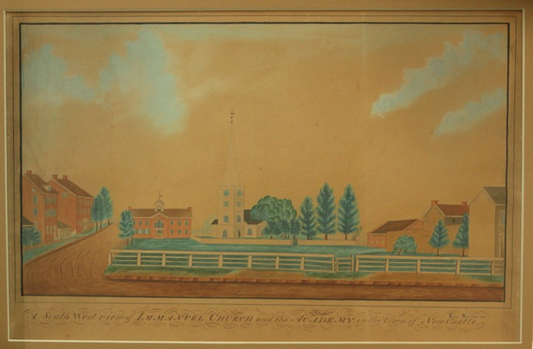
The Arsenal – under U.S. Control (1809-1850)
1809 Deed written but not executed conveying land for an arsenal
One and a half story building erected, Caleb Bennet appointed Military Store Keeper
1813 U. S. Arsenal on Schulkyl sent: 2-24pdr Cannon, 200 -24pdr: Round Shot,
502 Lbs Grape Shot, 600 Lb Cannon Powder
Four Cannon: Lawrence, Washington (20 lbs), Wasp, Hornet (6 lbs)
1843 U.S. requested title; town agreed “provided that the said Arsenal shall never in any case be used for the storage of gunpowder or the quartering of troops without the express assent of the inhabitants of the town”.
1851 Acquired by the Trustees of New Castle Common.

Slide 44
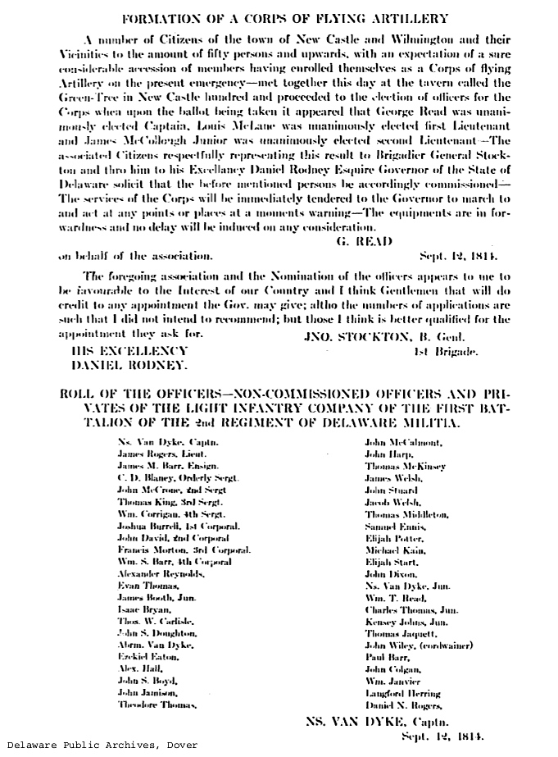
Green Tree Inn
Near Hare’s Corner (Farmers Market);
Site of early polling place
Gathering to establish a “Corps of Flying Artillery” elect G. Read (jr) as captain
Rea & Price, 1849

Slide 45
Fear in New Castle (1813-1814)
George Read Jr. sends 6 loads of furniture & goods to Christiana Bridge (account books 4 and 5/1813 )
Letters. From Mary Read — March 29, 1813
“New Castle is in a state of alarm… difficulty in procuring food. Mr. [ ] McMahon has offered the Reads asylum in case of an attack”.
George Read II to James Hamilton — November 8, 1814 [2 months after burning of D.C.]
“The threatening aspect of the war and our exposure on the sea, the Atlantic Coast to its ravages, has induced Mrs. Read to come to a determination of our removing her residence in March next into the interior of the country & she has given the preference to Carlisle. I feel anxious to have provided for her genteel and agreeable lodgings. Isabella, Mary & a servant boy will be the persons whom she will have with her. May I presume to solicit you to enquire if such lodgings could be procured in March next and at what rate; a mineral spring in the neighborhood of Carlisle is with Mrs. Read a considerable inducement to fixing on that place.”
Delaware Historical Society

Slide 46
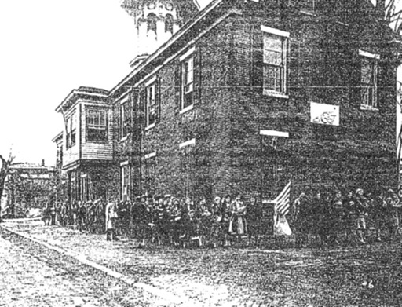
The Arsenal/New Castle Institute (1852-1930)
Students prepare to move from the New Castle Institute to the new William Penn School, Jan. 5, 1930
Del. Hist. Soc.
The building was taken over by Trustees of New Castle Common in 1852, and a second floor added. The school taught both boys and girls.
The Trustees provided sole support until 1874 when it needed funds for the Water Company
Subjects included: Greek, Latin, English, etymology, algebra, arithmetic, history, physiology and constitutional history

Slide 47
Advances, Setbacks in New Castle History
1655 Rule by Amsterdam, not Dutch West India Company
1664 Govt. center for three lower counties
    1682 Loses status as chief city to Philadelphia
    <1770 Loses shipping dominance to Philadelphia
    1777 Loses state capital to Dover
+ 1797 Finally, self governed
+ 1800s North/South Transportation hub
- 1824 Fire destroys many buildings
1832 NC&FT RR opens
- 1838 NC&FT RR Bypassed
1840 on Gains industry: railroad engines, iron, steel
- 1880 Loses county seat to Wilmington
- 1900-1960 Industries close
1920s Colonial revival awareness increases appreciation

