Slide 1
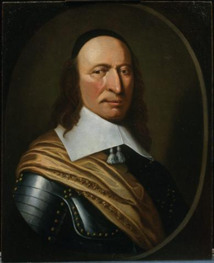
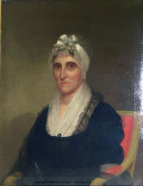
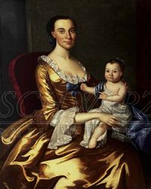
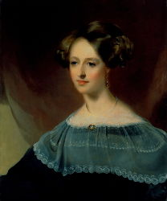
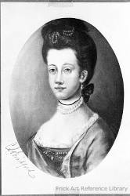
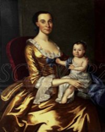
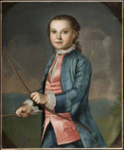
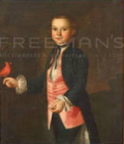
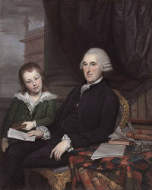
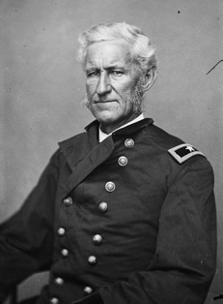
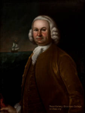
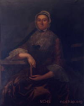
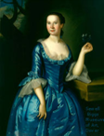
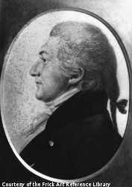
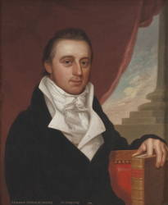
Class 5: People to 1850 --About Portraits. Age before beauty, [rank, wealth, family size, # portraits in NC, art vs representation….]
Peter Stuyvesant
Ann Clay BoothOP
Ann Curtis Clay
(11/13 living children)
Dorcas Montgomery Van Dyke Dupont
Mary Borden McKean
ThomasMcKean
Lorenzo Thomasdetails.php?wname=ann_curtis_clay
James McCallmont (1798)
Nicholas Van Dyke Jr. (1826)
http://nc-chap.org/census/riordan/tax1798.php
http://nc-chap.org/census/riordan/tax1826.php

Slide 2
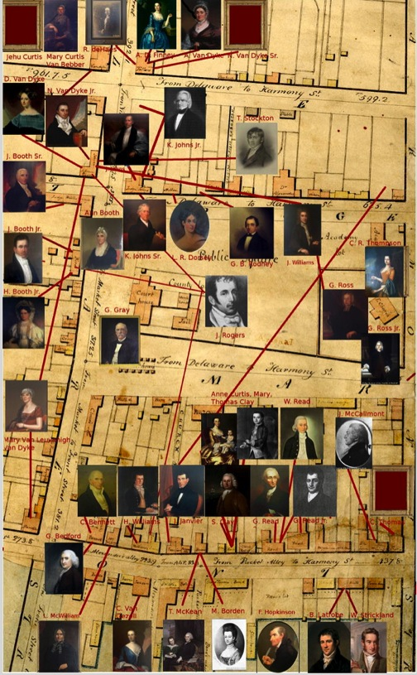
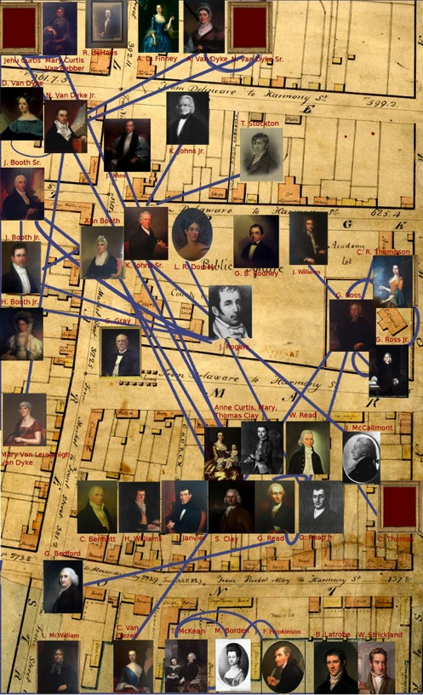
Portraits of the Rich and Powerful in New Castle (1750-1850)
By residence By relationship
With help from Louisa Wood Ruby, Head Photoarchives Research, Frick Art Reference Library and Heather Coyle, Curator of American Art, Delaware Art Museum http://nc-chap.org/portraits

Slide 3

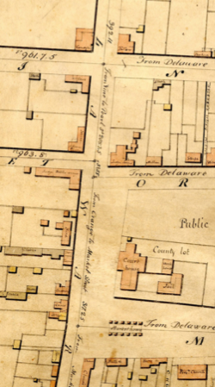
Sources: DHS, NCHS, neighbors Google, museums, and
Smithsonian index listings:
Mrs. Charles Irenee du Pont
(Dorcas Montgomery Van Dyke)
of New Castle,
(1806-1838) [d at 32]
Painted 1832 by
Thomas Sully
(1783-1872)
Parents: Nicholas Van Dyke Jr. &
Mary Van Leuvenigh
Children: Victor, Charles
Godey's Lady's Book 1844 says: "Sully, as all the world knows, paints exquisitely beautiful portraits of ladies. His praise is in all the parlours."
Father born, lived
She was born
Married
Sister lived
Died? CID house?

Slide 4
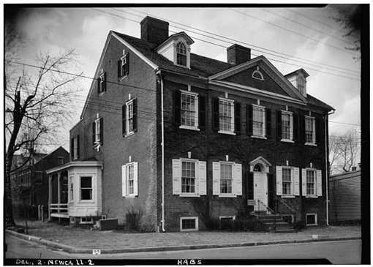
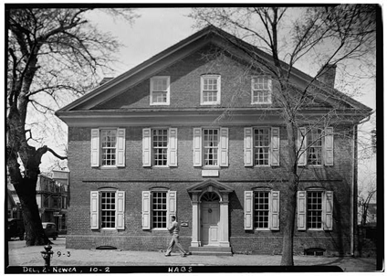
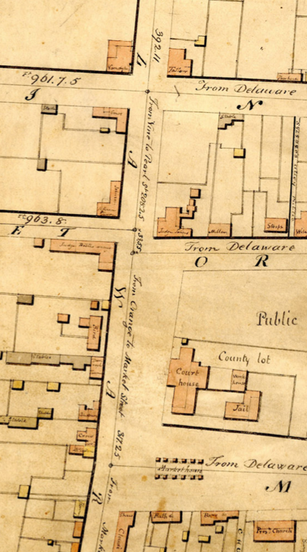
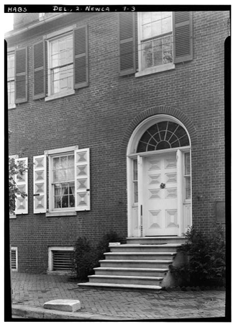
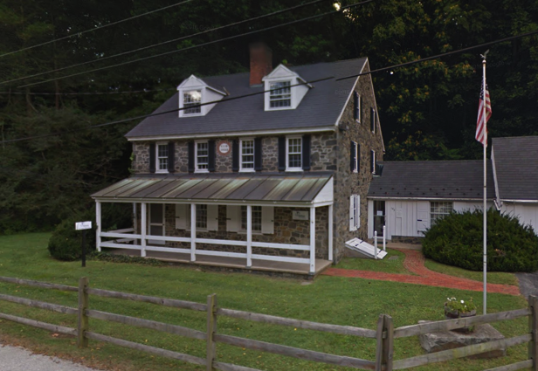
Father born, lived, Amstel House
She was born in Nicholas Van Dyke Jr House, aka Bridgewater house
Sister lived here
She died where? CID house near Hagley? Built 1823. One mile from Osher
Married here,
Lafayette attended
wedding

Slide 5
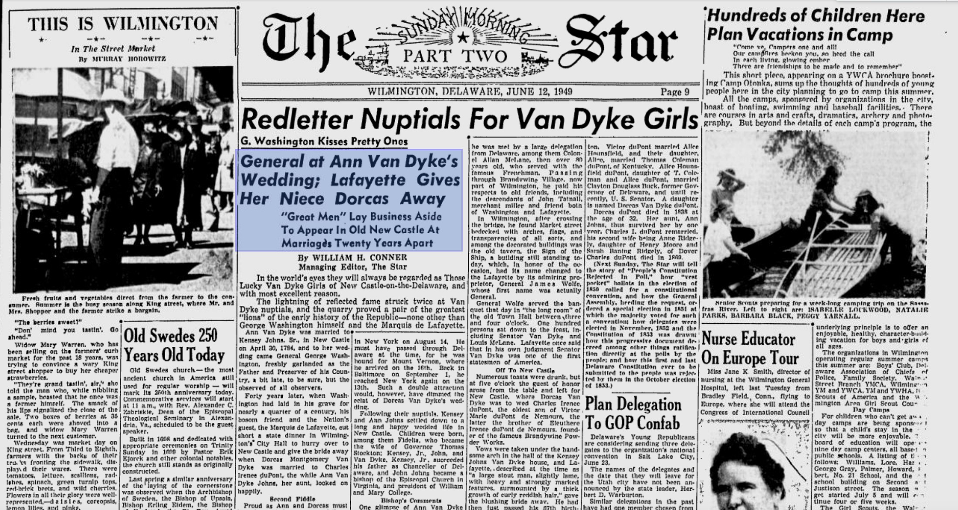
http://nc-chap.org/portraits/details.php?wname=dorcas_montgomery_vandyke

Slide 6
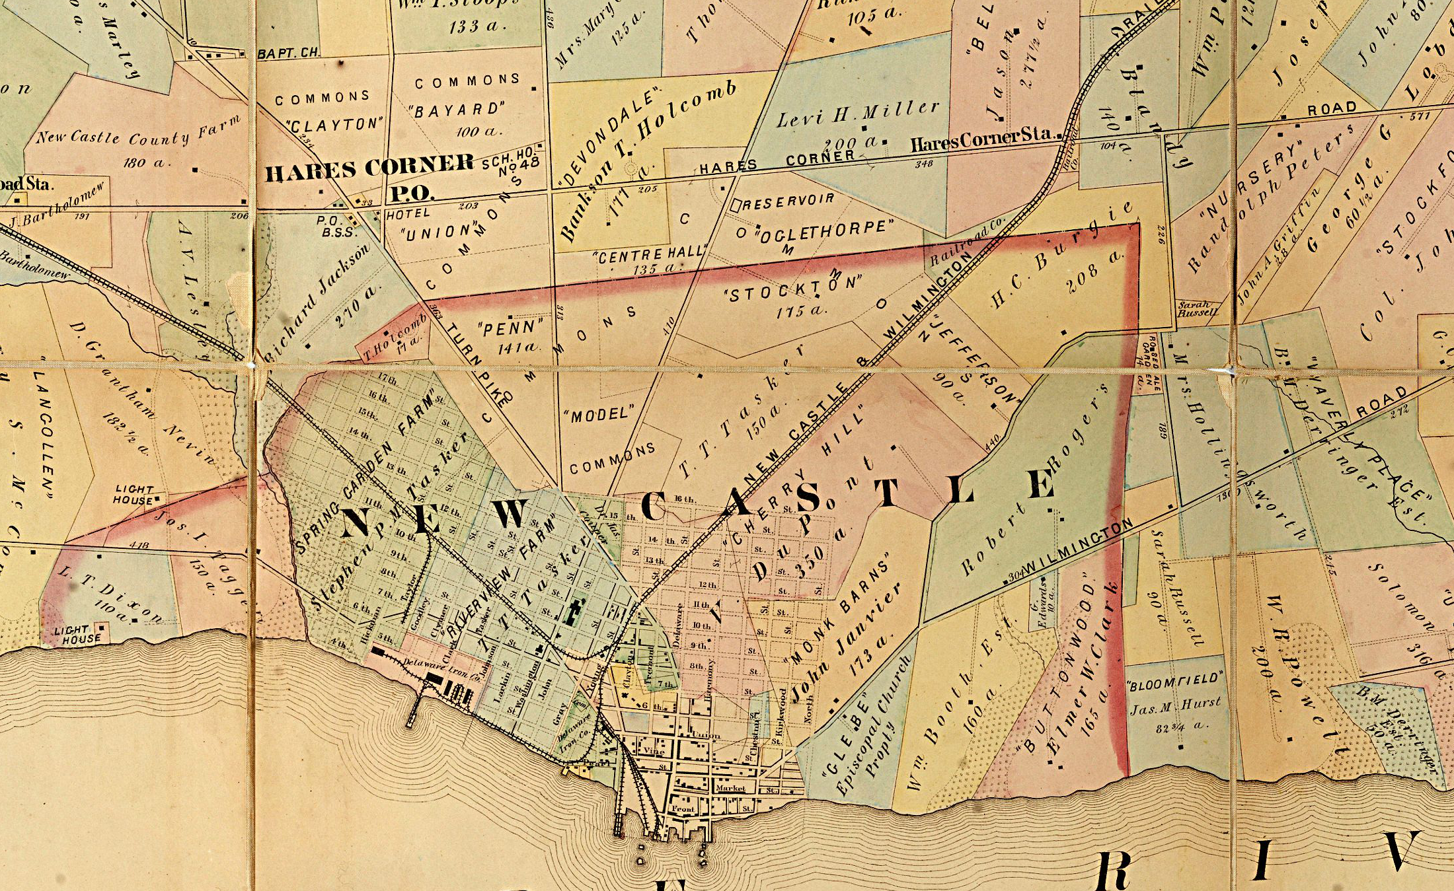
Hopkins Farm Line Map, 1878
V DuPont farm
(Hermitage)
http://nc-chap.org/maps/zoomify/fullScreen/hopkins1878.php

Slide 7
Portraits as Art
Barnes: (light, line, space, color)
He painted >2,600 paintings
Criticized as not penetrating (wikipedia)

Slide 8
Class 5: People to 1850 --About Portraits. Age before beauty, [rank, wealth, family size, # portraits in NC, art vs representation….]
Peter Stuyvesant
Ann Clay BoothOP
Ann Curtis Clay
(11/13 living children)
Dorcas Montgomery Van Dyke Dupont
Mary Borden McKean
ThomasMcKean
Lorenzo Thomasdetails.php?wname=ann_curtis_clay
James McCallmont (1798)
Nicholas Van Dyke Jr. (1826)
http://nc-chap.org/census/riordan/tax1798.php
http://nc-chap.org/census/riordan/tax1826.php

Slide 9
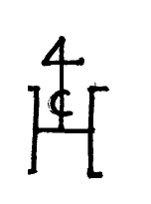
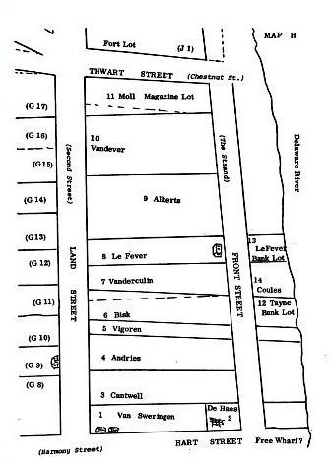
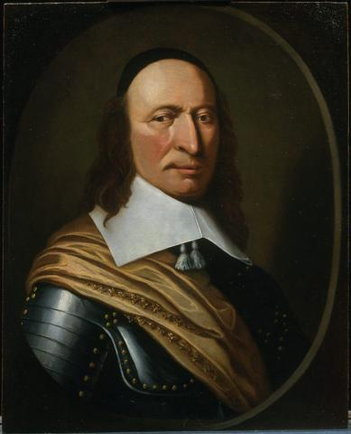
Portrait of Stuyvesant is attributed to known artist Henri Couturier, who lived in New Amsterdam, and HERE in New Amstel
http://nc-chap.org/chap/couturier/

Slide 10
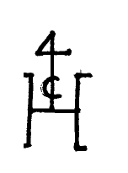
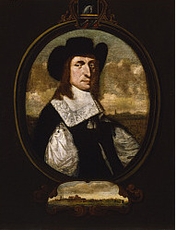
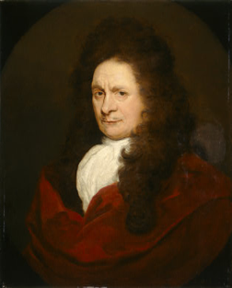
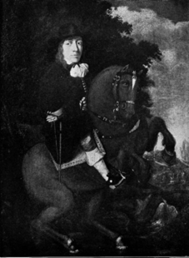
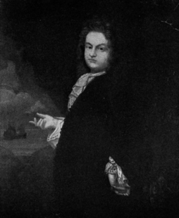
Henri Couturier, painter of Leiden, merchant in New Amstel and New Amsterdam.
Couturier was born in Leyden, the birthplace of Rembrandt. On Couturier's marriage certificate his occupation was that of "schilder" (painter). Ten months later he is listed on a document as a "a grosgrain cloth manufacturer (groff greysnreder)". Since his first child was born about this time, he probably needed a steady source of income. That he actually was a painter is shown by his becoming an "original member" of the Leyden St. Luke's guild.
Attr. Couturier
Olof Van Cortlandt Cornelis Steenwyck
Unknown painter
Charles Harris, New York Historical Society Quarterly Bulletin, July, 1927
William Stuyvesant Frederick Philipse

Slide 11
Evidence for Couturier as painter of A Stuyvesant portrait.
Executive Minutes of the Burgomasters, page 17
Friday, June 12, 1663, at the City Hall present Messrs. Marten Cregier, Olof Stevenzen van Cortlant and the Officer Pieter Tonneman.
The wife of Hendrick Coutrie appearing, she is told, the Burgomasters had learned, that she sold in retail; therefore she is bound to purchase the Burgherright. She answers, it was given to her husband by the Director General : asked, whether she had not given something: for it to the General, she says, her husband has painted the portrait of his Honour and drawn pictures of his sons.
…
Monsieur Hendrick Couterier, living on the South River, to demand and receive in his, the constituant's, name from Sieur Augustinus Herrmans such a quantity of tobacco, as is due him according to vouchers, to…
http://nc-chap.org/chap/couturier/

Slide 12
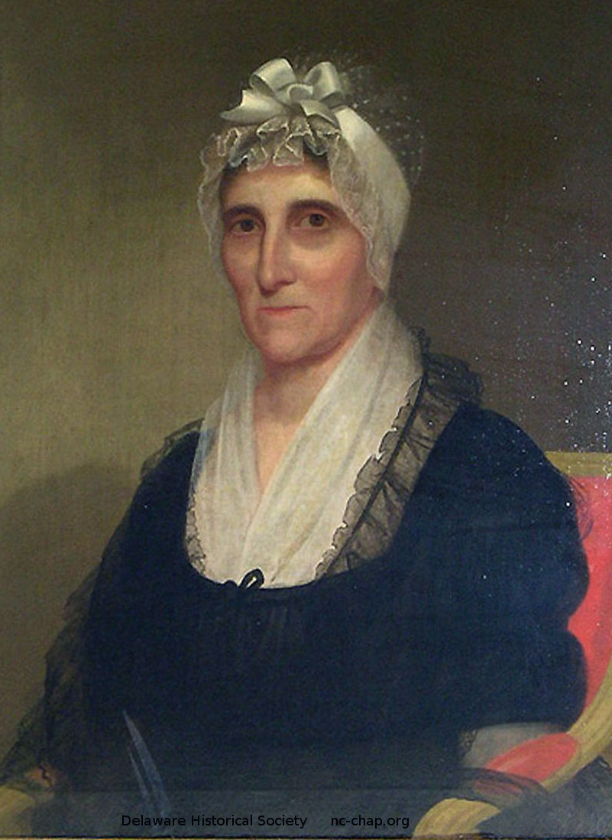
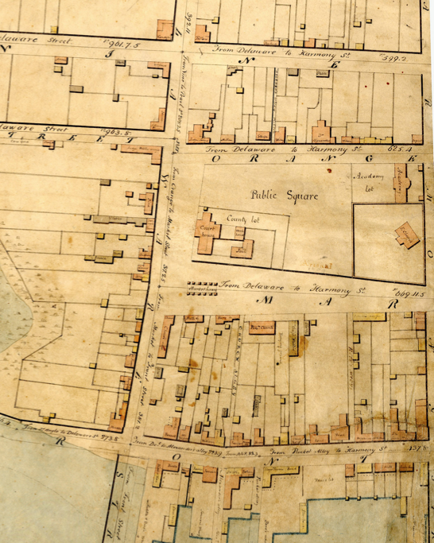
Ann Clay Booth (1759-1846)
Age as pictured: 60-70
Wife, (James Booth Sr.),
Mother of 8
Parents: Slater and Ann (Curtis) Clay. One of 11 children
Artist: unknown, 1820-1830
Lived at 222 Delaware, born 30 The Strand

Slide 13
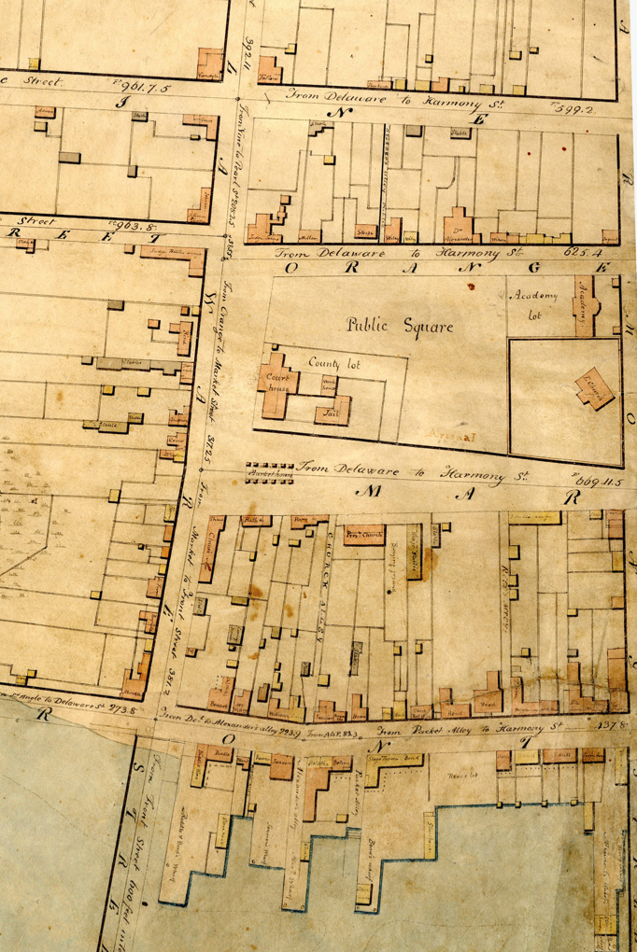
Vandyke/Johns
Vandyke
Booth
Clay
Clay
Read

Slide 14
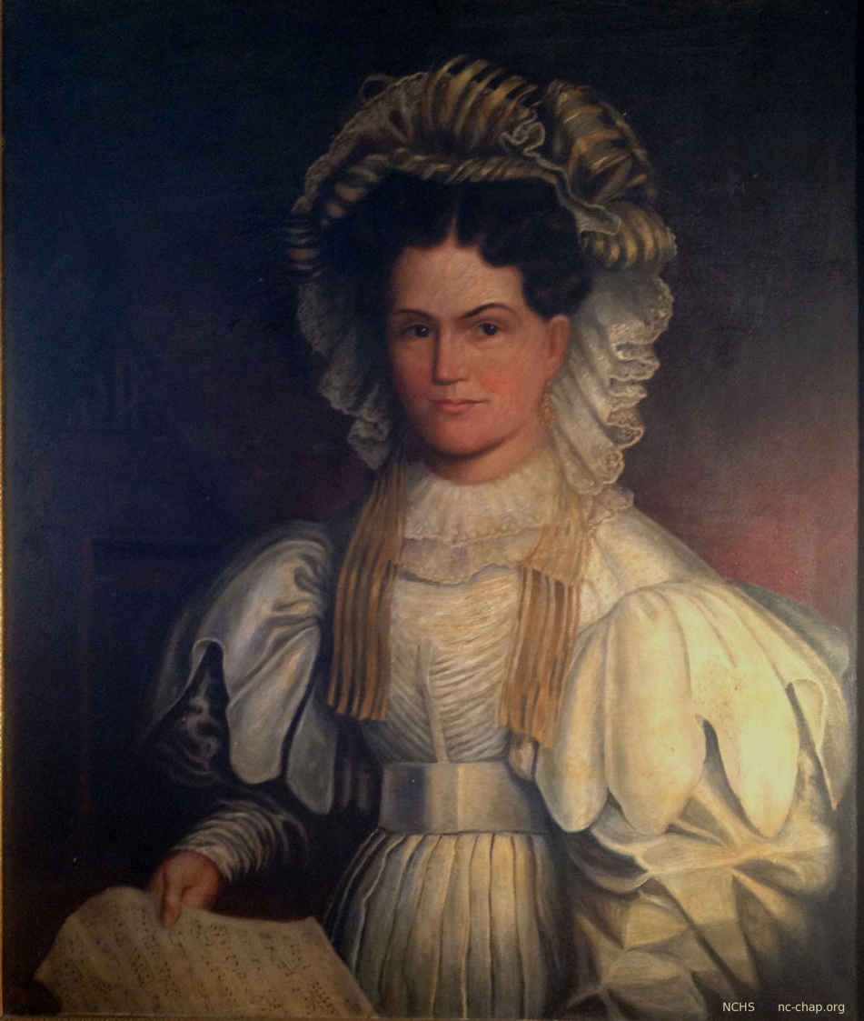
Dress styles of
Ann Clay Booth (1759-1846) and daughter-in-law Hannah Booth Jr. (1797-1857)
212 Delaware (”Booth House”)
222 Delaware (“David Finney inn”)

Slide 15
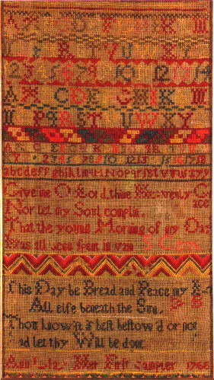
Sampler worked in 1766 at age 7 by Ann Clay
Give me O Lord thine Heavenly Grace
Nor let my Soul complin
That the young Morning of my Day
Has all been spent in vain
This Day be Bread and Peace my Lo[t]
All else beneath the Sun
Thou know'st if best bestow'd or not
And let thy Will be done
Ann Clay Her First Sampler 1766

Slide 16
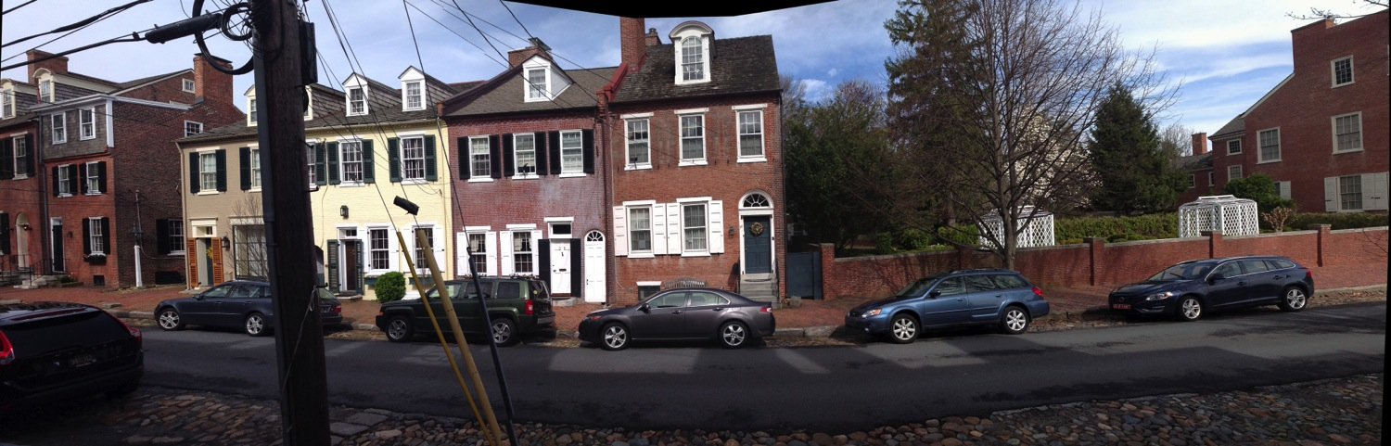
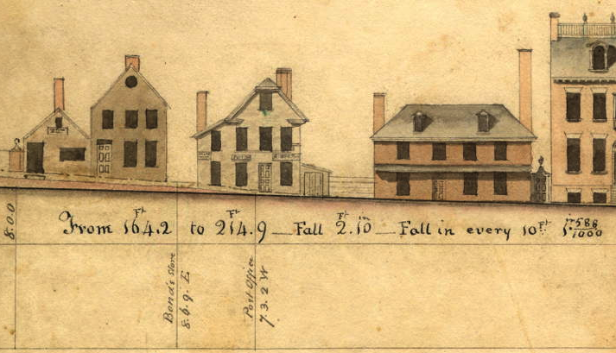
The Strand, 2014, 1803
~#24 (Thom. McKean) #30 Post Office G. Read Sr. G. Read Jr.

Slide 17
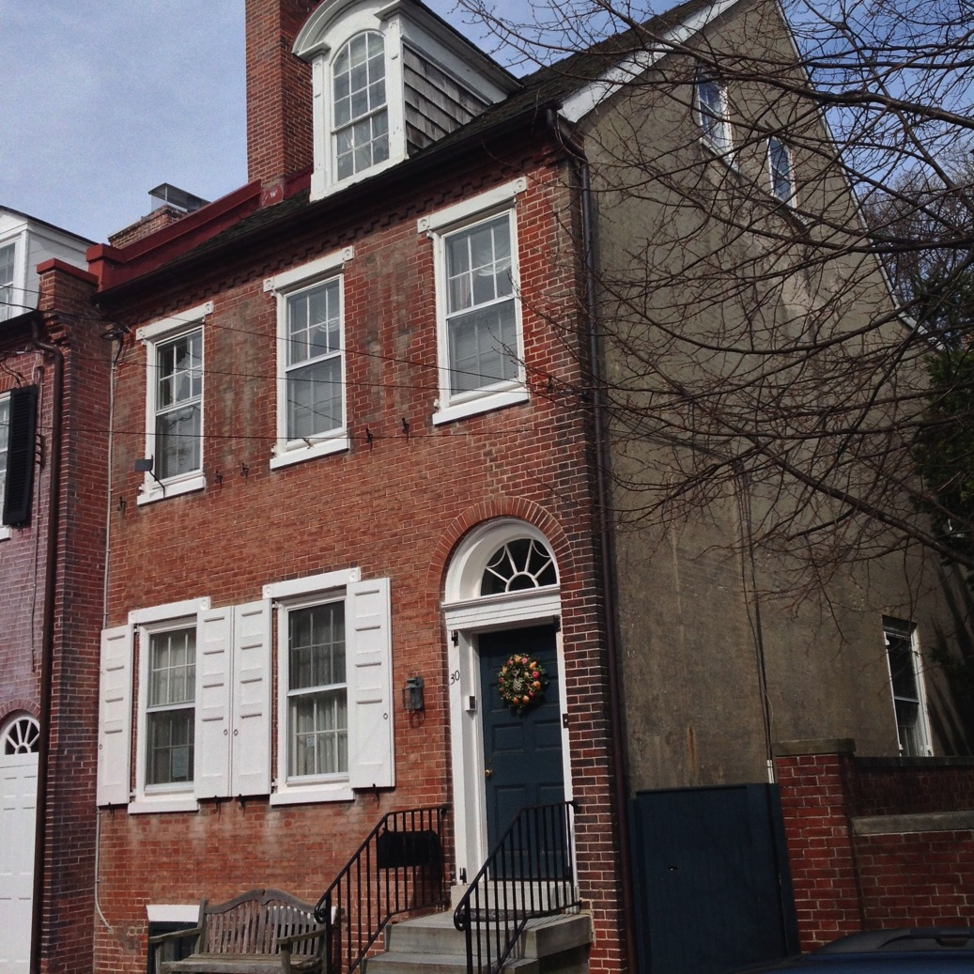
30
The Strand
(now)
Built by merchant James McCullough to replace his house burnt in the fire of 1824.
He also built the store and row of houses across the street at 25-31 The Strand.
Former residents:
Judge Bill Quillen
William Guthrie Esq.
Julia Jefferson
(before the fire)
Slator and Ann Curtis Clay,
Ann Clay Booth,

Slide 18
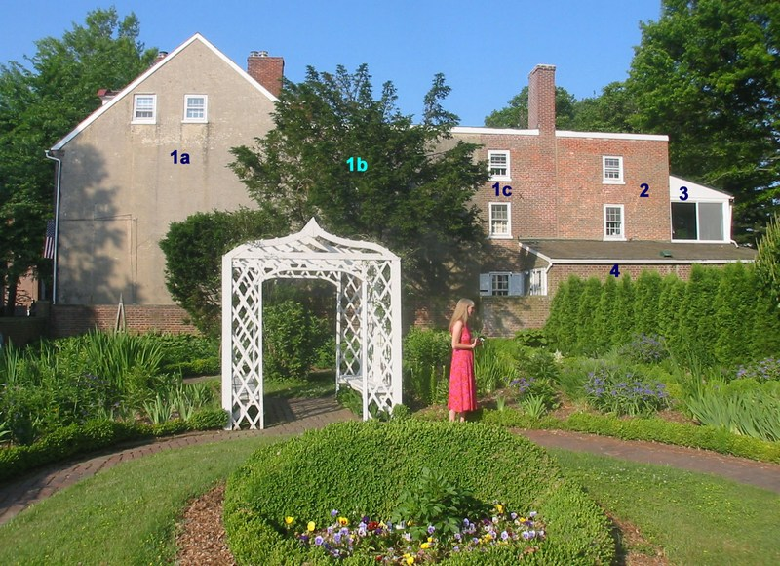
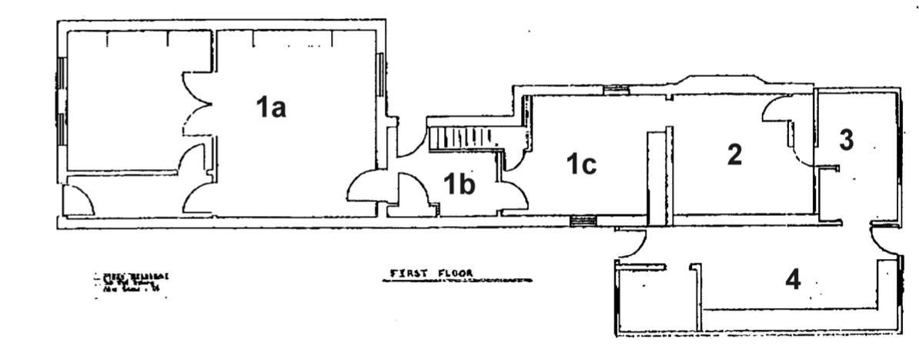
30 The Strand before the fire of 1824 was half the current size, but home to a family of up to 13 people and at least part of the first floor was a tavern.
We don’t know anything about room arrangement, location of the kitchen …
1824
c1860
c1960
c1670
Notes:
majewski

Slide 19

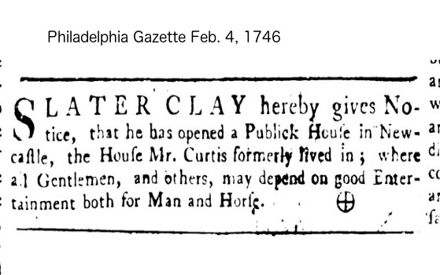
Ann Curtis Clay (1724-1789)
Mother of 13 including Ann Clay Booth, widow, ran tavern
Lived at 30 The Strand
Married Slator (Slater) Clay 1740 (d 1767)
Daughter Judge Jehu Curtis, Mary Brinckle

Slide 20
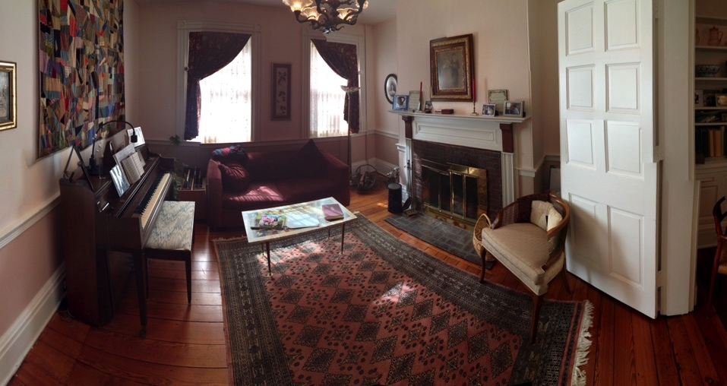
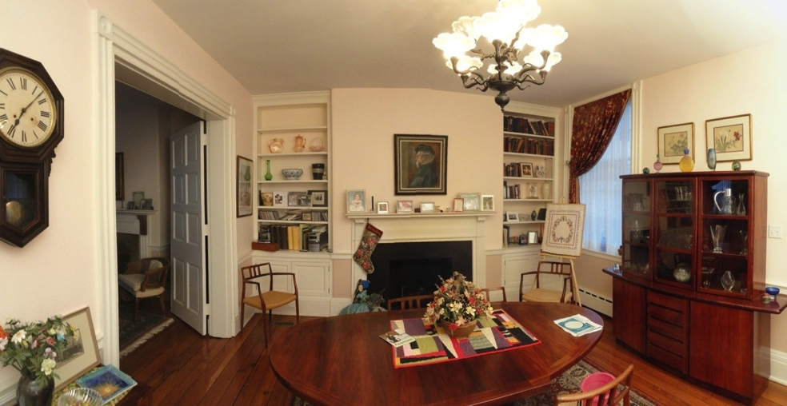
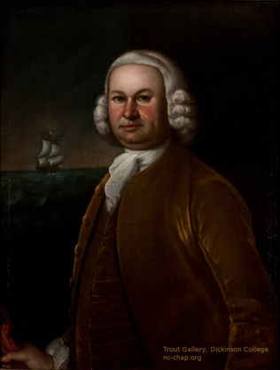
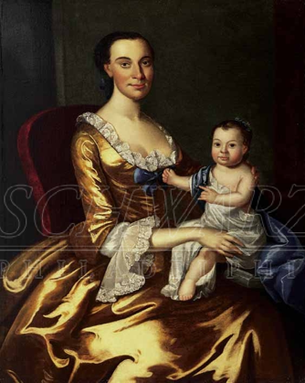

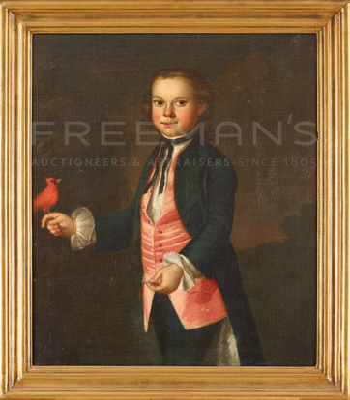
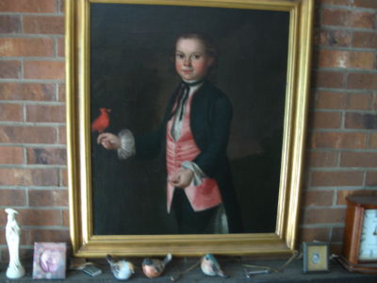
Slater Clay’s family. All painted by John Hesselius c1759.
http://nc-chap.org/portraits/slator_clay_jr.php

Slide 21
From Reminiscences by Elizabeth Booth, 1884, daughter of Hanna Booth Jr.
P 16, From what I can learn respecting my grandmother Clay
[Ann Curtis Clay], she must have been a woman of strong intellect and agreeable conversation. She possessed a business talent, enabling her to manage her property well and support her family during the revolutionary war, but was destitute of that extreme sensibility and tenderness of feeling that characterized my mother. It might have been from the circumstances in which she was placed. She was at that time a widow, her husband, Slator Clay, having died in 1767. As no goods were imported for some time previous to the war, articles of clothing were expensive and often difficult to obtain, and frequently people cut up what they could spare in the household to make garments…I have often regretted that my grandmother’s house was destroyed in the fire of 1824. I would like to view again the room my mother once showed me where my grandmother used to sit and read and write and adjust her accounts; and the large attic room, called Mount Racket, where the children were allowed to play and make as much noise as they pleased.

Slide 22
Class 5: People to 1850 --About Portraits. Age before beauty, [rank, wealth, family size, # portraits in NC, art vs representation….]
Peter Stuyvesant
Ann Clay BoothOP
Ann Curtis Clay
(11/13 living children)
Dorcas Montgomery Van Dyke Dupont
Mary Borden McKean
ThomasMcKean
Lorenzo Thomasdetails.php?wname=ann_curtis_clay
James McCallmont (1798)
Nicholas Van Dyke Jr. (1826)
http://nc-chap.org/census/riordan/tax1798.php
http://nc-chap.org/census/riordan/tax1826.php

Slide 23

Presidents (Washington, Jackson) and Vice presidents (Biden) have VISITED New Castle
Notes:
Talking about national rank and influence, not state governor, or judge -- more than you can shake a stick at. And you might want to.
Most people of national rank just passed through or visited (like Biden)

Slide 24



Thomas McKean (1734-1817)
Mary Borden McKean
(1744 -March 12, 1773)
Mary’s grave at main entrance to Immanuel Church
http://nc-chap.org/portraits/details.php?wname=thomas_thomas_jr_mckean

Slide 25

Brig. Gen. Lorenzo Thomas, U. S. Army
Adjutant General, 1861, Secretary of War “ad interim”, 1868
1804 Born in New Castle to Evan Thomas, Esq.
May have lived on E2nd
Attended New Castle Academy
Appointed to West Point by Sen. N. Van Dyke Jr., 1823 Graduated
1832 Married Elizabeth Colesberry (1806-1879) in New Castle, 9 children
1835 Served in 2nd Seminole war
1853 Chief of staff to commander of U.S. Army
1861 Adjutant General
1863 “Banished” by Sec. War Edward Stanton
Recruited and created black troops in MS.
He is “only fit for presiding over a crypt of Egyptian mummies like himself,””
1868 After Lincoln’s death, successor Andrew Johnson fired Stanton and replaced him with U. S. Grant, then Thomas.
(Read about Andrew Johnson impeachment)!
President Lincoln’s Recruiter: General Lorenzo Thomas and the United States COLORED TROOPS in the Civil War, M. Eggleston 2013
Notes:
Fueded with Stanton: said Thomas: only fit for presiding over a crypt of mummies like himself (he was 60) and a heavy drinker
Stanton was a radical republican (lincoln was moderate

Slide 26


Where did Gen. Thomas grow up in New Castle?
He was born in 1804 in New Castle to Evan Thomas, Esq. (1763-1836) who emigrated from Wales. They were apparently unrelated to Charles Thomas (of the current Episcopal parish house at The Strand & Harmony). He is shown in the census for NC from 1800-1830.
The Latrobe map of 1804-5 shows a brick “Thomas” house as the left half of a duplex a few feet from modern Plum Alley. This may be 136 E 2nd (Terry Gormley) but it needs to be checked out with title chains.
134-138 E 2nd
The N.H.R. inventory describes 134-138 E 2nd as “late 1700’s” . Note Georgian/Federal features: fan light or square transom, gabled roof, flemish bond, mostly symmetrical except for one door/alley.

Slide 27


Wealthiest people in New Castle
 | 1798 |  |  |  | 1815 |  |  |  | 1826
Last Name | First Name | Assessment |  | Last Name | First Name | Assessment |  | Last Name | First Name | Assessment
Baker (est) | Jacob | 7736 |  | Hand | Geo | 4668 |  | Vandyke Jr | Nichls | 2890
Stockton (est) | John | 2814 |  | Belvill | Jacob | 4045 |  | Booth | Jam | 2072
McCallmont | Jam | 2790 |  | Vandyke | Nichls | 3756 |  | Dickinson | Polly? Ann | 1950
Alexander | Archibald | 2727 |  | McCallmont | Jam | 3403 |  | Read II | Geo | 1866
Belvill | Jacob | 2466 |  | Gardner | Jn | 2997 |  | Guthrie | Wm | 1589
Riddle | Jas | 2400 |  | Booth | Jam | 2820 |  | Johns | Kensey | 1536
Johns | Kinsey | 2303 |  | Mundal | Jn | 2354
Booth | James | 2280 |  | Read II | Geo | 2269
Armstrong | Wm | 2257 |  | Barr | Robt | 2219
Keely (est) | Matthias | 2223 |  | Johns | Kensey | 2006
Megans | Thos | 2166 |  | Riddle | James | 1896
Darraugh | Jn | 2129 |  | Benett | Calib P. | 1869
Read sr I | Geo | 2105
Read jr II | Geo | 2071
http://nc-chap.org/census/riordan/

Slide 28
James McCallmont (1755-1824)
Owned the ferry monopoly
Physician, cofounder Med. Soc. De
Navy surgeon, Spanish POW
Lived at 56 The Strand
Painted by Thomas Sully (lost), and
“physiognotrace” by Saint-Memin
http://nc-chap.org/portraits/details.php?wname=james_mccallmont

Slide 29

Nicholas Van Dyke Jr. (1770-1826)
U. S. Representative (1807-1811)
U. S. Senate (1817-1826)
Trustee NCC

Slide 30





Does wealth bring happiness? Not for Nichs Van Dyke.
Born, grew up,
Amstel House
Built this,
400 Delaware
N VD Jr house
Built this,
300 Delaware
“Kensy Johns VD”
Built east half
The Hermitage
Senator Van Dyke disliked DC and sighed “for the shade of the Hermitage and the sweet .. course of domestic life” (1809).
He grew restless and put ads in the paper first to sell (1816), then rent his houses (1820). Built 300 Delaware in 1820, gave it to his son who died not long after. Nichs VD died in 1826 (at the age of 56)
http://nc-chap.org/resources/schroeder_hermitage.pdf - page=14

Slide 31

Ann Van Dyke Johns (1768-1839)
Lived at 2 E. 4th Street, 2 E 3rd Street
Married Kensey Johns Sr. (1784)
Children:
Fidelia (1785-1871)
Ann (1787-1874)
Susannah Stewart (1789-1862)
Kensey Jr (1791-1857)
John Johns (1796-1876) estranged?
Van Dyke (1798-1801) estranged?
Henrietta (c1800- 1837, m c1820, 1823) disowned*
Henry Van Dyke (1803 -1859)

Slide 32

Kensey and Ann Van Dyke Johns in Amstel House parlor.
They lived in this house while their house on the Green was being built.
On the table, in addition to the tea service is a snippet of her non-white wedding gown.

Slide 33


Slide 34

John Johns (1796-1876)
Estranged son of Kensey and Ann Johns?
Bishop of Virginia,
President W&M,
President Va. Theol. Seminary
John Johns was a respected and loved minister who served in Maryland and Virginia. Although he was born (July 10, 1796) and grew up in New Castle, his entire adult life was spent outside the state.
Bishop John apparently did not let others know of his distinguished and wealthy father.
http://nc-chap.org/portraits/details.php?wname=john_johns

Slide 35

What son of a prominent resident was an opium dealer and diplomat?
William Reed (1767-1846)
Consul General, Kingdom of Naples
Opium merchant with China
http://nc-chap.org/portraits/details.php?wname=william_read

Slide 36




What FOUR people who lived or worked in New Castle signed the Declaration of Independence?

Slide 37
What FOUR people who lived or worked in New Castle signed the Declaration of Independence?
George Read Sr., Thomas McKean, (DE), George Ross, (PA), Francis Hopkinson (NJ) ,

Slide 38












Some Faces in the New Castle Area --- by painter
H. Couturier? <1663
G. Hesselius c1712
J. Hesselius c1759
Peter Stuyvesant Tobias Bjork Anna Dorothea Finney Ann Curtis Clay Slator Clay
Charles Willson Peale
1787, 1804
Rembrandt Peale c1815
Sarah Miriam Peale?
Thomas, Thomas Jr. McKean Benjamin Latrobe Benjamin Latrobe John Johns
Charles St. Memin
Samuel Sartain <1811
Gilbert Stuart 1816
Thomas Sully 1832
James McCallmont George Read II Thomas Macdonough Dorcas Van Dyke Dupont

Slide 39
Next Week
Oct 11 - Class 6: People to 1950
Video interviews with people who remember:
trollies, gas lights, ice skating to NJ, dances in the Opera House,
the whipping post, hired help living in a 10' x 12' cabin,
working (and dieing) in local steel mills,
immigrating from Italy in the 20's then becoming American,
shad fishing and life on the waterfront and the Laird yacht basin

Slide 40


Erik Björk, pastor of Cranehook & Old Swedes Church
By Gustaf Hesselius
Erik Björk was one of the three Church of Sweden priests sent to America in 1697 to revive the churches and serve the remaining Swedes on the Delaware.
While initially pastor at Crane Hook, he supervised construction of Holy Trinity (Old Swedes’) Church in Wilmington and was pastor there from 1697 until 1713.
Portraits of him and his wife Christina Stalcop were painted by Gustaf Hesselius around 1712.
Hesselius lived in ‘Wilmington’ from 1711-1717, then PHL and MD where he painted ‘first American painting to depict a ‘scene’ (vs portraits)

Slide 41







ADIONC-1931
Portraits of the
Van Dyke Family
Of New Castle
Nicholas Van Dyke
John Crawley, 1813
John Crawley, 1813
Jefferson Davis(d)
Chalfant >1900?
Jacob Eicholtz
Jacob Eicholtz, 1825
Mary Van Leuvenigh Van Dyke
Nicholas Van Dyke, Jr.
Ann Van Dyke Johns Kensey Johns, Sr.
Thomas Sully, 1832
---
Sara Miriam Peale?
Dorcas Montgomery Van Dyke Dupont
Kensey Johns, Jr. John Johns

