Slide 1
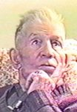
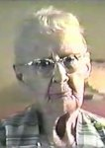
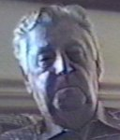
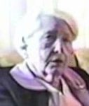
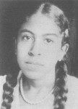
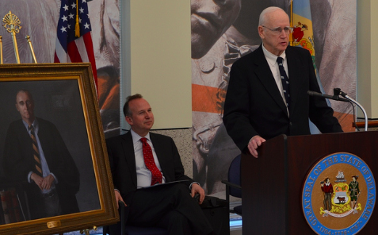
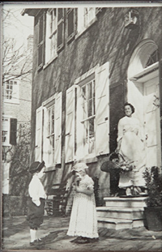
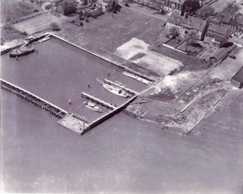
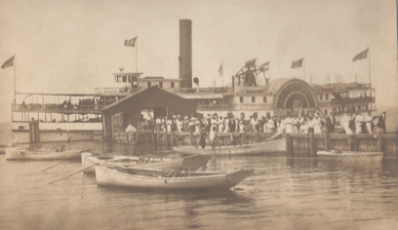
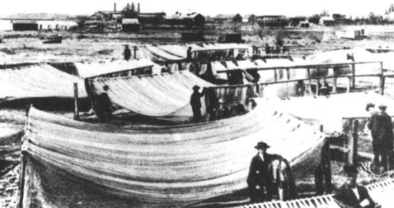
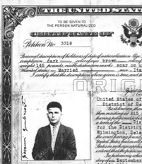
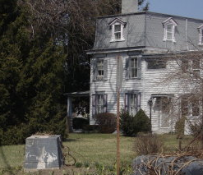
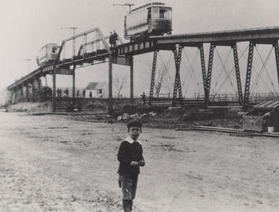
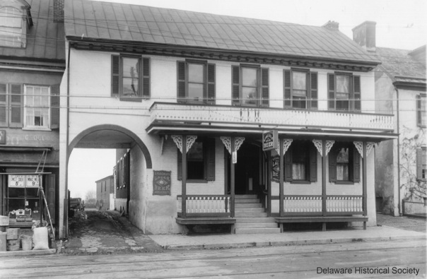
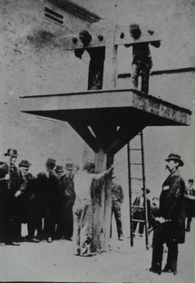
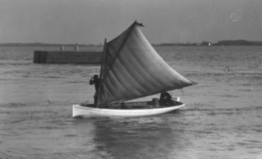
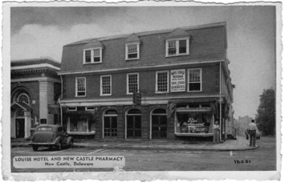
Oral Histories: Video interviews with people who remember these scenes:
John Gambacorta: coming to America, getting work, starting an auto business
Agnes Hewlett Megginson: Trolley (& bridge), school, whipping post, Gilpin House
Hugh Ryan: Shad fishing, Ft. Casimir, yacht basin, waterfront, Bull Hill area, playing hookey
Frances & Henry Haut: Bellanca, Courthouse, Wharf area, Delaware Street
Gladys Green Clark– Growing up black in New Castle
Bill, Marcia, Carol, Tracy Quillen: Prominent people who lived at 30 The Strand {no interviews}
Links: http://nc-chap.org/oralhistory/

Slide 2
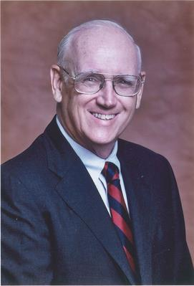
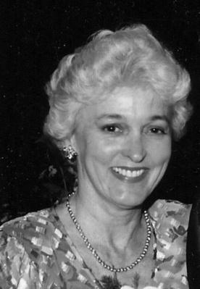
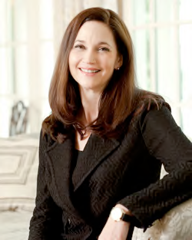
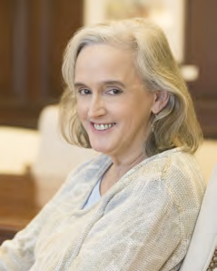
The Quillen Family
Residents of 30 The Strand 1970-2003
William T Quillen
1935-2016
Chancellor,
Del. Supreme Court,
Democratic Candidate for Gov.
Marcia Stirling Quillen
1937-2015
Director of Development, Wilm. Friends School
Development office, UD,
Elder N.C. Presby. Church,
choir member,
Headstart,
Delaware Adolescent Program,
Center to Prevent Handgun Violence,
Board of YMCA of Wilmington
one of the first two non-Quakers to serve as Trustees for Wilm. Friends School
Carol Quillen
(1961-
First female President,
Davidson College
Tracey Quillen Carney
(1963-
Administrator
Wilmington Friends (15y)
First Lady of Delaware (2017—
Focusing on efforts to help children succeed

Slide 3
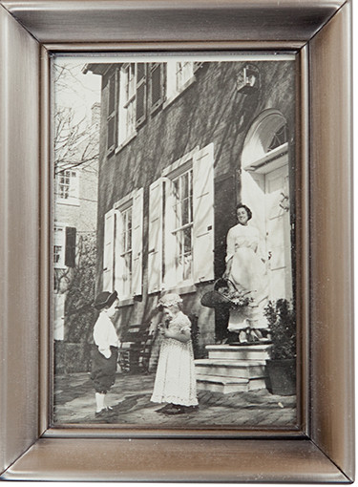
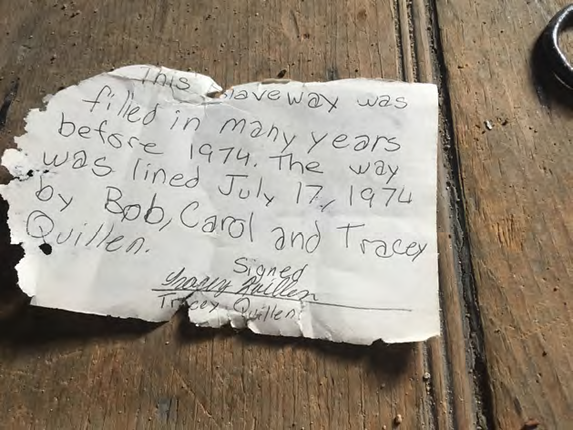
The Quillen girl’s childhood in New Castle
Carol participating in ADIONC with cousin Bob at 17 The Strand in the 60’s
A note left by 12 year old Tracy under
an attic trapdoor that she said was a “slaveway”. Neither she nor her mother remember anything about it.

Slide 4
Next Week: Class 7: The Civil war
Lincoln's map of slave ownership
(North) Regular army volunteers, "colored troops", "colored sailors", "witnesses to war”
(South) Rev. John Johns, Col. John Lambson, husbands of George Read III daughters
Diary of Ann Read Reeves, a New Castle woman who went to the South.
Military rule in New Castle
Julia Jefferson, Angel of Mercy
McCrone Pic Nic
What New Castle boy became Adjutant General under Lincoln, then (briefly) Secretary of State

Slide 5
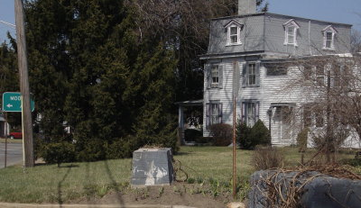

Slide 6
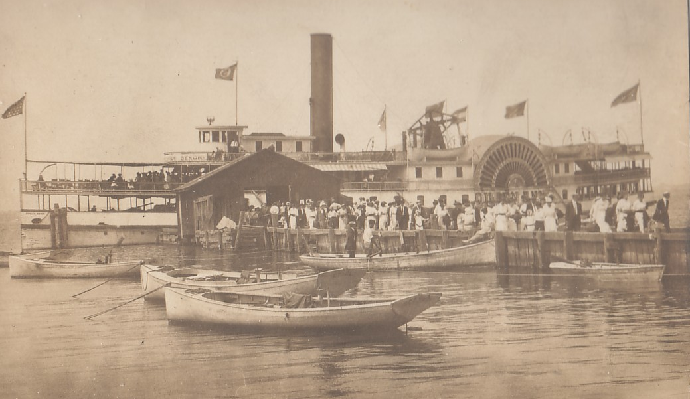

Slide 7
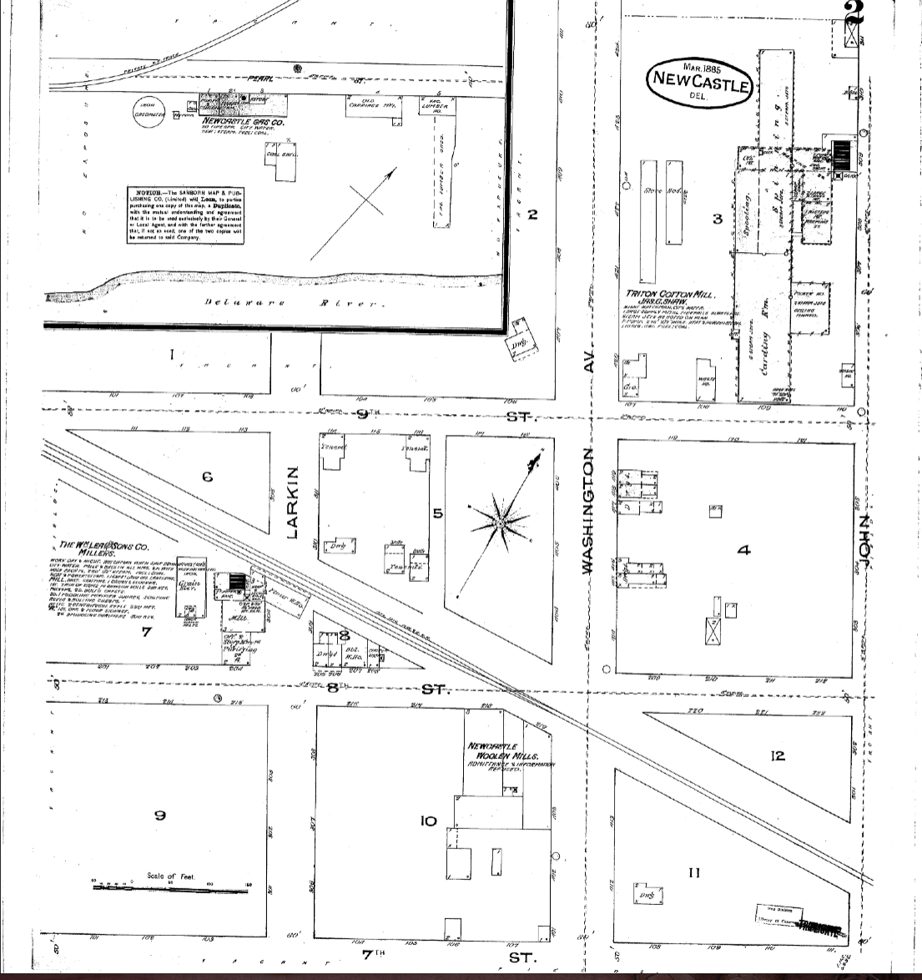

Slide 9
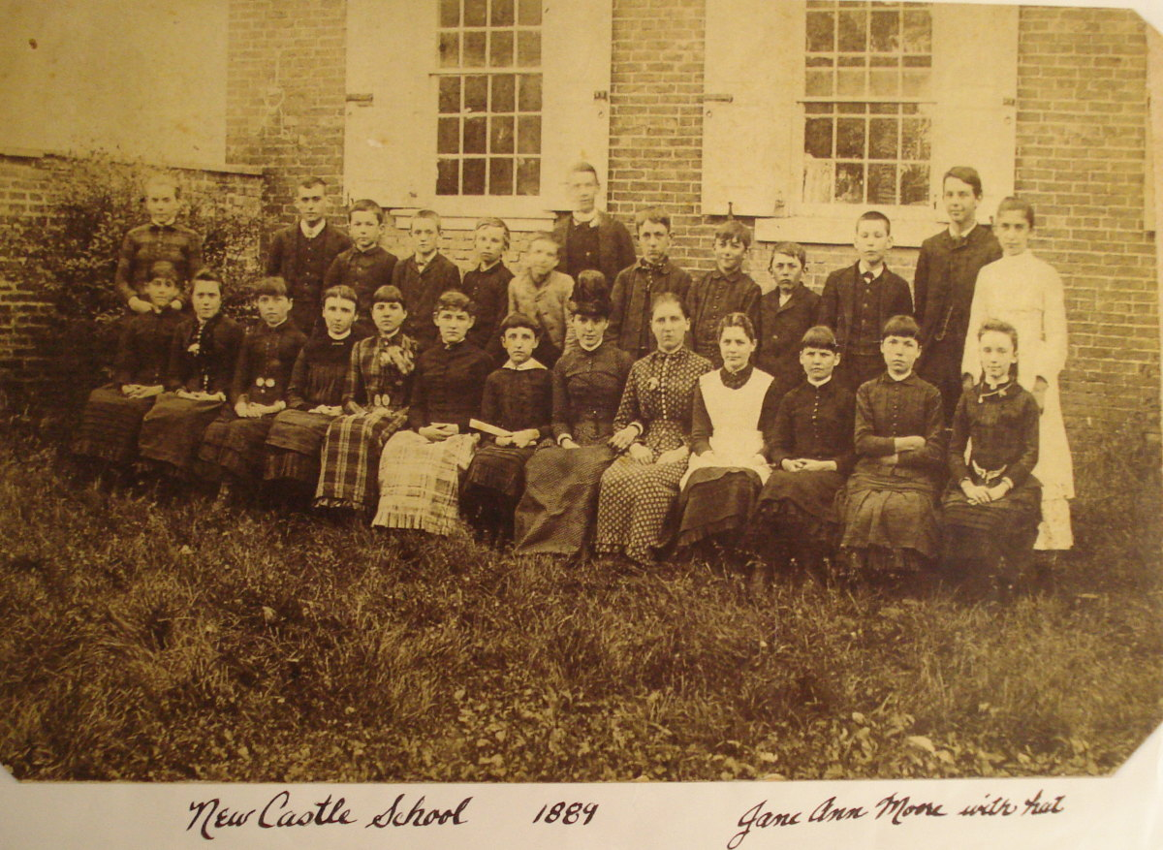
academy

Slide 10
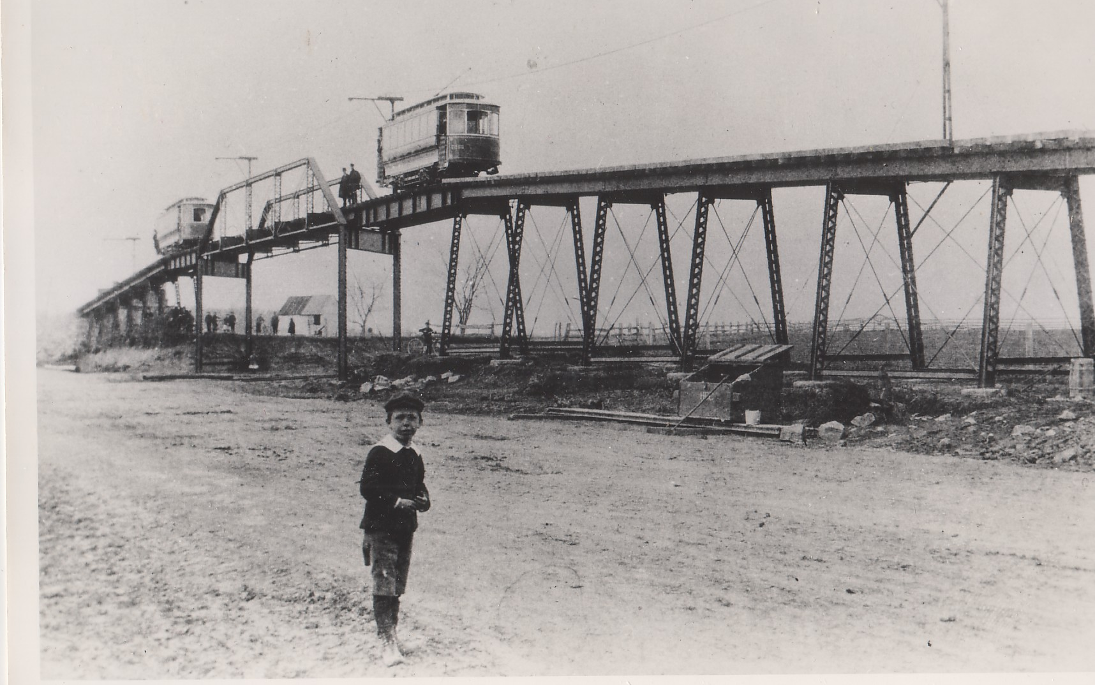

Slide 11
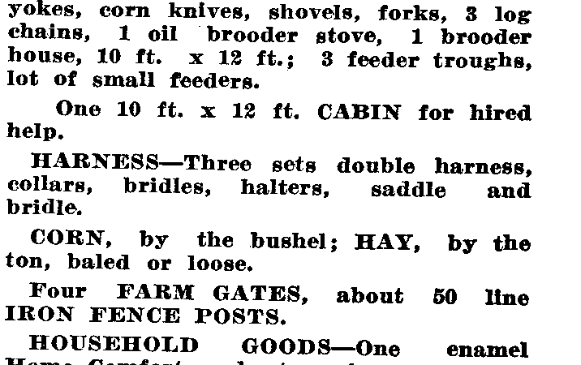

Slide 12
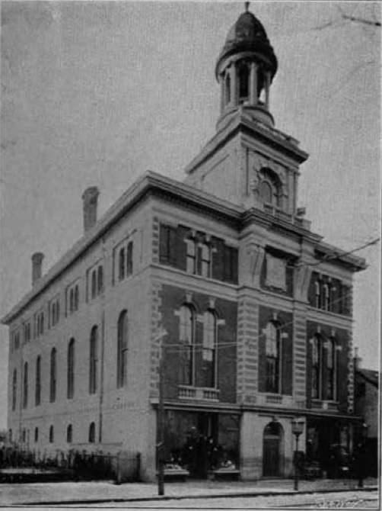
Opera House,
1899

Slide 13
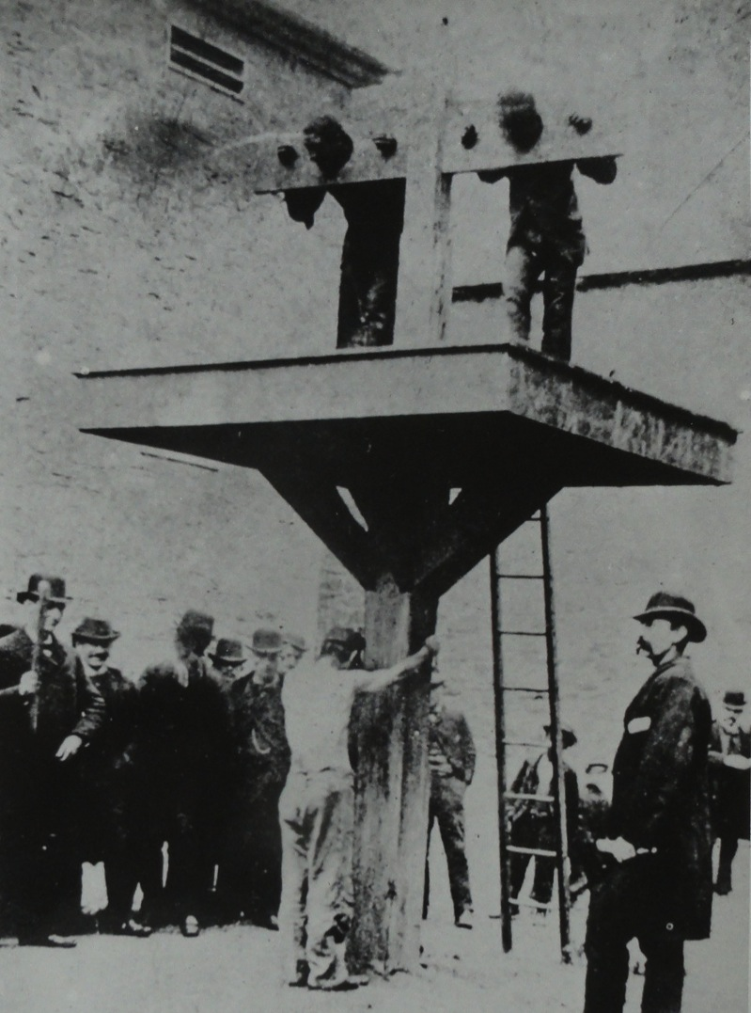

Slide 14
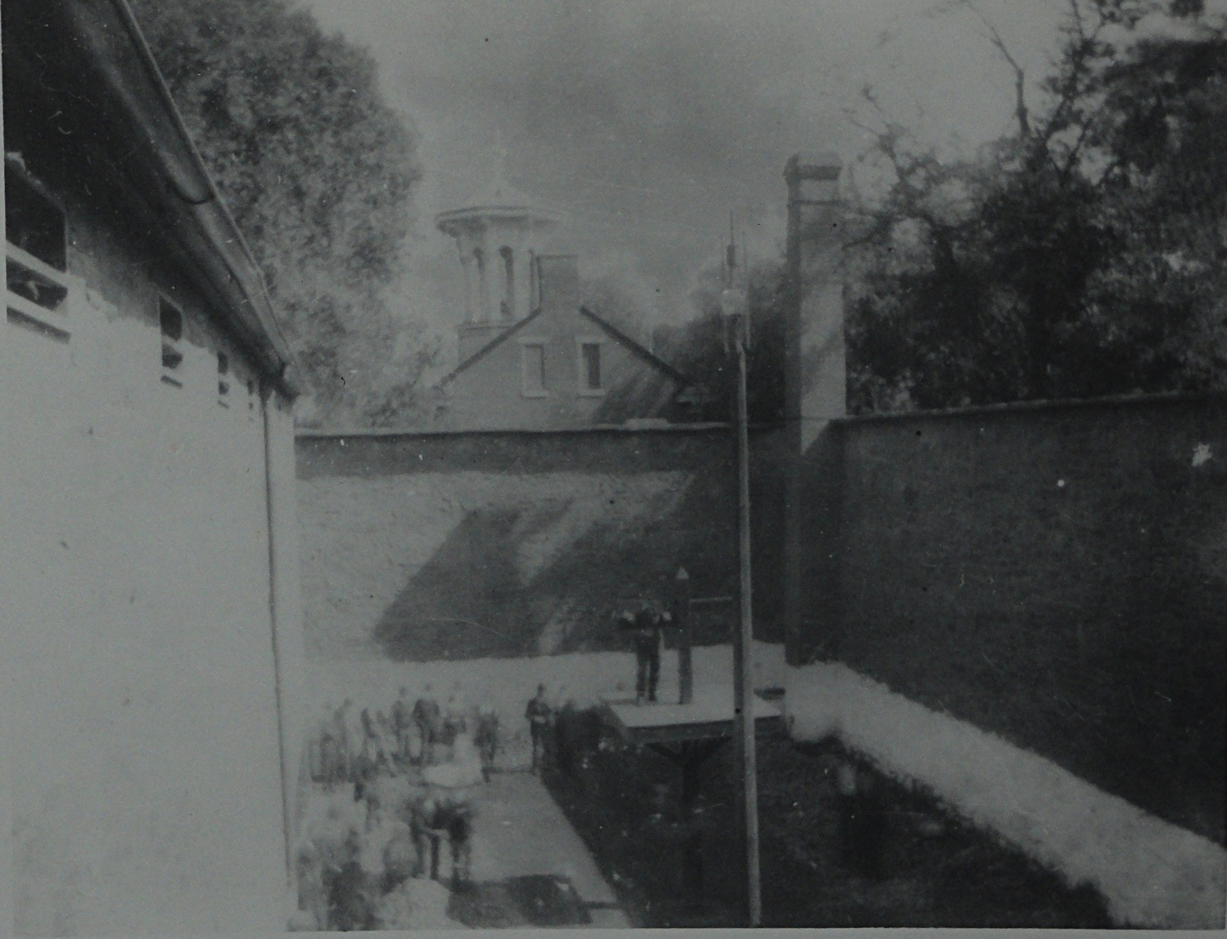

Slide 15
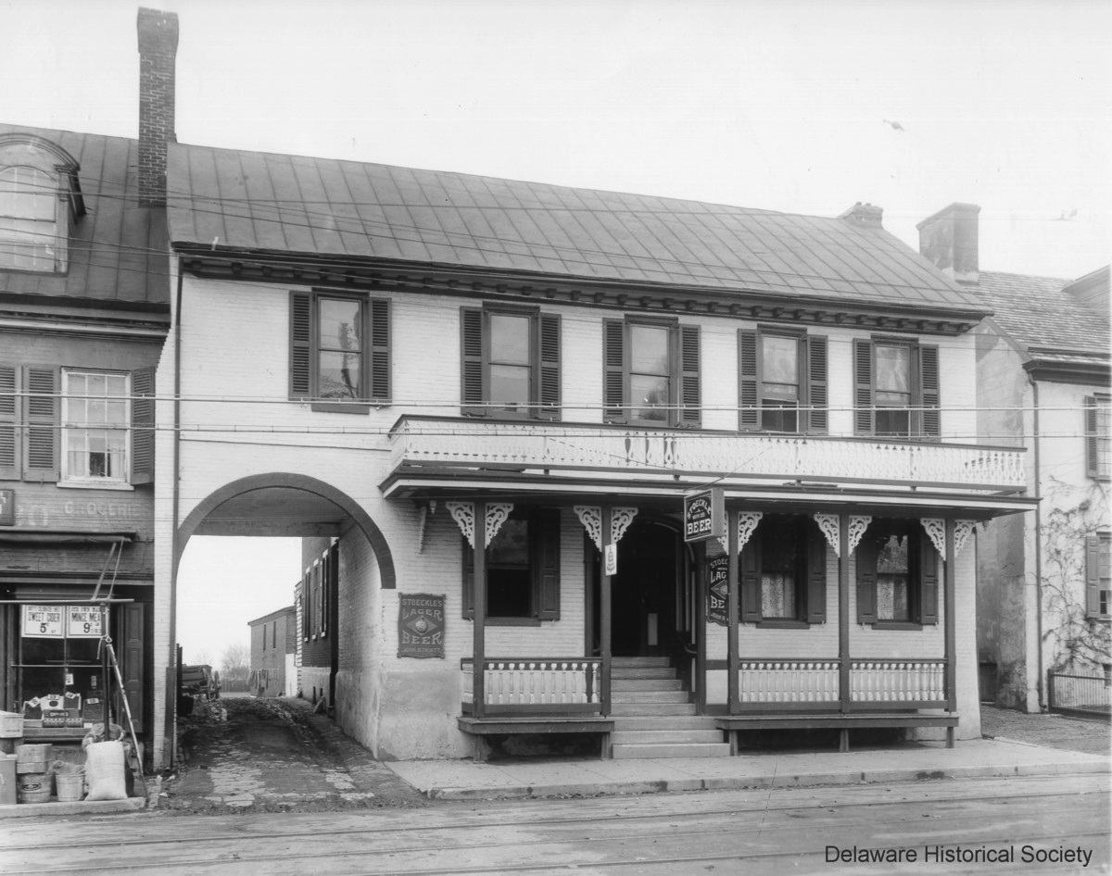

Slide 16
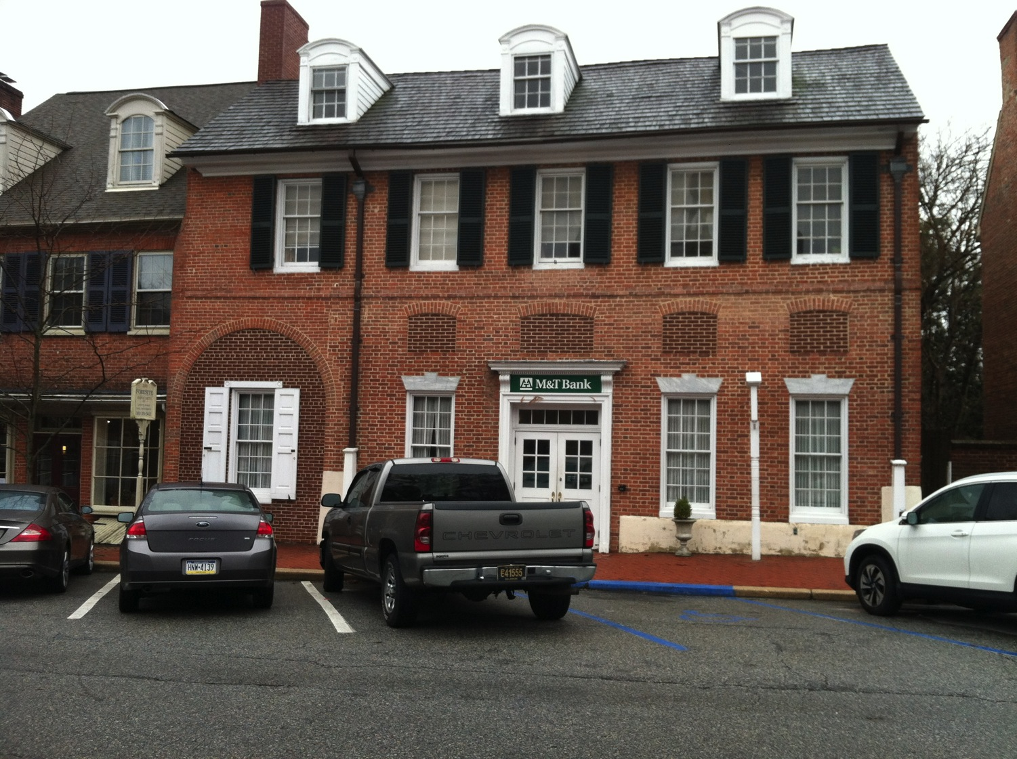

Slide 17
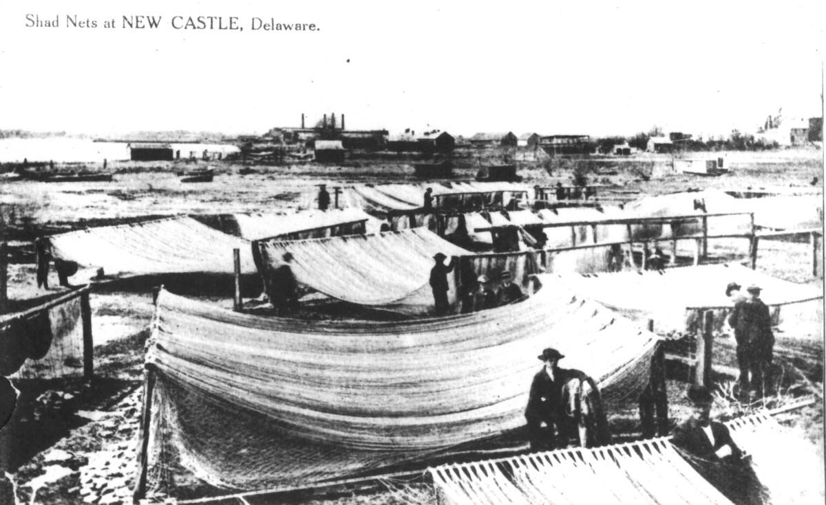

Slide 18
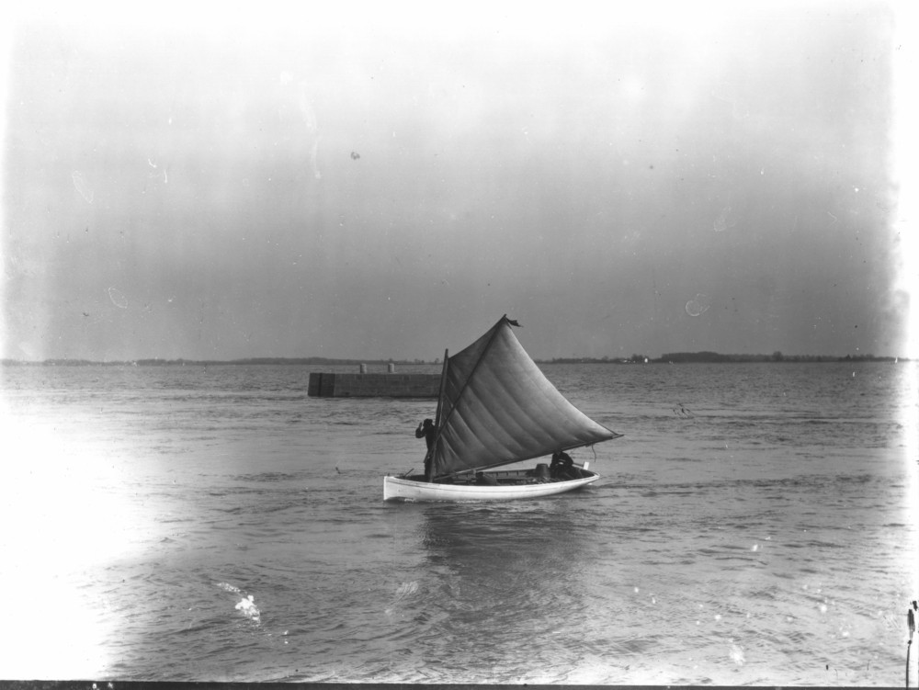

Slide 19


Slide 20
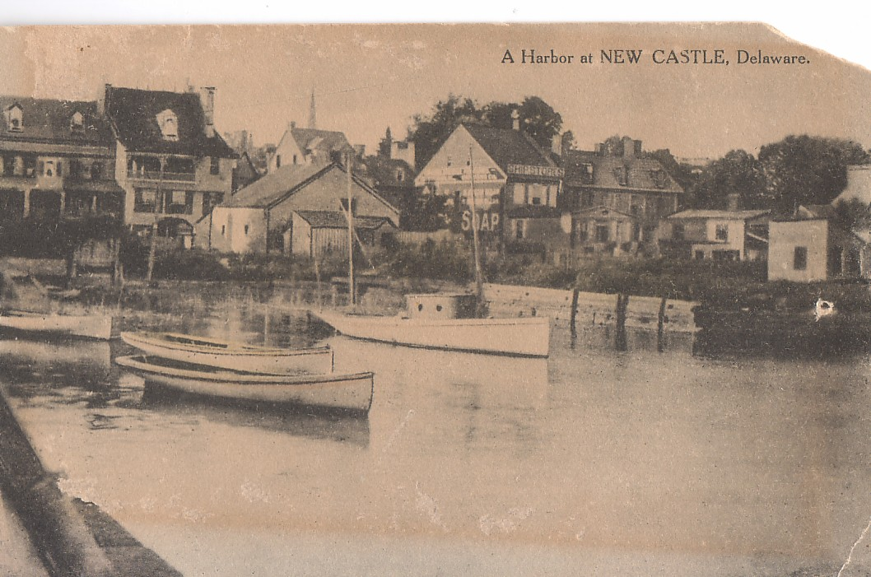

Slide 21
