Slide 1
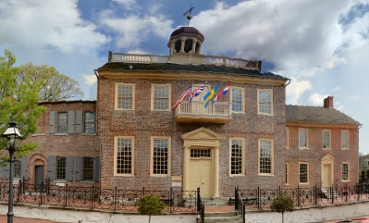
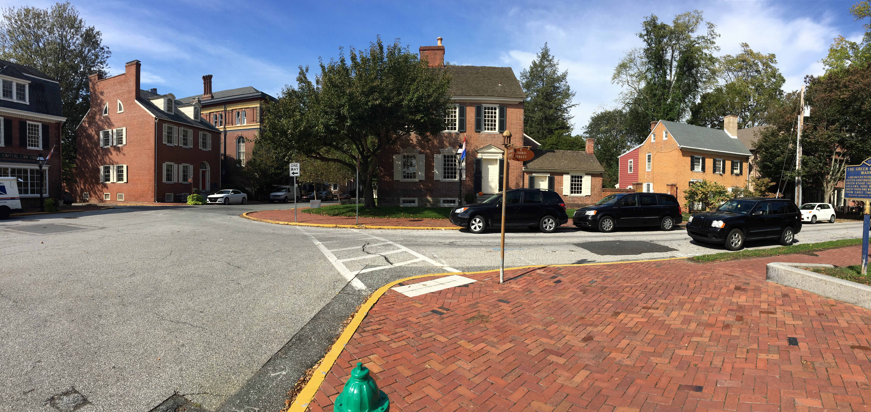
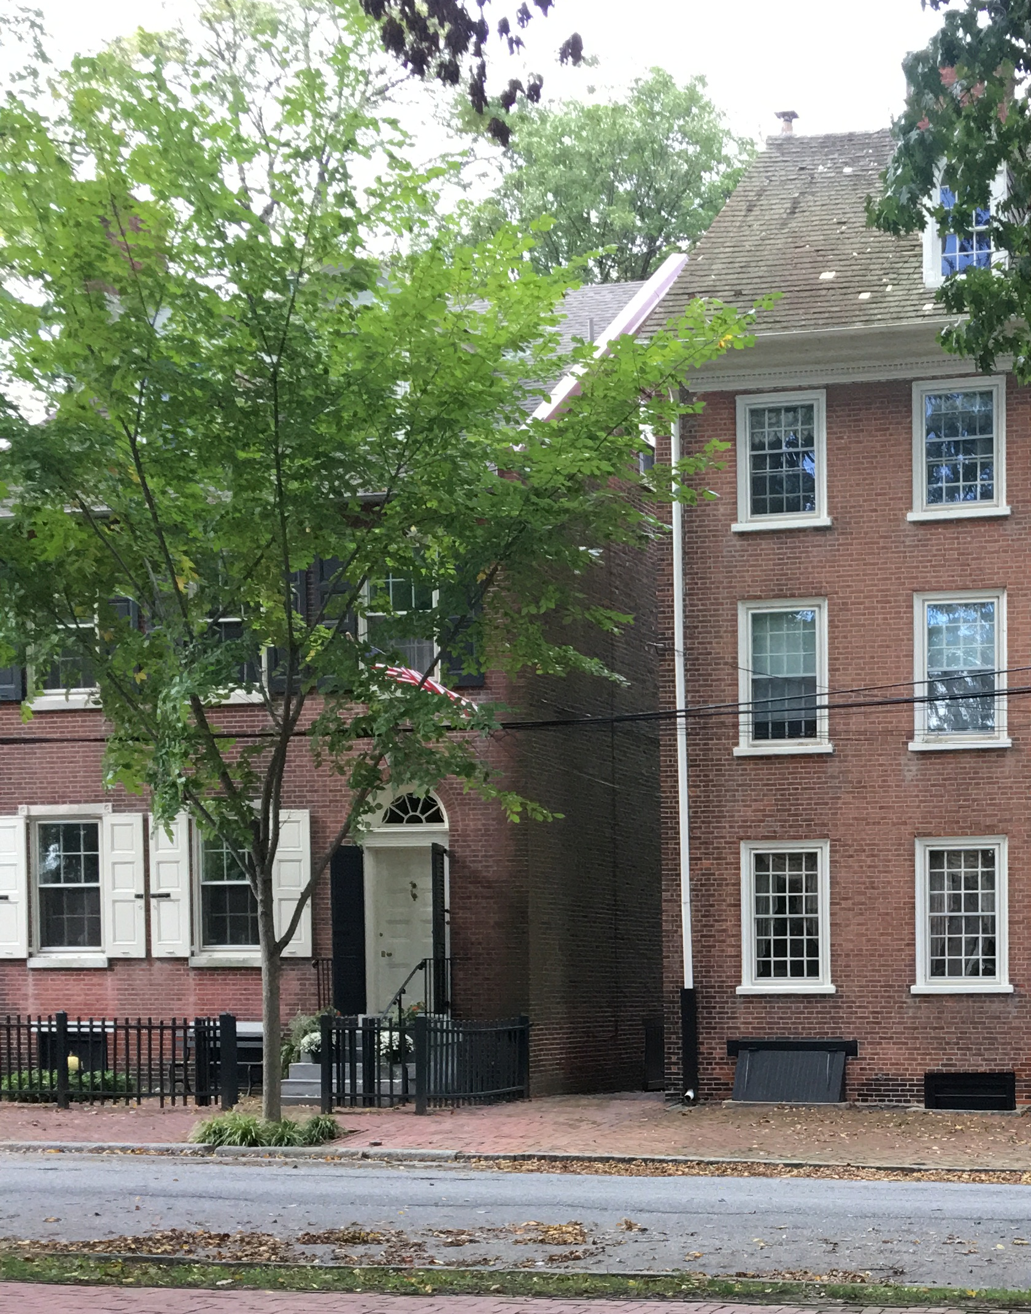
The Civil War; National and local items from 3rd & Delaware:
Garrett trial & fugitive slaves, (U.S. Supreme Court Justice Taney & DE Justice Jas. Booth Jr.)
Election in 1863; voters sign allegiance, enter under crossed bayonets; >99 % boycotted;
Home of N Van Dyke Jr. voted against Missouri Compromise
Boyhood home of John Johns, who was battlefield chaplain to confederate troops
“Little Yellow house”: 1860, 1870 home of woman who refuses to sign ‘’Lincoln’s oath of allegiance”, flees to slave plantation in Ark.
Graffiti “Vicksburg Surrenders, July 4, 1864” in window
Home? of Zachariah Gemmill earned govt. bounty for capture of member of Lincoln assasins
Panoramic view http://nc-chap.org/panoramas

Slide 2
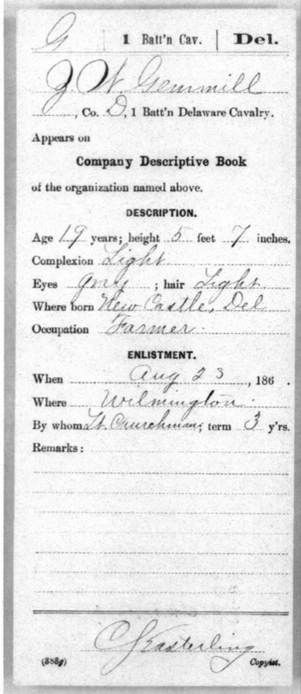
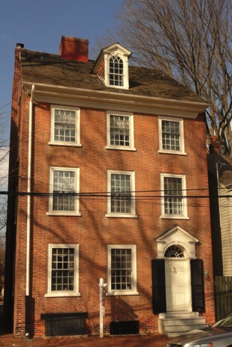
Sgt. Zachariah Gemmill
(1843-1922) Co. D. 1st Batt. Del. Cavalry
Gemmill was awarded $5,000 for the capture of one of the consiprators in the Lincoln assination conspiracy. Although German born George Azerodt was supposed to kill V.P. Johnson on April 14, at the same time as the Lincoln assassination, Azerodt could not do so. Instead he fled away from Booth, to the Northwest.
18 E 3rd
Gemmill House a.k.a Wiley House
Gemmill was sent to search for Azerodt at about 4 a.m. on April 20th
at the house of a man named Richter.
Richter denied any strangers were in the house, but Gemmill entered and found Azerodt.
Notes:
Enlisted at age 19, 5’7” light complexion and hair for three years. Listed as “farmer”

Slide 3
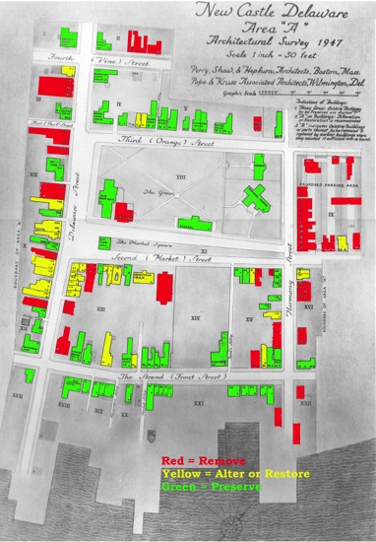
Where did Gemmills live?
18
E 3rd.
It’s known as the Gemmill house in town.
#18 and #20 Third Street report by
Jeanette Eckman, c1949:
  1801 Built for John Wiley by Peter Crowding
  c1824 owned by Jeremiah Bowman
  later Gemmill family
  Now (c1945) owned by Willliam E Myers,
  son-in-law of Mrs. Zachariah Gemmill
1860 Census does not show Gemmill near other E3rd residents.
John Wiley House report by Susan Williams, 1988
  c1800 John Wiley
  Died 1842, mortgage assigned to James Garland,
  then Jeremiah Bowman, died intestate in 1849.
  1902 William Myers bought from estate.
Some
Place
else

Slide 4
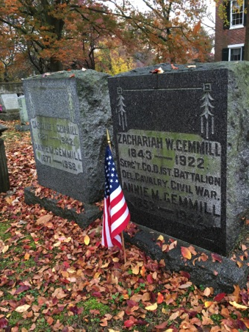
Zachariah W. Gemmill
1843-1922
Serg’t Co. D 1st Battalion
Del. Cavalry, Civil War
Where did he live?
1860 Census, New Castle City – Zachariah Gemmill Sr., Jr.,
They probably do not live on Green based on adjacent residents
1608 30 559 569 Hizar Thomas 26 M W Pa Master Bricklayer 200 350
1609 31 559 569 Hizar Caroline 24 F W Pa
1610 32 559 569 Hizar Lamus 4 M W Del
1611 33 559 569 Hizar Aquilla 24 M W Pa Bricklayer
1612 34 559 569 Taylor Benjamine 23 M W Pa
1613 35 559 569 Twigs James 25 M W Pa
1614 36 559 569 Allen Theodore 17 M W Del
1615 37 559 569 Bertrant Matilda 10 F W Pa Domestic
1616 38 560 570 Gemmill Zachariah 46 M W Del Deputy Sheriff 150
1617 39 560 570 Gemmill Anna M 46 F W Md
40 570 560 Gemmill Zachariah 16 M W Del
1618 2 560 570 Gemmill Elizabeth 13 F W Del X
1619 3 560 570 Gemmill James 8 M W Del X
1620 4 560 570 Gemmill David 6 M W Del
1621 5 560 570 Cork Julia 12 F B Del Servant
1860 Census, New Castle Hundred– are Gemmill farmers, but no Zachariah
924 10 150 152 Gemmill David W 51 M W Del Farmer 70,000 1,000
925 11 150 152 Gemmill Elizabeth 42 F W Pa
926 12 150 152 Gemmill Jane 22 F W Del
927 13 150 152 Gemmill Martha 19 F W Del
928 14 150 152 Gemmill James 16 M W Del X
929 15 150 152 Gemmill Virginia 10 F W Del X
930 16 150 152 Gemmill Charles 8 M W Del X
931 17 150 152 Gemmill Frank 6 M W Del

Slide 5
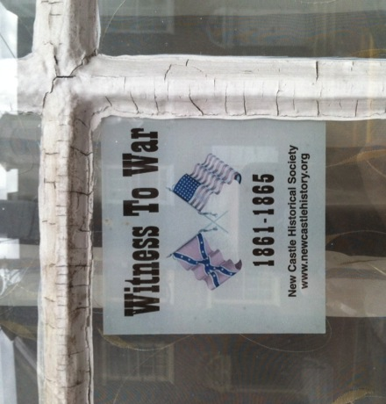
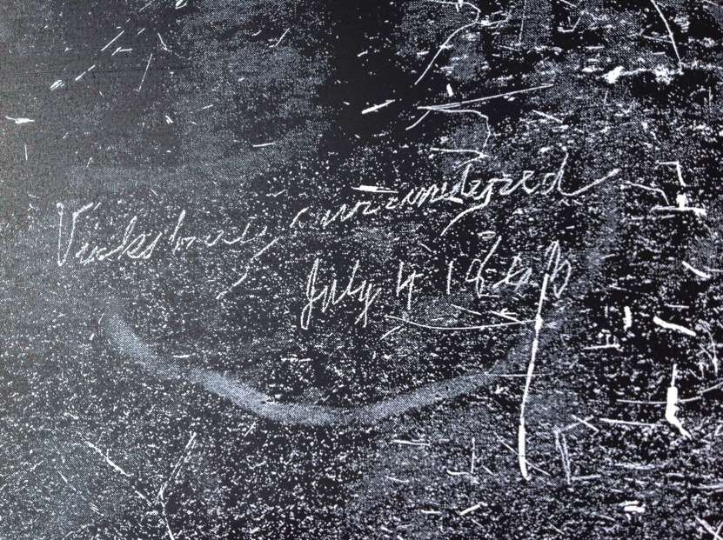
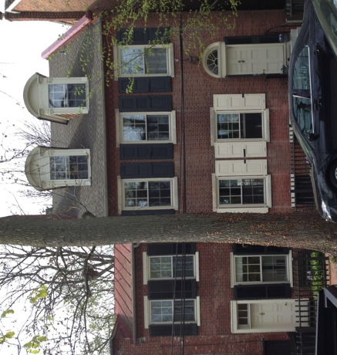
Witness to War (1861-1865)
Vicksburg surrendered
July 4, 1863
Scratched in a 2nd floor window at 16 E 3rd.
(G.B. Rodney house) Courtesy R. Cooch
Notes:
Maybe 40% of the houses in town built before 1865; many more by people who lived dthrough the war.
In May and June of 1863, Maj. Gen. Ulysses S. Grant’s armies converged on Vicksburg, investing the city and entrapping a Confederate army under Lt. Gen. John Pemberton. On July 4, Vicksburg surrendered after prolonged siege operations. This was the culmination of one of the most brilliant military campaigns of the war. With the loss of Pemberton’s army and this vital stronghold on the Mississippi, the Confederacy was effectively split in half. Grant's successes in the West boosted his reputation, leading ultimately to his appointment as General-in-Chief of the Union armies.

Slide 6
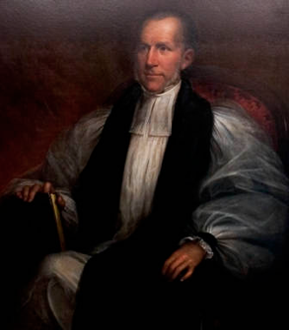
Citizens of Delaware who Served the Confederacy
Johns, John S.; Confederate chaplain and Episcopal bishop; 4th Bishop of Virginia who swore in Confederate President Jefferson Davis at the inauguration on February 22, 1862 and General Robert E. Lee into the Episcopal church. Born July 10th, 1796 in New Castle County, Delaware and died April 5th, 1876 in Fairfax County, Virginia (reference: Kensey Johns Family Bible). He had two sons who were officers in the Confederate army. His mother, Ann Van Dyke Johns, was the daughter of former Delaware governor, Nicholas Van Dyke.
Lambson, John Reed; 2nd Maryland Infantry, Co. "B". Colonel C. S. A
http://www.descv.org/DelawareConfederates.html

Slide 7
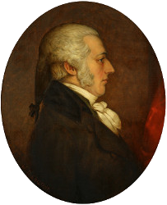
Sen. Nicholas Van Dyke Jr. on Slavery
1786, age 16, essay at Princeton College
Liberty and peace are inestimable blessings which are desired by all nations and individuals of every rank…. all persons are entitled to these blessings…
What then can make the Americans so desirous of kidnapping and reducing to slavery the faithful inhabitants of Africa?
January 1820, age 50, Vote in U.S. Senate “on the amendment offered to a bill for the admission into the Union, prescribing the restriction of slavery as an irrevocable principle of the State Constitution”.
I must vote against that amendment.

Slide 8
The “Read Birds” – the six daughters of George Read III
Five married military men; three of them or their husbands had ties to the South
Mary Anne Read (1811-1857) 1844 m James Martin Esq. of North Carolina (1819-1878), West Point, Major USA, Major Gen. CSA
Louisa (1814-1840) 1838 m Colonel Benjamin K Pierce USA (1790-1850)
Annie Dorsey Read (1818-1900) m Isaac Reeves USA of South Carolina (1818-1851) West Point. During the war she moved to Rossmere estate in AK (joint venture of GRII & brother GR IV). Her diary reveals deep attachment to the South.
Caroline Read (1820-1884) m Maj Gen William H. French USA (1850-1881), West Point
Julia Rush Read (1827-1908) m Maj. Gen. Samuel Jones CSA of VA (1819-1887), West Point
Emily Read (1829-1910). Never married. Writer: Two Hundred Years Ago: or, Life in New Sweden (1876) and novellas
Courtesy Florence Davies, NCHS, R. Cooch, R. Davis

Slide 9
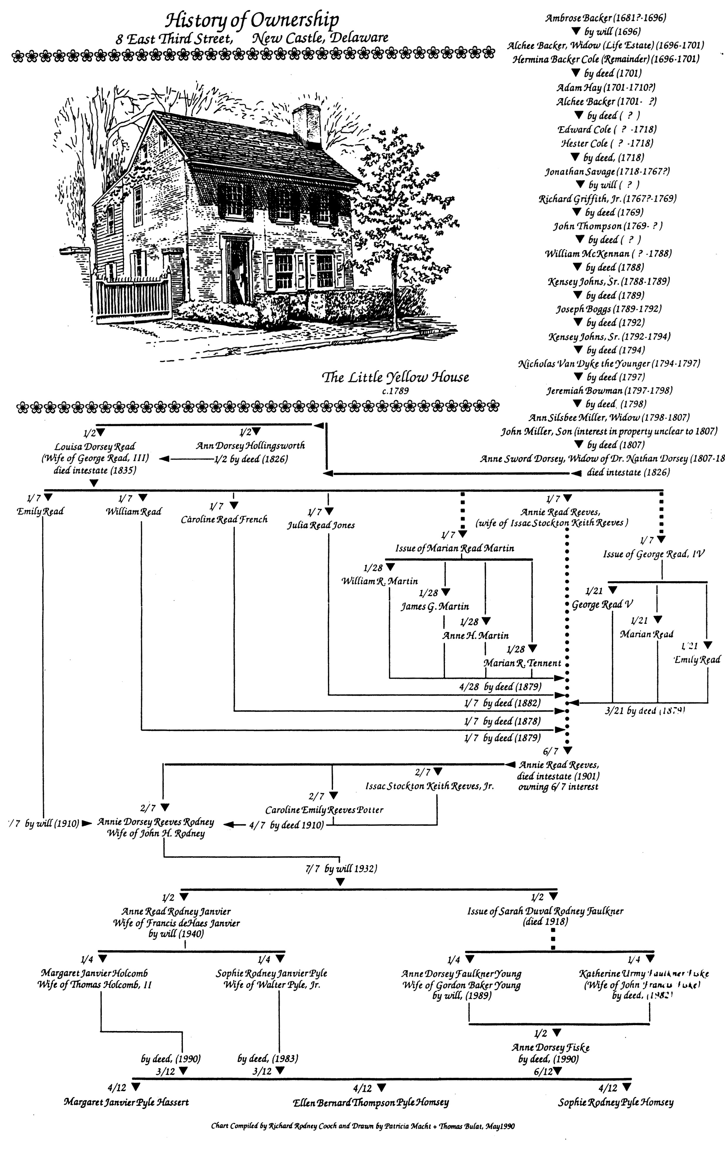

Slide 10
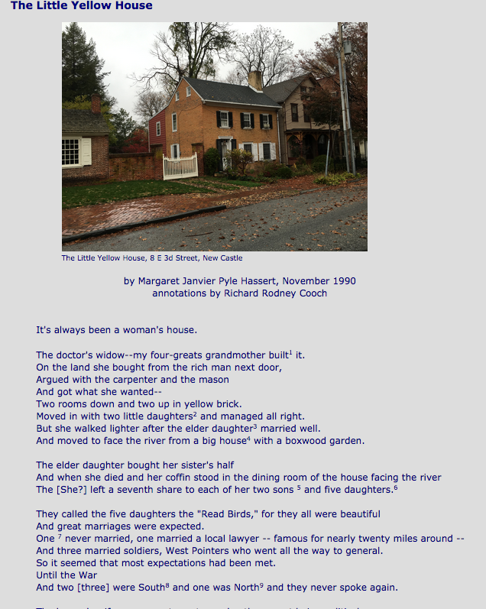
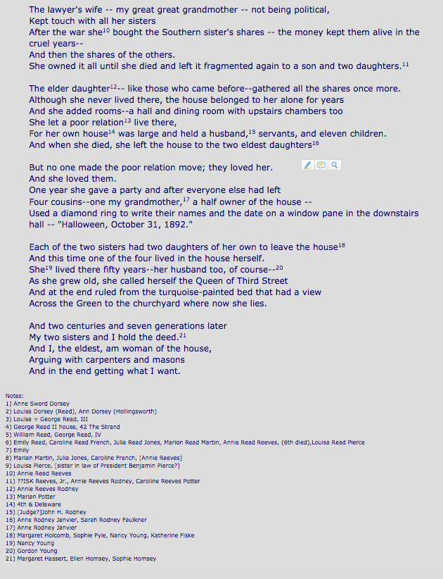
http://nc-chap.org/annie/Little_Yellow_House.php

Slide 11
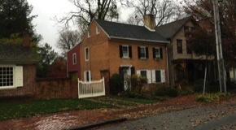
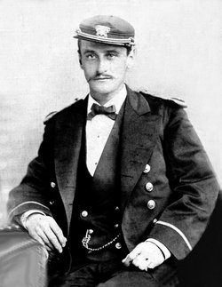
Annie Dorsey Read Reaves
She probably lived in the “yellow house” in 1860 & 1870 based on adjacent entries in census showing known neighbors and family tree (below)
Husband Capt. Isaac Reeves taught at USMA, died 1851
c1790’s
Why did she go to the South? In her diary, 1861: A fleet was preparing for embarkation…, and no one would be allowed to go unless taking the “Oath of Allegiance" to the Lincoln government Of course I who was running from the Oath who gave up my pension rather than take it …
Louisa Dorsey m G Read III -> Ann Dorsey Read m Capt. Reeves -> Ann Dorsey Reeves m John Rodney
-> Margaret Janvier Holcomb, Sophie Janvier Pyle and descendants.

Slide 12
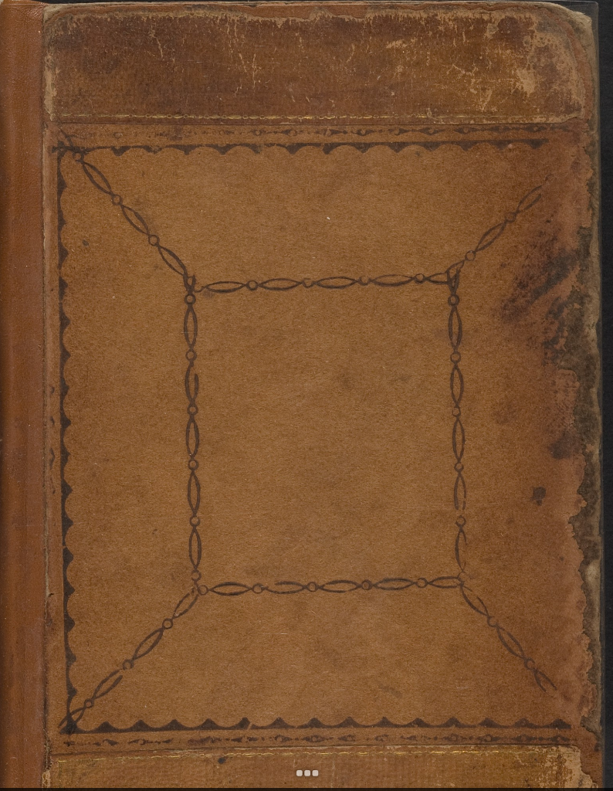
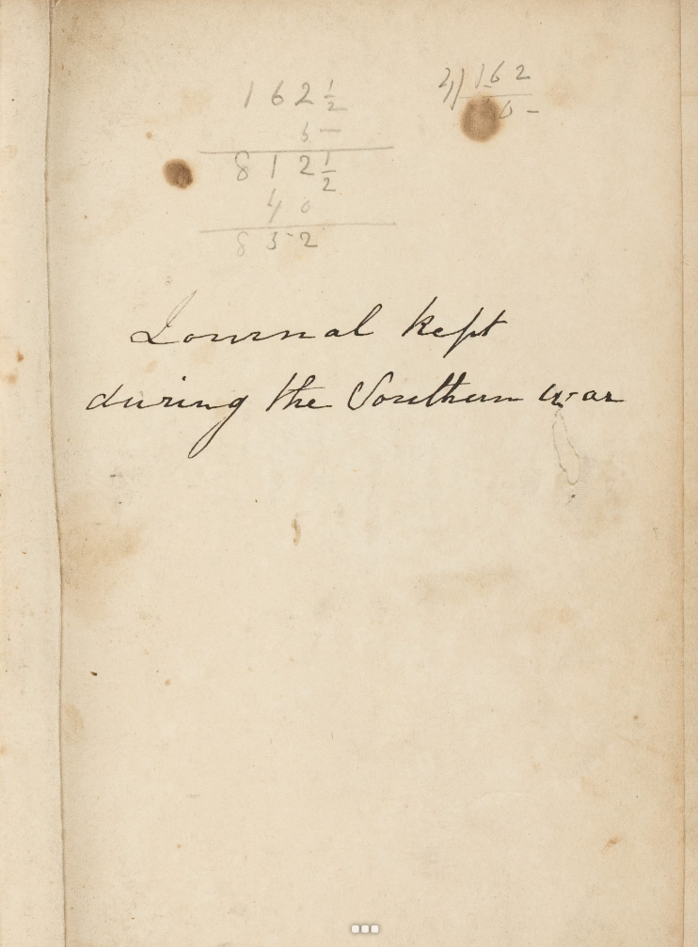
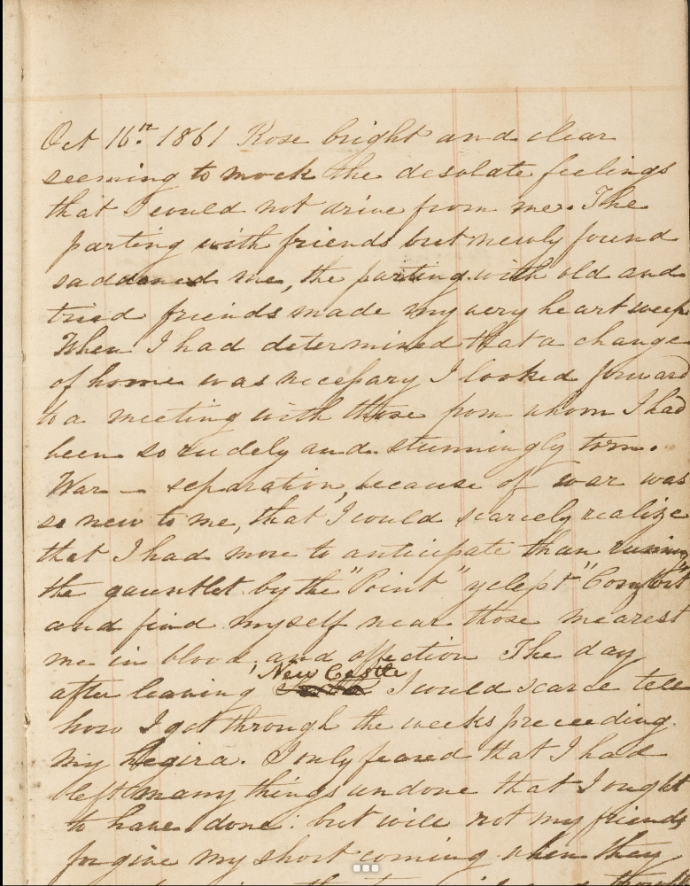
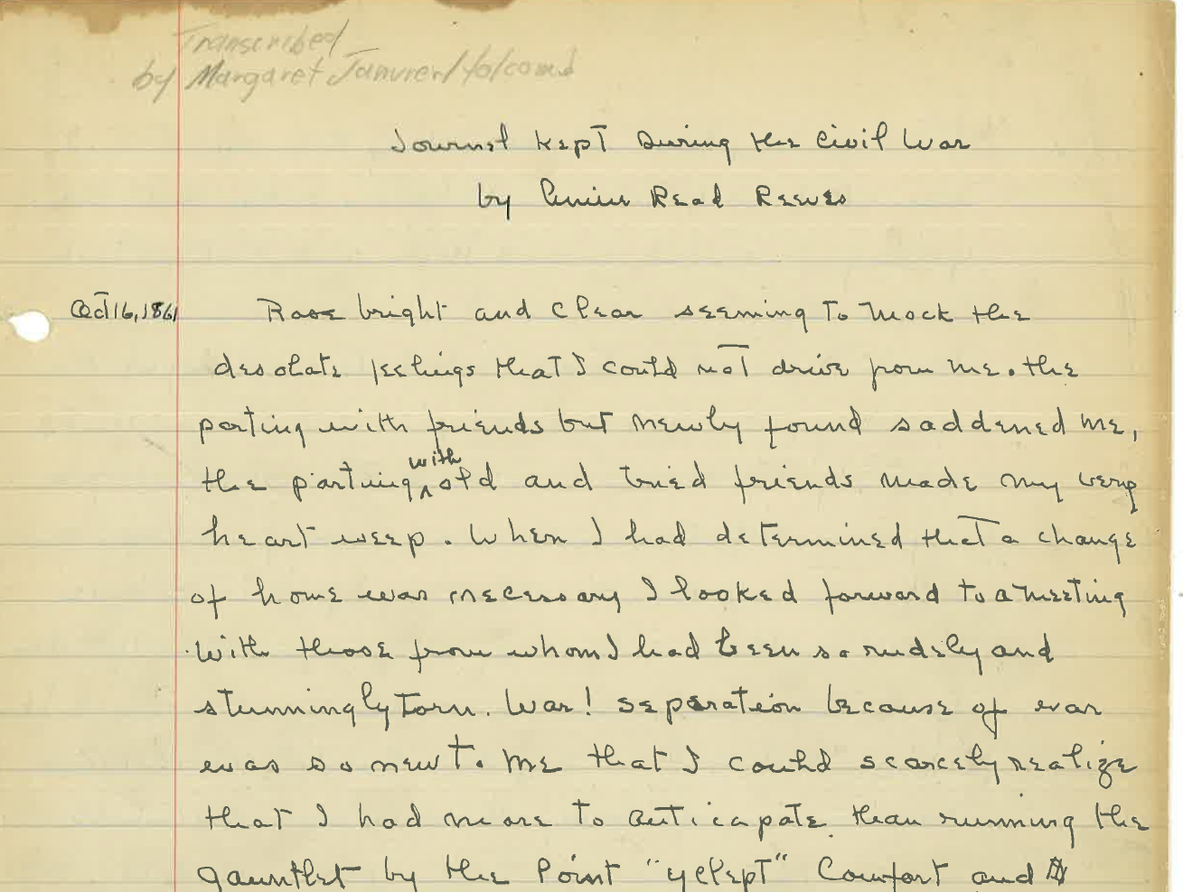
“Journal kept during the Southern war” Unknown author,
Images and transcription from Radcliffe/Harvard library in 2015 of a book purchased from a dealer
Partial transcription done years earlier of Annie Read Reeves’ journal by by Margaret Janvier Holcomb, courtesy R. Cooch
http://nc-chap.org/annie/

Slide 13
U. S. Oath of Allegiance, c1863
I ______ of the county of ______, state of _____, do solemnly swear, in presence of Almighty God, that I will henceforth faithfully support, protect, and defend the Constitution of the United States, and the Union of the States thereunder; and that I will, in like manner, abide by and faithfully support all acts of Congress passed during the existing rebellion with reference to slaves, so long and so far as not repealed, modified or held void by Congress, or by decision of the Supreme Court; and that I will, in like manner, abide by and faithfully support all proclamations of the President made during the existing rebellion having reference to slaves, so long and so far as not modified or declared void by decision of the Supreme Court: So help me God. (signature) Subscribed and sword to before me, at ______ this ___day of ____, A. D. 186_.
The above-named has _____ complexion, ____ hair, and _____ eyes; and is ___ feet ___ inches high.”

Slide 14
Ann Read Reaves at Rossmere
“Colophon” by Beverly Palmer to a 2014 exhibit on civil war diaries at Schlesinger Library, Radcliffe/Harvard. The author of the journal was unknown initially.
Ann Read Reeves grew up in New Castle, Delaware. In October 1861, when her one-volume diary began, she was a widow of means perhaps in her mid-40s, well-read, living in Delaware but about to take her leave. With her four children, seemingly all young adults, she was determined to leave “Yankee land” for the Confederacy. By December they had reached their destination, a plantation called Rossmere in Chicot County, Arkansas. While she gave no explanation for her devotion to the South, there is no mistaking Reeves’s ardor for the chivalrous plantation culture that she regarded as the apogee of civilization. She wrote of belles, beaus, and weekend visits eventually curtailed by raids carried out by despised Northern “invaders.” Reeves paid little attention to the slaves around her—180 of them at Rossmere when she arrived. She took them for granted, lumping them together with animals and property (“this raid was to take off horses, Beeves [cows] and negroes”).

Slide 15
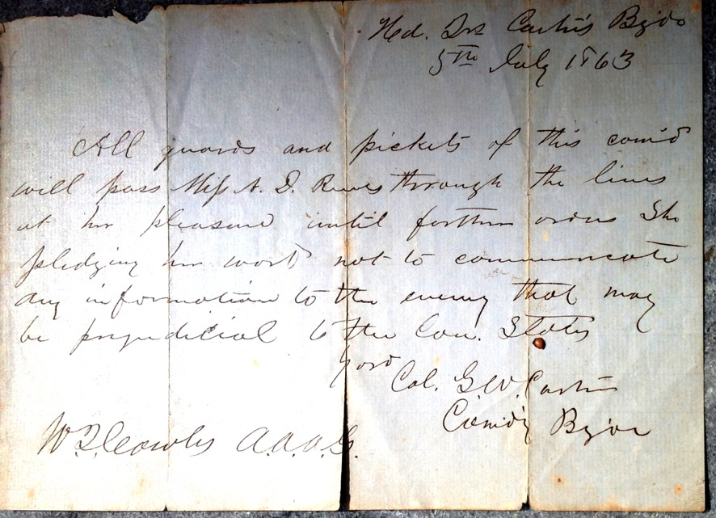
Pass for Ann Dorsey Read Reeves
??
5th July 1863
All guards and pickets of this com’d
will pass Miss A. D. Reeves through the lines
at her pleasure until further orders. She
pledging her word not to communicate
any information to the enemy that may
be prejudicial to the [illegible] States
???
???
??? A.A.A.G.
Courtesy R. Cooch

Slide 16
The provost marshal required an oath of allegiance for voters in the 1863 special election, and required them to enter the polls under crossed bayonets. The Democrats boycotted the election and the Republicans won by a 99.9% margin!
Sunday Star, May 3, 1908 Addenda to Part XLIV Alexander B. Cooper
A special election was held throughout the State on Thursday, November 19, 1863, to elect a Representative in Congress,.. On November 13, 1863, General Schenck,... issued his noted General Order No. 59... “That all provost marshals and other military officers commanding in Delaware shall support the judges of election on the 19th of November, 1863, in requiring an oath of allegiance to the United States as a test of citizenship of any one whose vote may be challenged on the ground that he is not loyal or does not admit his allegiance to the United States,” ... The obvious purpose and intention of these orders were to intimidate and prevent the Democrats from voting at the election. ... the Democrats of New Castle county, ... assembled in convention at the Court House in New Castle,...recommended that all Democrats of the county should … take no part in the said special election. ... when the votes cast at the election (held within 48 hours after the notice was sent out) were counted and officially announced, it appeared that only eight Democratic votes had been cast in the entire State, although the Democrats were largely in the majority. ...when the day of election arrived a provost marshal and a squad of soldiers appeared and were stationed at the polls …. The soldiers were lined up in front of the windows or place where the votes were received by the election officers in such a manner as to compel the voter to walk under crossed bayonets in order to cast his vote. Mr. Smithers, ... received 7,963 votes against eight for Mr. Brown.

Slide 17
Thomas Garrett, Judge James Booth Jr., Judge Roger Taney
In the New Castle Courthouse
Thomas Garrett was a ‘conductor’ on the underground railway.
Escaped slaves he aided were captured and brought to New Castle. Judge Booth freed them based on Delaware law
They were recaptured in Pennsylvania and their owners sued. U.S. Supreme court justice Taney (himself a slave owner) ruled in their favor, a precedent two years later for a new fugitive slave act.
From Delaware Online, 2015, Harry Themal
Roger Taney, author of the Dred Scott decision that slaves were property not citizens, and Thomas Garrett, who guided 2,700 slaves to freedom, faced each other in the New Castle Court House nine years before Taney's famous U. S. Supreme Court opinion.
In New Castle Taney fined Garrett for helping slaves to escape. Efforts to win Garrett a federal pardon have run into roadblocks. Their careers in a way mirror some of today's racial debates.
…
Taney, from the border state of Maryland, had freed his slaves and as a defense attorney had said that "slavery was a blot on our national character." But when the Dred Scott case reached the U. S. Supreme Court, over which he had presided for more than 20 years, Taney wrote an opinion in 1857 that shook the nation and is considered a factor in the Civil War. Taney died at 87 as the war was ending, on the day his home state abolished slavery.
Dred Scott was a household servant of a doctor and had moved from the slave state of Missouri to free states. Scott claimed his freedom in Missouri but Taney's majority opinion rejected that plea. He called blacks "people of an inferior order" and "altogether unfit to associate with the white race." His opinion held that the writers of the U. S. Constitution believed that blacks "had no rights which the white man was bound to respect."
The most important part of that decision was the ruling that Congress could not restrict the spread of slavery. He reasoned that "Negroes in bondage are property and the Constitution protects property owners from deprivation without due process of law." Therefore blacks "could be bought and sold and treated as an ordinary article of merchandise and traffic."

Slide 18
Examples of Those from New Castle
Involved in the Civil War
Regular Army
Brig. Gen. Lorenzo Thomas, Adjutant General, Sec. of War (briefly)
Army Volunteers
Capt. Aquila Hizar (survived to become a prolific builder in New Castle)
Capt. John Evans (killed in battle)
Sgt. Gemmill (captured a Lincoln conspirator)
John Anderson (dies of disease in Andersonville prison)
“Colored Troops”
“Colored Sailors”
Confederate Army
John Reed Lambson, wounded, property in NCCo confiscated)
“Witnesses to War”
Julia Jefferson, “Angel of Mercy” at Fort Delaware

Slide 19
Union Volunteers from New Castle
Sorted by unit and name
1 | Biddle | Uriah | Co I | 1st DE Infantry |  |  | 29 | Bird | Charles | Co E | 2nd DE Infantry |  |  | 57 | Sharp | Jesse | Co B | 9th DE Infantry
2 | Birch | William D. | Co I | 1st DE Infantry |  |  | 30 | Evans | John | Co A | 2nd DE Infantry |  |  | 58 | Eckles | James N. | Co D | 1st DE Cavalry
3 | Booth | James | Co E | 1st DE Infantry |  |  | 31 | Flinn | Thomas | Co F | 2nd DE Infantry |  |  | 59 | Gemmill | Zachariah | Co D | 1st DE Cavalry
4 | Callahan | John | Co D | 1st DE Infantry |  |  | 32 | Lock | Otto |  | 2nd DE Infantry |  |  | 60 | Bartlett | Joseph | Nields Ind Batt | DE Vol Lt Artillery
5 | Cannon | Joseph | Co I | 1st DE Infantry |  |  | 33 | McPike | Henry | Co H | 2nd DE Infantry |  |  | 61 | Hanson | James | Nields Ind Batt | DE Vol Lt Artillery
6 | Cavenaugh | Henry | Co I H D | 1st DE Infantry |  |  | 34 | Sutton | William | Co I | 2nd DE Infantry |  |  | 62 | Herbert | William H. | Nields Ind Batt | DE Vol Lt Artillery
7 | Challenger | David | Co I | 1st DE Infantry |  |  | 35 | Brown | Henry | Co F | 3rd DE Infantry |  |  | 63 | Foster | William W. |  | Milligan's Ind Cavalry
8 | Clark | William | Co D | 1st DE Infantry |  |  | 36 | Fitzgerald | Michael | Co K | 3rd DE Infantry |  |  | 64 | Bayard | Isaac | Co I | 3rd USC Infantry
9 | Conely | Michael | Co D | 1st DE Infantry |  |  | 37 | Point | J. T. | Co A | 3rd DE Infantry |  |  | 65 | Jenkins | J. H. | Co D | 3rd USC Infantry
10 | Dobbs | Henry | Co B | 1st DE Infantry |  |  | 38 | Shaw | James | Co K | 3rd DE Infantry |  |  | 66 | Merherd | Arthur | Co F | 3rd USC Infantry
11 | Freeze (Fries) | Thomas | Co D | 1st DE Infantry |  |  | 39 | Sheridan | Philip | Co D | 3rd DE Infantry |  |  | 67 | Duckery | John | Co I | 6th USC Infantry
12 | Green | Thomas | Co D | 1st DE Infantry |  |  | 40 | Foster | John W. | Co K | 4th DE Infantry |  |  | 68 | Wright | Garrison | Co D | 22nd USC Infantry
13 | Hizar | Aquilla | Co I | 1st DE Infantry |  |  | 41 | Hewes | William | Co H | 4th DE Infantry |  |  | 69 | Ambrose | Samuel | Co B | 25th USC Infantry
14 | Hizar | Thomas | Co I | 1st DE Infantry |  |  | 42 | Jordon | Henry P. | Co D | 4th DE Infantry |  |  | 70 | Brown | James W. | Co C | 25th USC Infantry
15 | Kemp | Charles | Co I | 1st DE Infantry |  |  | 43 | McNitt | Samuel | Co D | 4th DE Infantry |  |  | 71 | Collins | Alfred | Co C | 25th USC Infantry
16 | Kemp | Edward | Co I | 1st DE Infantry |  |  | 44 | Toner | John | Co F | 4th DE Infantry |  |  | 72 | Sterling | Thomas | Co E | 30th USC Infantry
17 | King | Davis | Co I | 1st DE Infantry |  |  | 45 | Cleaver | Isaac | Co H | 5th DE Infantry |  |  | 73 | Chase | Charles |  | 31st USC Infantry
18 | Martin | John | Co I | 1st DE Infantry |  |  | 46 | Dyer | John | Co E | 5th DE Infantry |  |  | 74 | Reason | Charles | Co D | 41st USC Infantry
19 | Martin | Robert | Co I | 1st DE Infantry |  |  | 47 | Jefferson | Charles | Co H | 5th DE Infantry |  |  | 75 | Meyers | Jeremiah | Co C | 127th USC Infantry
20 | McGlinchey | Edward | Co A | 1st DE Infantry |  |  | 48 | Rodney | John | Co B | 6th DE Infantry |  |  | 76 | Rodney | George B. | D Battery | 4th US Artillery
21 | McPike | John | Co G | 1st DE Infantry |  |  | 49 | Bassett | Granville | Co B | 7th DE Infantry |  |  | 77 | Vantine | Joseph E. |  | F2 USS Richmond
22 | Riddle | William | Co I | 1st DE Infantry |  |  | 50 | Challenger | Edward | Co B | 7th DE Infantry |  |  | 78 | Gormley | John |  | 23rd PA Infantry
23 | Shearer | Charles | Co I | 1st DE Infantry |  |  | 51 | Dellin | Robert | Co B | 7th DE Infantry |  |  | 79 | Rementer | John | Co E | 29th PA Infantry
24 | Sheridan | John | Co I | 1st DE Infantry |  |  | 52 | Temple | Henry | Co B | 7th DE Infantry |  |  | 80 | Thompson | R Lockyer | Co F | 115th PA Volunteers
25 | Shute | William T. | Co I | 1st DE Infantry |  |  | 53 | Vining | John B. | Co B | 7th DE Infantry |  |  | 81 | Truss | James W. |  | 3rd PA Cavalry
26 | VanTrump | Isaac | Co I | 1st DE Infantry |  |  | 54 | Vining | Joseph | Co B | 7th DE Infantry |  |  | 82 | Wright | George | Co I | 11th PA Cavalry
27 | Veach | William | Co A | 1st DE Infantry |  |  | 55 | Wise, Jr. | James | Co B | 7th DE Infantry |  |  | 83 | Watson | Archibald | Co B | 131st OH Infantry
28 | Young | William | Co I | 1st DE Infantry |  |  | 56 | Ferris | Charles | Co B | 9th DE Infantry |  |  | 84 | Lunt | Ira | Co D | 2nd ME Sharpshooters
 |  |  |  |  |  |  |  |  |  |  |  |  |  | 85 | Tidwell | George | Co D | 26th MS Volunteers
Source: Florence Davies, NCHS

Slide 20
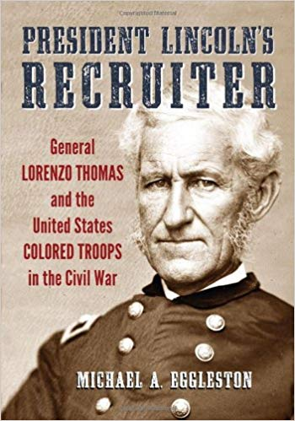
Brig. Gen. Lorenzo Thomas, U. S. Army
Adjutant General, 1861, Secretary of War “ad interim”, 1868
1804 Born in New Castle to Evan Thomas, Esq.
May have lived on E2nd
Attended New Castle Academy
Appointed to West Point by Sen. N. Van Dyke Jr., 1823 Graduated
1832 Married Elizabeth Colesberry (1806-1879) in New Castle, 9 children
1835 Served in 2nd Seminole war
1853 Chief of staff to commander of U.S. Army
1861 Adjutant General
1863 “Banished” by Sec. War Edward Stanton
Recruited and created black troops in MS.
1868 After Lincoln’s death, successor Andrew Johnson fired Stanton and replaced him with U. S. Grant, then Thomas.
(Read about Andrew Johnson impeachment)!
President Lincoln’s Recruiter: General Lorenzo Thomas and the United States COLORED TROOPS in the Civil War, M. Eggleston 2013
Notes:
Fueded with Stanton: said Thomas: only fit for presiding over a crypt of mummies like himself (he was 60) and a heavy drinker
Stanton was a radical republican (lincoln was moderate

Slide 21
Lorenzo Thomas Brief Time in the Spotlight
Lincoln, a moderate Republican assassinated April 1865 after the end of the war, succeeded by Andrew Johnson
Radical Republicans in Congress wanted harsher treatment of the South than Lincoln had promised.
Johnson tried to fire Edwin Stanton, Secretary of War (and State) but Congress passed the Tenure of Office law to block that.
Johnson replaced Stanton anyway with Thomas
Stanton locked himself in his office to prevent the takeover.
Congress impeached Johnson with Thomas a prime witness for defense.
The trial lasted months (with continuous press coverage) but Johnson was acquitted in the end.

Slide 22
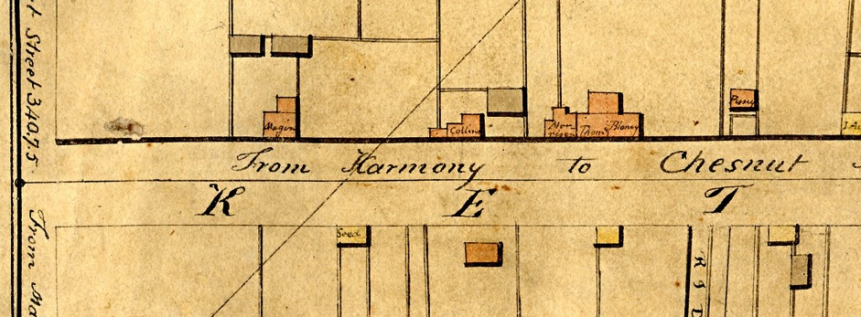
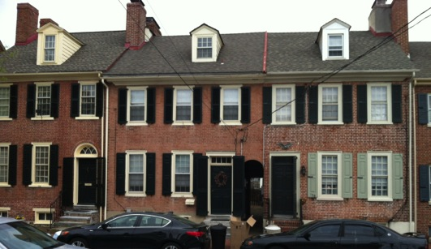
Where did Gen. Thomas grow up in New Castle?
He was born in 1804 in New Castle to Evan Thomas, Esq. (1763-1836) who emigrated from Wales. They were apparently unrelated to Charles Thomas (of the current Episcopal parish house at The Strand & Harmony). He is shown in the census for NC from 1800-1830.
The Latrobe map of 1804-5 shows a brick “Thomas” house as the left half of a duplex a few feet from modern Plum Alley. This may be 136 E 2nd (Terry Gormley) but it needs to be checked out with title chains.
134-138 E 2nd
The N.H.R. inventory describes 134-138 E 2nd as “late 1700’s” . Note Georgian/Federal features: fan light or square transom, gabled roof, flemish bond, mostly symmetrical except for one door/alley.

Slide 23
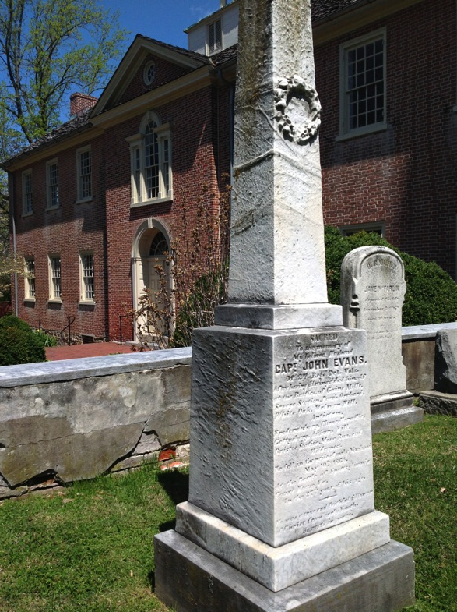
Sacred
To the Memory of
My beloved Husband
Cap't. John Evans
of 2nd Reg. Del. Vols.
After having distinguished himself
at the Battles of Gains Mills,
Savage Station, Peach Orchard,
White Oak, Malvern Hill,
Antietam,
Fredericksburg, Chancellorsville,
Gettysburg, Auburn Hill,
Bristoe Station, Mine Run and
Wilderness,
He fell in the pride of early manhood
May 10th 1864
at the Battle of Spottsylvania Court House, Va.
In the 27th year of his age.
------
He was a true and faithful follower of Christ from early youth.
He rests in peace.

Slide 24
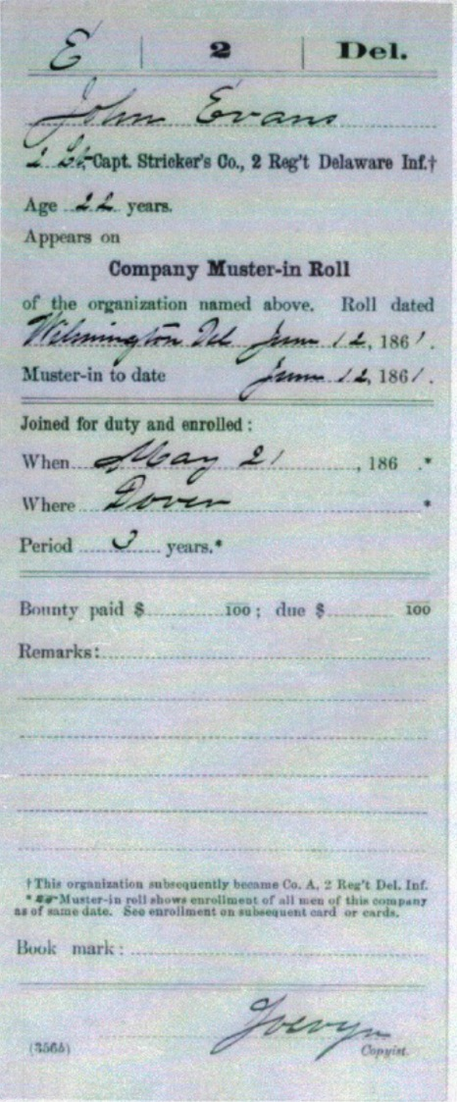
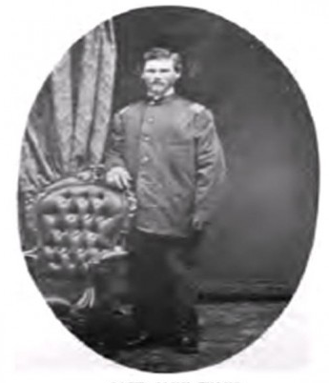
Sgt. Cyrus Forwood of Co. A, in a letter home, gave the following description: “Capt. Evans is as near like a rock as man can be, no matter how near him a shell may burst he will scarce look around toward it.”

Slide 25
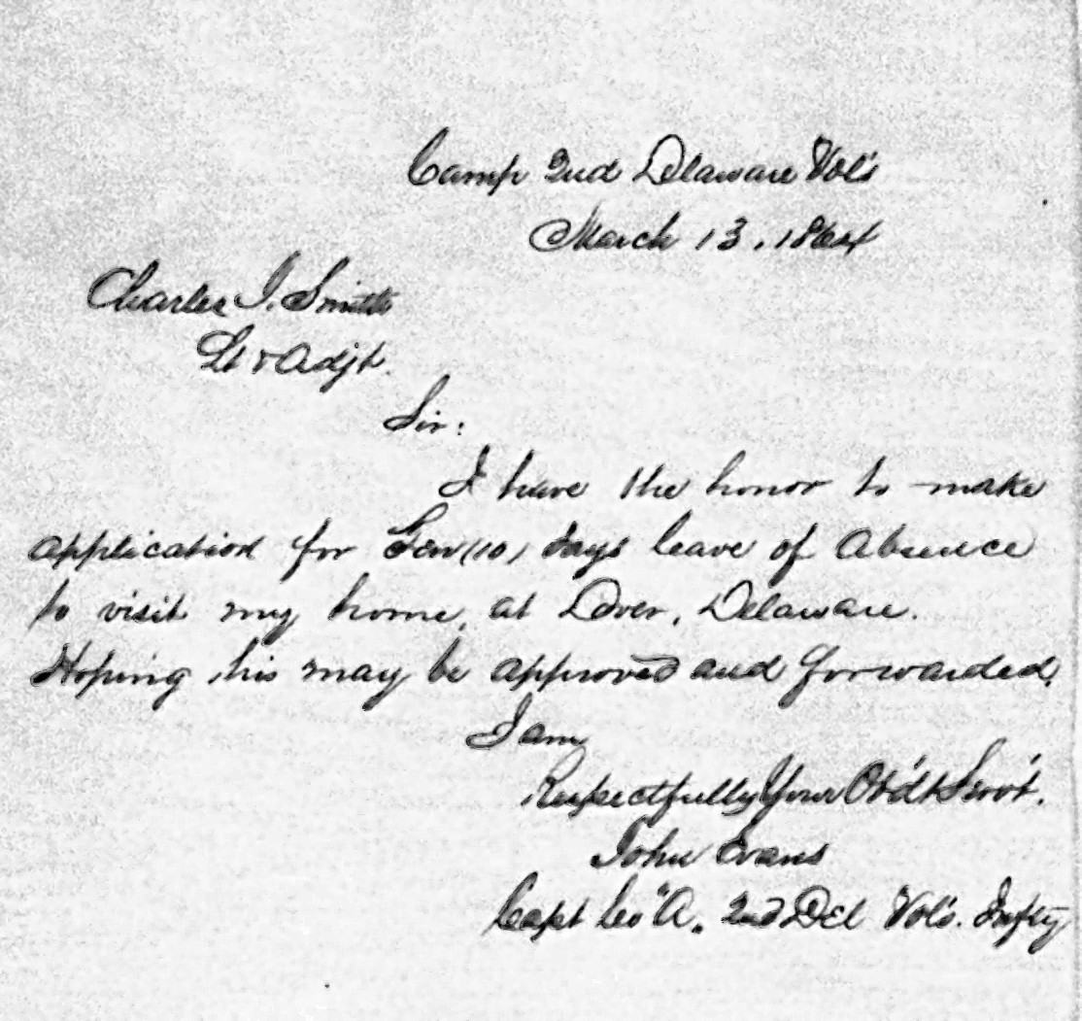
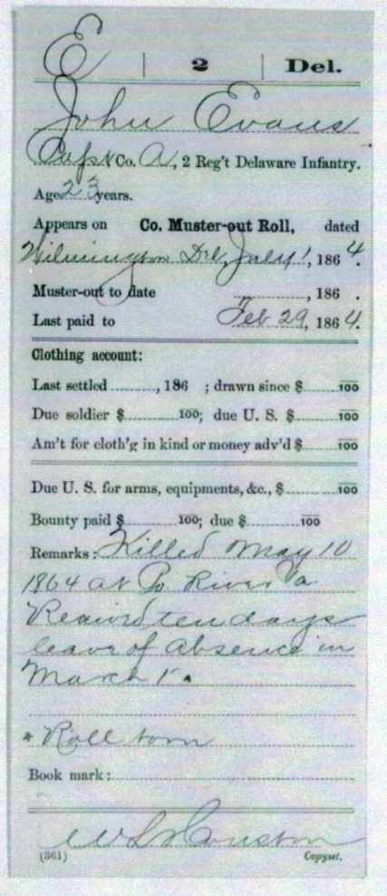
While on furlough two months before his death, Capt Evans married Miss Maggie Stroup of New Castle County, DE in a ceremony at 509 S. Thirteenth St., Philadelphia, PA
Notes:
Married on leave March 1864, killed May 1864 at Po River

Slide 26
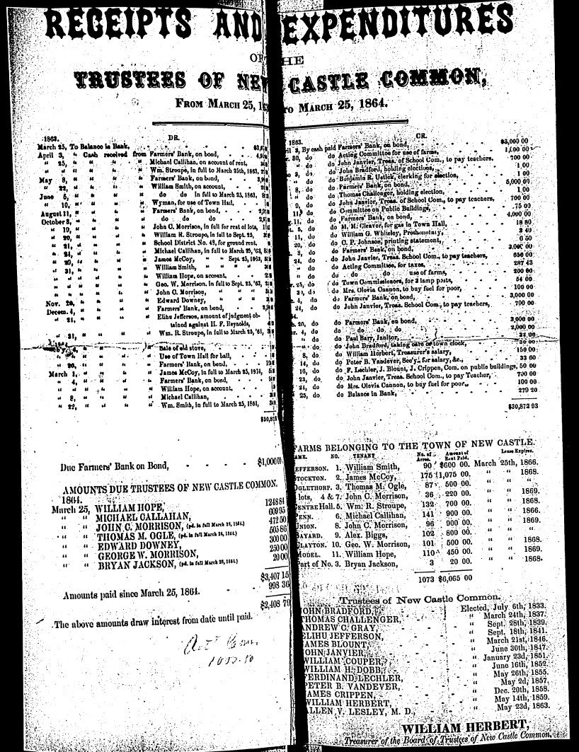
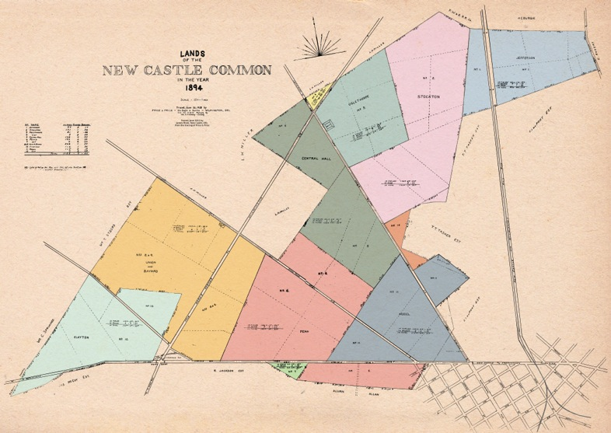
Miss Stroup lived on Center Hall Farm, one of the Trustees farms.
Captain Evans body was brought there before burial in Immanuel cemetery.

Slide 27
Information on John Evans in the 1860 census
ID House Line Family# Name Age Sex Race Born Occupation
321 40 310 320 Turner Leonora 14 F W Del
322 2 311 321 Brumfield Mary 54 F W England
323 3 311 321 Brumfield Mary 14 F W Pa X
324 4 311 321 Reynolds Andrew C 48 M W Del Dentist
325 5 311 321 McClain Edward 32 M W Pa Clerk
326 6 311 321 Evans John 23 M W Del Commision Merchant
327 7 311 321 Caussey William 23 M W Del Lawyer 1,000
328 8 311 321 Cann William 28 M W Del Merchant 2,000 4,000
329 9 311 321 Shaw James G 30 M W Pa Speculator 10,000 5,000
330 10 311 321 Plesants Charles F 28 M W Pa Clerk
331 11 311 321 Hartis George 40 M W England Ostler
332 12 311 321 Hartis Ann 25 F W England Domestic
333 13 311 321 Holladay Sarah 18 F W Ireland Domestic
334 14 311 321 Miller David 18 M M Del Servant
335 15 312 322 Cleland James 30 M W Ireland Merchant 7,000 2,200
336 16 312 322 Cleland Margaret 25 F W Md
337 17 312 322 Cleland John 3 M W Del
338 18 312 322 Boulden David 21 M W Del Clerk
He lived in a hotel or rooming house together with 12 other men, including James Shaw, Speculator who would build a mill after the war and found the ‘Shawtown’ area. Nearby lived David Boulden (store at 25 the Strand, Ivory Soap)
http://nc-chap.org

Slide 28
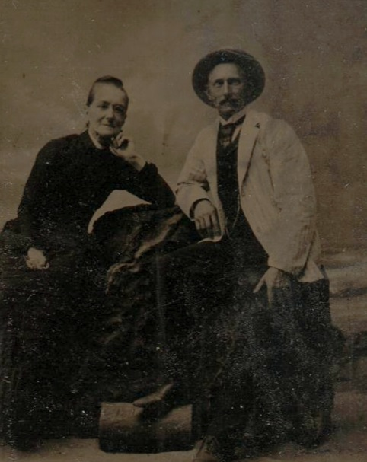
Capt. Aquila Hizar
Born at Booth’s Corner of German ancestry.
Grew up in Chester until age 16;
Learned bricklaying in Wilmington
April 1861 enlisted for 3 months in 1st Volunteer Delaware Infantry.
August 1861 enlisted as sgt for 3 years.
Took part in Bull Run, Antietam, Fredricksburg (2nd Lt.), Chancellorsville (1st Lt.), Gettysburg, Wilderness, Spottsylvania CH, Cold Harbor, Petersburg (Capt.) etc. (Banks Ford, Mine Run, Deep Bottom, Farmersville, Millford Junction, Auburn, North Ann, Prospect Hill, Reams’ Station, Po (.?) River).
Oct 1864 Mustered out.
Built: Knights of Pythias Hall, Order of Red Men, St Peter’s Church, his home ( W 4th), houses on W 5th etc.
Biographical and Genealogical History of the State of Delaware, Volume 1

Slide 29
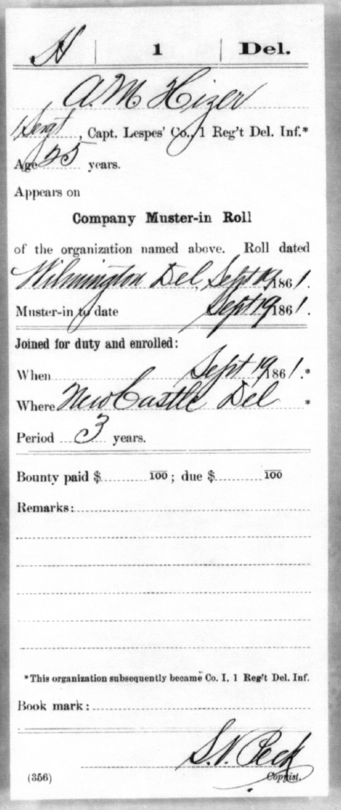
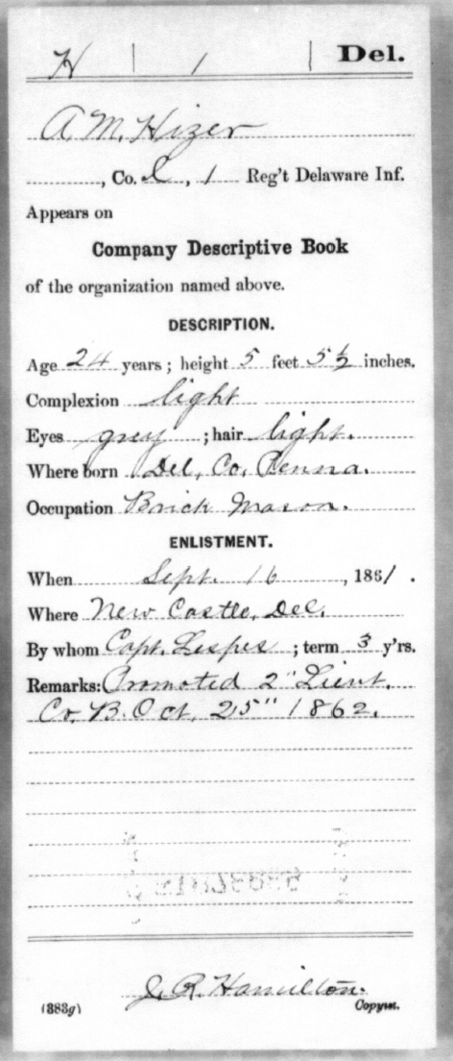
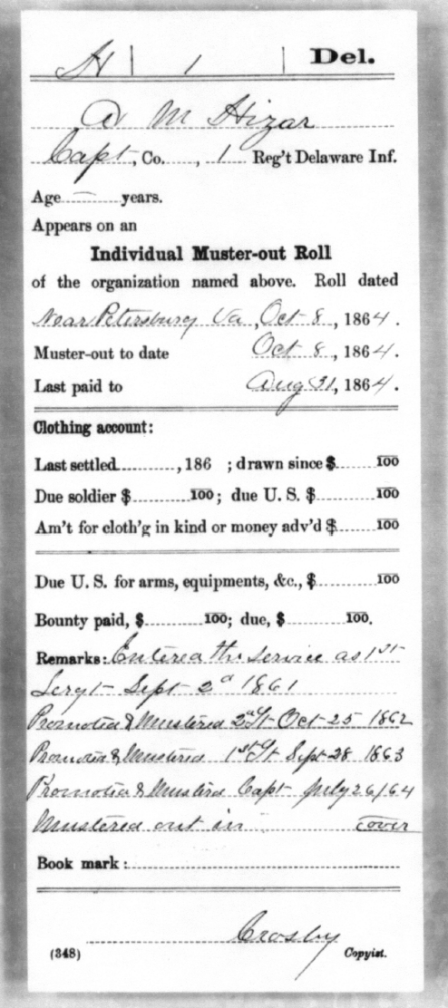

Slide 30
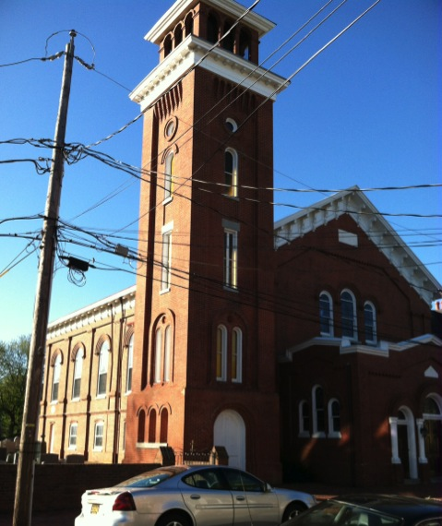
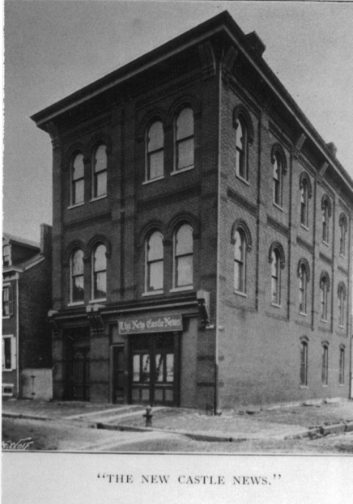
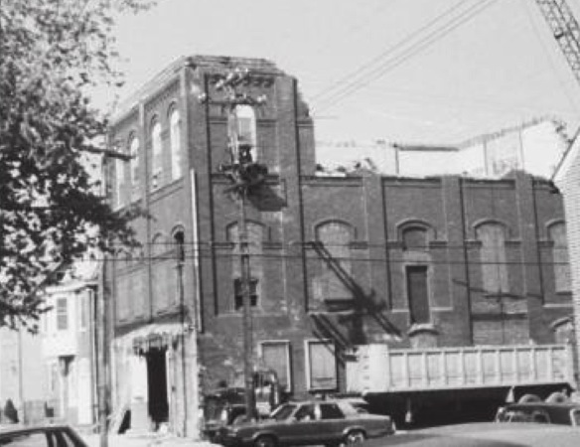
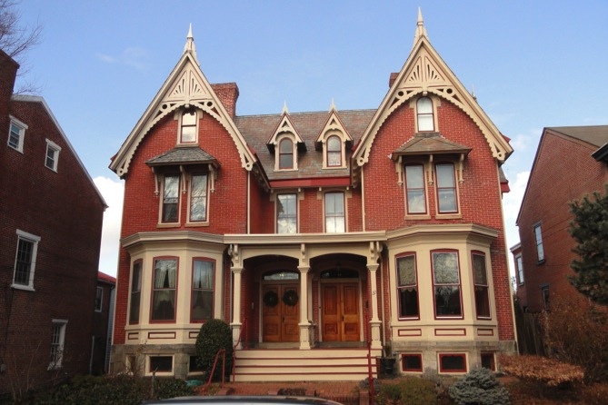
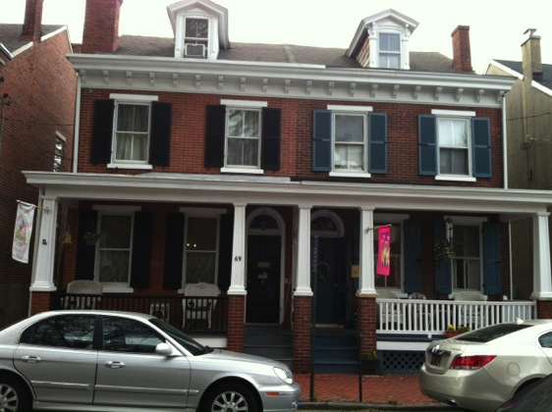
6th & South
Demolishing the Earle Theater in 1983
(5th & Delaware)
Aquila Hizar residence, 24 W 4th
71 W 5th

Slide 31
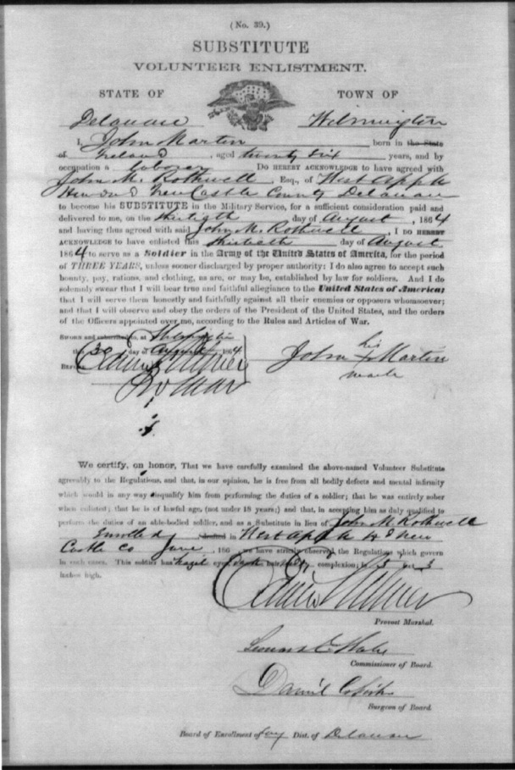
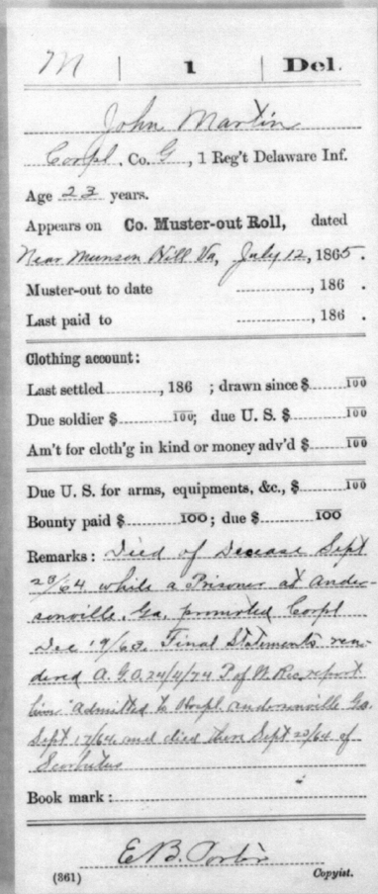
John Martin
John Martin from Ireland enlists August 1864 as a substitute for John Rothwell
Age 23, dies as POW at Andersonville, GA, July 1865
1860 census data disagree with military records about age, but suggests that he, wife and 2 children share a house with 6 other people
Notes:
Dies of disease while a prisoner at andersonville
Enlists as a substitue “for sufficient consideration”

Slide 32
1860 Census data for John Martin
HN Last First Age Sex Race Born
488 Martin John 30 M W Ireland Day Laborer
488 Martin Catharine 25 F W Del
488 Martin John 2 M W Del
488 Martin Mary 7 F W Del
488 McCann Mary 71 F W Ireland Widow 500 100
488 McGarthe Thomas 50 M W Ireland Day Laborer
488 McGlency Edward 25 M W Ireland Day Laborer
488 McPike Margaret 7 F W Del
488 Mellon Michel 50 M W Ireland Day Laborer
John Martin lived with his wife and family in a hotel or rooming house with 5 other people. The residents of adjacent houses were all artisans or laborers: shoemaker, blacksmith, trimmer, painter, bricklayer. In the house next door lived James Dungan, perhaps the person who married Julia Jefferson, “Angel of Mercy”

Slide 33
Casualties
1st Delaware Infantry Regiment
 | Officers | Men
Killed in action | 12 | 146
Died of Disease | 3 | 118
Wounded in Action | 38 | 533
Missing in Action | 1 | 102
Total Dead | 15 | 264
Untying the Political Knot, Read, McKay, Wade (2001)

Slide 34
National Park Service Database of
African-American Civil War Sailors
Born in New Castle:
Sailor detail: David Miller 5’ 7” Negro Enlists on “Massachussetts” Dec 12, 1863 Waiter/Cook
1860 census: Age 18, Servant, race: M
No supporting data from 1860 census:
George Hyatt
George Kennard
John Price
Alexander Whittaker
Stewart Whittico
http://www.nps.gov/civilwar/index.htm

Slide 35
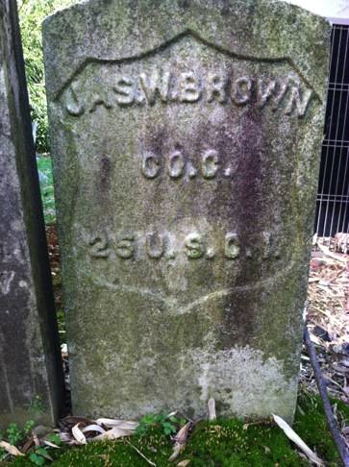
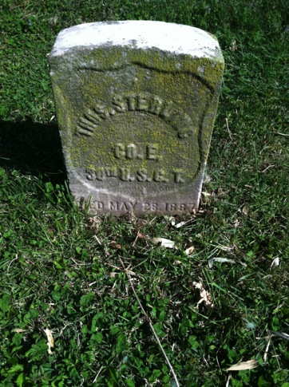
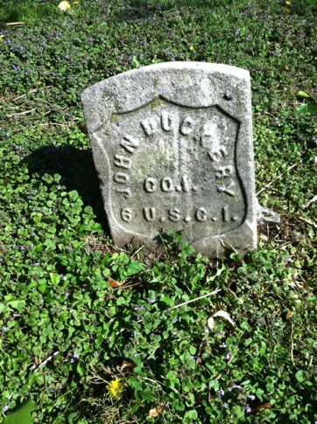
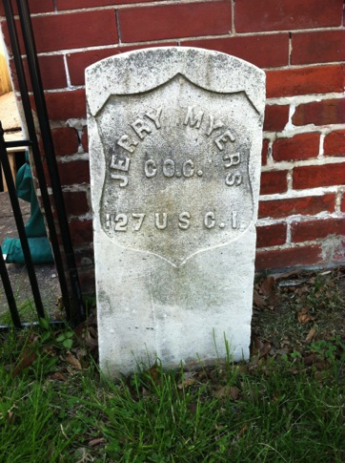
U. S. Colored Troops
(954 from Delaware)
Pvt. Pvt. Pvt.
James W(esley) Brown Thomas Sterling Thomas Duckery Jerry Myers
25 USCT 30 USCT 6 USCT 27 USCI
Headstones in Bethany U. A. M. E Mt. Salem
Census data for NC: Two James Browns, age 28 and 46 in 1870; Thomas Starling age 46 in 1870; Duckery family is in census 1850-1870 but no Thomas. Jerry Myers at age 28 in 1870;
None are on Beer’s Atlas, 1868

Slide 36
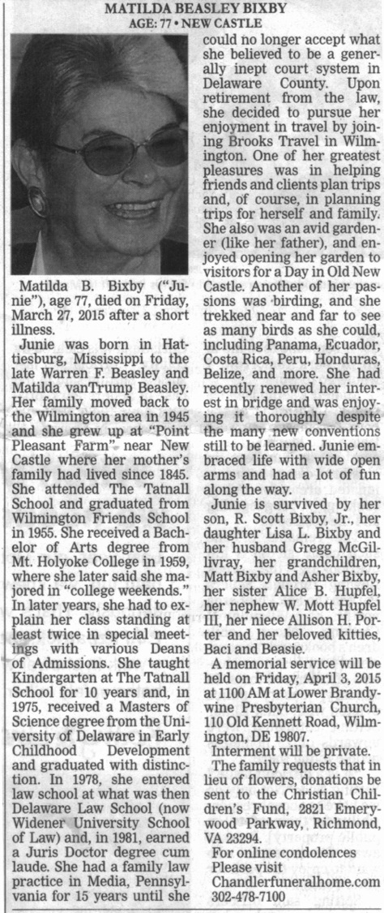
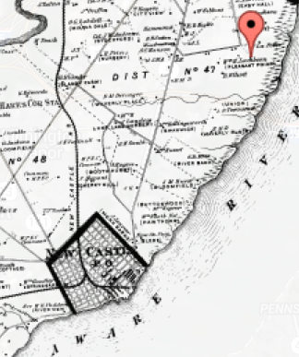
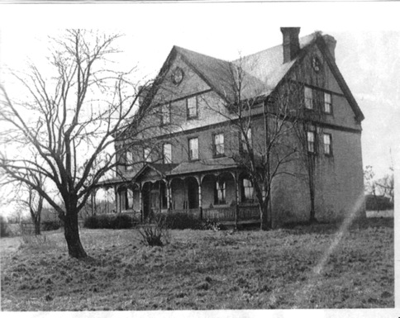

Matilda (Junie) Bixby (1938-2015),
The Strand and Point Pleasant
and
John Reed Lambson (-1882),
Point Pleasant,
Colonel, CSA., Lawyer
and
Isaac Van Trump
2nd Lt. 1st Delaware Infantry, USA

Slide 37
Junie Bixby lived at Pleasant Point near New Castle and on The Strand in New Castle. Pleasant Point was at the end of Lambson Lane near the site in the 1600's of the Swedish Cranehook Church. Tank farms and warehouses now fill the area. Her parents, Warren F, Beasely and Matilda Van Trump Beasley sold the property for development. Parts of the house such as the staircase, were Incorporated into the house on The Strand.
Pleasant Point was built by Giles Lambson c1839 on land purchased from Stidham heirs (descendents of the Swedish owners of Cranehook land c1700).
In 1861 Giles, Sr. died and estate settlement was in the hands of Moses Lambson, his son and James Crippen, his son-in-law. It was almost immediately taken out of their hands when John R. Lambson, another son, defected to the Confederate side, and the U.S. Marshall seized all the properties of his deceased father, Giles, Sr.
nc-chap.org/maps/pdfs/pleasantPoint.pdf

Slide 38
A presidential pardon for John R. in November 1865 released the properties to the executors.
John R. Lambson was the 8th child of Giles Lambson and Catherine Hamann, born in 183 1. On July 17, 1862 the District Court of the United States alleged that he gave aid and comfort to the Rebellion by bearing arms in the army of the Rebels. In the fray he was wounded
In the foot and suffered an amputation. He spent some time imprisoned in Fort Delaware. In some fashion he reached South Carolina where Thomas F. Bayard, lawyer, wrote him a letter on August 4, 1863. The next contact in the record is another letter to him from Bayard on September 26, 1865. It appears that he may have been in Washington, D.C. on December 23,
1865 where he acknowledged a presidential pardon from President Andrew Johnson and agreed to abide by the terms of pardon (President Andrew Johnson with his Proclamation of Amnesty on May 29, 1865 granted a pardon to all ordinary persons who had participation in the Rebellion on taking an oath of allegiance.).
We know from the family bible that "John R. Lambson was a conscientious objector and went to the South."

Slide 39




Fort Delaware Prisoners & Civilian Sympathizers

Slide 40

Visitthefort.com Archived web page (2008)

Slide 41

Fort Delaware
July 28, 1862
Miss Julie A Jefferson,
I am the
recipient of a bucket filled with
green and can fruit, box of cigars,
cake and catsup etc prepared and
sent by you.
It is much pleasure that I have
the honor to acknowledge at your
hands the delightful treat.
Please accept my most humble
and sincere heartfelt thanks.
With remembrance,
I am Very Respectfully
R.G. Patterson

Slide 42
Fort Delaware
July 11, 1863
Miss Jefferson,
Your kind offer yesterday to furnish pillows + c for the hospital was stated to Dr. Sullivan, Surgeon in Charge. He requests me to have you send all you can. Also any delicacies that you may be able to spare. We reviewed our three hundred wounded prisoners last night and we have no place to put them but on the hard boards in the barracks. If you will send them down on the tug today, we will [illegible] a thousand obligations to you. I go to Philadelphia in about an hour to see if I can get beds, blankets and other necessary articles consequently I will be unable to accept your kind invitation to visit you this evening. Present my kind regards to Madam Burton and tell her I will see Mr. Dolby today. The General directs me to say that you have permission to visit the Island at pleasure.
Sincerely Your Friend,
J.G. MacConnell
Transcribed by Rebekah Weagraff

Slide 43
Saturday, September 12, 1863
“Had a conversation with three young men, who have been detailed to bury the dead. One of them, named Scott, from Mississippi – a member of Bankhead’s Brigade – handed me an envelope from Miss Julia Jefferson, upon which she had written my name, when visiting the cemetery in Jersey, and stated that she wished me to furnish him with certain articles of clothing, when she next sent a box. This young lady is a true friend of the South, and will be remembered with gratitude by scores of our brave Confederates, who are now suffering imprisonment”
Tuesday, September 15, 1863
“Had the pleasure of receiving two large baskets of vegetables from my wife, and a box of clothing from Miss Julia Jefferson. The latter was intended for the use of our young men from Portsmouth – some of whom are in great need. Saw Capt. Ahl, about my going to the barracks to distribute the articles. He said, that it would be necessary for him to consult with Gen. Schoepf, before making a reply”
Transcribed by Rebekah Weagraff

Slide 44
Sunday, October 4, 1863
“A box came from Miss Julia Jefferson, with clothing to be distributed among sundry prisoners of the Fourth Texas, and other regiments. The articles are accompanied by a good lot of peaches, and sweet potatoes, for my own comfort. This faithful almoner, and her associates ought ever to be remembered by the boys from ‘Dixie’”
Tuesday, November 17, 1863
“Received a letter from Miss Lydia Jefferson – for which she has my thanks, as one of the few friends who have ventured a word of sympathy in my imprisonment”
Saturday, December 12, 1863
“Had the pleasure of a piece of nice mince pie, the first I have tasted this season. It was sent to Mr. Paddock by Miss Lydia Jefferson, with the request that I be allowed to share it”
Transcribed by Rebekah Weagraff

Slide 45


Slide 46

Life Under Military Control
Military Police (Provost Marshal) control business, travel, elections, even charity gatherings

Slide 47


On Liberty
Nicholas Van Dyke junior[age 16], Composition at Princeton College
"It has been observed, (and with much propriety) that they who most loudly clamour for Liberty, do not most liberally grant it." Liberty and peace are
inestimable blessings which are desired by all nations and individuals of every rank. It is the hope of the future enjoyment of these that animates a nation to have recourse to arms, to defend itself against the injuries threatened by a presumptuous and insulting foe. What else could have incited the brave sons of America to rise in arms against the veteran forces of Britain. Was it not a desire of these that encouraged them to persist and under so many disheartening circumstances, and to declare independence which they have now firmly established? But how frequently does it happen, that those who are the Warmest friends for it, after they have obtained their wished for it, turn a deaf ear to the prayer
of their fellow creatures. And it could not have been more
clearly specified than in the present constitution of America. That all persons are entitled to these blessings, few will offer to deny; and if so there are many at this time who appear to act contrary to the dictates of their consciences. The Americans have now gained the apparent summit of perfection and are able from experience to make an estimate of their values, as well as of the miseries of slavery. What then can make the Americans so desirous of kidnapping and reducing to slavery the faithful inhabitants of Africa. Do they suppose, that they are not of the human species or incapable of discerning between liberty and slavery? It is said that after they are brought to America, they have an opportunity of becoming acquainted with the truths of the gospel.
But it might be asked, if those who have the possession of them ever give themselves the least trouble to instruct them in those truths. It cannot be supposed from the manner in which they are
generally treated, that they ever become more corrupt, and acquainted with many vices which
are unknown in their native country. It is
very certain, that persons under such cruel masters,as those generally are, unto whose hands the unhappy Africans fall, cannot pay much
attention to the preparation for a future state.
Were it through a motive of instructing them,
and not of interest, the Americans would have
invented some more effectual means before this.

Slide 48


Nicholas Van Dyke jr . Votes against admitting Missouri into the union as a free state.
It was eventually admitted when tied to the admission of Maine a free state in March 1820
https://archive.org/details/speechofmrvandyk00vand/page/14

Slide 49
What was the cause of the civil war?
States rights –
Don’t tread on me– limit Federal power
Self government
Make the South Great Again –
Noble tradition – our way of life
Slavery is immoral– it must be abolished
The Economy
Missouri Compromise -- to prevent the spread of slavery new states must be free (or admitted in pairs)
All of the above

Slide 50

Map showing the distribution of the slave population of the southern states …. 1860
http://opinionator.blogs.nytimes.com/2010/12/09/visualizing-slavery/?_r=0
Notes:
Darkest black = 80% or greater black

Slide 51
NY Times Opinion Pages
Visualizing Slavery, by Susan Schulten
The map uses what was then a new technique in statistical cartography: Each county not only displays its slave population numerically, but is shaded (the darker the shading, the higher the number of slaves) to visualize the concentration of slavery across the region. The counties along the Mississippi River and in coastal South Carolina are almost black, while Kentucky and the Appalachians are nearly white
The map reaffirmed the belief of many in the Union that secession was driven not by a notion of “state rights,” but by the defense of a labor system.”
Though Lincoln had abundant maps at his disposal, only this one allowed him to focus on the Confederacy’s greatest asset: its labor system.
http://opinionator.blogs.nytimes.com/2010/12/09/visualizing-slavery/?_r=0

Slide 52

The first reading of the Emancipation Proclamation to the Cabinet, F. B. Carpenter (Bicknell)
Notes:
What is the war all about? States rights? Abolition of slavery?

Slide 53

Percentages of slaves in each county in 1860, Sussex was 10X higher; counties in the deep south were >100X higher.

Slide 54
Introduction to Untying the Political Knot
Read, McKay, Wade (2001), available New Castle Public Library
Tiny Delaware played a major role in the War Between the States. One of four slave states that did not secede from the Union, Delaware furnished a greater percentage of men to the Union Army than any other state, and it is estimated that as many as 2,000 Delawareans may have served in the Confederate Army and Navy. Much of the gun powder fired by the Union military came from E. I. Dupont & Co.'s Hagley Mills, and Wilmington's shipyards built northern warships. Harland & Hollingsworth completed three monitors plus several gunboats. Pusey & Jones on the banks of the Christina River in Wilmington launched a half-dozen gunboats. Wilmington's Tilton Army Hospital cared for convalescent soldiers while Fort Delaware, the Union's second largest prisoner of war facility, was constructed on Pea Patch Island in the middle of the Delaware River just off Delaware City .

Slide 55
January 4, 1861
The critical state of the country fills us with sorrow and alarm.. May God Help us. There seems no hope else. W.T. Read Diary
Years of tension reached the boiling point when Lincoln was elected.
South Carolina called a state convention and voted to secede from the U.S. followed by MS, FL, GA, LA, TX, then VA, AK, TN, and NC. In Feb. 1861 these 7 states met in Montgomery, AL, created the confederacy and name Jefferson Davis president.
April 12 Fort Sumter was attacked.
April 13 The news reached Wilmington and Delaware via telegraph.
April 15 Lincoln issues a proclamation calling for 75,000 men in the field for 3 months to put down an “insurrection too powerful to be suppressed by the ordinary course of judicial proceedings.”
Delaware’s quota is one regiment, 780 men.
April 19, 1861
We are in the midst of Civil War. Success to the Stars and Stripes.
W.T. Read Diary

Slide 56
New Castle and The Civil War
Vignettes from on or near the Green in New Castle:
Courthouse: 1863 Dem. Convention ->Oath Allegiance ->Boycott->99 % loss
Del. & 3rd: Boyhood home of man who swore in Jeff. Davis in Richmond
Next door (yellow house): 1860, 1870 home of woman who refuses to sign ‘’Lincoln’s oath of allegiance”, flees to slave plantation in Ark.
Two doors: Graffiti “Vicksburg Surrenders, July 4, 1864” in window
Next door: Home of Zachariah Gemmill earns govt. bounty for capture of member of Lincoln Assassination plotters
Second street: Home of highest ranking person ever to have lived in New Castle. A general who became (VERY briefly) Secretary of War after the assassination.
Men who fought (both bravely and not) for both sides
Women who brought comfort (to the enemy or not depending on your side)
Notes:
Next: was s attitude in state

Slide 57


Reality of Slavery in N.C. in 1792
Treatment of Escaped Slaves
Abraham, property of a man living near the current mall, was jailed for 6 month for escaping, and to be sold in 6 weeks.
Courtesy Donald Whiteley, Osher student
Notes:
Treated as property, not humans; jailed 6 months until paid for or sold

Slide 58
Untying the Political Knot (Continued)
Read, McKay, Wade (2001)
The First State played a major role in the history of African American freedom. Thomas Garrett, who lived at Fourth & Market Wilmington, organized and operated a branch of the Underground RaiIroad running from near Seaford through Middletown and Odessa to Wilmington. In 1841 , he was arrested, tried and convicted of hiding fugitive slaves in a celebrated state trial held in New Castle. Harriet Tubman conducted slaves through Delaware to freedom during the 1850's. She was assisted by other free people of color and escaped slaves. From 1863 to 1865 Delaware furnished 924 men to the Union Army as components of four U.S . Colored Troops Regiments.

Slide 59
Timeline of Statistics of Slavery in Delaware
Black Anthony, the first African, arrives in New Sweden
1664 African slaves are 20% of the population as the English replace the Dutch
Slaves are < 5% of the lower counties population
Slaves are 20% of the population
1775-1783 Manumission increases; Quakers directed to free slaves.
Selling slaves to the south is banned by law
Abolition societies are established in Dover and Wilmington
Delaware’s percentage enslaved declines more rapidly than any other state
An attempt to abolish slavery is unsuccessful
All Delaware slaves sold out of state are automatically free
Blacks are banned from state-aided schools
1840 Slaves are 13% of the state’s black population and 3% of total population
The number of free blacks leaving Delaware for the North rise
Despite Delaware’s refusal to ratify it, the Thirteenth Amendment abolishes
slavery in Delaware
Freedom and Slavery in Delaware, William H. Williams, 1999

