Slide 1
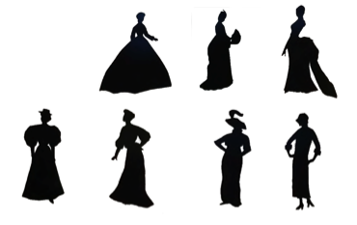
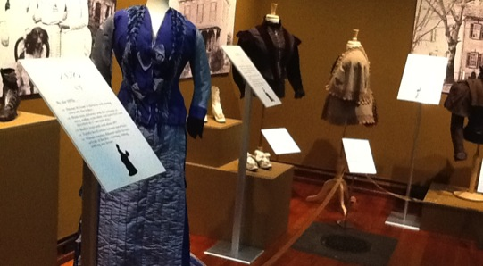
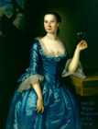
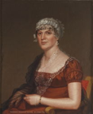
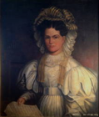
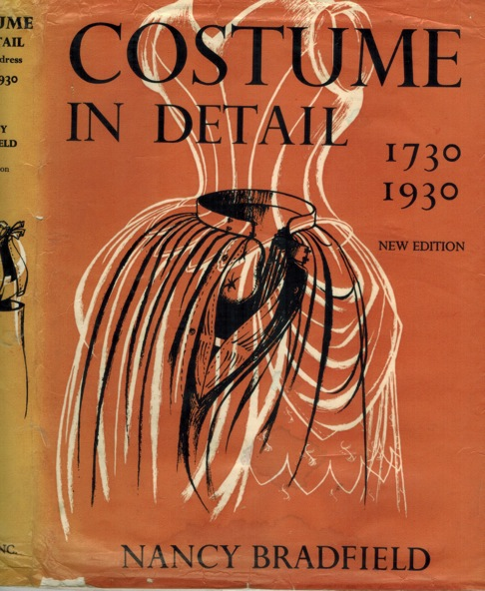
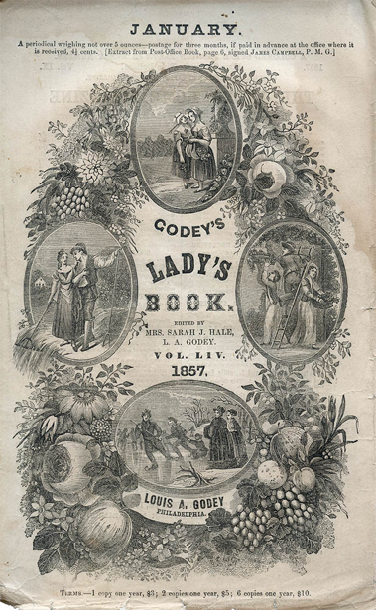
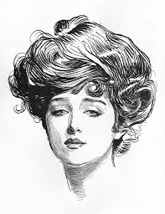
What Men and Women Wore in New Castle
Silhouettes:
1860-1920
The Height of Fashion: Delaware Women Dress Up”
By Susan Hannell, Peggy Litchko & Betsy Martino 2014
Plus Fashion Plates from
other sources.
Video
A ‘Gibson Girl’
Notes:
history, dates people, AND what they wore. Both men and women
Start with men. Easier really only 2 major changes in 150 years. So much mmore reasonable than women. Distinguishible style change every 10 years …. Like today

Slide 2
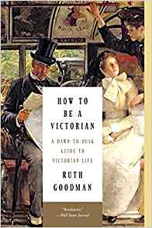

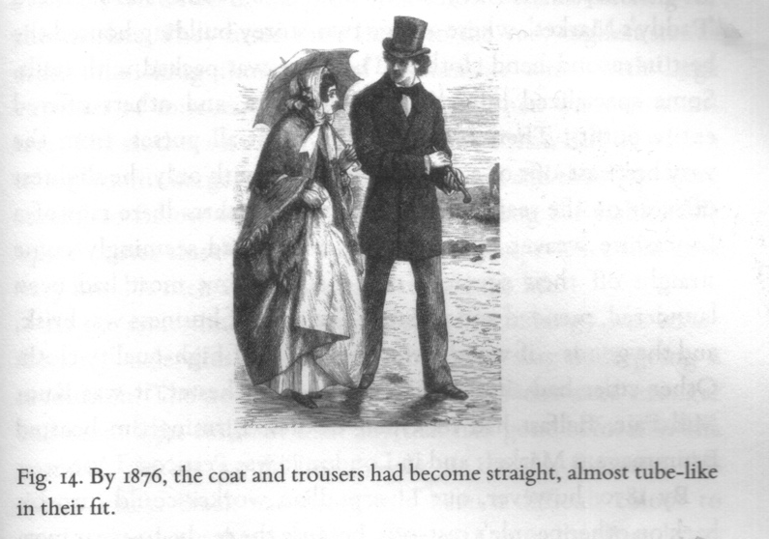
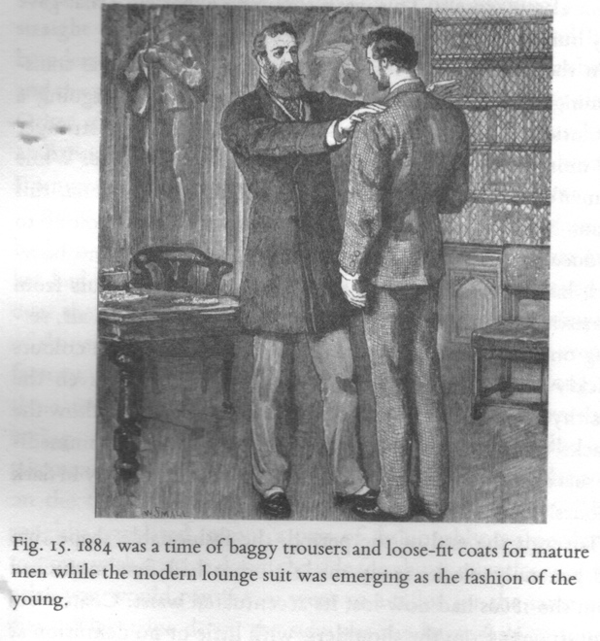
Comparison of clothing men’s clothing worn in
New Castle with that worn in Victorian England
In England, according to Ruth Goodman:
Hats were rarely removed in public
Waistcoats & jackets were both to be worn at all times
Shirts not to be seen except in very informal situations.
Pants became straight legged similar to modern ones
Underpants & undershirt or ‘union suit’ were worn
Notes:
Left By 1876 the the coat and pants had become almost tube like
1884 the modern loung suit was emerging, similar to dress suit today.

Slide 3
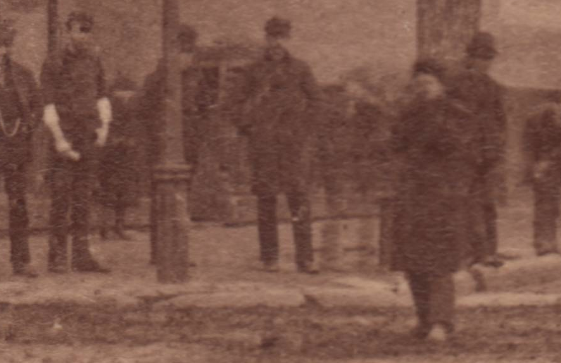

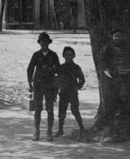
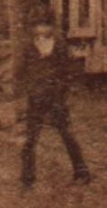
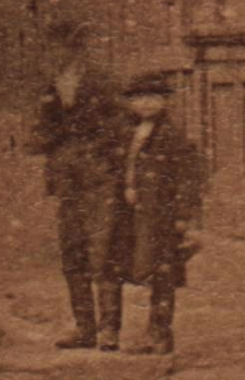

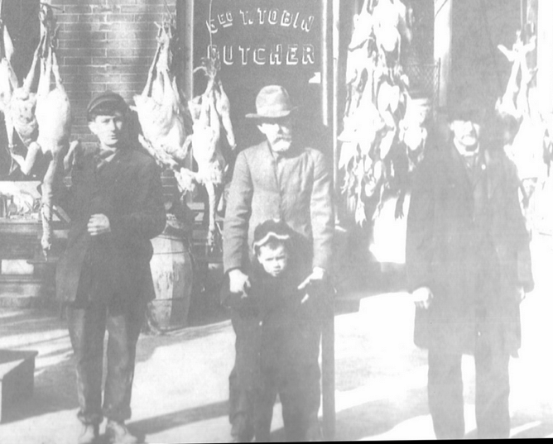
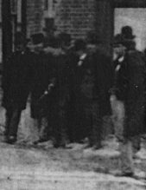
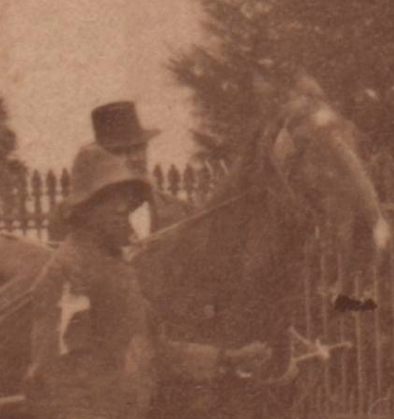


Men’s and boys clothing in New Castle c1878, late Victorian times. EVERY ONE of the people was wearing a hat, almost all were wearing a jacket and many were wearing a waistcoat (“vest”).
Notes:
Conclusion: clothing not so different late 1800’s new casstle and england

Slide 4
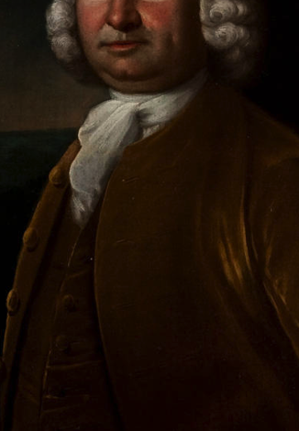
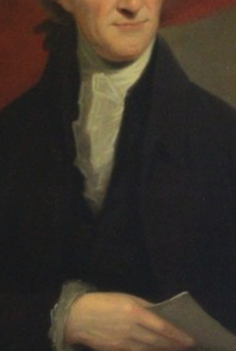
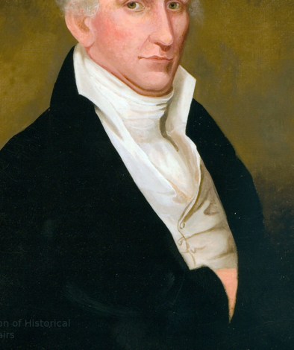
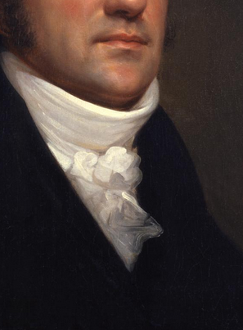
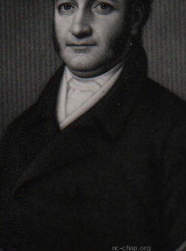
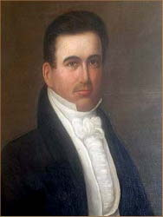
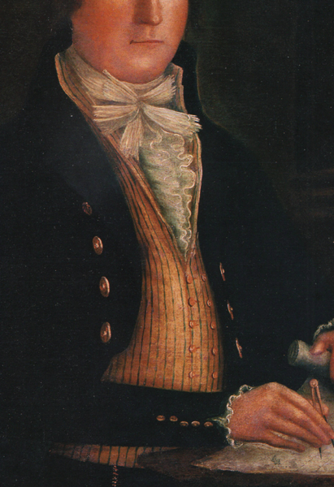
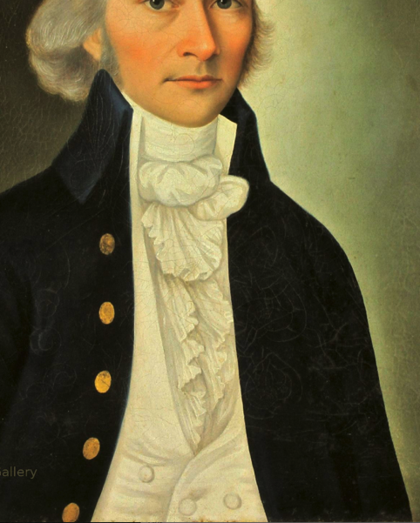
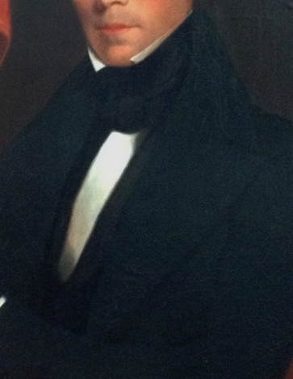
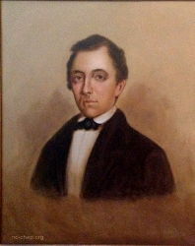
Neckwear in portraits of men from New Castle was a cravat or ruffle until about 1830.
Coats were single or double breasted and full cut except for two seamen with youthful figures. [Cutaway jackets emphasize one’s midriff]
1759
d1798
c1804
<1811
c1830?
1785
c1805
1830
1840-1850?

Slide 5
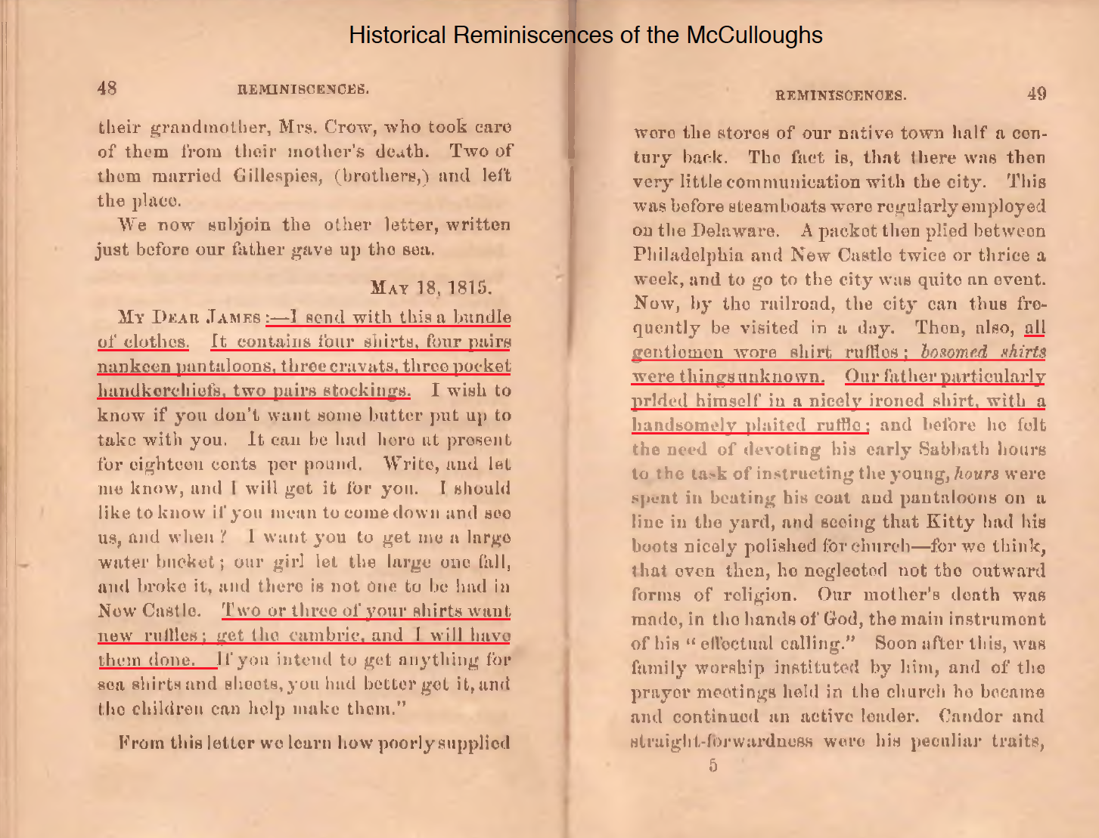

In 1815, Mrs. James McCullough (builder of 30 the Strand) sent her husband a package including cravats and yellow cotton pants, and comments that he needs new ruffles on his shirts. (He particularly liked “a handsomely plaited ruffle”)
Nankeen trousers:
(yellow cotton)
Notes:
He was still at sea, a captain, surprising that he wore these dress clothes

Slide 6
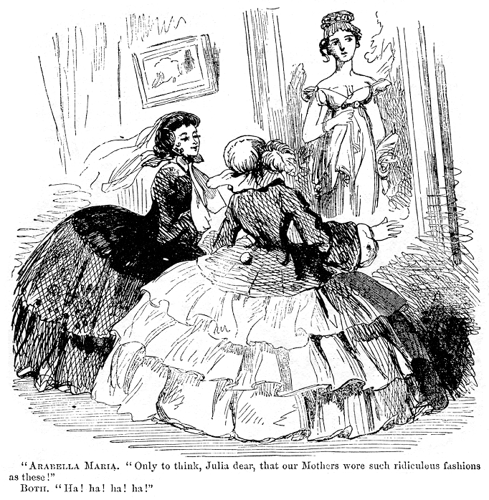

Slide 7
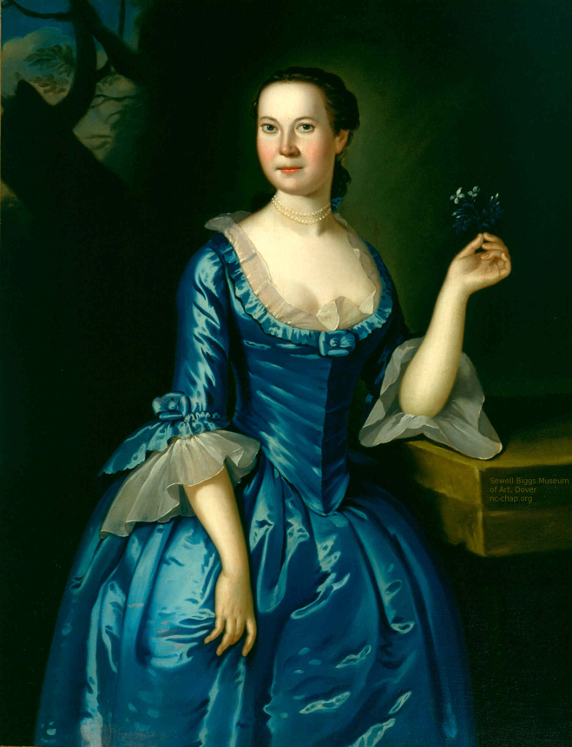
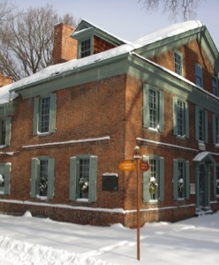
c1759, Anna Dorothea Finney
Amstel House, 2 E 4th, by John Hesselius
Lace trimmed satin dress
Panniers under skirt, or dome-shaped hoops,
One piece; not separate bodice and skirt
Bodice closed with hook & loop
No stomacher
Worn over a stiff corset of whalebone strips

Slide 8
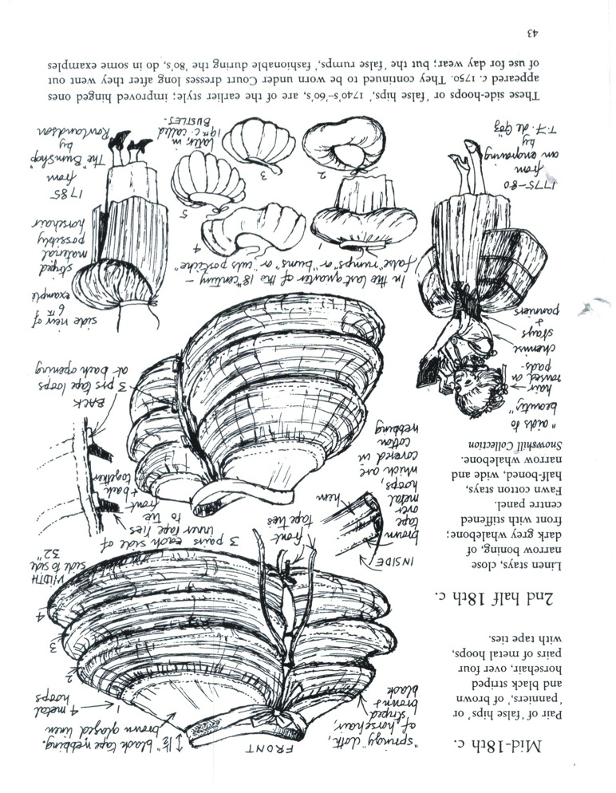
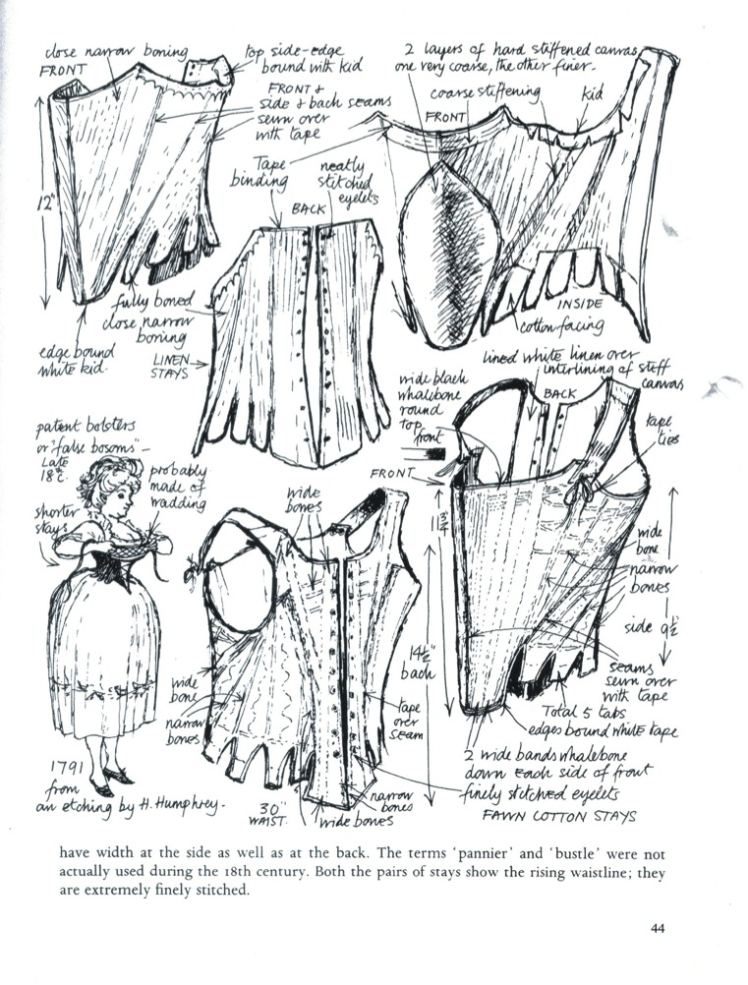
Paniers/false hips with metal stays
Nancy Bradfield, 1968

Slide 9
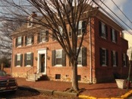
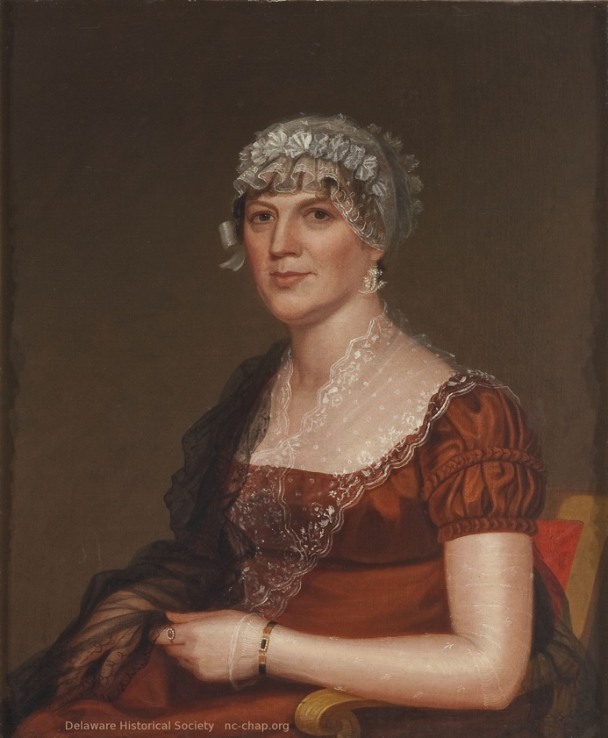
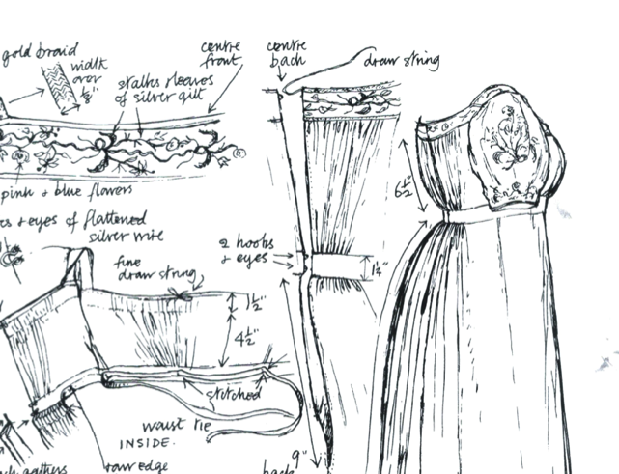
c1813, Mary Van Leuvenigh Van Dyke
2 The Strand, 300, 400 Delaware, by John Crawley
High waist
Lace/gauze scarf
Short sleeve, shocking bare arm
Extraordinary cap
Style: empire, regency (federal period)
Notes:
Lived at strand & Delaware, then 212 delaware
Empire (napoleon bonaparte, classic greek revival)
Regency: after george III, was incapacitated (insanity, porphyria?)and a regent controlled the govt. before Victoria,

Slide 10
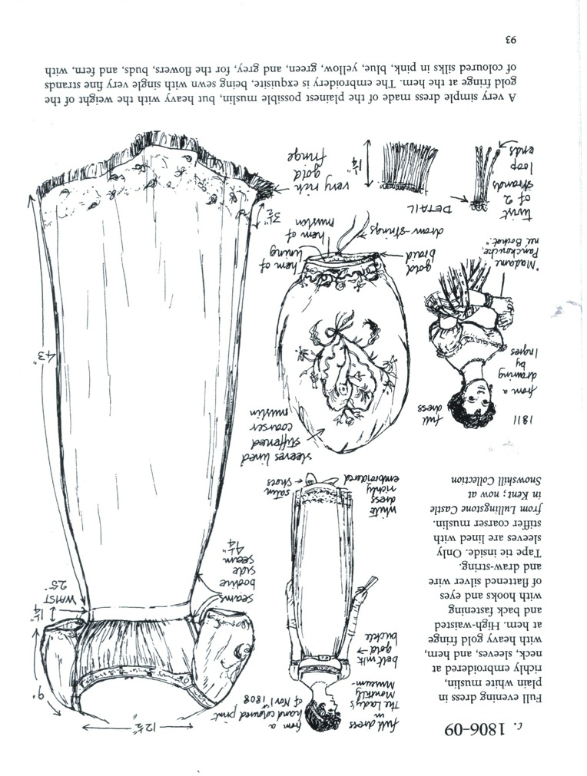
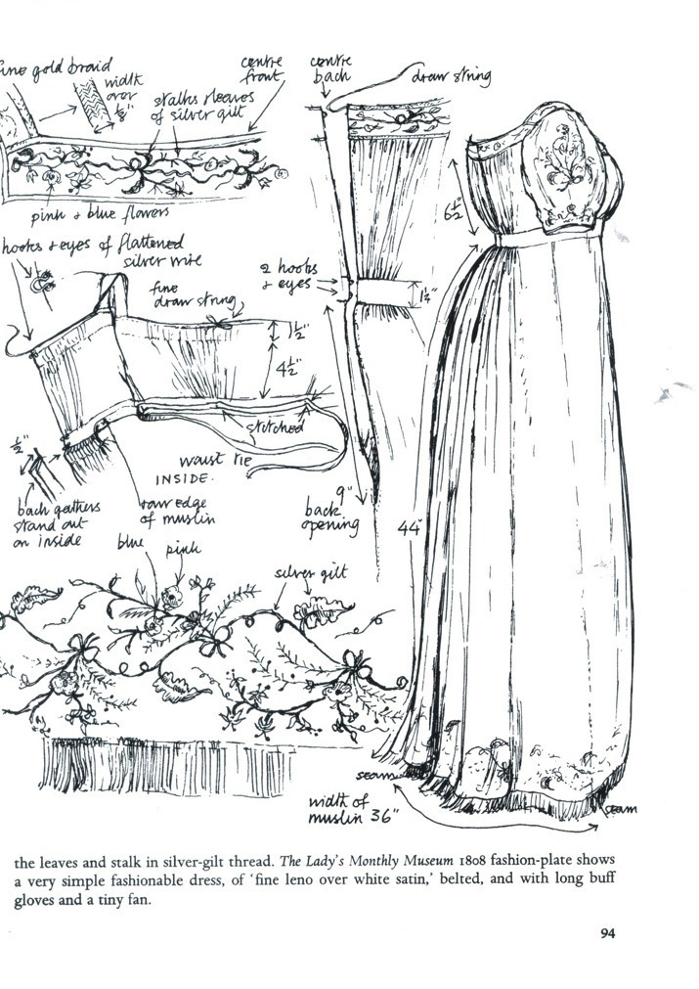
Notes:
Great for ‘pear shaped figures’

Slide 11
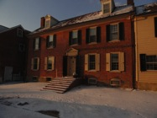
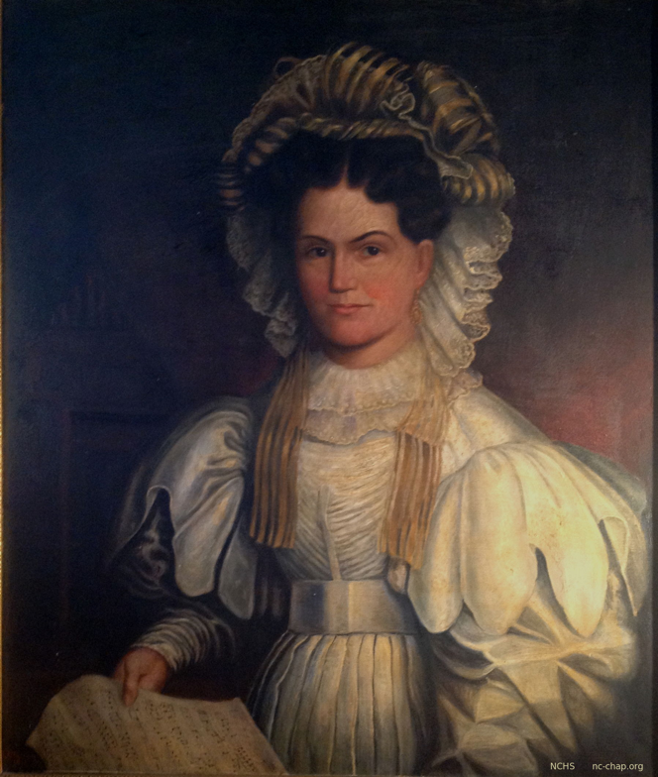
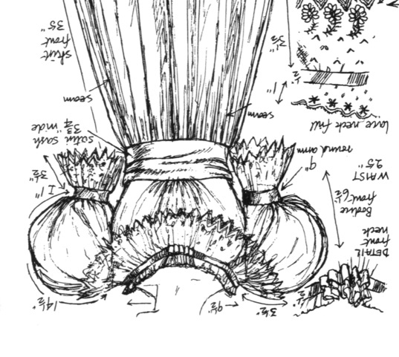
1830-40? Hannah Booth
212 Delaware
Elaborate cap
Lace collar
Satin sash?
‘Leg of mutton’ (gigot) sleeves

Slide 12
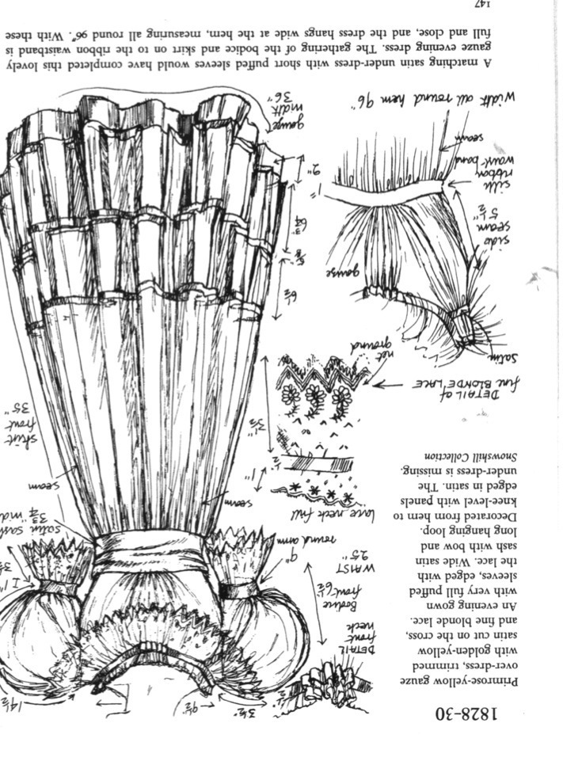
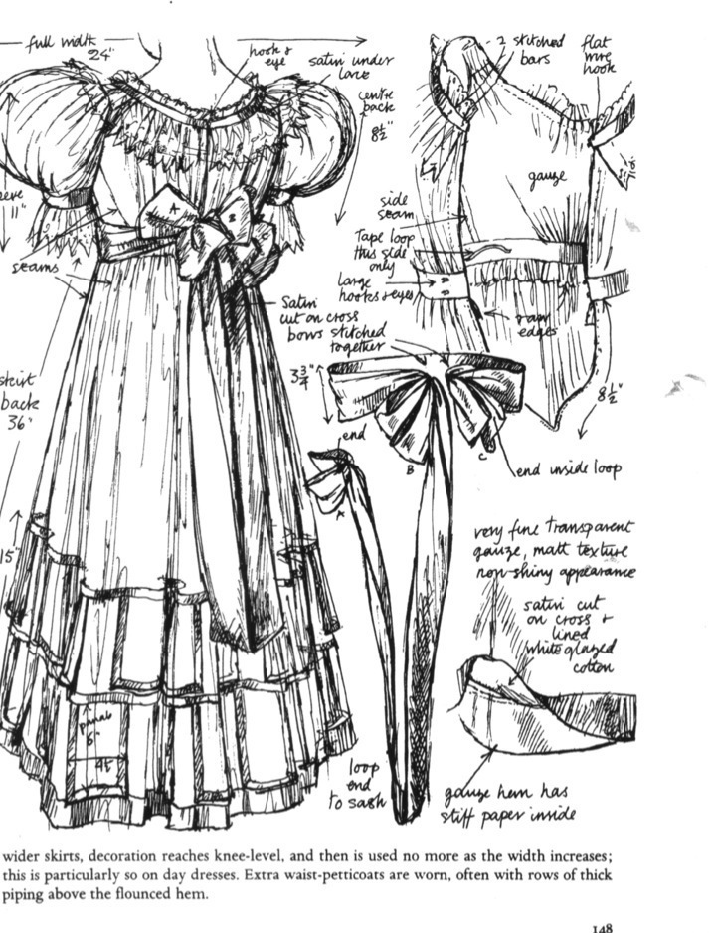
Notes:
Construction details; this is an evening gown. Like Mrs. Booth, lots of fancy stitching

Slide 13
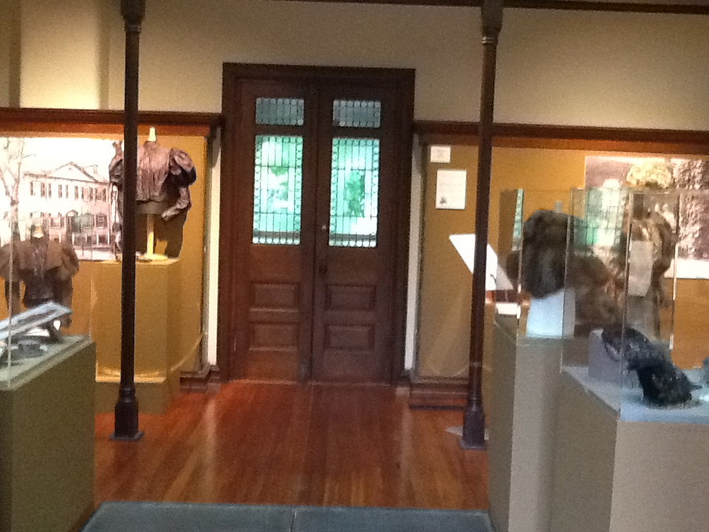
The Height of Fashion: Delaware Women Dress Up”
By Susan Hannell, Peggy Litchko & Betsy Martino 2014

Slide 14
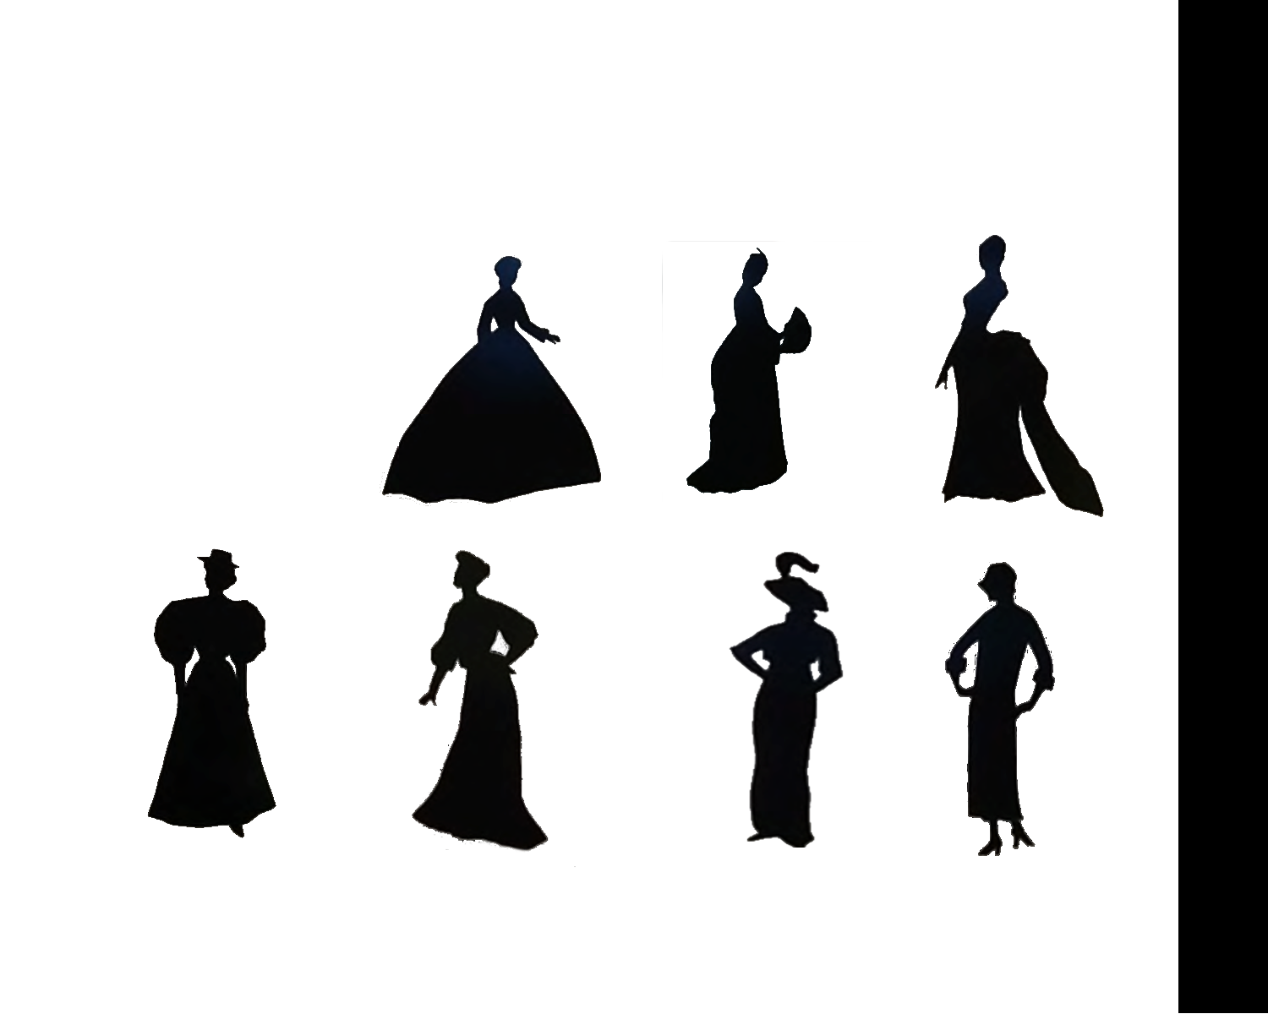
Silhouettes –
1860 - 1920
1860 1870 1880
1890 1900 1910 1920
Notes:
Silhouttes like these oversimplify what the dresses are like. I like them, maybe Because they are so simple to recognize, I’ll run through them again at the end of the class to refresh your memory of them

Slide 15
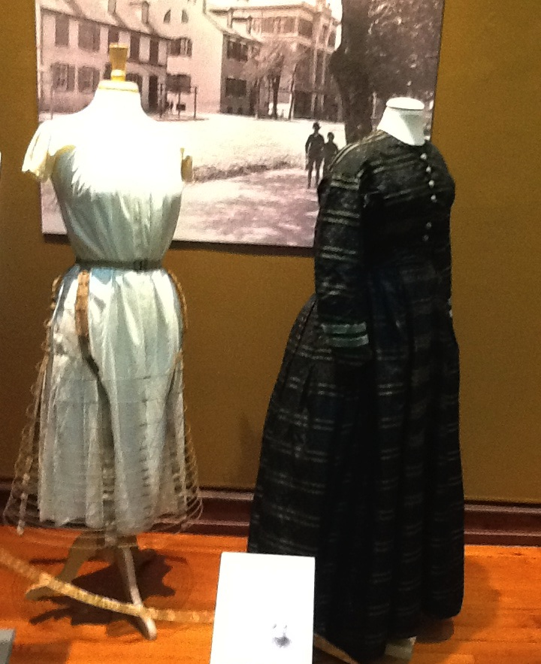
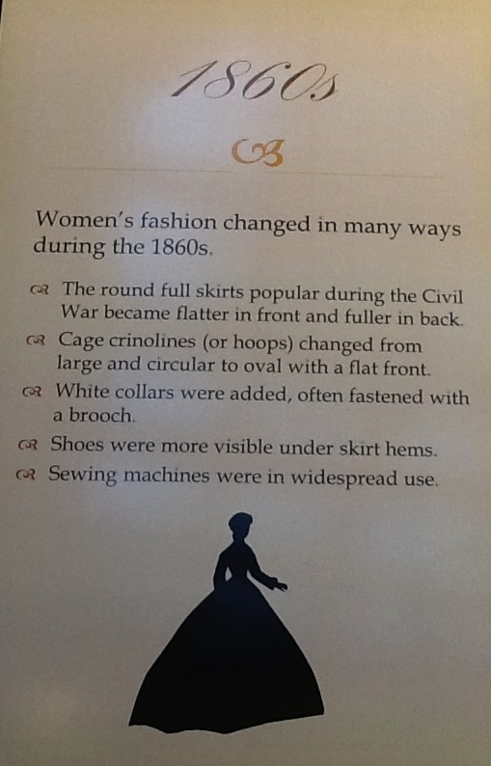
Notes:
1860’s
Round skirts
Mannikin on left has cage crinolin / hoop

Slide 16
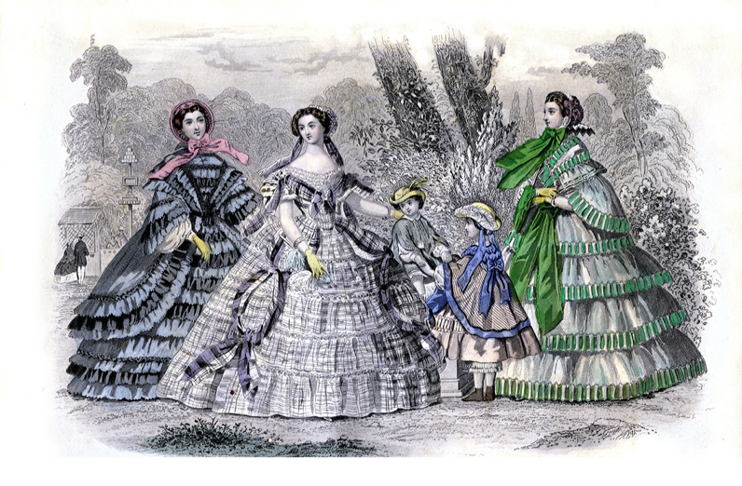
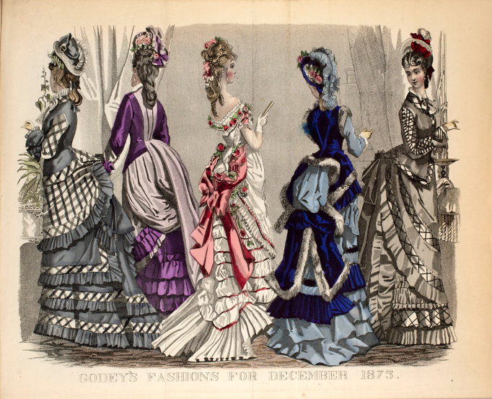
Godeys Ladys Book
Philadelphia magazine, 150,000 circ. In 1860
New Castle people would know what fashion is fashionable
1860 1875

Slide 17





Gift of Mrs. T. Coleman Dupont of Wilmington and Buena Vista; “possibly belonged to her grandmother, Dorcas Van Dyke Dupont” (but b1803-d1838).
Notes:
1870’s ruffles, trains, mermaid style, bustle

Slide 18

Notes:
1880s
Big bustles

Slide 19


Notes:
No bustles
Tight corsets and fully blouses gave wasp waists
Enormous leg of mutton sleeves

Slide 20




Gibson Girls – 1895 -- composite American girls by Charles Dana Gibson
Tall, slender, ample bosom, exaggerated S-curve torso, hair
piled high on her head, she dominated comical little men
Notes:
Sexy independent women
Even thugh minimized men
scurve with ridiculous corse
Last of victorian influence

Slide 21


“Lingerie dress”
Notes:
1910s
Lingerie dress
Hobble skirt became common
Corsets finally decreasing

Slide 22

Notes:
1920’s flappers,
No corsets, loose clothing,
Hemlines almost to the knee
Oh you kid.

Slide 23




Slide 24







1860
1870
1880
1890
1900
1910
1920
What date?
Notes:
Let’s review the changes in styles from 1860 to 1920
I’ll select a style and outline it red. You tell me when it deates from
We’ll start with an easy one – very slim, cloche hat, ‘shockingly high hemline

Slide 25
1920, Flapper
1860
1870
1880
1890
1900
1910
1920
What date?
Notes:
Of course the flapper outlined in gray.
Another easy one
the lady outline in orange – 1860-1910

Slide 26
1920, Flapper
1860, civil war, hoops
1860
1870
1880
1890
1900
1910
What date?
Notes:
Right scarlet ohara in 1860, with hoops
Now the lady with the feather, no hoops but a hobble skirt

Slide 27
1920, Flapper
1910, hobble skirt
1860, civil war, hoops
1870
1880
1890
1900
1910
What date?
Notes:
Obviously post victorian, but not yet very free
Harder. The lady with the s curve

Slide 28

1920, Flapper
1910, hobble skirt
1860, civil war, hoops
1900, S-shape
1870
1880
1890
1900
What date?
Notes:
The excruciating s shaped corset was featured in Gibsons drawings
Next the woman has big shoulders and no waist.

Slide 29

1920, Flapper
1910, hobble skirt
1860, civil war, hoops
1900, S-shape
1870
1880
1890
What date?
1890 wasp waist
Notes:
Wasp waist of 1890s; bustles are gone
The next is hard – mid victorian, but only two dates 1870 and 1880? Which is it

Slide 30


1920, Flapper
1860, civil war, hoops
1910, hobble skirt
1880 big bustle
1900, S-shape
1870
1880
What date?
1890, no bustle
Wasp waisted
Notes:
Right 1880 big bustle
The 1870 style did habe bustles and elaborate skirts/trains

Slide 31









Parallels between architecture, furniture and clothing:
1700’s (Georgian, Chippendale)
Projecting horizontal elements
Heavily carved legs
Hoops & panniers
Early 1800’s (Federal, Sheraton, Empire)
Flat, fanlight only ornamentation
Uncarved, flat, veneered
Late Victorian
Simple drop
Porches, projecting windows, multicolor, asymmetrical cross gables
OMG

Slide 32


New Castle resident Lisa Samson Made a A Civil War Era Dress from Simplicity Pattern 3723
Blog about Simplicity Pattern
https://thepragmaticcostumer.wordpress.com/2014/10/28/one-pattern-to-rule-them-all-a-civil-war-era-dress-made-from-simplicity-3723-part-1/
Notes:
Complex construction: 27 pieces in dreess pattern

Slide 33

What’s underneath a Victorian day dress?
Un
9) Out for a visit, taking
along a homemade cake
Un
8) Bonnet & gloves
Dress from

Slide 34

6) Overslip
7) Day dress & belt

Slide 35

Un
Un
4) Underslip
5) Hoops

Slide 36

Chemise
1) Chemise
Chemise
3) Corset
2) Pantalettes

Slide 37

Rita Meek in modern Victorian style silk ball dress. Made by Thomas Tear, New Castle
Worn in 2016 at the 4th annual
Fezziwig’s Ball, the 2nd Saturday in
December at the Arsenal in New Castle.
James Meek in modern tails rented from Jos. Bank.

